Slide 1
SOFIA's remarkable spectroscopic achievements and promise
Bill Reach
SOFIA/USRA Chief Science Advisor

Slide 2
SOFIA
Stratospheric Observatory for Infrared Astronomy
Collaboration between NASA and DLR
Highly modified 747-SP aircraft with a 2.5-m telescope
Flies up to 13.7 km (45,000 feet), above 99.9% of the atmospheric water
Mobility: enables occultation observations from remote locations
Near Space Observatory that comes home after every flight
Notes:
2

Slide 3
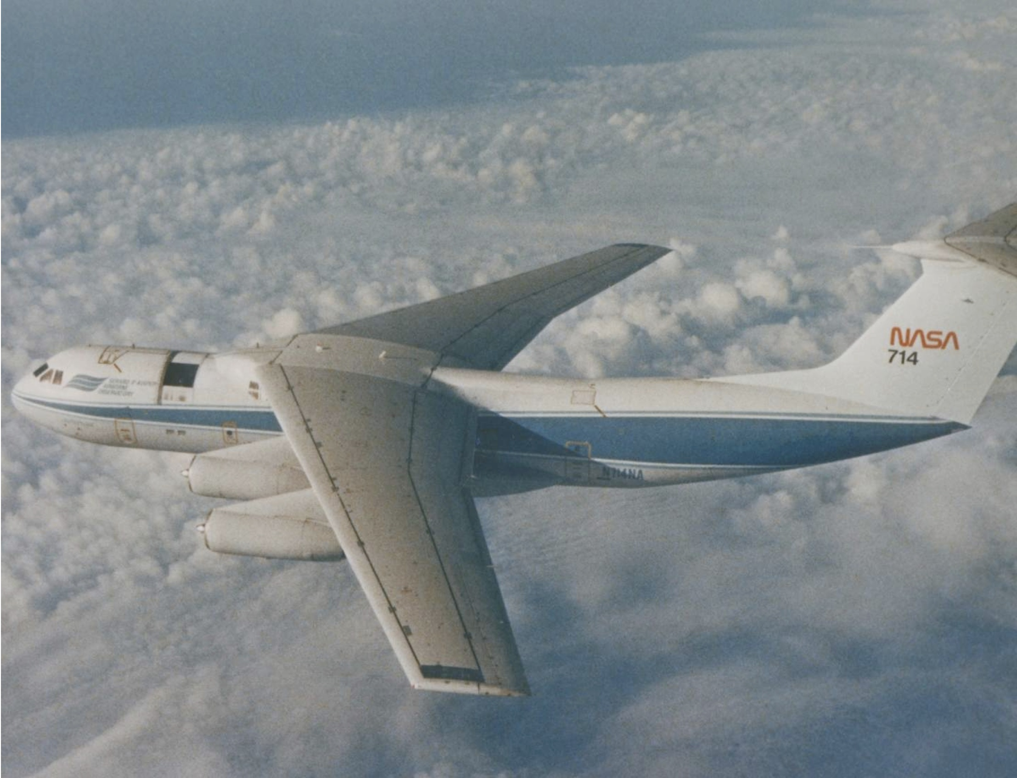
KAO
Kuiper Airborne Observatory
Astro-planes fly to the left
From KAO to SOFIA
  Community agreed decommission KAO for future SOFIA
  Plane larger (C-141 to B747-SP)
  Mirror larger (0.9 to 2.5 m) and moved to behind the wing

Slide 4
From Erickson:
NASA’s Kuiper Airborne Observatory, 1971–1995: An Operations Retrospective With a View to SOFIA

Slide 5
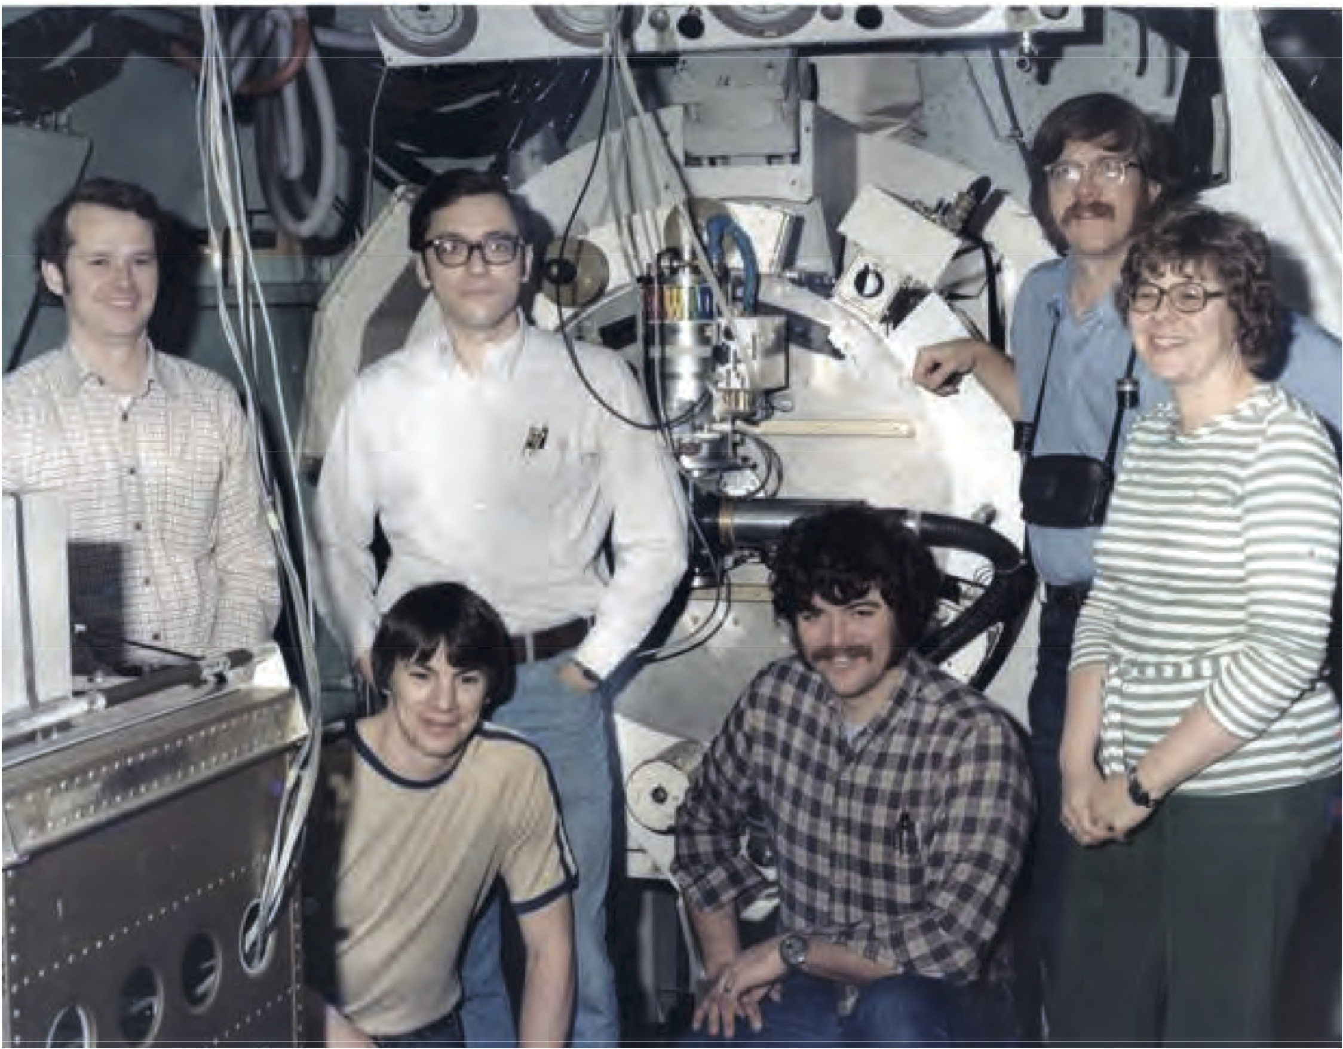
Bill
Jim
Dan
Judy
George
Terry

Slide 6
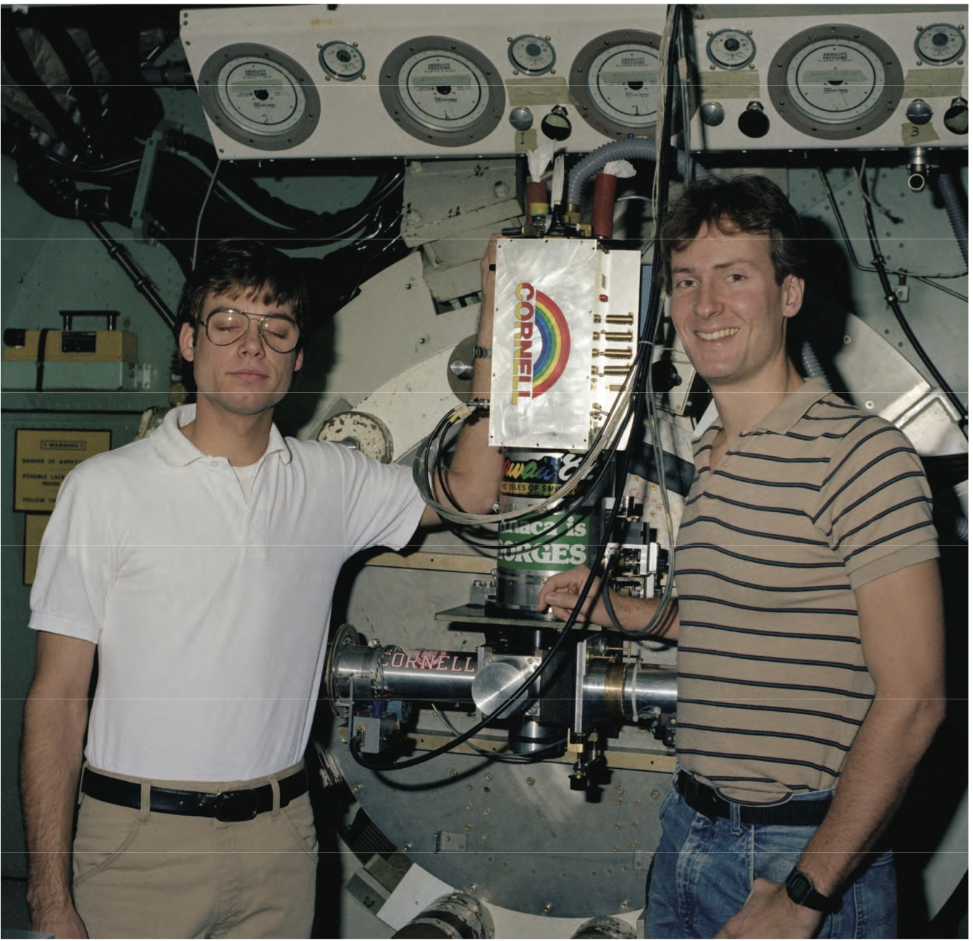
KAO Instrument development at Cornell
1982 photo from the era when I was an undergraduate working in Houck’s lab
Mark Shure (L), Paul Graf (R)
Hanging around lab taught me:
  Instrument developers were supposed to discover something NEW to graduate
  Its possible to eat instant coffee dry
1982

Slide 7
Jim was the
#4 KAO observer
From Erickson:
NASA’s Kuiper Airborne Observatory, 1971–1995: An Operations Retrospective With a View to SOFIA

Slide 8
Community involvement
KAO: 126 Principal Investigators on KAO
SOFIA (as of Cycle 5): 247 Principal Investigators, 949 unique guest investigators
Proposal Cycle

Slide 9
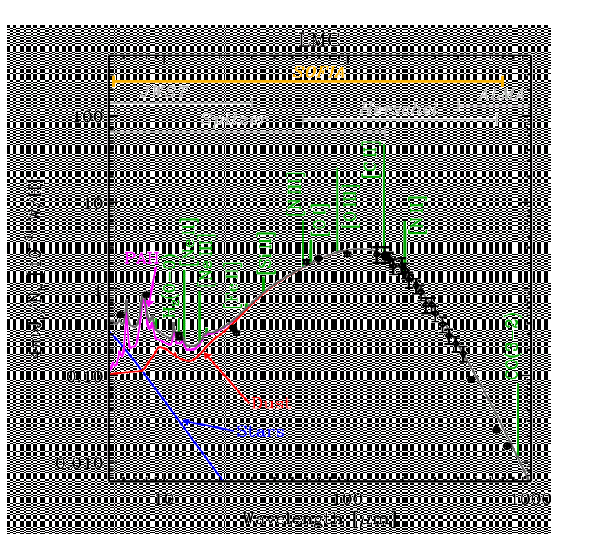
SOFIA is the only Community-Access Observatory that
currently operates in 28-320 μm wavelength range
SOFIA-Unique
R=100,000
Mid-IR
EXES
28-320 μm
upGREAT
L1
SED of LMC, based on data from Spitzer, IRAS and FIRAS (F. Galliano)
Notes:
Forward focus is on the science that requires observing in ALMA-JWST gap with instrumentation that complements those facilities.
(1) Reveal the molecular universe: organics, IR probes the denser portions of these regions and because the IR also probes species with no permanent dipole.
(2) Detail the Galactic Center (the local truth helps understand the larger universe) – too bright for JWST
(3) Magnetic Field studies of Cloud dynamics, star formation and the ICM. – need multiwavelength, mutliscales to untangle

Slide 10
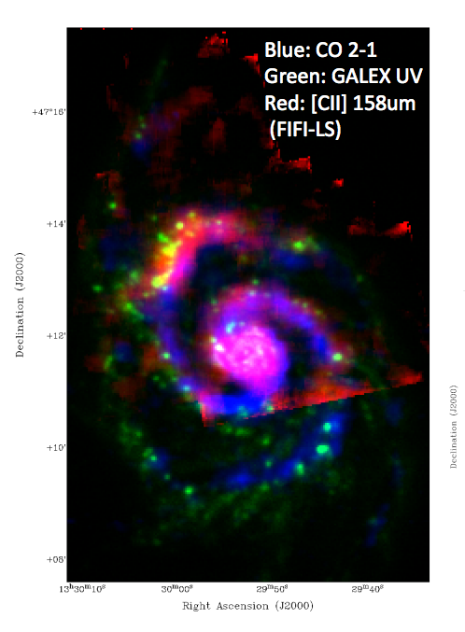
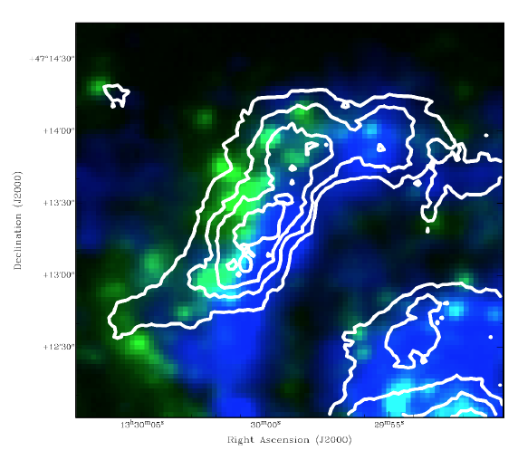
ISM in Nearby Galaxies: [C II] in M51
Cycle 4 joint impact program (Pineda/Stutzki)
[C II] contours overlaid over the molecular gas (blue) and hot stars (green).
[C II] traces the middle ground where stars form.
Pineda, J. et al, 2017 in prep.

Slide 11
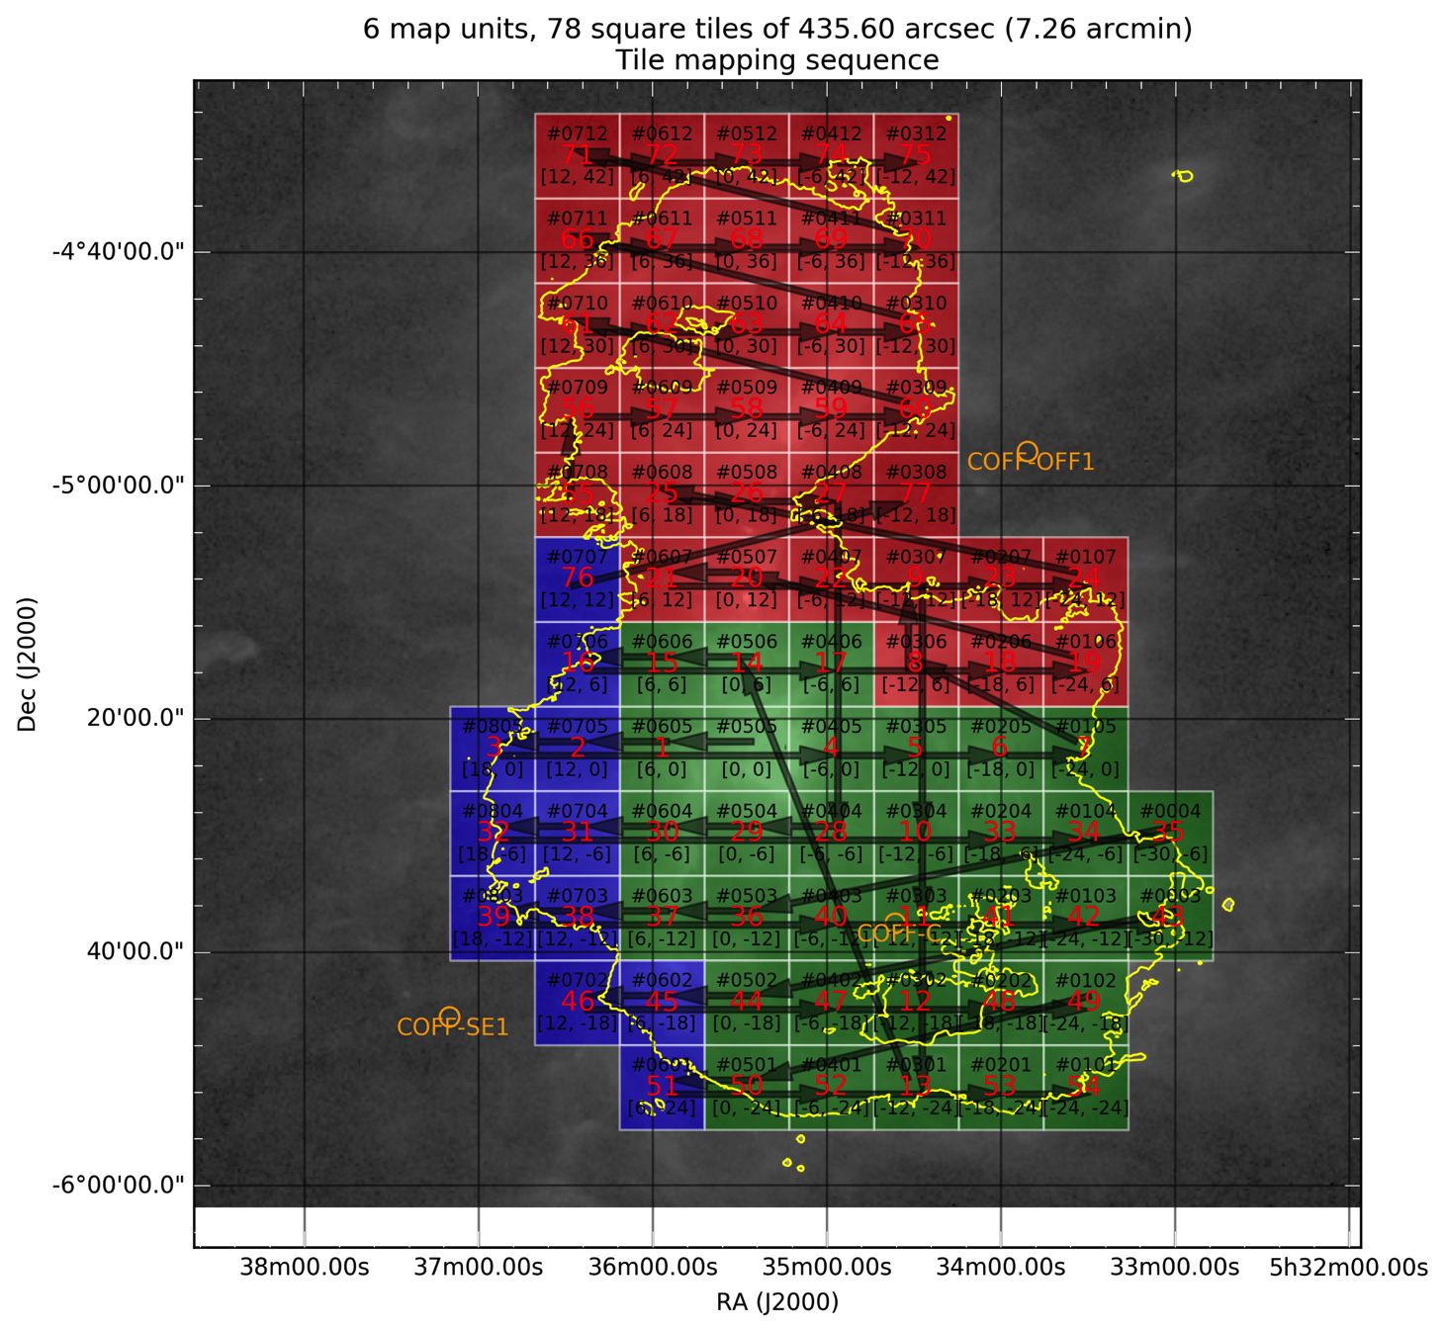
Massive Star Formation: [C II] in Orion
Cycle 4 impact program (Tielens)
An entire square degree mapped with velocity-resolved [C II]
SOFIA’s mapping rate is 50 times that of Herschel for these projects

Slide 12
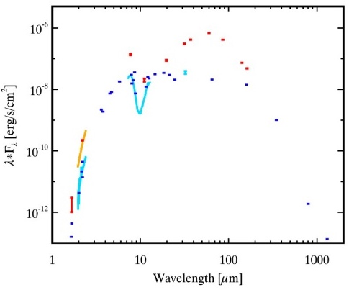
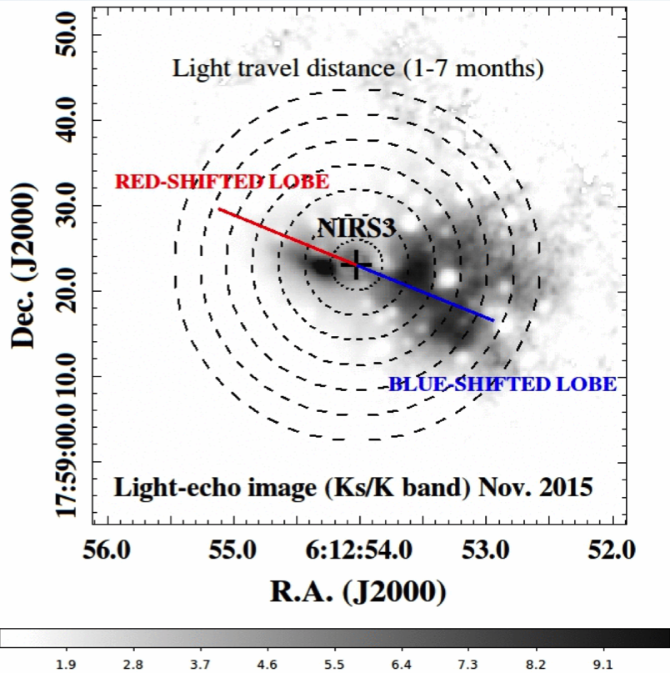
Time variability far-infrared sources
FU Ori-type object S255IR NIRS 3: first far-infrared observations of such outburst
crucial to derive the mass accreted during the event and the total energy being released by the burst.
Images taken a few months apart reveal motion of light-echo, from which Caratti o Garatti, et al. (2016, Nature Physics) could infer that the burst began in June 2015.
FIFI-LS Field Imaging Far-Infrared Line Spectrometer
FORCAST Faint Object InfraRed CAmera for the SOFIA Telescope

Slide 13
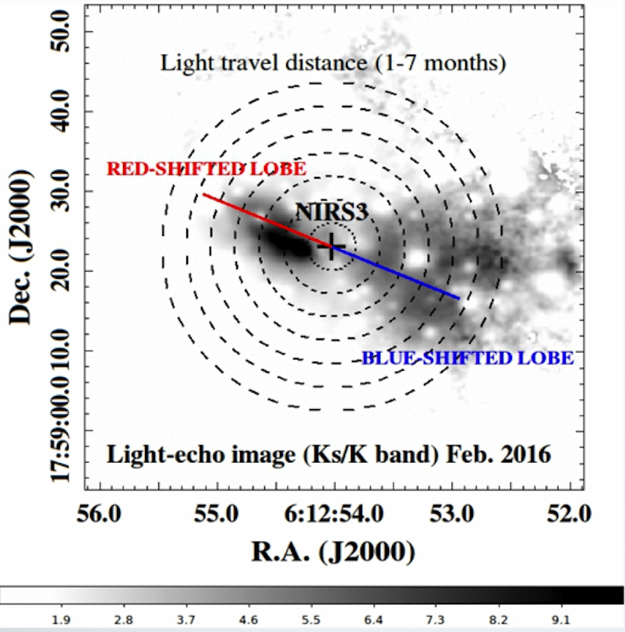
Time variability far-infrared sources
FU Ori-type object S255IR NIRS 3: first far-infrared observations of such outburst
crucial to derive the mass accreted during the event and the total energy being released by the burst.
Images taken a few months apart reveal motion of light-echo, from which Caratti o Garatti, et al. (2016, Nature Physics) could infer that the burst began in June 2015.
FIFI-LS Field Imaging Far-Infrared Line Spectrometer
FORCAST Faint Object InfraRed CAmera for the SOFIA Telescope

Slide 14
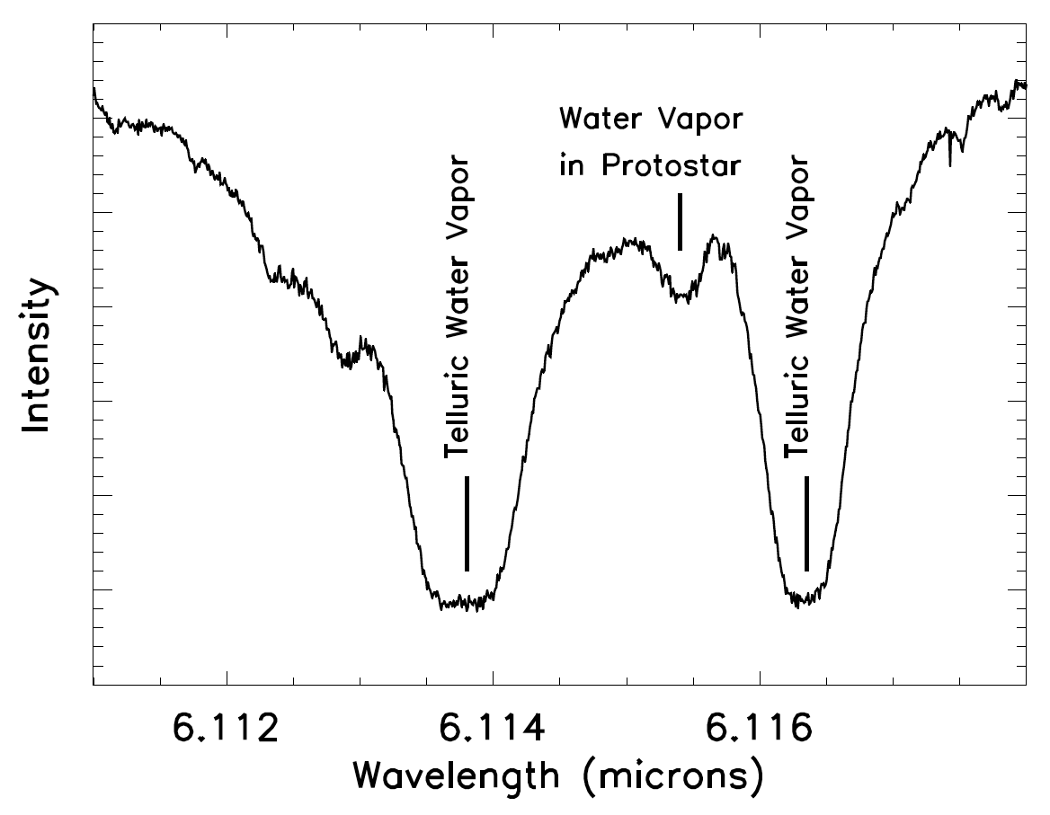
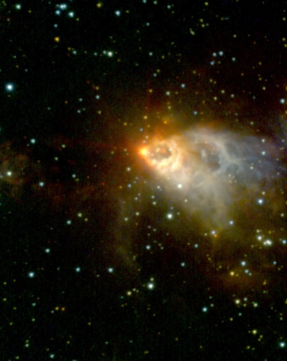
EXES Observations of Water in AFGL 2591
~10 Msolar protostar in Cygnus region
0(0,0)→ 1(1,1) and other H₂O transitions
T_{ex} ~ 500 K, likely produced by evaporation of grain mantles
(C. de Witt, M. Richter, EXES Team)
(Colin Aspin et al. , NIRI, Gemini Obs.)

Slide 15
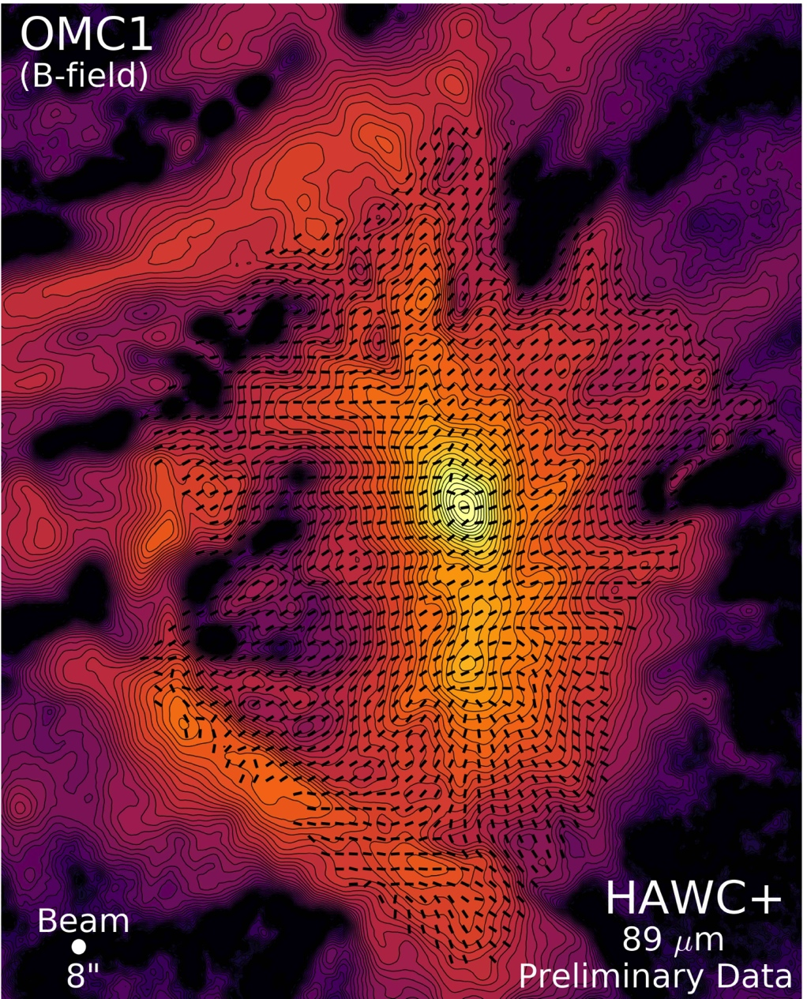
Orion with HAWC+
Recently commissioned HAWC+ adds the capability of observing polarization in the Far-IR
Far-IR polarization of thermal radiation is due to emission of aligned dust grains, whereas Near-IR polarization has the component of scattered light.
Magnetic Fields directions

Slide 16
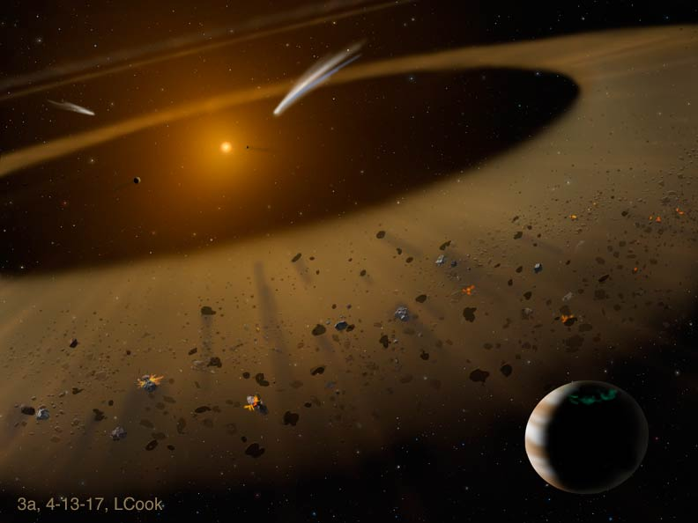
Debris around Nearby Star ε Eri
SOFIA showed that the dust in the inner 25 AU of the ε Eri debris disk system arises principally from collisions between planetisimals (Su, et al. 2017, Astronomical Journal)
3

Slide 17
Origin of Interstellar Dust in the
Early Universe
Temim and collaborators measured the amount of dust in supernova remnant G54.1+0.3
Dust generated in the explosion ejecta expands outward, forming a shell
When the dust passes very close to other stars in the cluster, it is briefly heated. SOFIA caught that dust and allowed measurement of the total mass of dust.
The mass of dust generated by this supernova is large enough to show that even very young galaxies can have significant amounts of dust

Slide 18
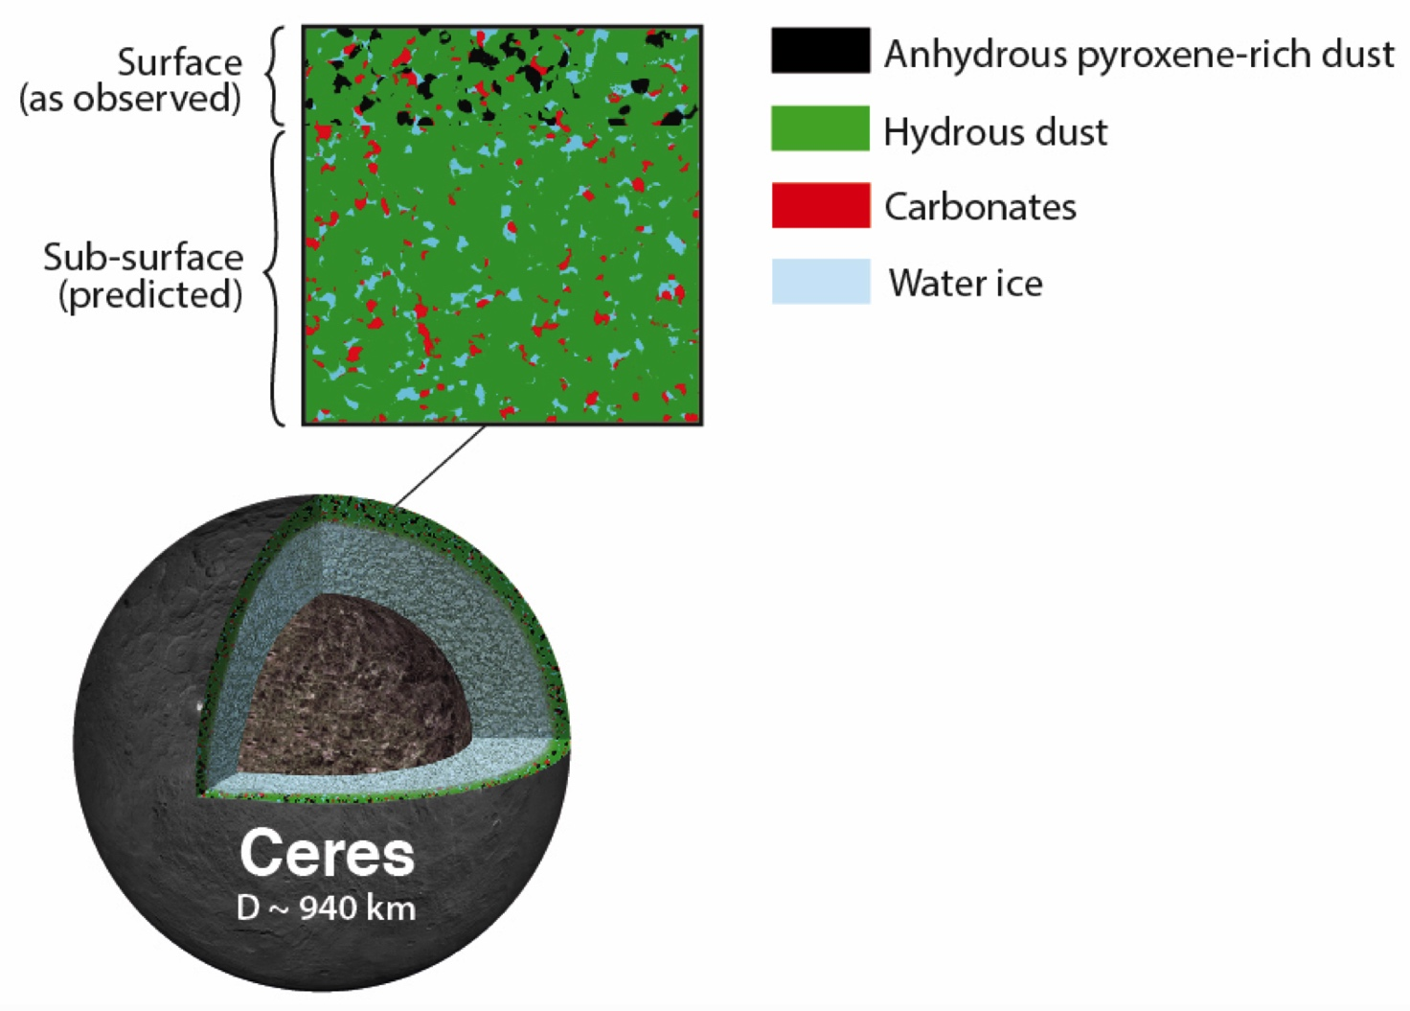
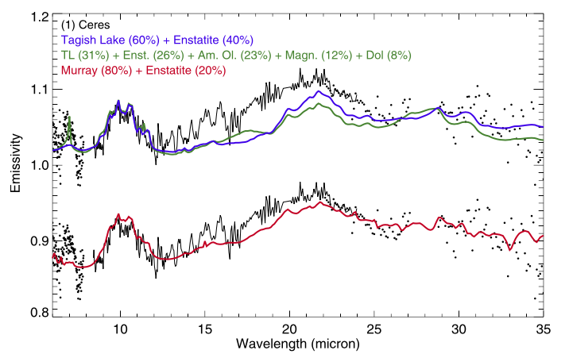
Don’t Judge an Asteroid by its Cover: Mid-infrared Data from SOFIA Shows Ceres’ True Composition

Slide 19
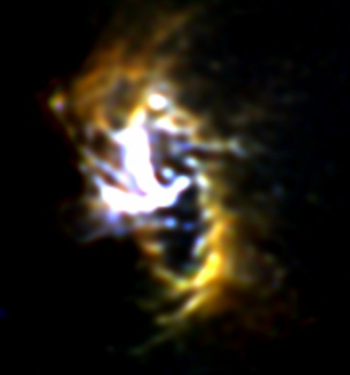
Galactic Center CND
highest resolution (3”) image of the circumnuclear ring ever obtained
White central emission is from the hot dust heated by ionized gas of the northern and eastern arms
Almost perfect 1.5 pc radius ring is seen in cooler dust (T~100K) centered on the Massive Black Hole and tilted about 23 degrees to the line of sight and the galactic plane.
It is rotating in the direction of galactic rotation. (Guesten etal 1987)
The ring is resolved with a width of about 0.3 pc.
There is interesting small structures along the ring, almost periodic in nature.
19(blue), 31(green) and 37(red) μm

Slide 20
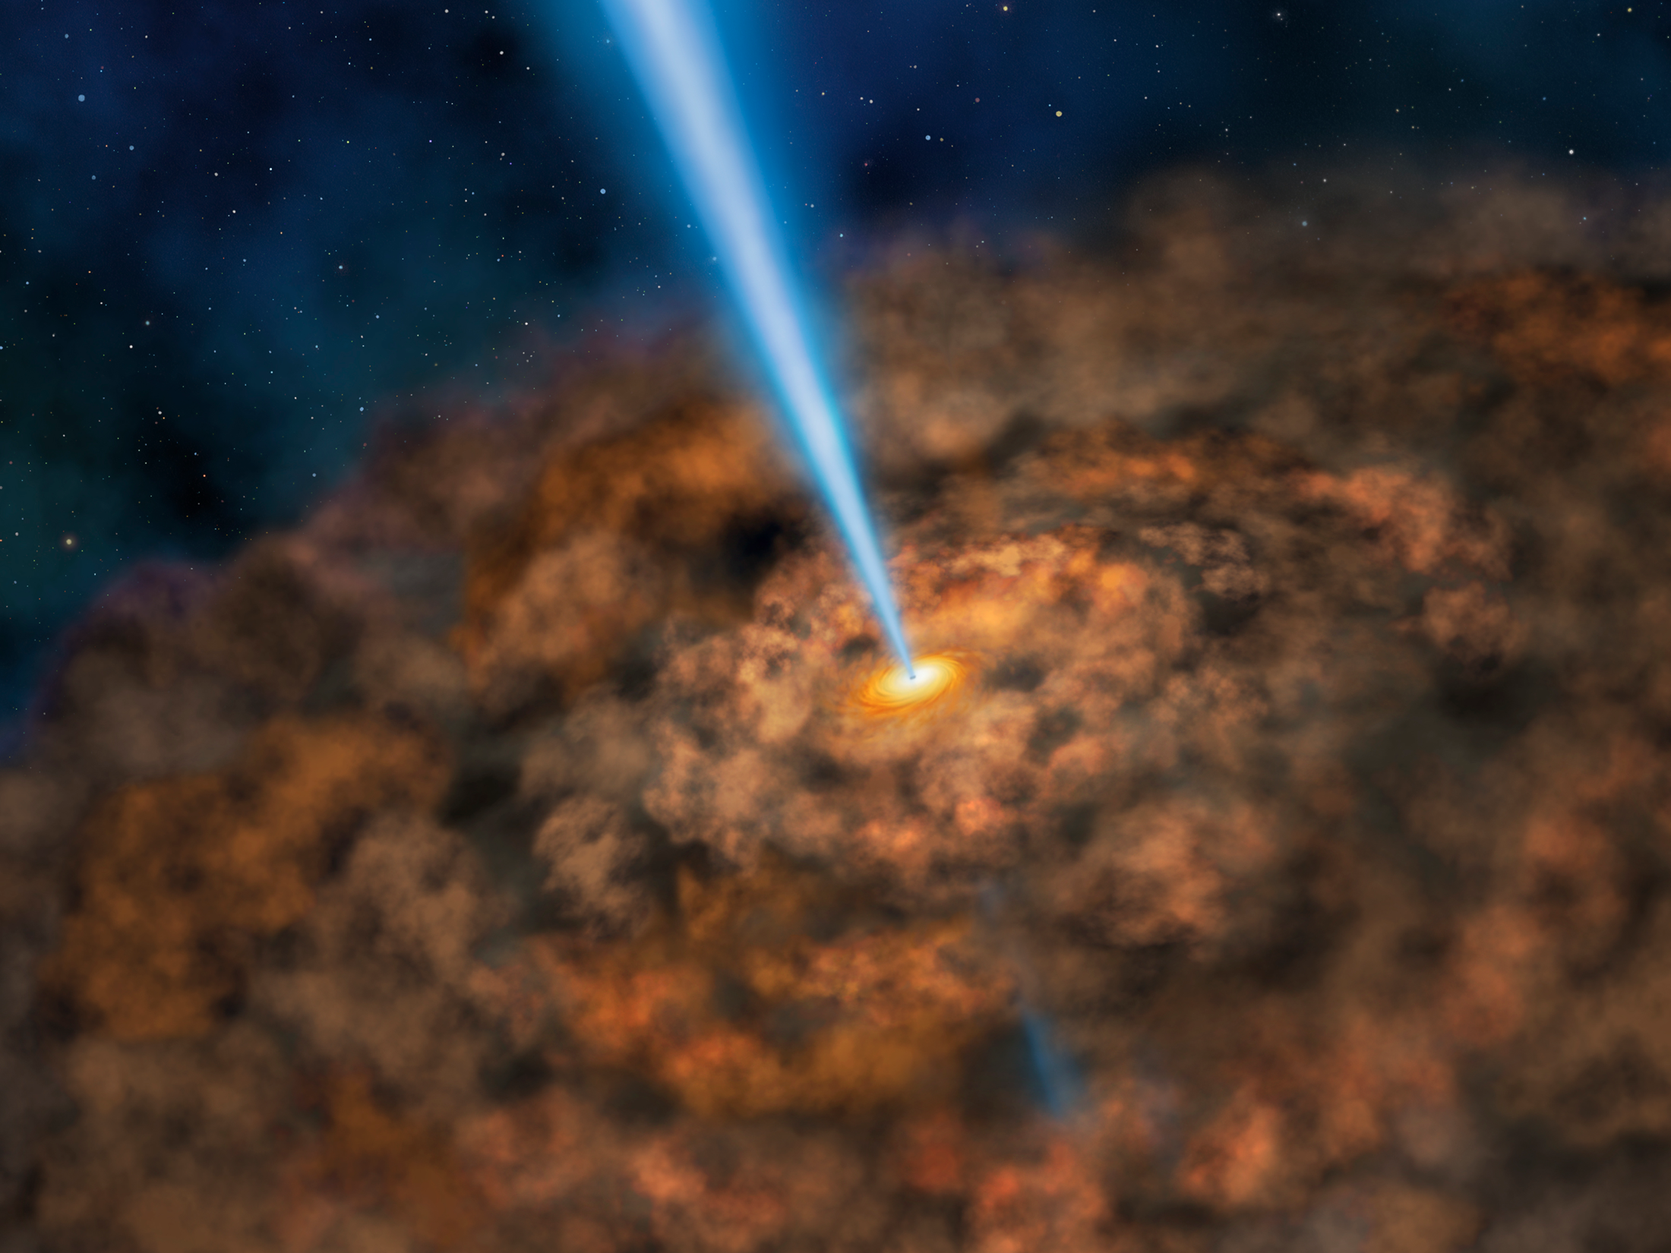
SOFIA Finds Cool Dust Around Energetic Active Black Holes
Fuller et al (2017 ApJ)
Separate AGN from Star Formation contribution based on nuclear PROFILE and SED
Utilized SOFIA’s angular resolution (relative to Spitzer) and 30-40 μm capability

Slide 21
Probing infall with ammonia absorption
Absorption measurements much more straightforward to interpret.
Sample of ~>10 now published
Infall (“collapse”) is the Holy Grail of star formation
SOFIA THz absorption allows us to measure the gas infall rate
  Typical accretion rate is 10⁻³ M_{sun}/yr
F.Wyrowski -

Slide 22
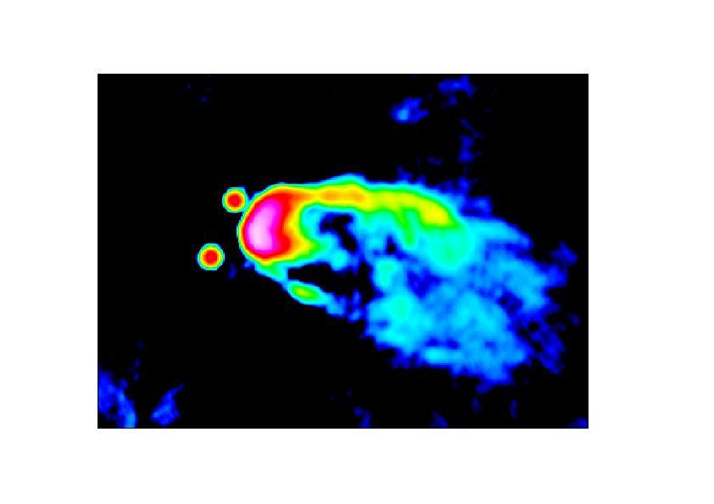
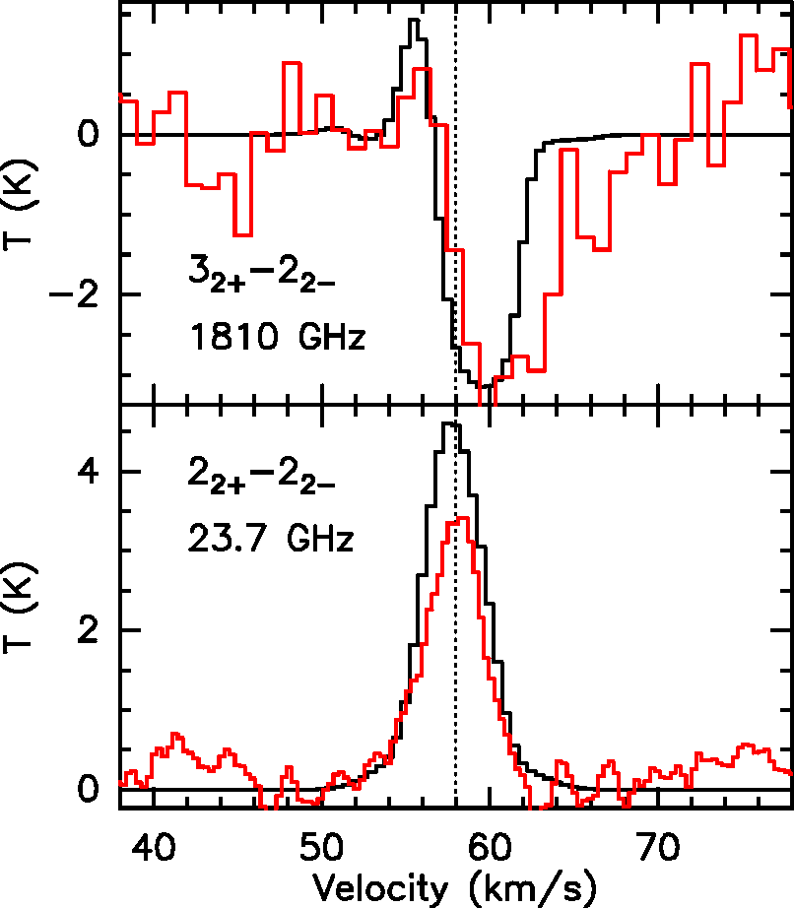
Probing infall with ammonia absorption
Absorption measurements much more straightforward to interpret.
Sample of ~>10 now published
Infall (“collapse”) is the Holy Grail of star formation
SOFIA THz absorption allows us to measure the gas infall rate
  Typical accretion rate is 10⁻³ M_{sun}/yr
Vsys
G34.26+0.15 VLA 3.6cm
F.Wyrowski -

Slide 23
SOFIA
Stratospheric Observatory for Infrared Astronomy
Instrumentation developed by labs separate from SOFIA Program
  Early Science Instruments: FORCAST (Cornell), GREAT (MPIfR)
  Other 1st and 2nd Generation: FLITECAM (UCLA), FIFI-LS (German), EXES (UC Davis), HIPO (Lowell), HAWC (U Chicago/JPL)
Notes:
23

Slide 24
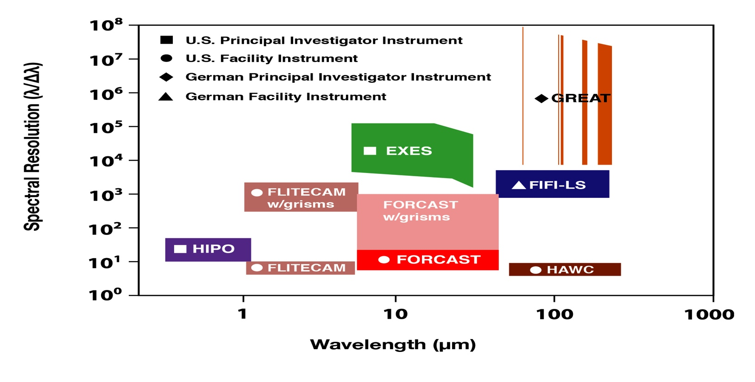
SOFIA Science Instruments
HIRMES

Slide 25
Science Instrument Development
TYPES OF SCIENCE INSTRUMENT (SI)
  Facility: Operated and maintained by Science Mission Operations
  Principal Investigator: Operated and maintained by PI, all can use
  Special Scientific Instrument: PI and requires PI approval to use
  Technology Demonstration: PI instrument, can be narrow focus
FUTURE INSTRUMENTS
  There will be calls for new instruments ~ every 3 years
  2nd Gen Call selected HAWC+ (in use now), Facility SI upgrade
  3rd Gen Call selected HIRMES (expect 2019), Facility SI
  Approximate funding for new instruments and technology is $3-5 M/yr
  4th Gen Call is underdevelopment

Slide 26
HIRMES (NASA Goddard/Moseley)

Slide 27
Spectroscopy is where SOFIA shines
In comparison, imaging suffers from high backgrounds making airborne observations significantly less sensitive than space
At high resolution, and outside deepest telluric features, can achieve space-like performance

Slide 28
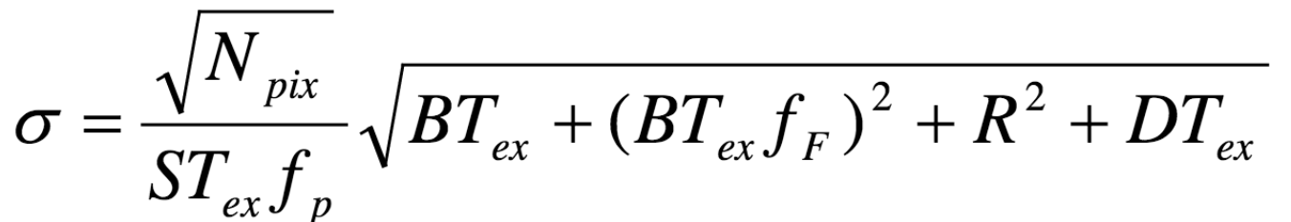
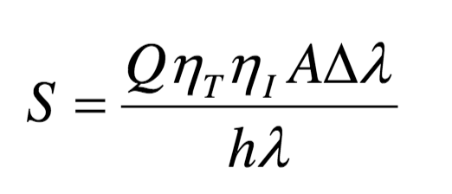
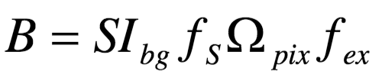
Increasing Resolving Power Reduces effect of Background
Noise in single exposure time T_{EX}
Line brightness signal scales as R=λ/Δλ
noise scales as sqrt(R)
Signal/noise scales sqrt(R) for lines

Slide 29
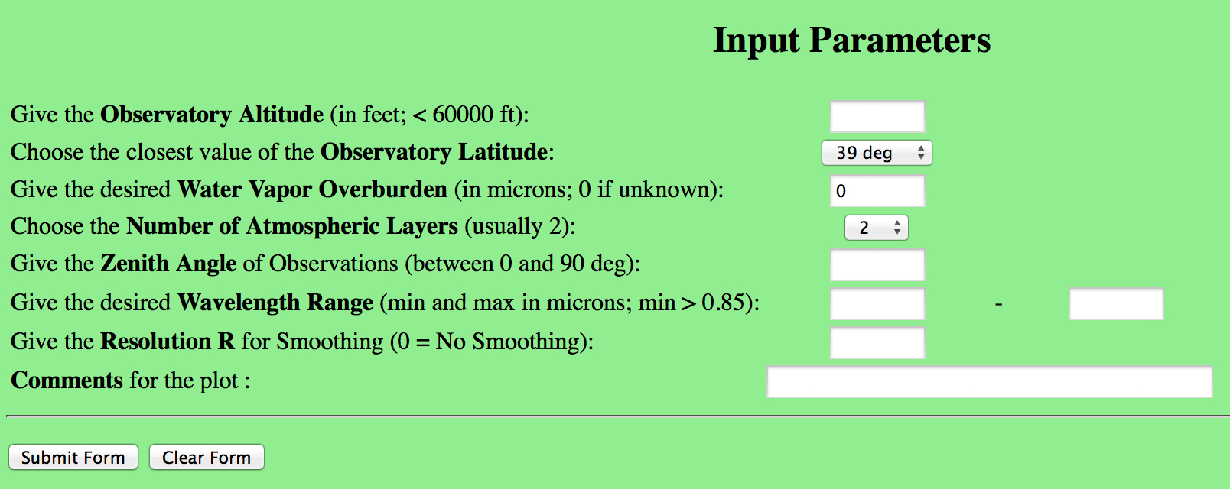
Atmospheric Transmission
ATRAN can provide transmission curves easily
Caveat that the THz values show factor-of-2 discrepancy
Also the H2O and O3 are qualitatively different
  O3 is higher-altitude and more time-variable

Slide 30
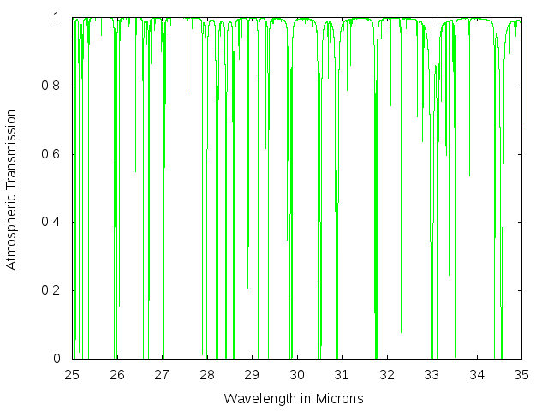
Example: Transmission for H2 S(0)
Overview of 25-35 micron range shows it is high transmission except in deep lines

Slide 31
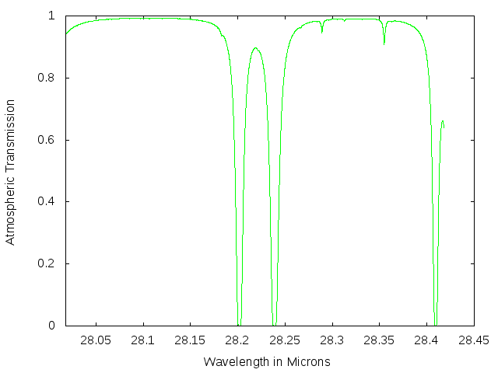
Example: Transmission for H2 S(0)
Zooming in shows there is in fact significant absorption, so careful calibration and possible Doppler shift needed

Slide 32
Spectroscopy is where SOFIA shines
Imaging spectroscopy is particularly good
  Leading-edge technology
    Multiplexing: upGREAT -> 14 pixels with THz receivers
  Large reaction mass compared to spacecraft
  Replenishment of cryogens; powerful cryo-cooler
  GREAT mapping 50 times as fast as Herschel/HIFI
Instrument development opportunities are anticipated for SOFIA

