Slide 1
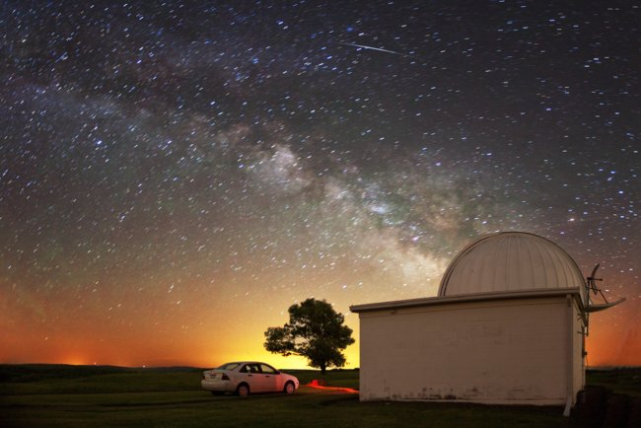

Slide 2
Hi Gordon,
Oy vey! Really!
I have only the fondest memories of working with George. Nonethe- less, looking at this photo now, I wish the Cornell Chronicle had destroyed it and all vestiges of it years ago - I look like a cross between a 70's rocker and a Mexican bandito. Speaking for myself, I'm afraid an updated photo would carry the caption: "Time Ravages Former Cornell Grad Student".
Best regards,
Gary

Slide 3
CCAT-p: a high throughput, high sensitivity telescope for star and galaxy formation and cosmology
Gordon Stacey
Cornell University
Representing the CCAT consortium

Slide 4
Who is CCAT-p?
Cornell University
German consortium led by University of Cologne
  Cologne, Bonn, Ludwig Maximilian, Max Planck Inst. for Astrophysics
Formed CCAT Observatory, Inc.
Canadian consortium led by University of Waterloo
  Waterloo, Toronto, British Columbia, Calgary, Dalhousie, McGill, McMaster, Western Ontario
Formed Canadian Atacama Telescope Corp (CATC)
CCAT is a Joint Venture between CCAT Corp & CATC

Slide 5
CCAT-Prime is a high surface accuracy 6 m submm telescope
What is CCAT-p?

Slide 6
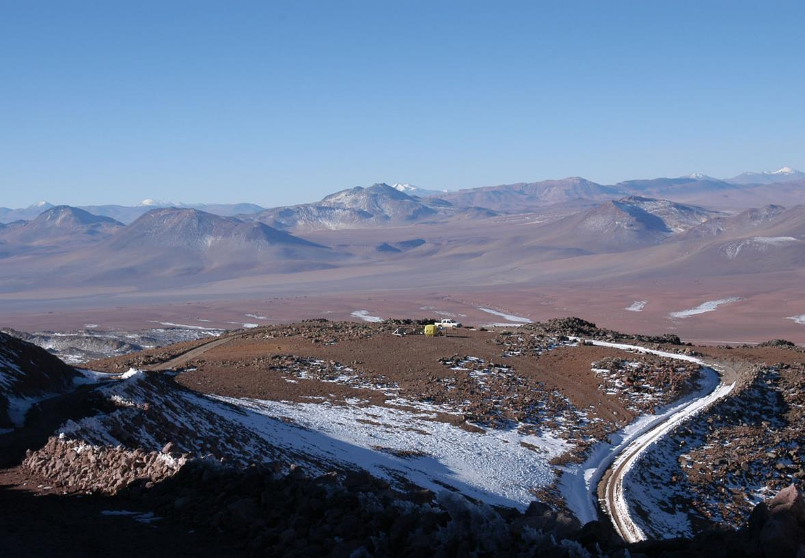
Where is CCAT-p?
Cerro Chajnantor at 5600 m

Slide 7
6 meters? Why are we doing this?
Unique site enables unique science
High accuracy (< 11 μm rms), low blockage telescope (< 1%) maximizes surface brightness sensitivity
Extraordinary throughput optimizes for science enabled by large scale surveys
CCAT-p paves the way for a large (25 meter) aperture at the site

Slide 8
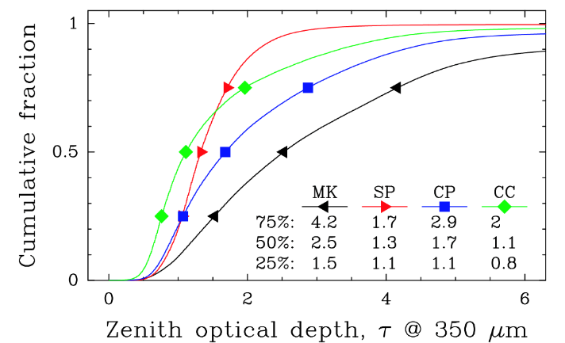
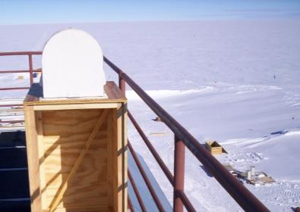
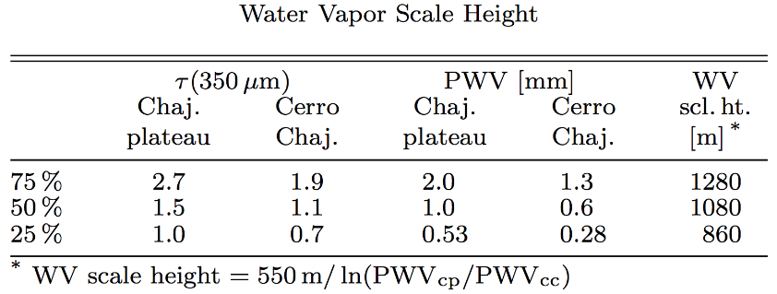
5000 meter is good, but 5600 meters is better
Submillimeter sensitivity is all about telluric transmission
Simon Radford ran tipping radiometers at primary sites for more than a decade –
Simultaneous period for CCAT vs. ALMA site: median is 0.6 vs. 1 mm H₂O ⇒ factor of 1.7 in sensitivity
Radford & Peterson, arXiv:1602.08795
26 June 2017

Slide 9
Median Zenith Transmission
Median CCAT transmission even better than South Pole due to warmer, less dense atmosphere
Tropics: Ω = 3 π sr, A_{med} = 1.1 (z < 60°)
Pole: Ω = 1 π sr, A_{med} = 1.4 (z < 60°)
26 June 2017

Slide 10
Chajnantor Site opens up the THz Windows

Slide 11
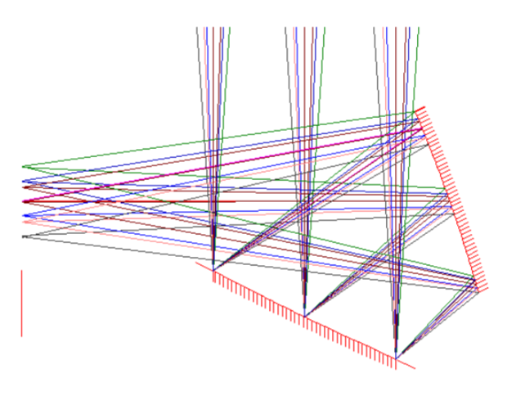
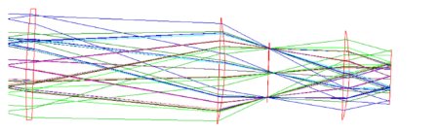
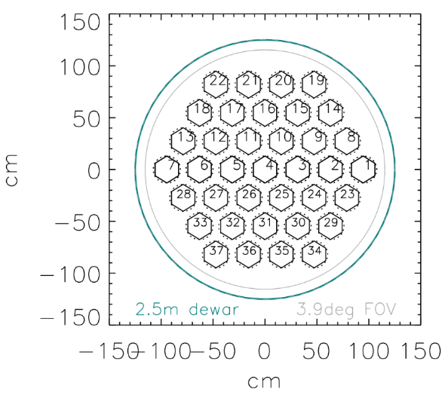
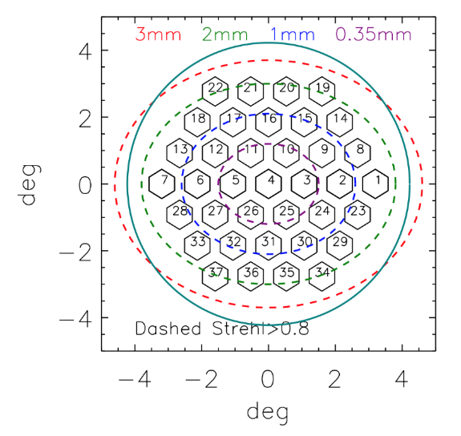
Crossed Dragone Design
Original concept published in 1978: C. Dragone AT&T Tech. Mem. 57, 2663
Used in 2 <2 m CMB experiments (QUIET, C. Bischoff. et al. 2013) and the Atacama B-Mode Search, T. Essingger-Hileman et al. 2009
0.9° diameter optics tubes are mostly enclosed
in Strehl>0.8
(diffraction-limited)
3 mm = 37 OT
2 mm = 33 OT
1 mm = 19 OT
0.35 mm = 7 OT
26,000 pixels
58,000 pixels
110,000 pixels
400,000 pixels
Optics tube
7.8° FoV
M. Niemack, Applied Optics 2016
26 June 2017

Slide 12

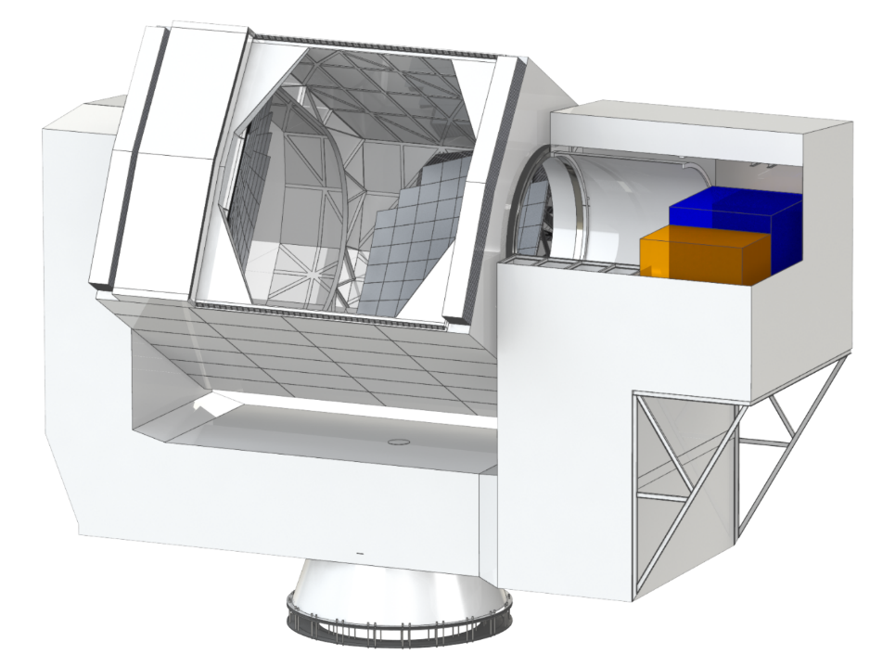









CCAT-prime
General Layout
Shutter
Mirrors M1 & M2 Elevation Housing Yoke Structure Support Cone
Being designed and built by Vertex Antennentechnik GmbH
26 June 2017
Notes:
High throughput telescope, flat focal plane
Crossed-Dragone design
Map the CMB 10x faster than existing experiments
Platform for cameras with > 10⁵ pixels
Aperture diameter: 6m
Wavelength: (200) 300 – 3100 μm
Emissivity – lower than sky for all wavelengths

Slide 13
P-Cam
Seven subcamera “tubes” populated with TES bolometers
FoV ~ 0.9 degree with feedhorn fed 1.5 λ/D pixels
  20,000 to 60,000 pixels per subcamera @ 350 μm; numbers scale from 60,000 as 1/λ²
  dichroic polarization sensitive bolometers at longer wavelengths
Cameras are modular (size, optics, filtration), easily exchanged
Start with very modest numbers of pixels and growth to fill out camera, then entire CCAT-Prime FoV if so desired

Slide 14
CCAT-Prime Science
GEco: Star formation in the Milky Way, the Magellanic clouds and other nearby galaxies through submm spectroscopy and photometry
kSZ: Probing of the nature of dark energy, gravity on large scales and neutrino mass sum through kinetic SZ effect
  Polarization foregrounds: Galactic dust science & CMB poln corrections
GEvo: Evolution of DSFG through submm-mm wave surveys.
IM-EoR: EoR intensity mapping in [CII] at redshifts from 5 to 9.
Stage 4 CMB: CMBR polarization at 10 times the speed of current facilities ⇒ inflationary gravity waves and the sum of the neutrino masses.
26 June 2017

Slide 15
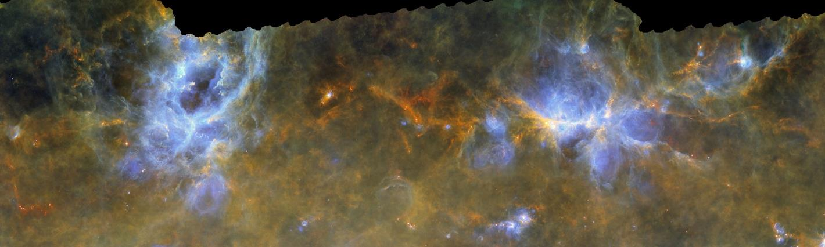
GEco: Galactic Ecology Science
15” imaging over 200 (°)² scales of the Milky Way, LMC, SMC in:
  [CI] tracing gas temperature and mass
  Mid and high-J CO & ¹³CO tracing gas excitation, shocks, density and mass
  Also: [NII] tracing embedded SF regions and numbers of ionizing photons
Tracing accumulation and flows of gas into cores and young stars
Requires high site for short submm (200 μm, or 1.5 THz) studies

Slide 16
“CO dark” Gas

Slide 17
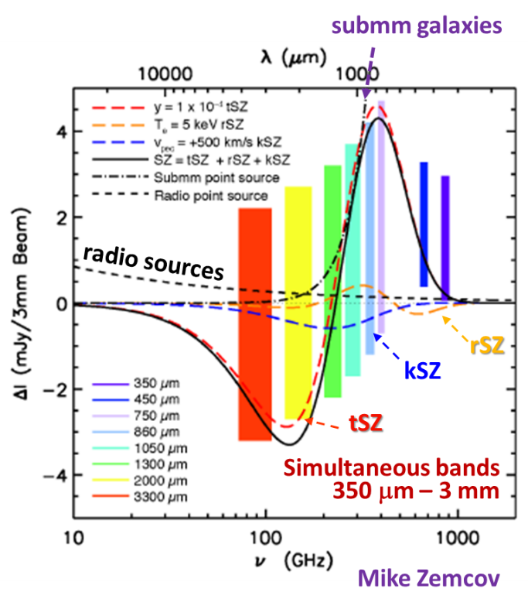
kSZ: Cluster Science through the Sunyaev-Zel’dovich Effects
Direct observations of the most massive bound entities in the Universe through Sunyaev-Zel’dovich effects
7 colors: 0.35 to 3 mm spectral coverage separates out the tSZ, rSZ, radio galaxies and submm galaxies from kSZ
Constraints: optical depth, velocity, and electron temperature

Slide 18
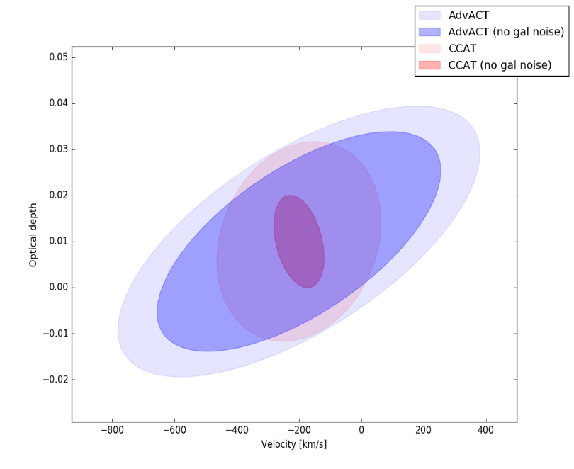
Fundamental Physics Probes
Directly measure velocities of 1000’s of clusters
Constrains and/or eliminate models about dark energy and modified gravity.
Improve constraints on the measurements of the sum of the neutrino masses.
Cluster characterization to inform cosmology
Example Survey 1000 (°)² measuring 3000 clusters with M > 2.7 × 10¹⁴ M in 3000 hrs
CCAT-prime velocities appear much better than Advanced ACTPol
F. de Bernardis and A. Mittal
Notes:
Important information on the history of reionization. If the universe had not recombined to be neutral then photons would have continued scattering and destroyed correlations at sub-horizon scales in the CMB.

Slide 19
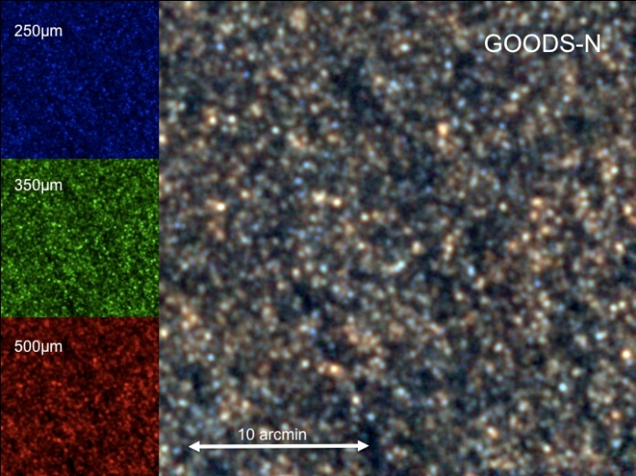
Obscured SF over Cosmic Time
P-Cam Subcamera FoV = 0.9°
P-Cam 350 um pixel
CCAT-p aperture lowers 3.5m Herschel confusion limits
Herschel surveys limited to ~ 6.3 mJy (1σ) confusion limit
5.5 m CCAT-p goes a factor of ~ 2.6 deeper into the confusion
  2.4 mJy (1σ) in 3 hrs @350 μm
One camera, using best 50% weather→ 100⁽°⁾² (or 300 ⁽°⁾²!) survey @ 350 μm) per year
Pushes down the luminosity function in the most active epoch star formation in the Universe
HerMES Lockman Hole North;
Oliver et al. (2010, 2011)
26 June 2017

Slide 20
CCAT-prime and Herschel
Courtesy of B. Magnelli
26 June 2017

Slide 21
CCAT-p Explores FIR Luminosity Function
Courtesy of B. Magnelli
26 June 2017
Notes:
CCAT enables hundreds of square degrees per year so we get the big beasts and go down a factor of 3 to 10 over Herschel at redshifts beyond 4

Slide 22
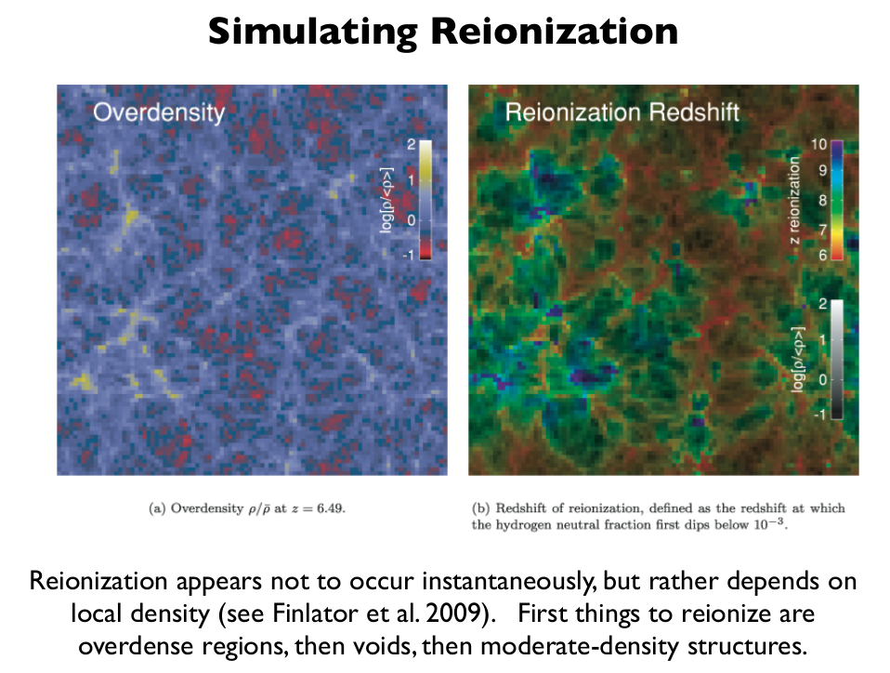
EoR-IM: Intensity Mapping of [CII] in the Epoch of Reionization
Aggregate [CII] signal from star forming galaxies at z ~ 5 to 9 ⇒ 3-D information:
  Reveals the process of reionization and the underlying dark matter distribution over the cosmic time when the first galaxies formed
Combine with SKA 21 cm HI line tracing neutral ISM concentrations

Slide 23
Intensity Mapping of [CII] from the EOR
Measure large scale spatial fluctuations of collective aggregate of faint galaxies via redshifted [CII] 158 μm line (+possibly other lines at other z’s)
  Resolution into individual galaxies not required
    Clustering scale 0.5 to 1 Mpc or ~1-2’ at z = 5-9, - good match for 6-m aperture (40”@ 1mm)
    16°² surveys: spectral/spatial mapping speed critical
    FoV ~ > 1° matches 40 Mpc void size-scale: systematics
    Need moderate spectral resolution R ~ 300-500
  Bandwidth of z ~ 5-9 signal is 0.95-1.6 mm (190-315 GHz)
    Identify interloper lower z CO by line multiplicity – complete at z > 0.8
    Sensitivity is at a premium: high site, very low emissivity telescope is essential!

Slide 24
Prediction of the [CII] Signal Strength
Gong et al 2012
Noise requirement = 8 × 10⁻¹⁴ W/m²/sr
RP = 500

Slide 25
Large BW × FoV Spectrometer
Trans-mm wave from ~ 0.95 to 1.6 mm (315-188 GHz)
Direct detection for optimal sensitivity
Resolving power requirement is modest, ~ 500 or 600 km/sec
Need a spectral × spatial product > 20,000 to complete a 16°² survey in 4000 hours.
Spectrometer extremes:
  312 spectral positions, 64 spatial positions w/ grating
  1 spectral sample, 20,000 spatial positions w/ FPI
Notes:
CO foregrounds: BW = 127 GHz. At z = 0 10% of the time get two lines. At z > 0.8 get two lines always.

Slide 26
EoR IM Science Program
The spectral multiplexer is challenging at present
The spatial multiplexer is very straight-forward
Requirement: EoR IM 16⁽°⁾² survey in 4000 hours
Predictions: 90” beams with top 2 quartiles of weather:
Using 3.2 cameras dichroic pixels tuned to 1.1 and 1.4 mm wavelength, we can survey a 16⁽°⁾² field to the required a 1σ noise limit of 8 × 10⁻¹⁴ W/m²/sr in
4000 hours integration time
Total number of pixels: 3.2 × 1050 (dichroic) or 6.4 × 1050 single color
One third (or even 1/6th) the number of pixels of grating because we accepted 4 spatial modes
26 June 2017
Notes:
14 hours, 1.5 overhead –
Would go to just 2200 hours with RP = 300

Slide 27
A Tough Experiment!
The zenith transmission is:
  97.9 to 96.6% at our site
  96.9 and 95.1% at ALMA site
Telescope emissivity is 2%
  Going off-axis makes a difference!
System emissivity is ~ 5.9%
  Going to 5600 m makes a difference!
    Would need 4.1 compared with 3.2 tubes
  Window emissivity makes a difference (2%)
Spectrometer transmission is 40% including DQE of 80%
Note that the same stringent requirements hold for the grating spectrometer
26 June 2017

Slide 28
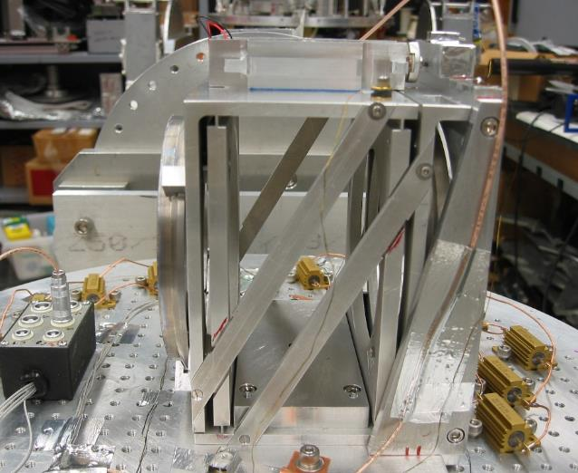
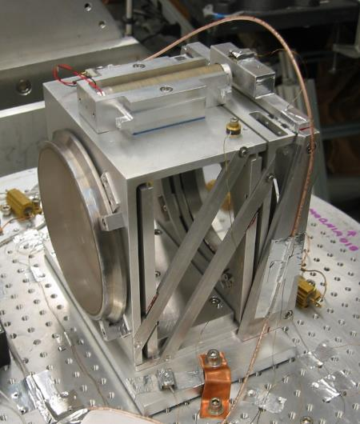
Fabry-Perots in Development
R = 10⁶ FPI at 112 um for HIRMES on SOFIA
These are based on free-standing metal mesh
Developing silicon substrate-based FPI:
  Silicon AR coatings (dual layer) with microstructures
  Metalized (superconducting) broad-band reflectors
26 June 2017

Slide 29
Comparisons to other Coeval Facilities
EoR IM: surface brightness: WFE, emissivity, site, and FoV:
  Sensitivity (Jy/beam) ∝
    1/Ruze Efficiency
    ~ (System Emissivity)^{1/2} – telescope, warm optics and sky
    1/(warm transmission) – includes telescope efficiency, sky transparency
  Mapping Speed ∝
    (Sensitivity referred to EOR beam)²
    Field of view accepted/field of view of P-Cam subcamera
Teles. | WFE (rms), Ruze eff. | Med. PWV | η_{sky} (245 GHz) | tel. emis. | Raw Sens.² | P-Cam FoV | FoV (dia.) | Mapping Speed
APEX | 17 μm, 97% | 1.0 | 0.945 | 10% | 0.86 | 24.8’ | 11.4’ | 1/16
JCMT | 25 μm, 93% | 2.0 | 0.901 | 10% | 0.93 | 19.8’ | 9.0’ | 1/28
LMT | 70 μm, 58% | 2.0¹ | 0.901 | 15% | 0.51 | 5.9’ | 8.0’ | 1/77
CCAT-p | 10.5 μm, 99% | 0.60 | 0.962 | 2.8% | 1 | 54’ | 143 | 1→7
¹This weather is only 4 months/year; ²Refers to a 65” beam and source elevation of 50°
26 June 2017

Slide 30
Comparisons to other Coeval Facilities
kSZ; GEvo: short submm bands: WFE, emissivity, site, and FoV:
Point source foregrounds
Teles. | WFE (rms), Ruze eff. | 1st Q PWV | η_{sky} (860 GHz) | tel. emis. | Raw Sens.² | P-Cam FoV | FoV (dia.) | Mapping Speed
APEX | 17 μm, 69% | 0.6 | 0.25 | 10% | 0.54 | 24.8’ | 11.4’ | 1/1.4³-1/5.9⁴
JCMT | 25 μm, 44% | 1.0 | 0.12 | 10% | 1.31 | 19.8’ | 9.0’ | 1/8.3³-1/56⁴
LMT | 50 μm, 4% | 1.0¹ | 0.12 | 15% | 1.47 | 5.9’ | 8.0’ | 1/8.6³-1/640⁴
CCAT-p | 10.5 μm, 87% | 0.4 | 0.39 | 2.8% | 1 | 54’ |  | 1→7
¹This weather is only 4 months/yr; ² Point source – el. = 50°; ³beams, ⁴areal coverage
1’-scale kSZ Science
Teles. | WFE (rms), Ruze eff. | Med. PWV | η_{sky} (245 GHz) | tel. emis. | Raw Sens.² | P-Cam FoV | FoV (dia.) | Mapping Speed
APEX | 17 μm, 97% | 1.0 | 0.945 | 10% | 0.86 | 24.8’ | 11.4’ | 1/16
JCMT | 25 μm, 93% | 2.0 | 0.901 | 10% | 0.93 | 19.8’ | 9.0’ | 1/28
LMT | 70 μm, 58% | 2.0¹ | 0.901 | 15% | 0.51 | 5.9’ | 8.0’ | 1/77
CCAT-p | 10.5 μm, 99% | 0.60 | 0.962 | 2.8% | 1 | 54’ |  | 1→7
¹This weather is only 4 months/year; ²Refers to a 65” beam and source elevation of 50°

Slide 31
Schedule
Four (4) year project (July 2017 to June 2021)
20 months Detailed Design [PDR @ 4 months; CDR @ 10 months, FDR @ 18 months.]
13 months Fabrication which includes a Trial Assembly in Germany
3 months Shipping & Receiving
12 months Assembly/Checkout
  Including 3 months unpacking/inspection and sequenced transport to summit
26 June 2017

Slide 32
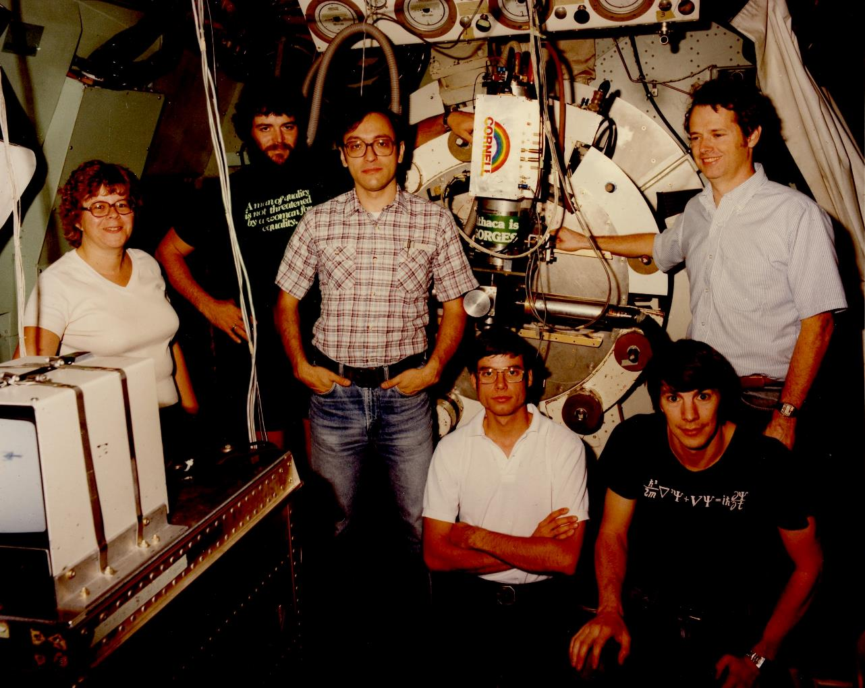
Houck Group (with guest observer) on KAO 1981

