Slide 1
Silicon Diffractive Optics Enable
a New Generation of High Resolution
Spectrographs for the Infrared
Dan Jaffe
University of Texas at Austin
Notes:
The work I will describe here, the path from a new type of diffraction grating to new world in high resolution infrared spectroscopy, touches Cornell at several important points. On my first visit to see Gordon Stacey, now just over 20 years ago, I gave a lunch talk about silicon diffractive optics. A conversation I had with Jim Houck about IRS during that visit got me thinking about the charms and virtues of spectrographs with no moving parts and no adjustments. The first use of the new techniques we were developing came in the production of a set of grisms for Terry Herter’s FORCAST instrument for SOFIA, devices that gave FORCAST a low and medium resolution spectroscopic capability. This work led to the grisms we fabricated for NIRCam on JWST. In the FORCAST work, the spectroscopy effort was led by Luke Keller at Ithaca College who had been one of the pioneers in the grating lab.

Slide 2
First-generation high resolution
spectrographs for the IR
Small wavelength coverage:
CSHELL: λ/200
Phoenix: λ/100
CRIRES: λ/70
Small coverage means lots of
moving parts.
Many surfaces.
Hard to get decent slit sizes at
high resolution.
Instruments already quite large
and so not too stiff.

Slide 3
What should a high resolution infrared spectrograph have?
-High spectral resolution- what is high?
-Large continuous wavelength coverage
-Throughput is everything if you are not a PRV person
-Stability and ease of use
-Reliable, high quality pipeline

Slide 4
Resolving power is equal to phase delay across the beam measured in wavelengths
divided by the ratio of the angular size of the slit to the diffraction limited angular scale.
R= λ/Δλ = (2Lsinδ)/λ • θ_{diff}/θ_{slit}
Where L is the grating length and δ is the grating angle.
In immersion, the internal wavelength
shrinks by a factor of n, the
refractive index

Slide 5
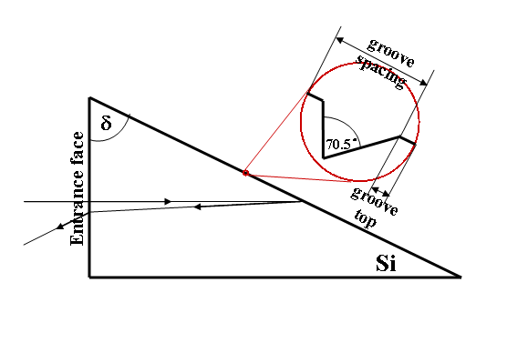
The invention of the immersion grating by Dan Jaffe
The “eureka moment”- Spring 1992
If you illuminate a grating from inside a transparent
medium, the density of the medium leads the light to
see the grating as “longer”, that is, bigger by a factor
of the refractive index, n, which is 3.4 for silicon

Slide 6
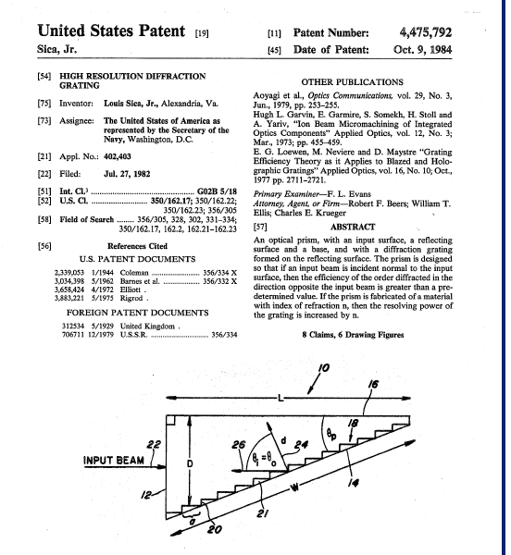
The invention of the immersion grating by Dan Jaffe
2.The “oh” moment –
discovering a US
patent from 1984

Slide 7
The invention of the immersion grating by Dan Jaffe
3.The “hah” moment- finding an article from Nature, 1954

Slide 8
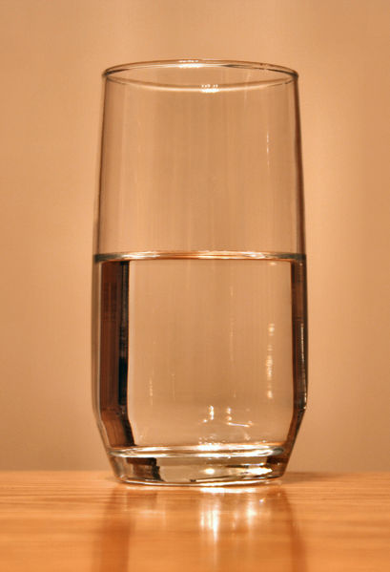
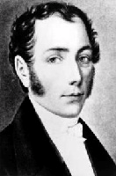
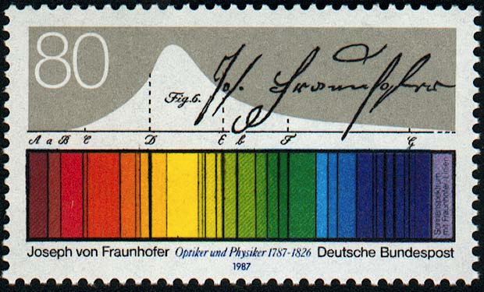
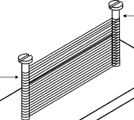
The invention of the immersion grating by Dan Jaffe
4. The “duh” moment: Gegenseitige Einwirkung der im
Wasser und anderen brechenden Mitteln gebeugten
Strahlen Joseph Fraunhofer 1823
The interaction of diffracted radiation in water
and other refractive media.
Fraunhofer immersed his gratings in
water, linseed oil, and turpentine.
We immerse ours in solid silicon but
the physics is the same.

Slide 9
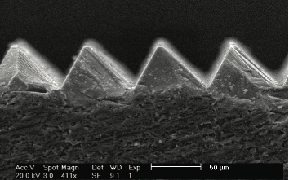
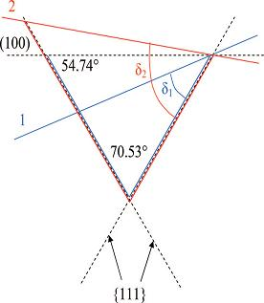
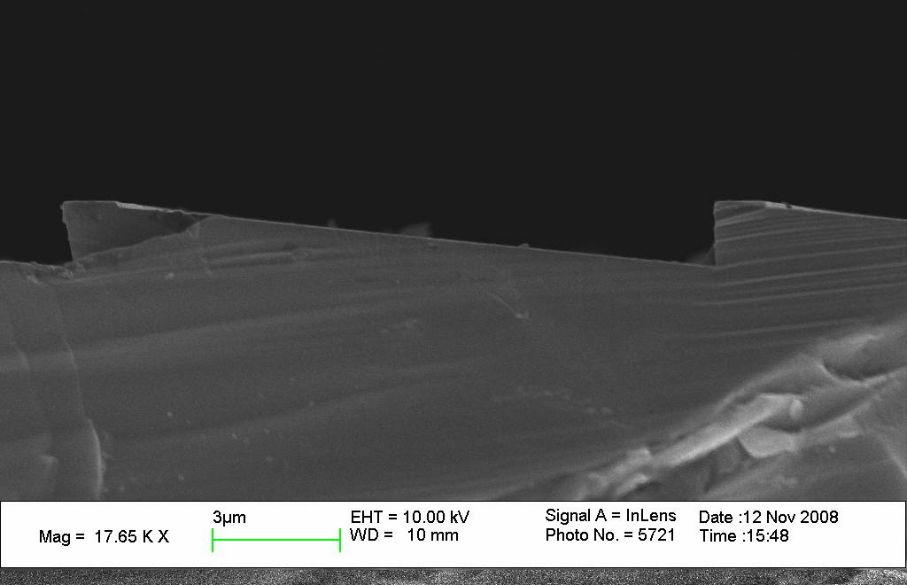
A. Immersion Grating
- Groove Shape
Crystallographic orientation determines the blaze angle
for the grating.
Blaze angle: 63.4°
Blaze angle: 6.16°
*Cutting angle depends on desired blaze angle δ
Notes:
Groove geometry is formed in chemical etching in silicon crystal due to selective etching on silicon crystal planes (100 vs. 111) in alkaline solutions. Aqueous KOH is most commonly used as etching chemical. KOH etches faster and more on (100) plane instead of (111). Eventually it will form an apex by two {111} planes after all (100) plane is gone. The angle defined by {111} planes is 70.53° in theory. We can make use of this property to make groove shape with our desired blaze angle δ (shown in left figure as δ1 in blue and δ2 in red.). Right side SEM pictures show etching result of silicon grooves of 63.4° and 6.16°.
9

Slide 10
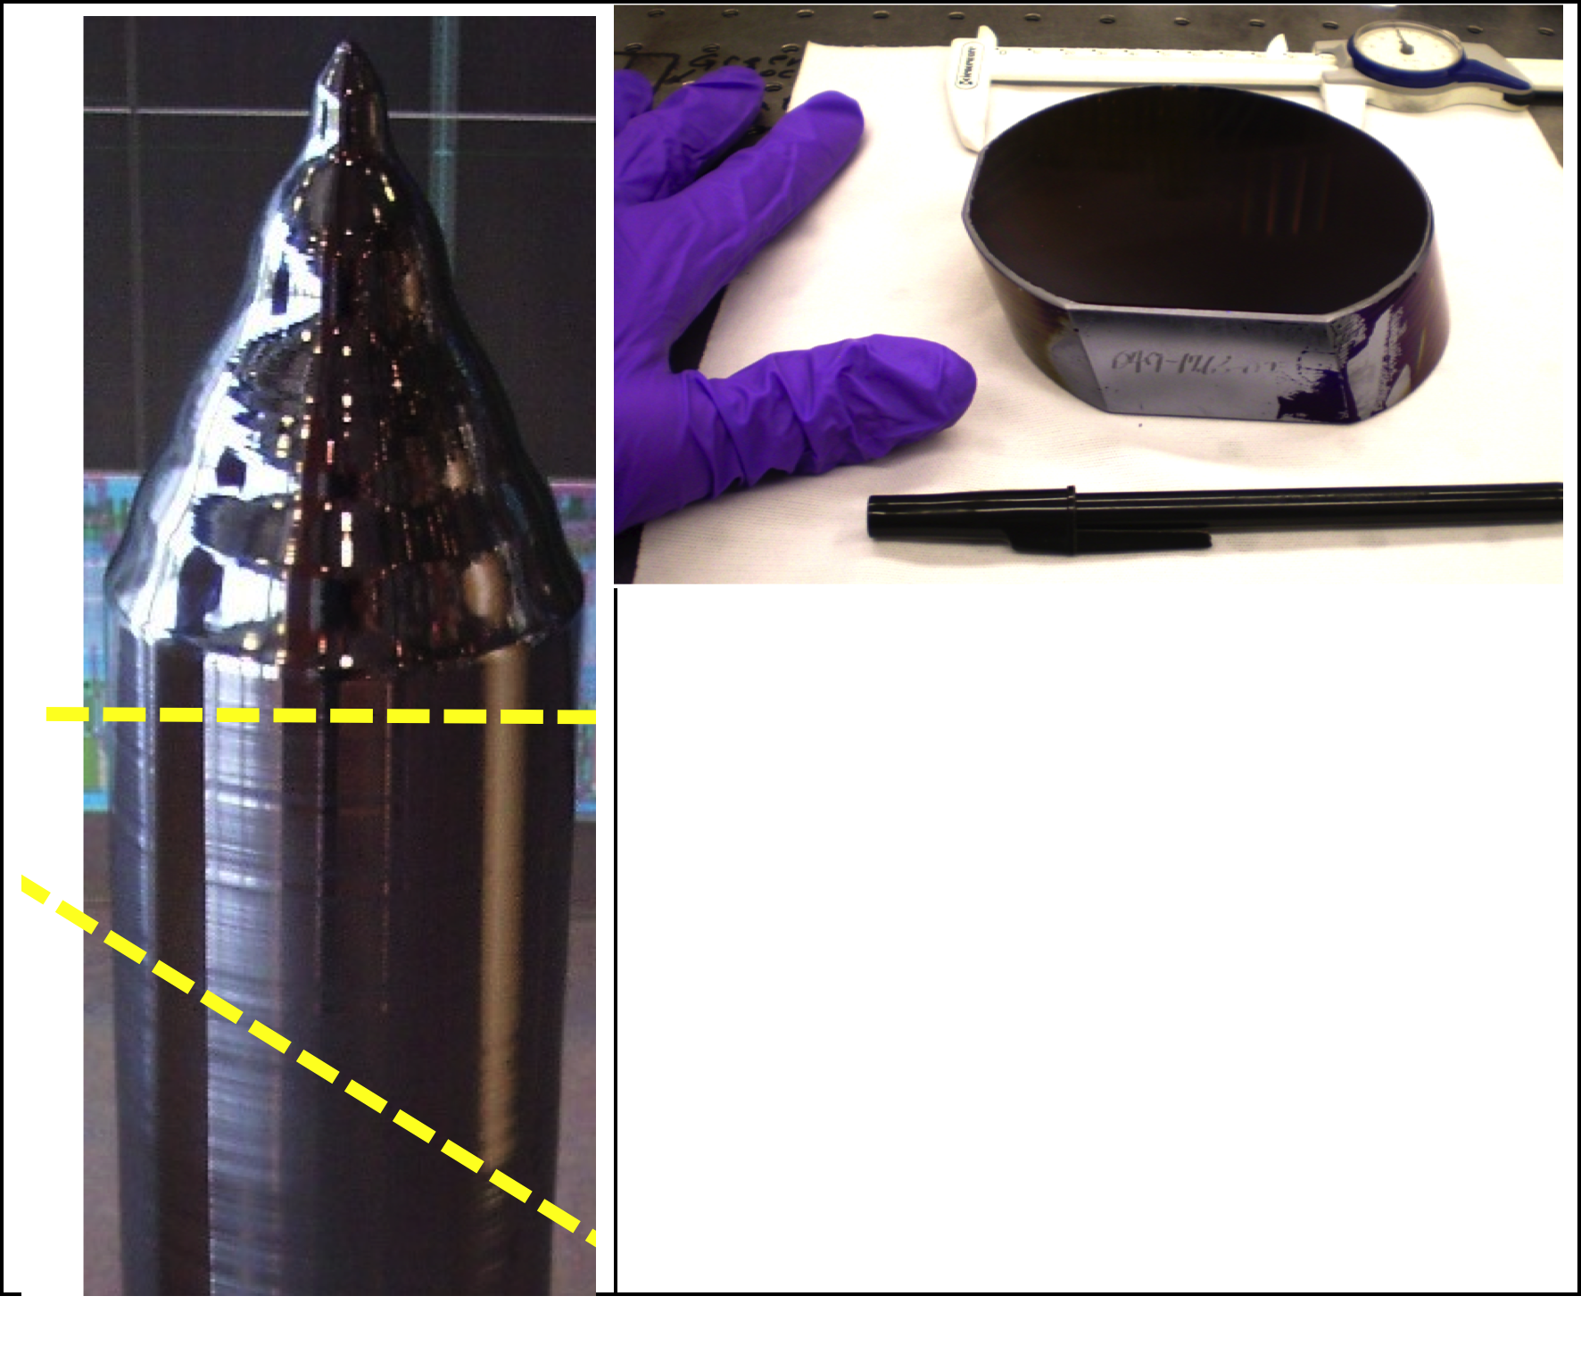
The thick substrates require a completely independent process
chain from what wafers require.

Slide 11
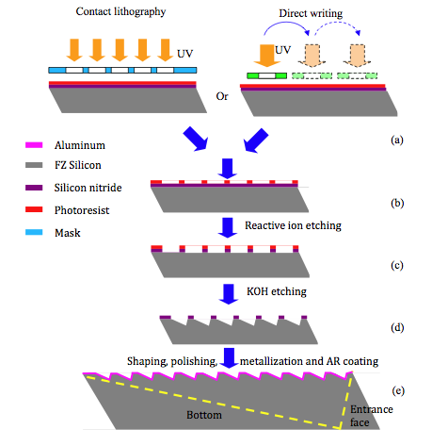

Slide 12
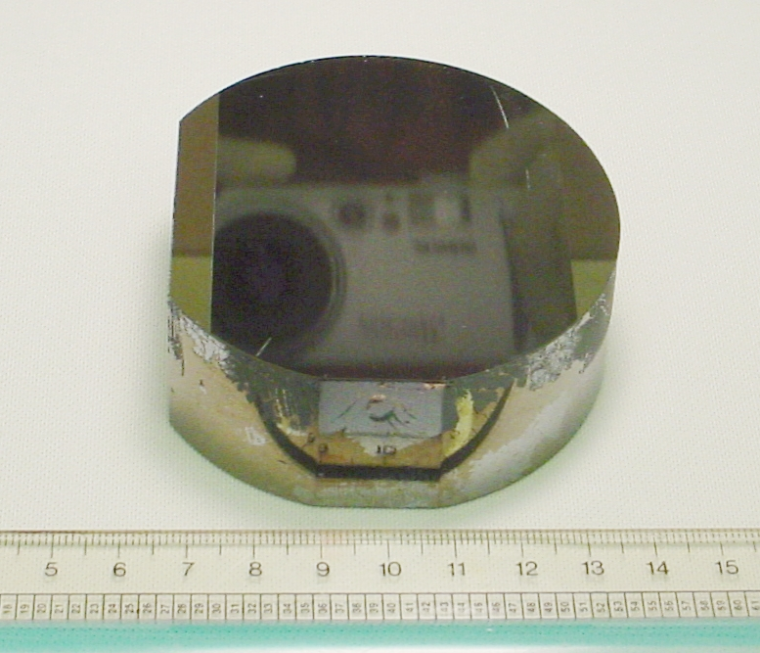
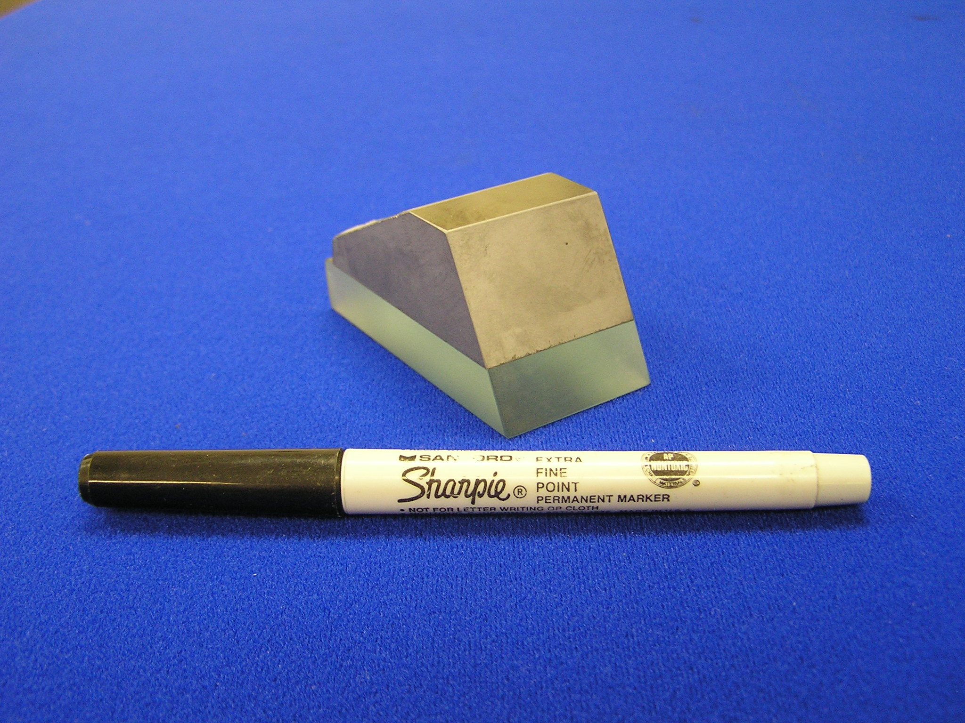
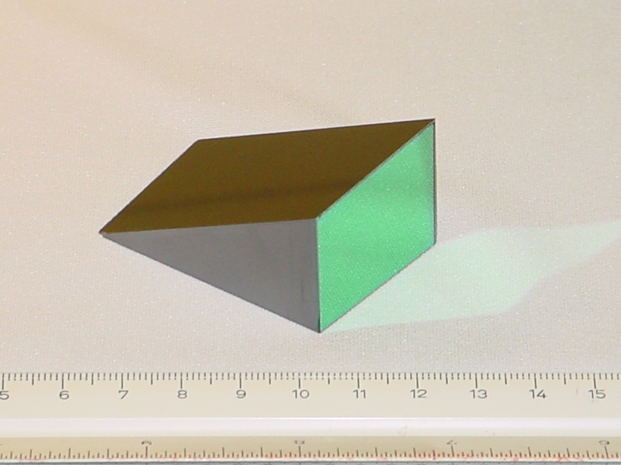
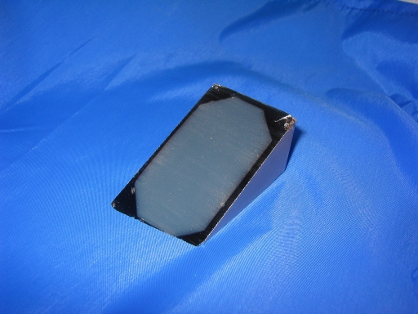
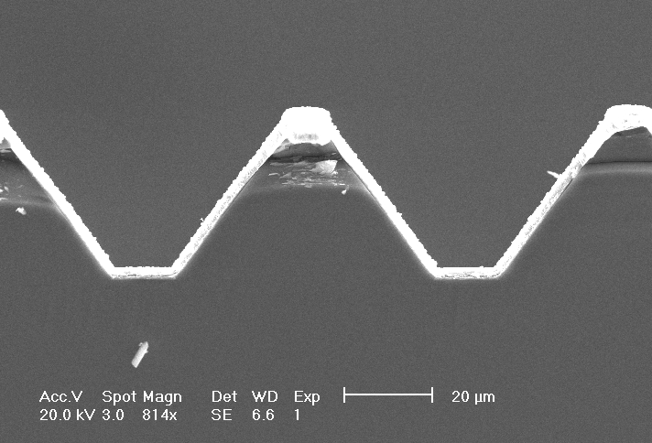
Si Immersion Grating Production
Grating etched into
silicon puck
Puck cut into prism
and then polished
Flat entrance face
antireflection coated
Device completed by aluminizing the
grooves along the hypotenuse
36 mm
elliptical C.A. corresponds to
a 24 mm circular beam
Note: Only the bottom of
the coating matters
12
Notes:
12

Slide 13
Degree of difficulty: scales with
[(n-1) sinδ]/λ for grisms and with
[2nsinδ]/λ for immersion gratings.
Scales with length of grating divided by width of slit in units of diffraction limited width.
Forcast grism 1: δ=11º λ= 30 μm, DD=1
Other Forcast grisms: DD=1-10
JWST grisms: DD= 9
IG for IGRINS: DD=120
IG for GMTNIRS: DD= 250

Slide 14
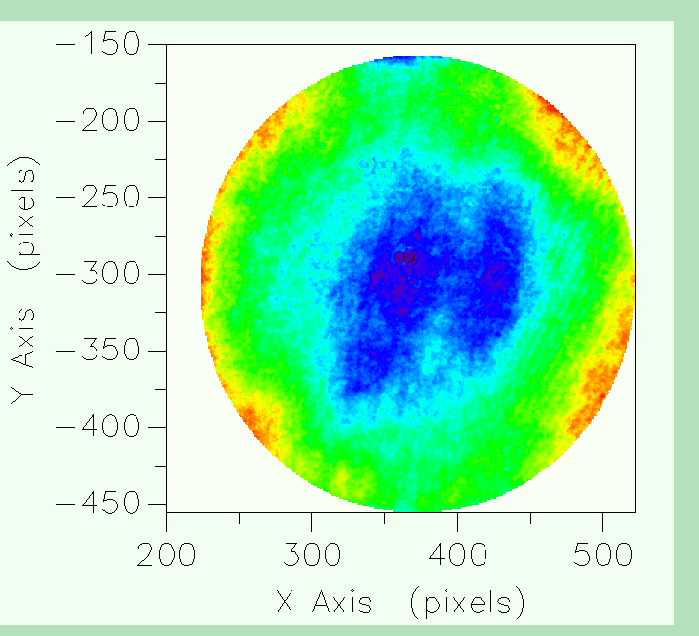
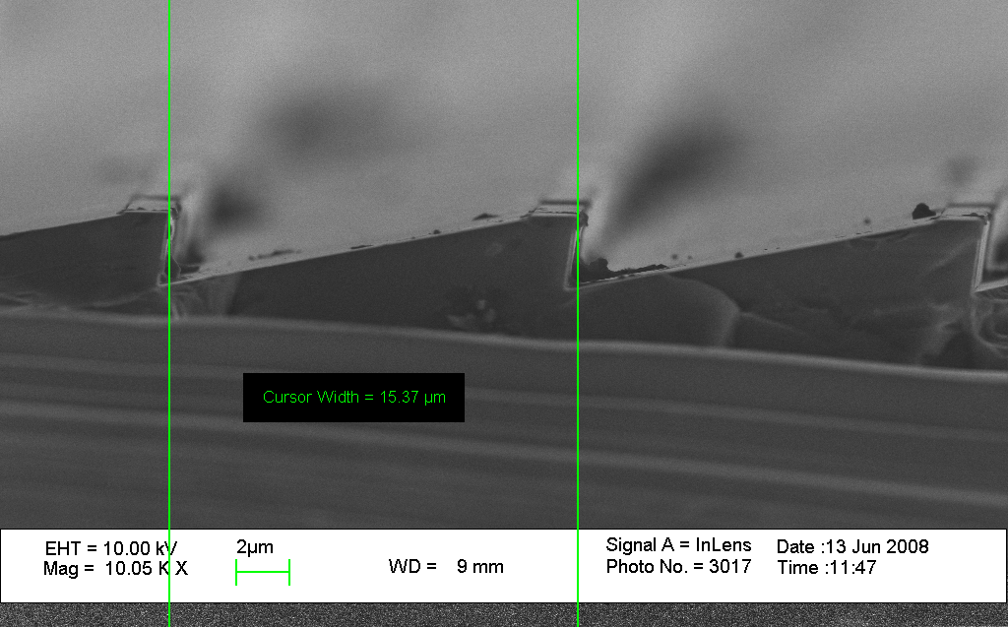
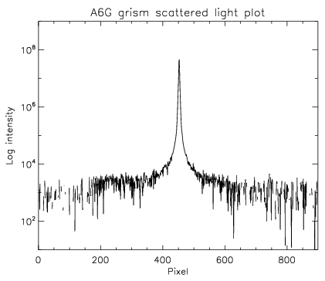
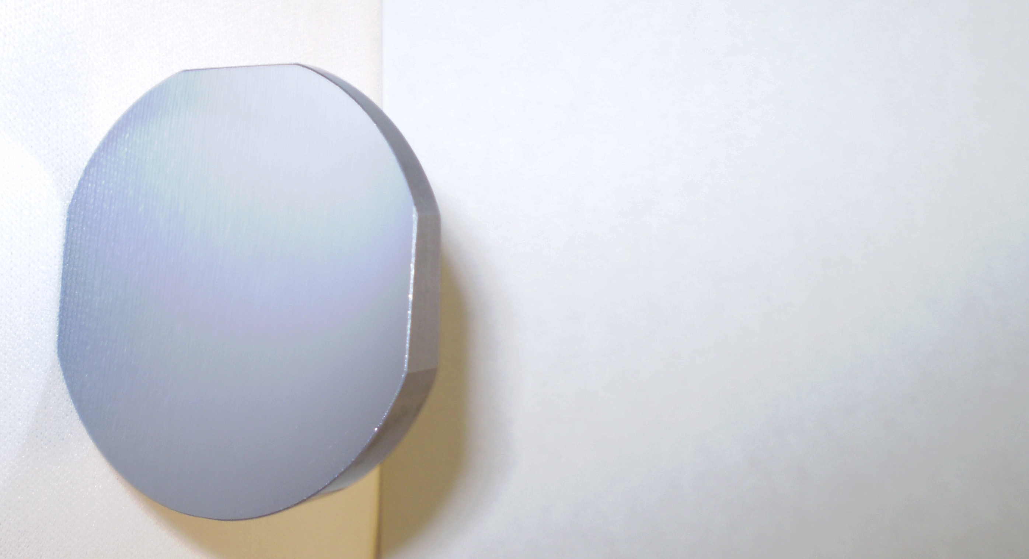
JWST NIRCam Grisms
λ/100 rms grating surface
10⁵ dynamic range
Flight Part
Notes:
Tests using internal light agree with the external measurements.
little numbers give the order numbers.
1.523 um light is used, which is near the “short end of GMTNIRS’ operating range”
the end-to-end grating quality is already of “science grade”

Slide 15
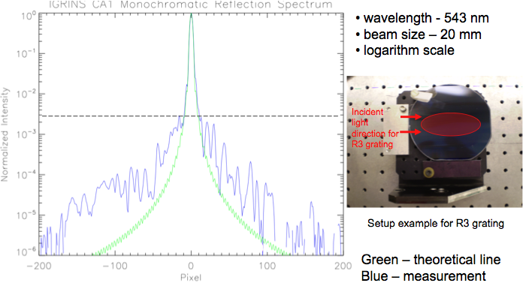
IGRINS Immersion Grating- Complete 2011
Surface is λ/6 peak to valley. Efficiency ~80%

Slide 16
The continuous wavelength coverage problem:
Number of diffraction limited resolution elements per order = # of grooves
Resolving power, R = order # • # of grooves • θ_{diff}/θ_{slit}
Required detector size = 3 • # of grooves • θ_{diff}/θ_{slit} = 3 • R/ order#
Order # , m = 3•R/N_{pixels}
For a 2048 detector and R = 50,000, this implies m= 75 (about IGRINS)
For an R3 grating at 2 microns, this would require a grating constant of 11.5 l/mm
This is too coarse for ruling. A silicon immersion grating will be 3.4 times finer
and micromachining makes this easy.

Slide 17
Chips have limited real estate and you usually have to face sacrificing
slit length, sampling, resolving power, or spectral grasp.
The Earth’s atmosphere
helps you avoid this problem
by showing you where to
put the dichroics.

Slide 18
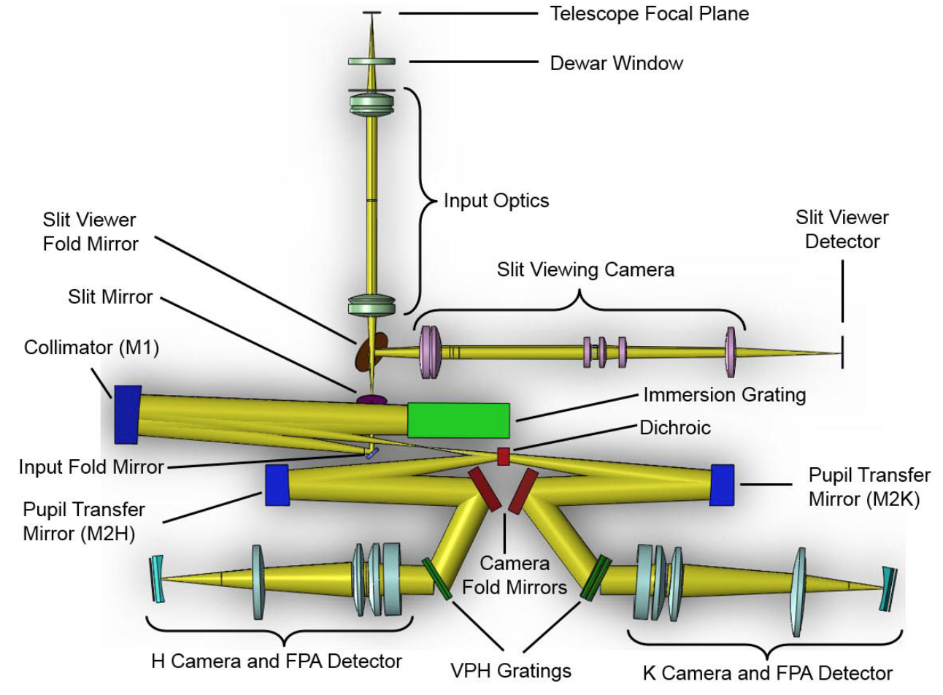
IGRINS (UT and KASI)
covers all of 1.4-2.45 μm
in one exposure at R=45,000
with no gaps!

Slide 19
IGRINS on McDonald 2.7m
2014-2016, no cold moving parts,
warm calibration system with
moving mirrors
IGRINS on 4.3m DCT 2016- and
McDonald 2.7m 2017-
No moving parts, sky emission and
absorption lines, white spot

Slide 20
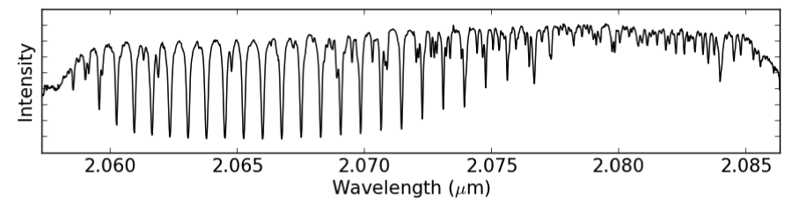
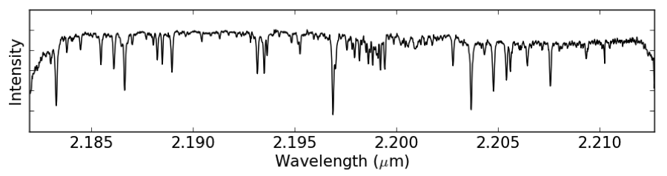
IGRINS Spectrum of a star, not corrected for telluric absorption
Region covered by the Phoenix spectrograph
Notes:
Phoenix: KPNO 4m
20

Slide 22
IGRINS first light was March 2014
24 papers published or in press, many more in progress
Analysis tools still building
Gemini South in Spring 2018

Slide 23
OH Night sky in the H band
(Chan Park et al.)
Spectrum of the entire H band
as measured with IGRINS
Notes:
Good data in hand- dedicated spectra from March and May plus off beam side of each observation since then.
The audience for this paper is both a general one and the specific audience of extragalactic spectroscopists, especially IFU spectroscopists. We need to identify groupings of lines and test how well we can predict the variation of intensity of the weak ones as the strong ones vary.

Slide 24
H₂ rovibrational transitions observed with IGRINS
Kyle Kaplan UT PhD thesis and Kaplan et al. (2017)
Lines up to high v, J, and excitation energy all visible (typical of UV excitation)
Lines all narrow
Gas motions only 1-4 km s⁻¹
Unlikely shocks

Slide 25
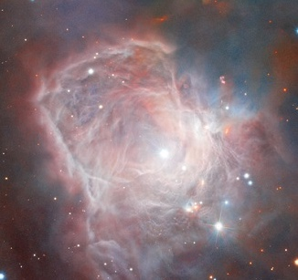
NGC 2023
High S/N NGC 2023 spectrum is especially impressive!
Over 200 H₂ lines observed!

Slide 26
Analysis tools are essential
With enough lines, you
can unpack effective
temperature, gravity,
and magnetic field.
Moog Stokes:
Deen (2013)

Slide 27
TW Hya Sokal et al. (2017 in prep)
Simultaneous determination of
T_{eff}, log g, and B

Slide 28
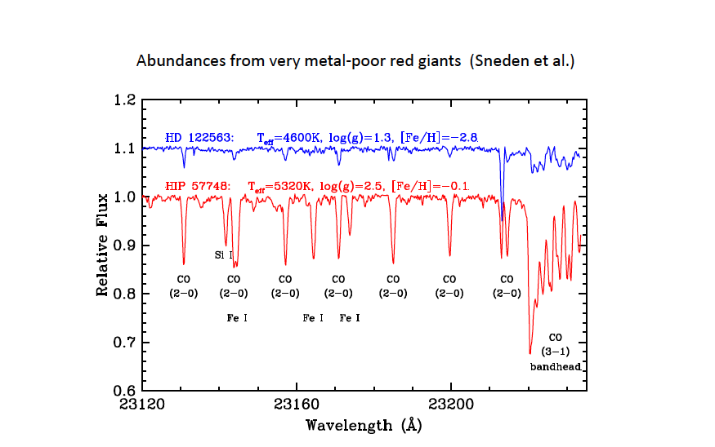
Spectra of metal-poor giants (Afsar et al. 2016, ApJ 819)

Slide 29
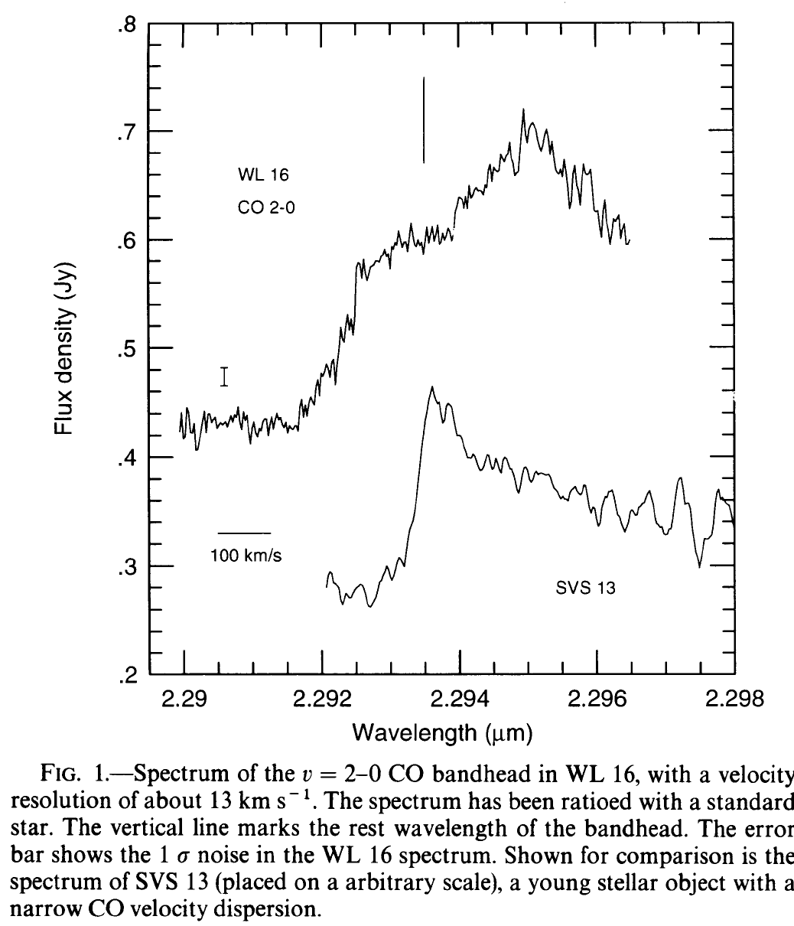
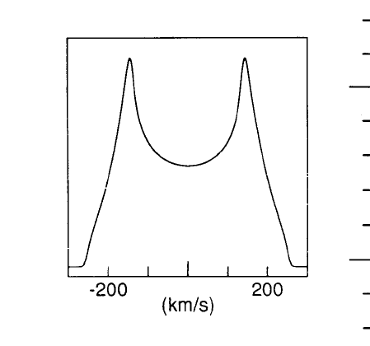
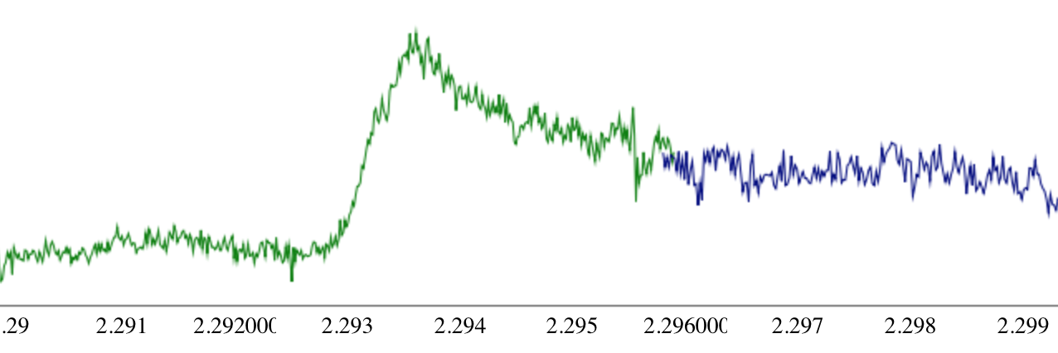
Serpens 2: CO bandhead at 2.29353 microns
A. Lyo et al. (2017, ApJ in press)

Slide 30
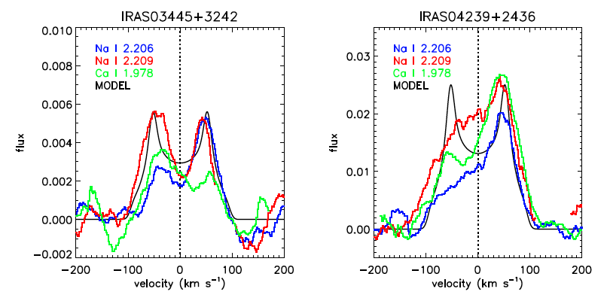
S. Lee et al. 2016 ApJ 826

Slide 31
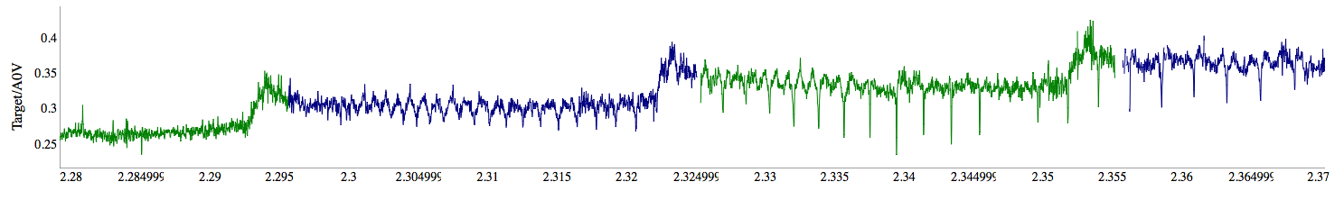
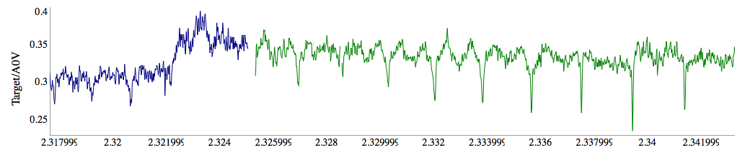
IRAS 04239: CO Bandhead Emission
Blowup of the 3-1 bandhead

Slide 32
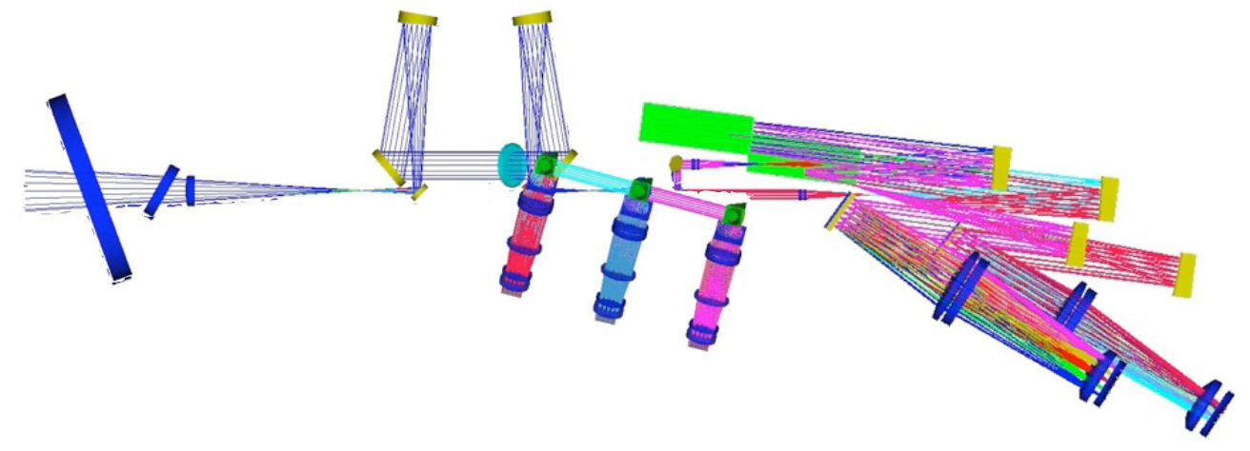
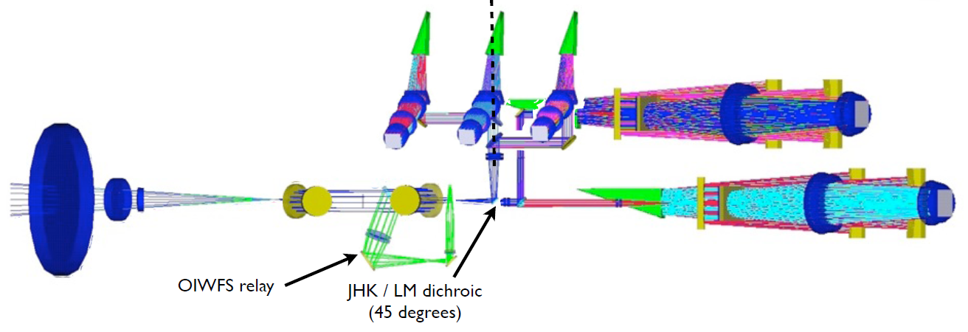
GMTNIRS for GMT will have JHK R=60,000
LM R= 90,000 all at once

Slide 33
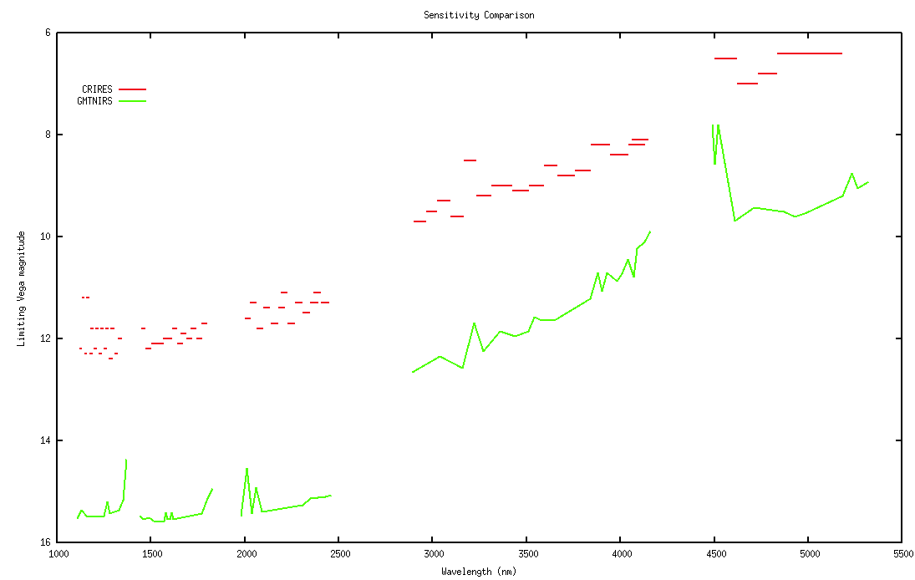
The comparative advantage of GMTNIRS over the current
CRIRES is about a factor of 20,000 in speed. This arises
from bigger scope, modern detectors and the immersion
gratings.

Slide 34
Thank You

