Slide 1
TripleSpec: The “Cloned” Near-IR Spectrograph
Terry Herter, Chuck Henderson, John Wilson, Keith Matthews, Marco Bonati and the TSpec team (at Cornell, UVa, Caltech, JPL & NOAO)
2017-06-27

Slide 2
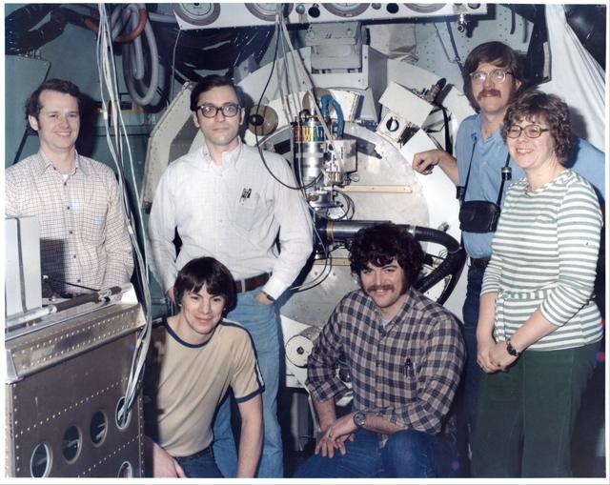
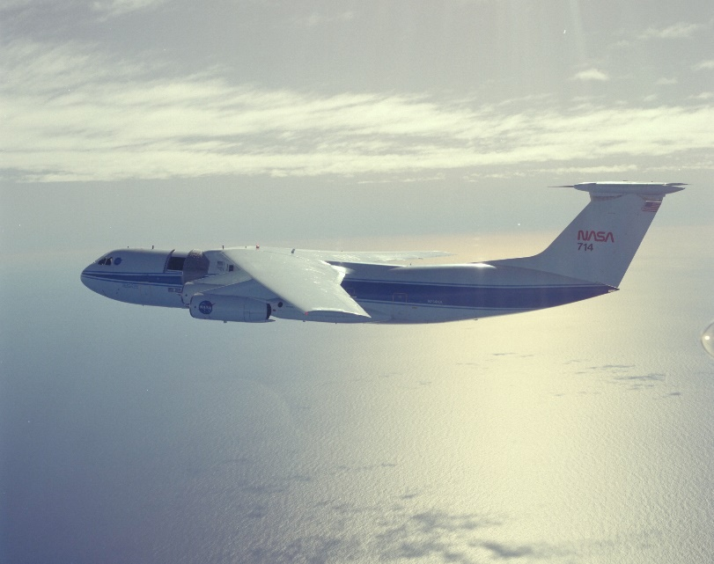
1977
NASA Kuiper Airborne Observatory (KAO)
Jim Houck, Dan Briotta (Cornell University), graduate student Terry Herter (University of Rochester, kneeling), George Gull (CU), Bill Forrest, Judy Pipher (UofR), with the Cornell mid-infrared grating spectrometer, 1977. Houck’s group also observed earlier from the Learjet, as did Forrest.

Slide 3
Some quick lessons from Jim
Science drives the instrument
  You need spectroscopy for “real science”
Don’t polish the cannonball
  “Better” is the enemy of “good enough”
Lunch together
  It provides group cohesion and a fertile ground for brainstorming
A sufficiently clever person …

Slide 4
Design Principles
Science with medium resolution spectrograph:
  Late-type stars, brown dwarfs, embedded objects, redshifted galaxies, etc.
Design parameters:
  Spectral coverage: ∼ 0.9 – 2.5 μm
  Spectral Resolution: λ/Δλ ∼ 3000
  High throughput & Background limited sensitivity
Engineering Requirements:
  Mechanically and thermally stable
    Achieved: < 1 pixel shift over all orientations
  Simple to maintain and operate
    No moving parts (TSpec2 and 3 have one)
  Reasonable LN2 hold time
    > 5 days achieved
    LN2 cans maintain cryogen over all dewar orientations

Slide 5
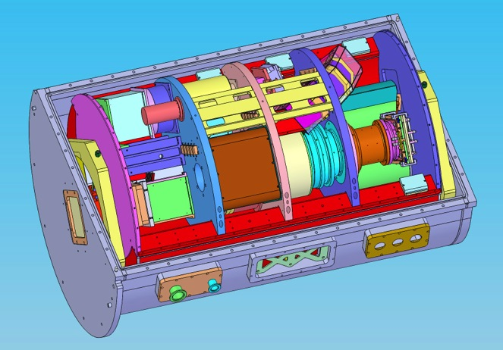
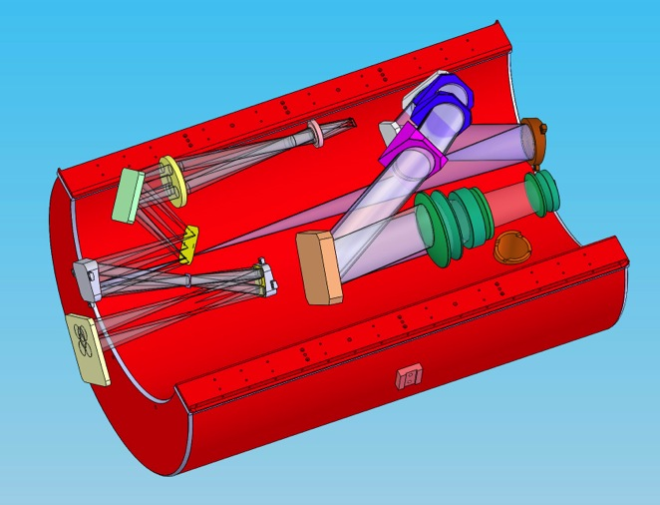
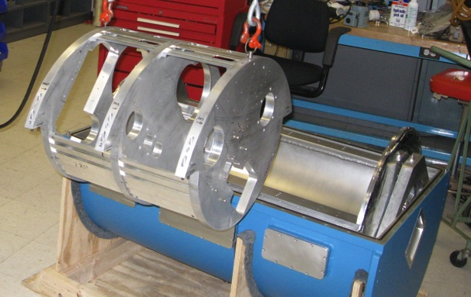
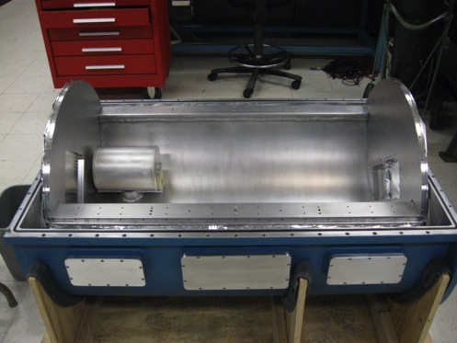
Rigid Tubular backbone
Reduces flexure as instrument is rotated
Crescent Shaped Tank Cools and Provides Structure

Slide 6
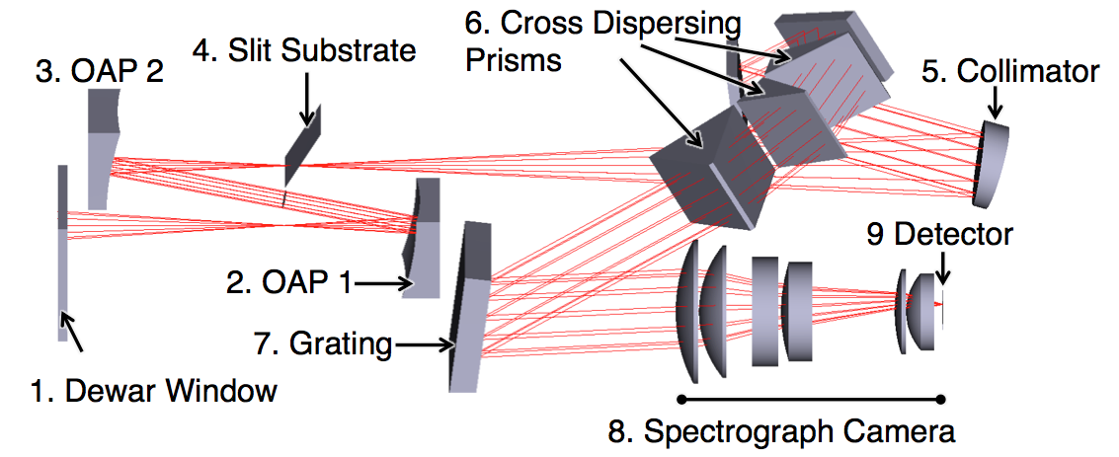
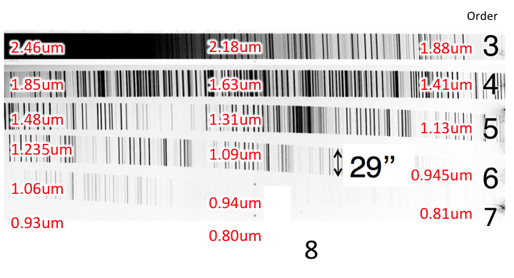
Spectrograph Optical Design
Fore-optics (2-4) change between telescopes
Dewar and aft-optics (5-9) stay the same between telescopes

Slide 7
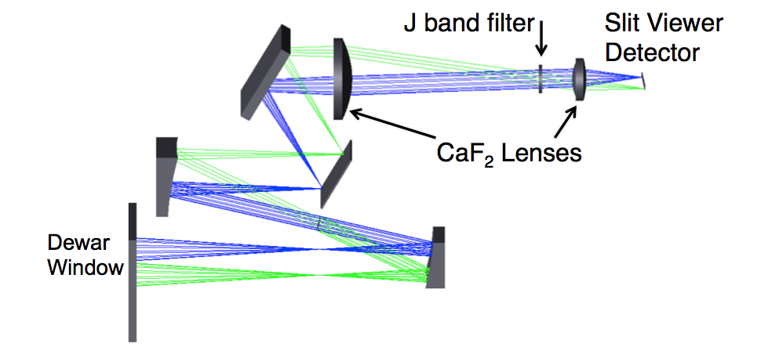
Slit Viewer Allows You to Align Source on the Slit
Every spectrum is synced with a slit viewer field
Notes:
Marco nicely synced up so you get 1 SV per spectrograph image and can always go back to check on source

Slide 8
Instrument Summaries
Spec / Location | Palomar | APO | Keck | Blanco
Instrument Name | TripleSpec | TripleSpec | NIRESª | ARCoIRIS^{b}
Working Name | TSpec1 | TSpec2 | TSpec3 | TSpec4
Telescope Aperture | 5.08 | 3.403 | 10 | 3.934
Mounting Position | Cass | Nasmyth | Bent Cass | Cass
Telescope f# | 16 | 10.4 | 16 | 7.8
Slit width (″) | 1.0 | 1.1 | 0.5 | 1.1
Slit length (″) | 30 | 35 | 15 | 28
Wavelength Range (μm) | 0.95 – 2.5 | 0.95 – 2.5 | 0.95 – 2.5 | 0.85 – 2.5
Spectral Resolution | 2700 | 3730 | 2700 | 3500
Sampling (pixels/res. ele.) | 2.7 | 2.1 | 2.7 | 2.09
Slit viewer band | K | K | K | J
ªNear Infrared Spectrograph
^{b}Astronomy Research using the Cornell Infrared Imaging Spectrograph

Slide 9
Saturn Nebula (PNe)
An extracted ARCoIRIS spectrum for the Saturn planetary nebula (NGC 7009) is plotted, in counts vs. wavelength (in microns) space, where each of the spectral orders is color-coded. The spectrum consists of a 100-seconds exposure on-slit, followed by the subtraction of a 100-seconds exposure off-slit (for sky background removal).

Slide 10
An extracted ARCoIRIS spectrum for Saturn’s moon Titan is shown, in counts vs. wavelength (in microns) space.
Massive broad-band absorption by hydrocarbon species (e.g., methane) is evident across the z’YJHK wavelength region.
Observation is an ABBA sequence– acquired 2015-07-02, @10-seconds per nod.
An extracted ARCoIRIS spectrum for the dwarf planet Pluto is shown, in counts vs. wavelength (in microns) space.
An absorption triplet, observed in each of the YJH bands, arises due to molecular methane in Pluto’s tenuous atmosphere.
Observation is an ABBA sequence – acquired 2015-07-02, @60 seconds per nod.

