Slide 1



The SPICA infrared space observatory – project status
    Peter Roelfsema
    SAFARI Principal Investigator
    SPICA European consortium lead
    on behalf of the SPICA/J and SAFARI consortia

Slide 2
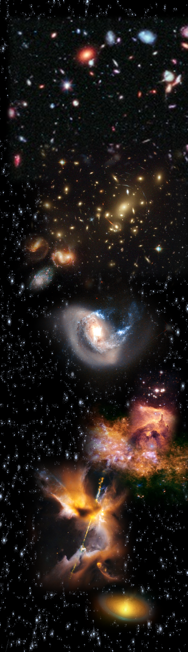
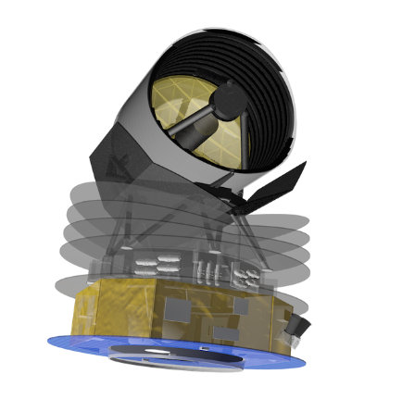
Contents
SRON and its mission(s)
The goal – a big cold IR facility; SPICA
The heart of the matter – SPICA science
  The science case for the (far) IR
  Requirements for the mission and instruments
Mission overview
  Satellite concepts
  Instruments, capabilities
M5 proposal under evaluation within ESA
  Candidate selection - December 2017
  Next milestone; mission selection in 2021

Slide 3
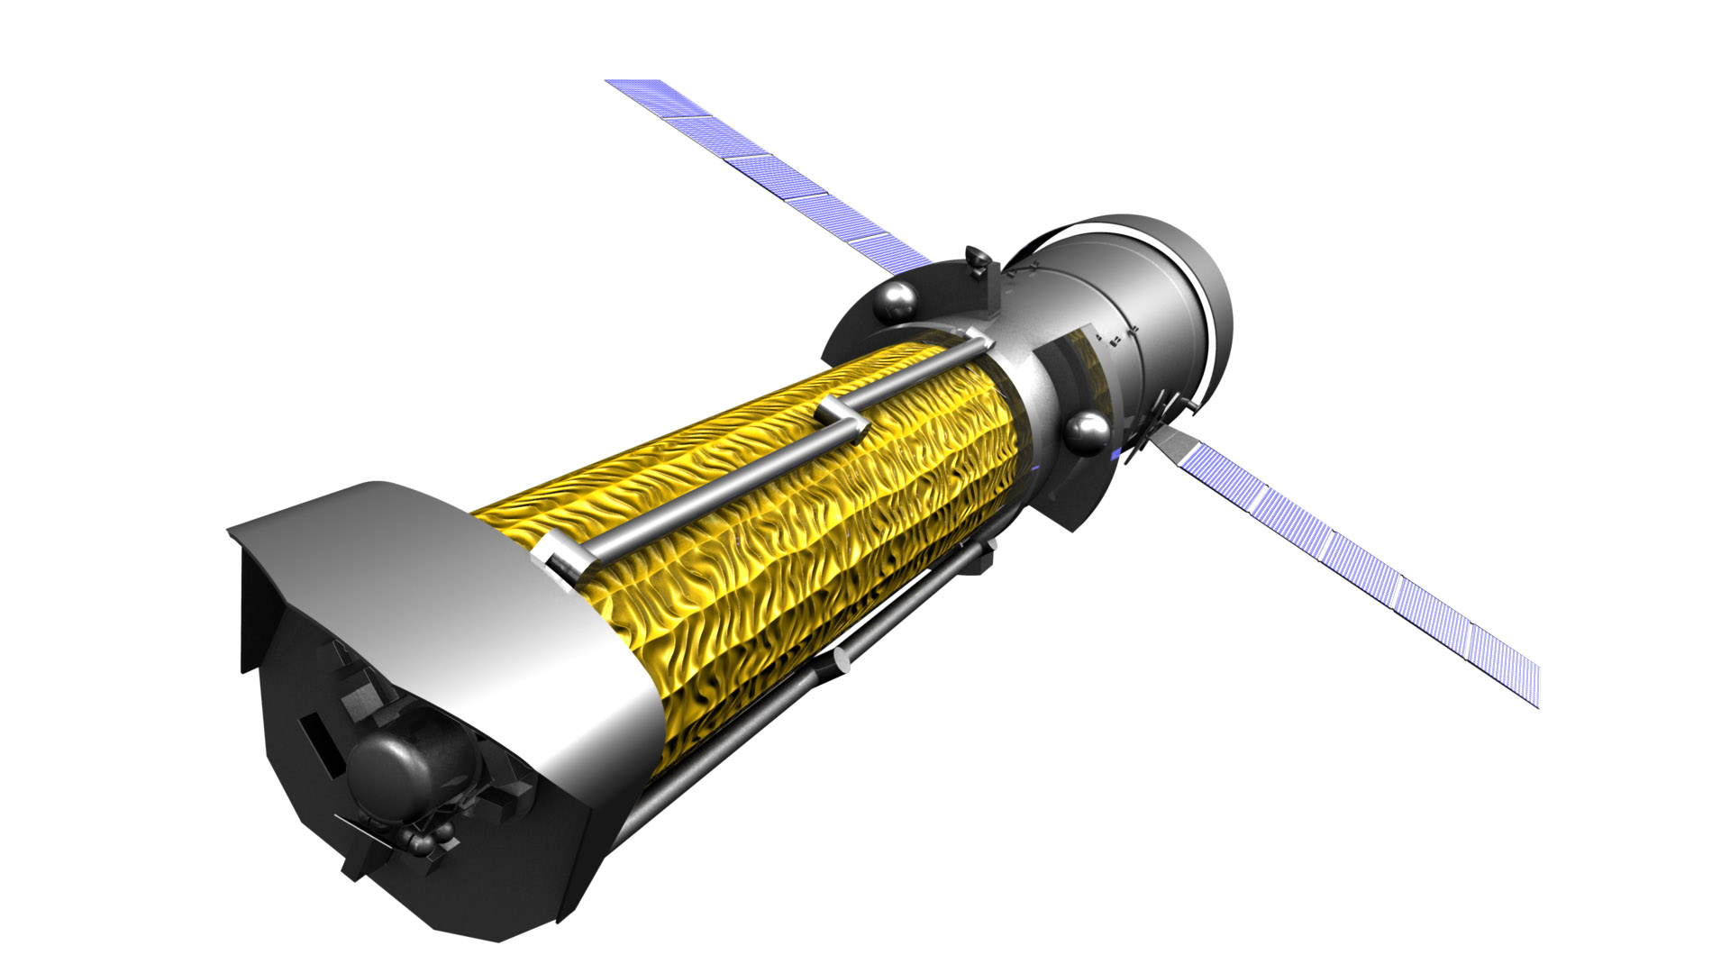
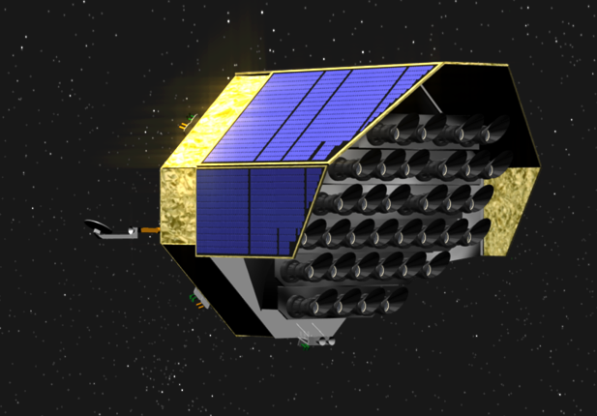
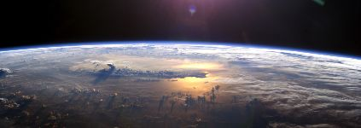

SRON
Dutch national expertise institute for scientific space research
enabling breakthroughs in scientific research from space
ESRO-2 ESRO 1968 BEPPOSAX NIVR/ASI 1996
OGO-5 NASA 1968 XMM-NEWTON ESA 1999
TD-1A ESRO 1972 CHANDRA NASA 1999
ESRO-4 ESRO 1972 ENVISAT ESA 2002
ANS NIVR 1974 INTEGRAL ESA 2002
COS-B ESA 1975 AKARI JAXA 2006
ISEE-3 NASA 1978 GOCE ESA 2009
EINSTEIN NASA 1978 HERSCHEL ESA 2009
SMM NASA 1980 LISA PF ESA 2015
IRAS NIVR/NASA 1983 SENTINEL 5 Prec. ESA 2017
EXOSAT ESA 1983 HITOMI JAXA 2016
MIR/COMIS IKI 1987 SENTINEL 5 ESA 2019
HIPPARCOS ESA 1989 PLATO ESA 2025
COMPTON GRO NASA 1991 ATHENA ESA 2028
ISO ESA 1995 SPICA ESA/JAXA 2029

Slide 4
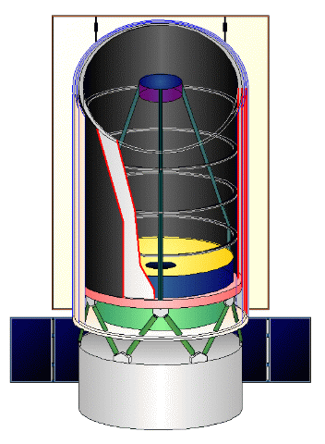
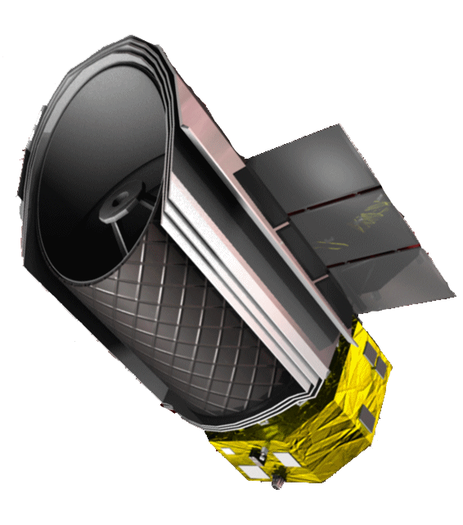
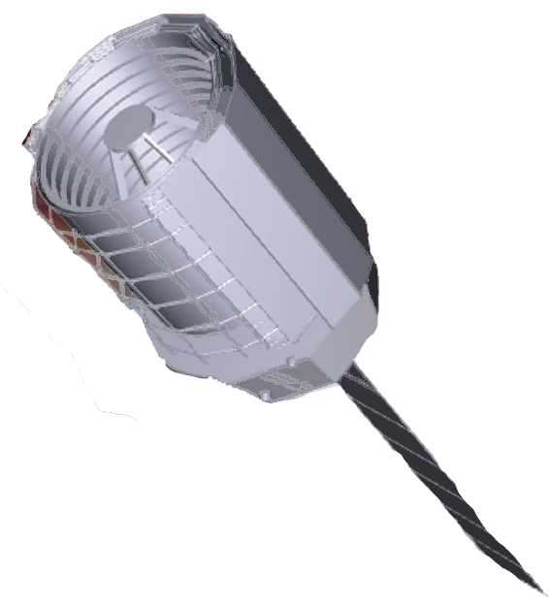
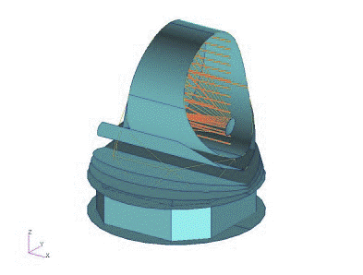

…the long history of SPICA
1995-2000 Japanese HII/L2 project
  Cryogenic telescope as follow up for after (then) FIRST
2007 – ESA gets on-board: JAXA mission with ESA telescope
  Yellow book, ESA telescope studies
2010 – HIIB to HIIA launcher → smaller telescope
  …economic crisis (and Fukushima)
2011/2012 – ‘Risk Mitigation Phase’
  Good plan, but too big for Japan → ESA needs to scale up
2014 – joint JAXA/ESA CDF mission study → M5 concept
  Mission lead moves from Japan to Europe
2015 – Japan passes Mission Definition Review
NOW – European/Japanese proposal for ESA/M5
  Candidate selection in December, mission selection 2021

Slide 5
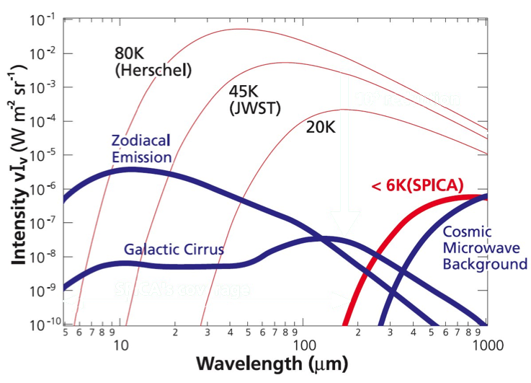
The SPICA ‘sweet spot’ – the dusty universe
A unique observatory
looking through the veils, enabling
transformational science
…imagine going
a factor 100+ deeper
than Hershel!
What is so unique?
A COLD, big mirror
→ true background limited Mid/Far-IR observing
~20 to ~350 μm inaccessible for any other observatory
→ the wavelength domain where obscured matter shines
        fill the blind spot between JWST and ALMA @ R~ few 1000
10⁶ reduction in
background!
<8K
SPICA

Slide 6
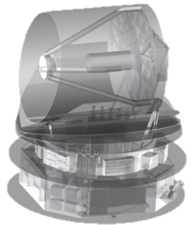
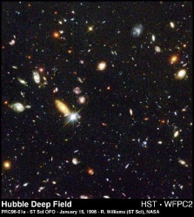
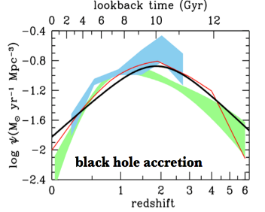
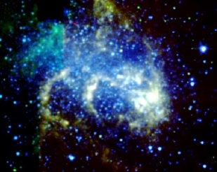
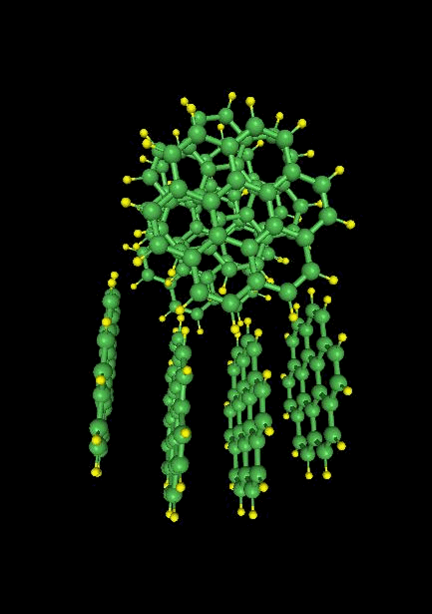
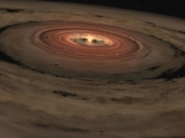
SPICA’s science
M5; unveiling dusty matter in the universe

Slide 7
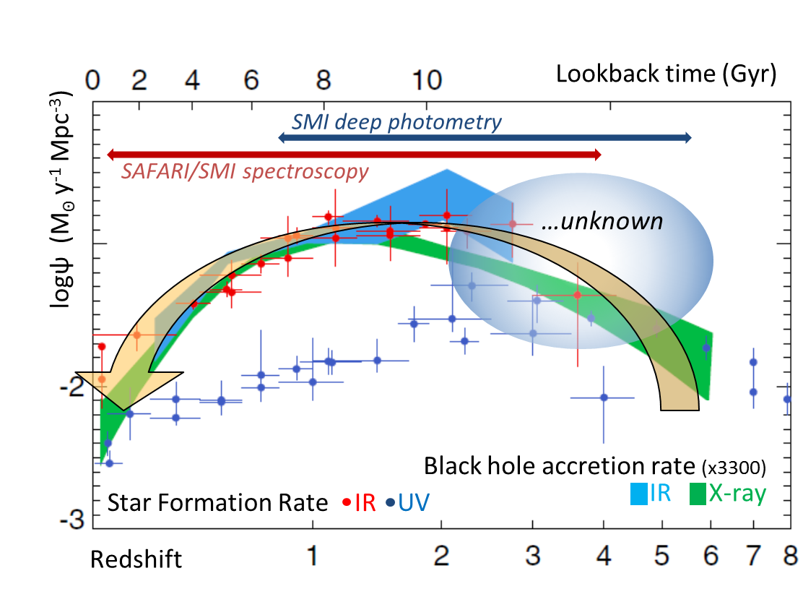
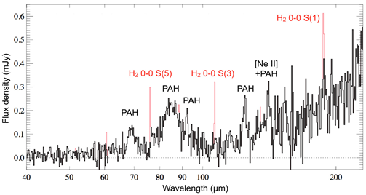
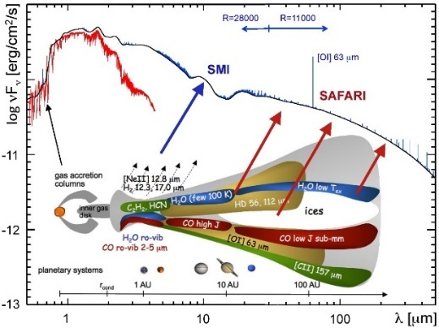
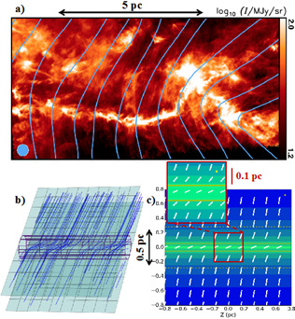
Science Objectives – mission design drivers
What processes govern star formation
across cosmic time
- what starts it, controls it, and stops it?
  What are the major physical processes in the most
  obscured regions of the universe?
  How is this related to the enrichment
  of the universe with metals
What is the origin and composition of the first dust,
how does this relate to present day dust processing?
What is the thermal and chemical history of
the building blocks of planets?
What is the role of magnetic fields
in dust filaments?

Slide 8
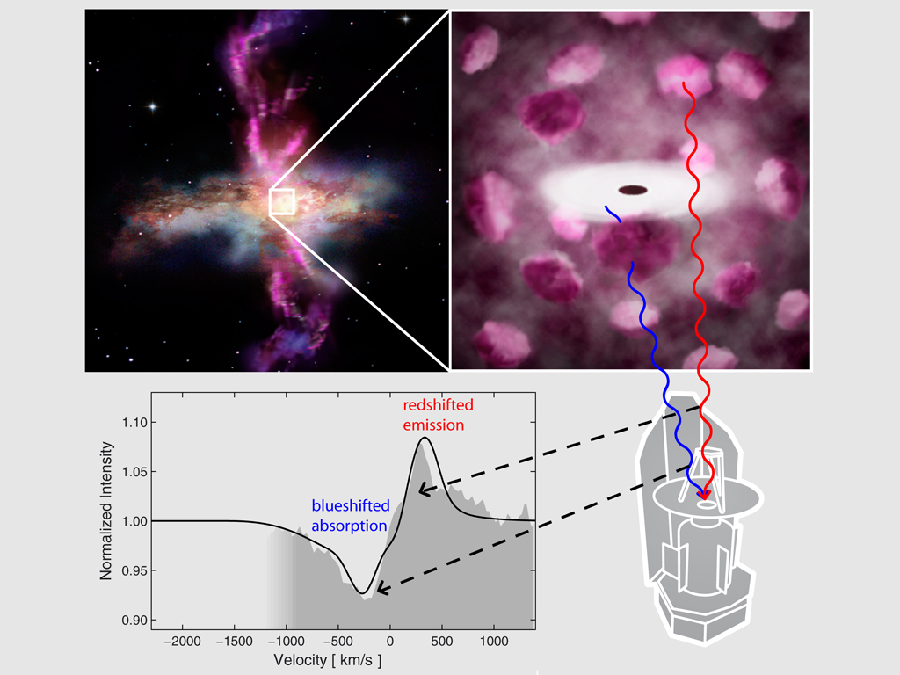
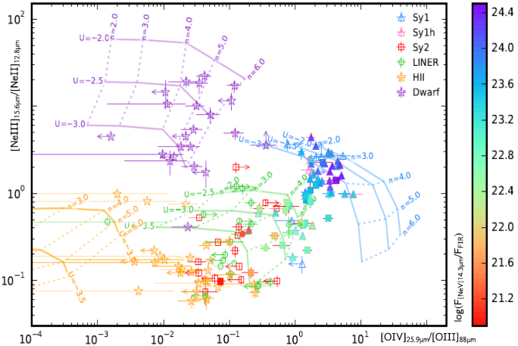
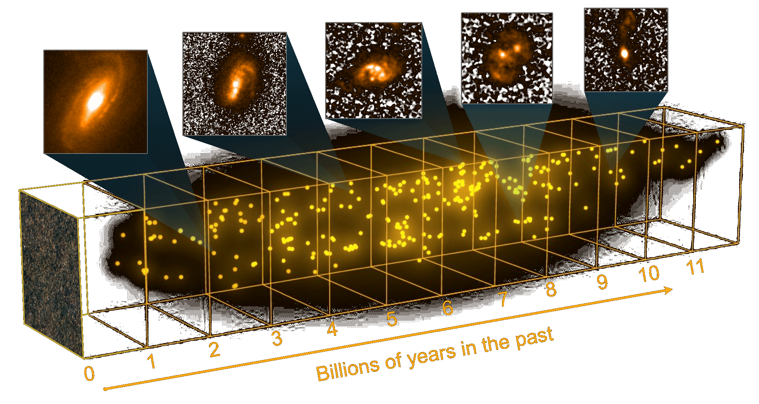
Evolution of IR-luminous galaxies
FAR-IR diagnostic tools with lines/bands
  Line-ratios/PAHs
  → physical state of dust and ionised gas
  Line strengths → metal enrichment
  Line profiles → outflow/infall, cycling of matter
  Discriminate between Active Galactic Nucleus
  and star-formation
So far only we ‘only’ sampled the ‘local universe’…
…SPICA measures physical conditions out to 10Bn years ago

Slide 9
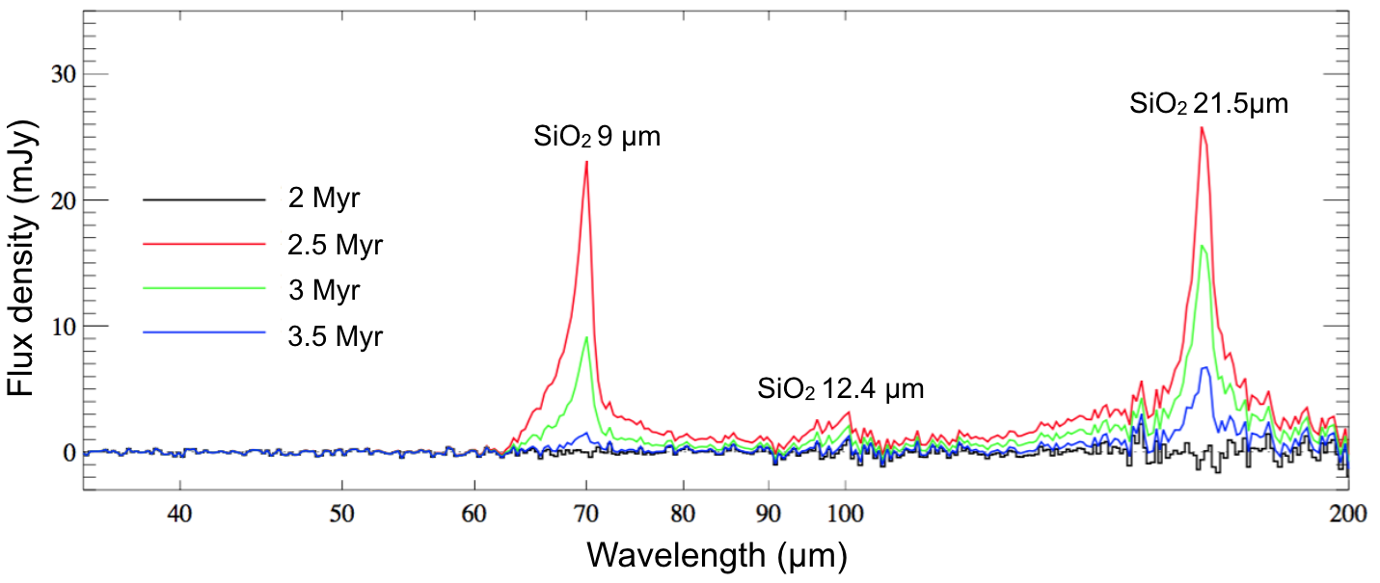
The first galaxies – H₂ and dust at ~1 Bn yr
Simulated SPICA observations of high-redshift (lensed) galaxies
(z~10, 10 hr integration time)
PAH features readily detected
Shocked H₂ lines ~ 7x10⁻²⁰ W/m²
Simulated SAFARI spectrum for 10⁶ M¤ Pop III starburst at z=7: Silicate features at z~5-7 beyond JWST
→ grain chemistry of the first dust

Slide 10
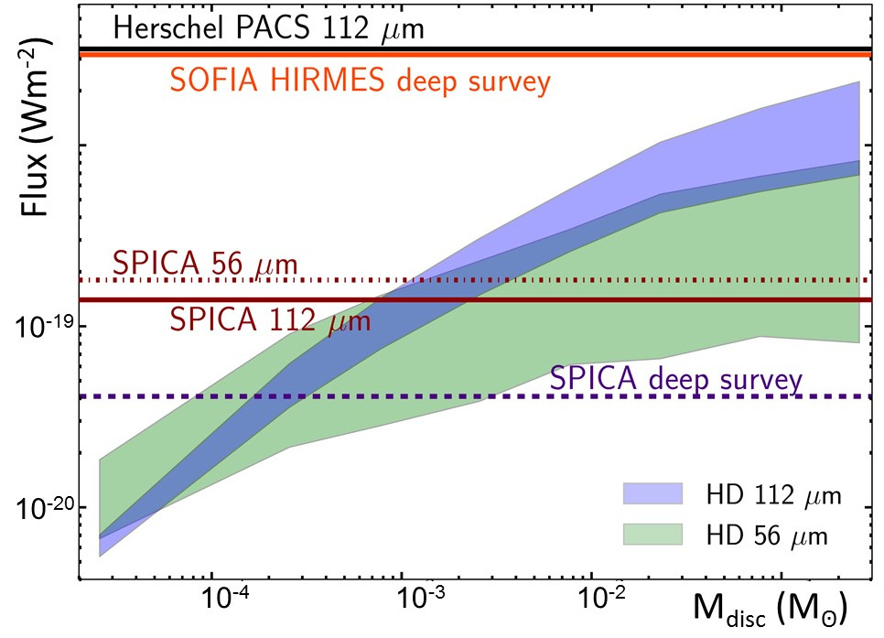
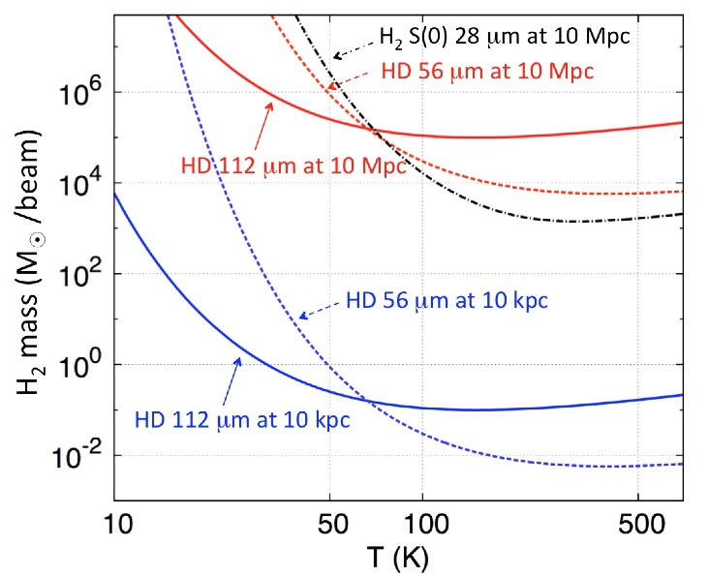
HD – probing the mass of planetary disks
HD 56/112 µm lines in the SAFARI bands
  Direct tracer of gas mass in PPD’s
  Opens new domain of disk masses
Trapman et.al. 2017

Slide 11
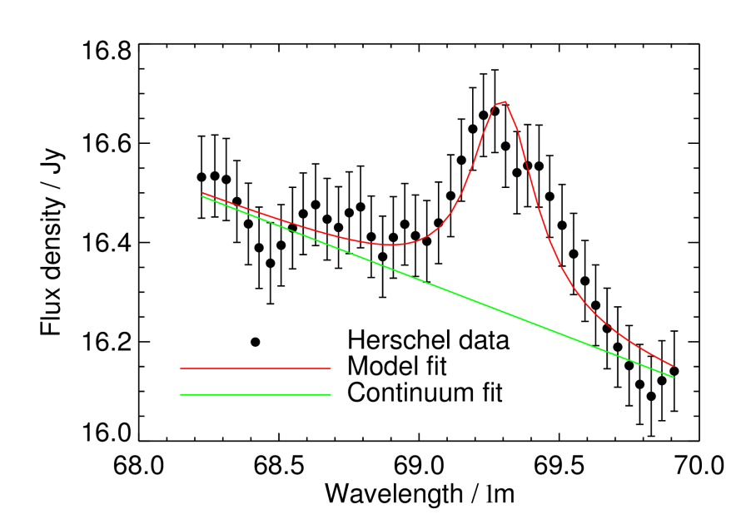
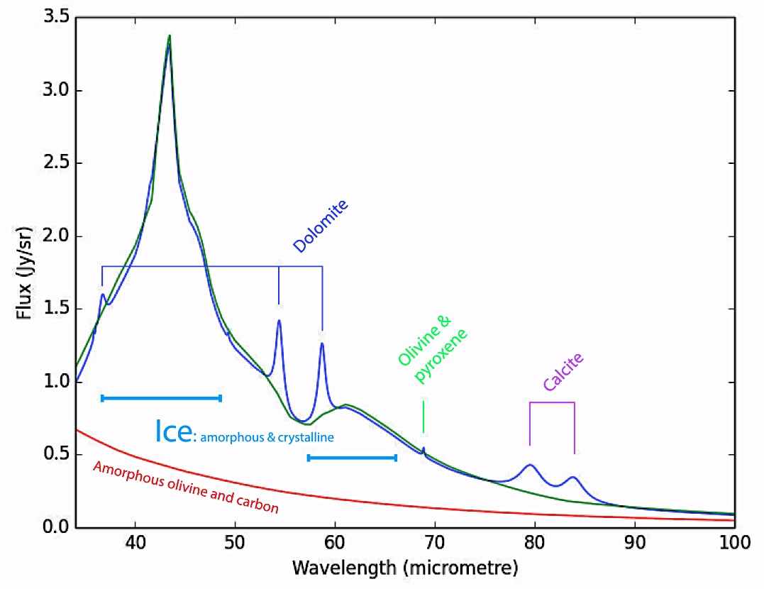
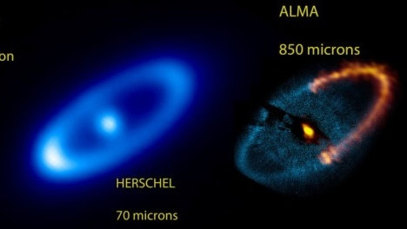
Mineralogy
69 µm feature for β-Pic (de Vries et al. 2012)
The mineralogy of micron-sized dust particles in discs directly probes the composition of their parent bodies
SPICA provides access to the far-IR resonances of several minerals, allowing a precise determination of their composition and structures
The the composition of refractory dust in its exo-comets and make a direct comparison with our Solar System
Notes:
SPICA will provide access to the far-IR resonances of several minerals, allowing a precise determination of their composition and structures, thanks to both their peak wavelength and width of the solid-state feature, which depend on relatively large-scale movements in the crystal.
Of particular interest, the 69 mm band of crystalline olivine (Mg_{2-2x}Fe_{2x}SiO₄) was studied with ISO and Herschel (e.g., Sturm et al. 2010, Mulders et al. 2011, de Vries et al 2012). The band is sensitive to grain temperature, size and composition, making it an invaluable probe of the physical and chemical properties of planetary systems.
These studies at 69 mm are complementary to the 10 and 20 mm features covered by previous Spitzer surveys and future JWST programs in tracing much colder larger grains further out in the disc. In b Pictoris, it was possible to study the composition of refractory dust in its exo-comets and make a direct comparison with our Solar System (de Vries et al. 2012).

Slide 12

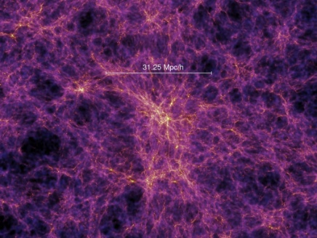
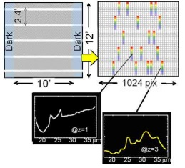
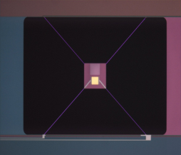
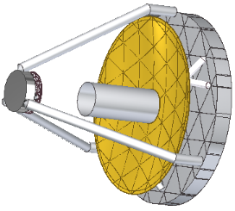
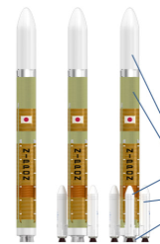
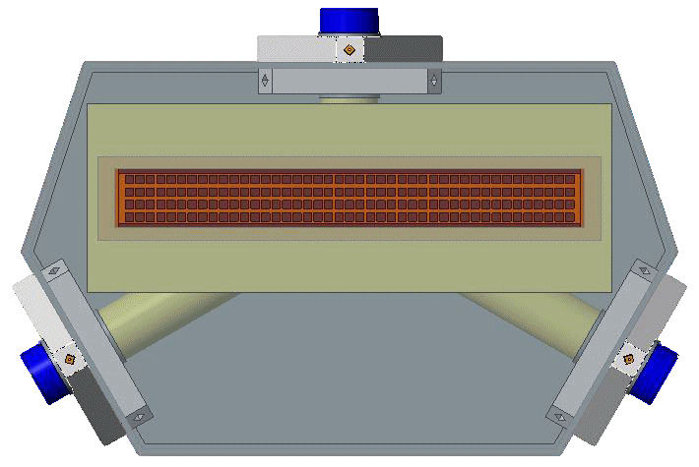
The SPICA mission the M5 configuration

Slide 13


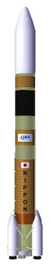







SPICA – proposed to ESA/M5
ESA-led mission
  with large JAXA contribution
‘PLANCK configuration’
  Size - Φ4.5 m x 5.3 m
  Mass - 3450 kg (wet, with margin)
  Mechanical coolers, V-grooves
2.5 meter telescope, < 8K
  Warm launch
12 - 230 μm spectroscopy
  FIR spectroscopy – SAFARI
  MIR imaging spectroscopy – SMI
  FIR polarimetry – POL
‘standard’ Herschel/Planck SVM
Japanese H3 launcher, L2 halo orbit
5 year goal lifetime

Slide 14
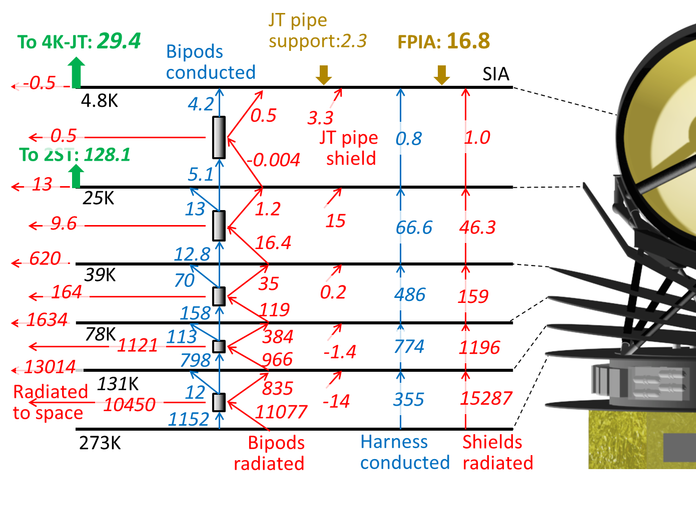
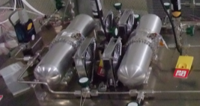
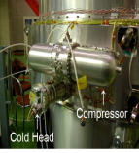
Main challenge –<8K telescope thermal design
Active cooling to 4K and 1.7K
  Detector modules at 50mK with dedicated mK coolers (SAFARI)
V-grooves – passive cooling to 40K
Detachable support struts
4K JT
20K ST

Slide 15
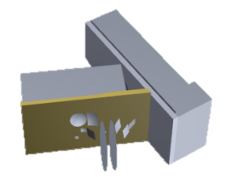
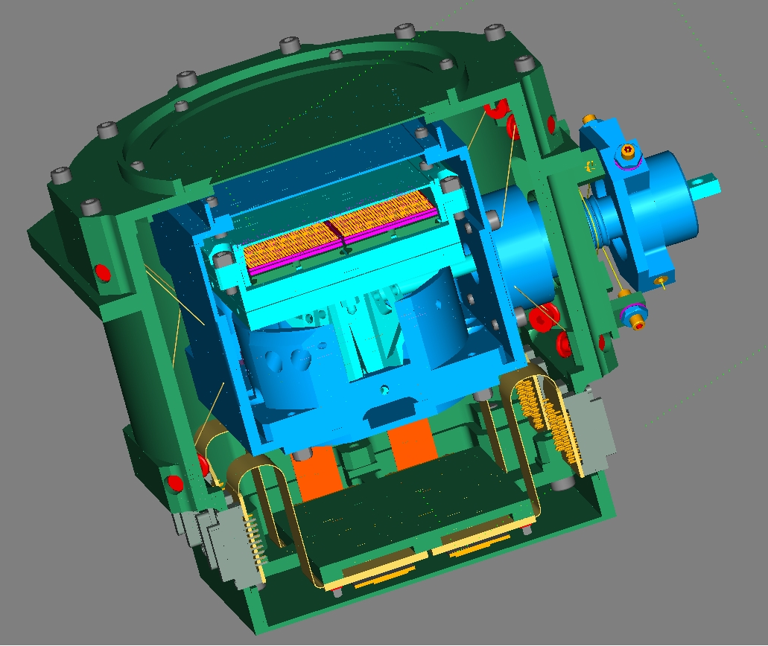
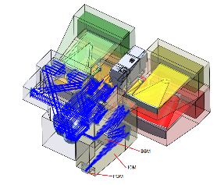
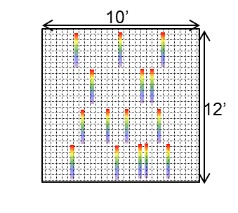
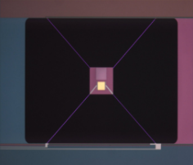
The SPICA Instruments

Slide 16
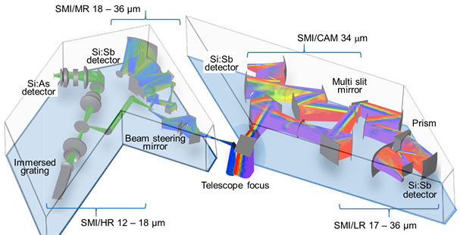
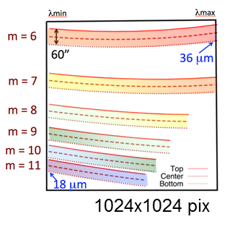
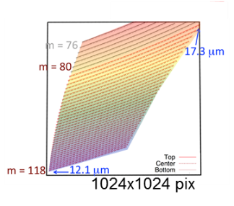
The Mid-infrared Instrument SMI
SMI/LR-CAM – large area low resolution surveyor
    17 – 36 μm, R = 50 – 120
    4 slits (10’ long) with prism
    Detector: Si:Sb
    Camera mode 10’x12’ FoV
  SMI/MR – medium resolution mapper
    18 – 36 μm, R = 1200 – 2300,
    1 slit (1’ long) with grating
    Detector: Si:Sb
  SMI/HR – molecular physics/kinematics
    12 – 18 μm, R = 28,000
    1 slit (4” long) with immersion grating
    Detector: Si:As

Slide 17

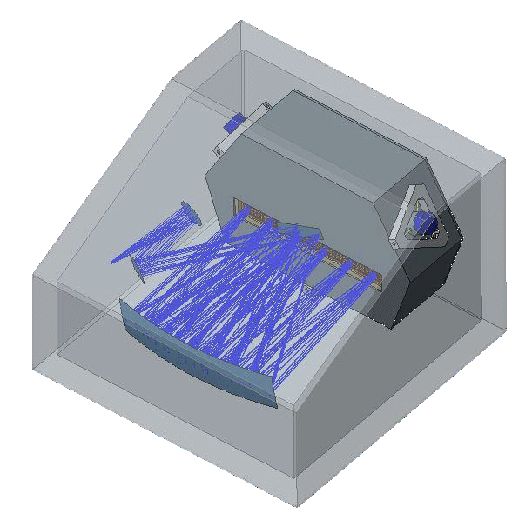
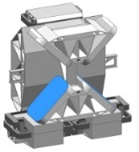
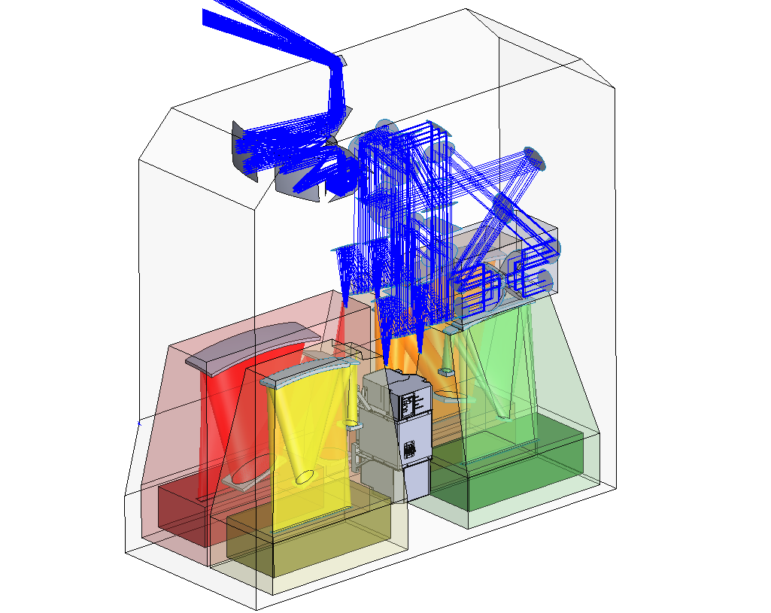




The Far-IR instruments SAFARI, POL
SAFARI - high sensitivity grating spectrometer
  Basic R~300 mode → 1hr/5σ -5-7×10⁻²⁰ W/m² (4.6 m²)
      Improves with better TES performance!
  Martin Puplett Interferometer to provide High-R mode
  4 bands instantaneously covering 35-230 micron
  …limited imaging capability: 3 pixels on-sky
POL - imager polarimeter
Polarization sensitive bolometers
  3 bands: 110, 220,350 µm
FPA architecture designed and tested
Readout analogous to PACS system

Slide 18
SPICA capabilities - spectral resolution
ALMA
λ/δλ (δv)
Herschel
SMI/HR
10000
(30 km s⁻¹)
SMI/MR
1000
(300 km s⁻¹)
JWST
Herschel
Herschel
SAFARI
100
(3000 km s⁻¹)
SMI/LR
2 μm
20 μm
200 μm
Wavelength
Notes:
NOTE: Animation shows potential additional wavelength coverage for SAFARI spectrometer – to be studied in Phase A if selected. HOWEVER – this is NOT part of the SPICA baseline for the M5 proposal!!!
Note the HRS spectral resolution – this is a unique capability

Slide 19


SPICA sensitivity/speed – a huge leap forward
  Raw sensitivity improvement >2 orders of magnitude
  Instantaneous full spectra → additional huge step in efficiency
Notes:
Sensitivity shown for PACS is for a single line setting. With SAFARI you get the whole band in one go.
ALMA performance is for full ALMA
FISICA 6.6e-19 5.1e-19, 7.5e-19, 1.2e-18, wav=37.5,75,150,300 um

Slide 20


The SAFARI grating spectrometer the ‘European’ instrument

Slide 21








SAFARI system design
SAFARI system design – with existing technology
CAL
SKY
ZERO
mK cooler
Focal-Plane Relay
Beam steering mirror
SW
VLW
Martin- Puplett
Dichroic
Dichroic
Flip mirror
LW
MW
Grid

Slide 22




For ultimate sensitivity; Transition Edge Sensors
Resistance→
G
Bolometer
- G
Temperature → (~50 milli-K)
human hair
Limit in NEP: phonon-noise ~T√G
Challenges:
~milli-K environment
Very sensitive to E/B fields
Small pixels (480 μm), low thermal conductance G
→ trying layout with ‘long thin legs’

Slide 23



TES NEP – SAFARI goal is within reach!
SAFARI requirement: ~2x10⁻¹⁹ W/√Hz
Ongoing TES research: achieve best possible device layout
  Working towards larger array sizes
  Production process
  Optical characterization

Slide 24
Detectors: integrated TES/grating modules
Linear TES arrays with FDM readout
  Detector at 1.5 Fλ separation in spectral domain
  Profit from already achieved TES/FDM performance
    Further TES improvement will give still better sensitivity
Integrated FPA/Grating unit
  Grating optics at 1.7K
  Shielding integrated in structure
    Builds on SAFARI/FTS development
  Detector modules suspended inside at 50mk

Slide 25


High Resolution - Martin-Puplett interferometer
Mechanism as in original SAFARI concept
Sensitivity factor of ~2 below R=300 mode
Compact layout achieves R~11000-2000

Slide 26


Development work – detector system elements
Cooler EM built and tested, also with JAXA coolers
FDM 132 pix/channel demonstrated
  Requirement: 160 pix/channel
PTBC5 SQUID
LC
array
LC
array
TES array

Slide 27
Large consortium, many responsibilities
JPL

Slide 28







Focal Plane Unit
Ready for phase A
Detector arrays
Detector assembly
Grating module

Slide 29

Summary
SPICA: the next mid-far infrared space observatory
  2.5 m diameter mirror, actively cooled to 8 K
  unprecedented sensitivity in mid/far IR
  …do the things that were impossible/difficult with Herschel
  Focus: spectroscopy of the obscured universe,
        straddling the gap between JWST and ALMA
  ESA/JAXA project with PI-provided instruments
  Open for astronomical community
        open for further collaboration(s)
    SPICA is proposed as a candidate for ESA M5
      Candidate selection December, final selection Q1/2021
      Launch ~2030
        very well placed to actually fly in the ‘30-ies
SPICA curious/supporter/joiner?
P.R.Roelfsema@sron.nl or bradford@submm.caltech.edu
www.spica-mission.org

Slide 30







Infrared Space Observatories – pushing deeper
Herschel 2009-2013
ISO 1995
SPICA!
IRAS 1985
Akari 2006
IRTS 1995
JWST 2018
Spitzer 2003
Notes:
History – why its so pigging difficult – what we have learned

Slide 31

Mission Status
Mission well defined
  Spacecraft elements, responsibilities
  Instrument complement ready to start phase-A
Japan: SPICA passed ‘Mission Definition Review’
  SPICA officially in ‘Pre-project’ phase (~phase A)
    2027/2028 H3 slot tentatively assigned to SPICA
M5 proposal under evaluation
  ESA-led mission (~550M€) with JAXA participation
    JAXA committed to support at the ~300M$ level
  European/Canadian/US instrument – SAFARI
  Mission candidate selection: December
→ Phase A/B1 under ESA-led study team
    Mission final selection: 2021
    Launch: 2030/2031

Slide 32


SAFARI – evolution dictated by the science
Original design: Imaging Fourier Transform Spectrometer
  Fast/efficient large area spectroscopic mapping
  …but limited in maximum sensitivity due to photon noise
  Best achievable 1hr/5σ 'only' ~2-3×10⁻¹⁹ W/m² (6 m²)
      Independent of TES performance!
New approach for better sensitivity: grating spectrometer
  Basic R~300 mode → 1hr/5σ -6-8×10⁻²⁰ W/m² (4.6 m²)
      Improves with better TES performance!
  Martin Puplett Interferometer to provide R~3000 mode
      Backup: Fabry-Pérot Interferometer
  4 bands covering 35-230 micron
  …but limited imaging capability:
  only 3 pixels on-sky

Slide 33

Development work – detector system elements
Detector goal performance reached in the lab
FDM 132 pix/channel demonstrated
PTBC5 SQUID
LC
array
LC
array
TES array

Slide 34
Development work – cooler, high resolution chain
Cooler EM built and tested → upcoming tests with JAXA coolers
Martin-Pupplet development ongoing in Canada

Slide 35
Steps to take before (~) going for the M5 proposal
Major (very hard!) prerequisites - Japan
Telescope diameter ≥2.5 mtr
→ very strong push on JAXA (Shibai)… success in April 2015
JAXA must commit formally (by SAFARI September cons. Mtg.)
→ informal yes before Bordeaux, formal statement in October
Major prerequisites – SAFARI/’European’ SPICA consortium
Solid/consistent high sensitivity/flexible SAFARI (grating) design
→ consolidated Nov 2015/Mar 2016, MPI high-R confirmed Jan/2016
Further re-distribution of workload/lightening of SRON’s load
→ JPL to pick up major part of detector work – June 2015
→ Germany; beam steering mirror – September 2015
→ Taiwan; calibration source – summer 2016
Solid consortium basis
→ 7⁺ national meetings (also soliciting ideas) – January-May 2016
→ SAFARI/POL; science backing + design – Q2/Q3 2016

Slide 36


Building the M5 proposal
Proposal writing: joint European/Japanese effort
  Close coordination with SPICA/J
    Weekly bi-laterals
  Three science teams, each with two coordinators
    Galaxy evolution, nearby galaxies, planet formation
    On average bi-weekly telecons
    Science reviewed internally (continuous), at ISAB and by ‘pink reviewers’
  Technical teams
    SPICA overall, SMI, SAFARI/SPEC, SAFARI/POL
  Managerial, programmatic, financial
    PRR+SPICA/J
…a non-trivial excersize;
  ~ 10 expertise domains
  ~ 3 (‘sub-optimally aligned’) time-zones
  ~ 4 (‘sometimes orthogonal’) cultures
  ~ 2 (very) different ‘agency-approaches’
  ….but the result is what counts; 51 solid pages, 500+ supporters,
  3 committed agencies… let ESA be the fourth

Slide 37

Who provides what
Focal Plane
Instrument Assembly
Telescope
(ESA）
FIR Spectrometer （SAFARI）
Payload
Module
NL + European countries
+ Canada, US, Taiwan
Cryocooler
MIR Instrument （SMI）
Bus Module
Launcher
Focal Plane
Attitude Sensor
SPICA Data Center
Complexity in responsibilities and interfaces
  → challenging AIV program

Slide 38

Telescope support structure
Launch and in-flight requirements differ
→ in space truss separation

Slide 39






Telescope – 2.5m Ritchy-Chrétien
Herschel heritage
ESA/industry studies
Preliminary design:
  M1: 2.5m F/1
  M2: ~0.6m
  M1-M2 distance ~2m

Slide 40

Harvesting
Observing time
mission will be open for all astronomers
  Guaranteed for instrument groups – i.e. us! – (details TBD)
  Detailed implementation of e.g. ‘Key projects’ TBD
  Time Allocation Committee

Slide 41
Star formation and black hole accretion
Why is the rate of galaxy evolution changing so dramatically over time?
SPICA spectroscopy will fully characterize 1000+ galaxies
Densities
Metallicities
Radiation field
Outflow/infall
Deep photometry will extend traditional SED analysis to z~5/6
→ We will redraw IR Madau/Dickinson, i.e. unaffected by extinction, out to z~6
Lookback time (Gyr)
SMI deep photometry
logψ (M_{ʘ} y⁻¹ Mpc⁻³)
SAFARI/SMI spectroscopy
…unknown
Black hole accretion rate (x3300)
Star Formation Rate
IR
UV
IR
X-ray
Redshift

Slide 42

Magnetic field in dust filaments
Hershel @5"-10" – galactic dust in thin filaments
PLANCK @5' – large scale magnetic field seems perpendicular to filaments…
→ need to measure magnetic field within filaments @5"-15”

Slide 43

Star and Planet Formation and Evolution
Unique areas of planet formation to be studied with SPICA:
The water trail → tracing the snow line
From pristine dust to differentiated bodies
  → making the link to the Solar System
The gas revolution:
  measuring the reservoir
  in planet forming regions
Gas dissipation and
photo-evaporation
  setting the clock for
  planet formation
Notes:
POINT 1: Do planets accrete their water reservoir locally when they form, or is water delivered through collisions with comets and asteroids? Observations of water vapour and water ice throughout the era of planet formation are the only way to answer this question. SPICA has unique access to water lines over a wide range of excitation (100 – few 1000 K) as well as the far-IR water ice bands between 40 and 70 mm (crystalline and amorphous). For the first time SPICA has the unique possibility to access both water phases simultaneously to determine their mass balance and to track their evolution over time.
POINT 2: Solids are the building blocks of planetary systems, growing from pristine submicron dust particles into km-sized planetesimals. SPICA will provide a direct link to our own Solar System by comparing distant planet forming and debris discs with our own asteroids, comets and Trans Neptunian Objects (TNO). SPICA is the only facility that will observe the far-IR resonances of large grains and solid bodies to determine mineral properties such as their
temperature, iron content and specific composition.
POINT 3 : The gas content is key to establishing a generalised scenario for the formation of planetary systems. The evolution of the gas reservoir links directly to the fundamental mechanisms of planet formation, such as the build-up of gas giants, planetesimal collisions and the presence of volatiles in planetary atmospheres. SPICA will have unique access to atomic and molecular tracers of the gas reservoir. None of the facilities operating before or at the same time (JWST, ALMA, ELT/TMT) have access to the lowest rotational lines of HD. These lines will revolutionise the measurement of gas mass through the planet formation stages.
POINT 4: Photoevaporation is crucial for the lifetime of primordial gas in protoplanetary discs. Thus magnetically or radiation driven winds set the clock for planet formation and impact the architecture of planetary systems. The 12-18 μm wavelength range gives access to a unique combination of atomic and molecular wind tracers, e.g. [NeII], [FeII], H2, HD. ELT/TMT/JWST will not have any high spectral resolution instrument operating in this wavelength range before SPICA is launched. SPICA SMI/HRS will measure the dissipation and photoevaporation of the gas without severe background contamination by the Earth atmosphere.

