Slide 1
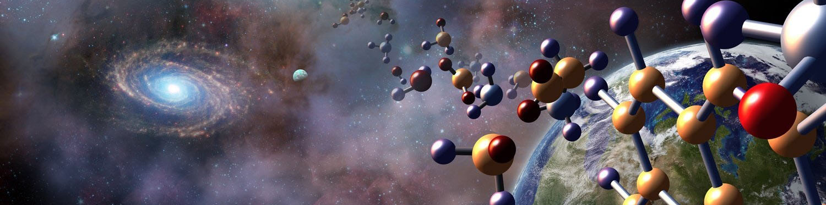
The Origins Space Telescope (OST)
Margaret Meixner
Space Telescope Science Institute,
Johns Hopkins University
on behalf of the OST Science Technology Definition Team
asd.gsfc.nasa.gov/firs
1

Slide 2
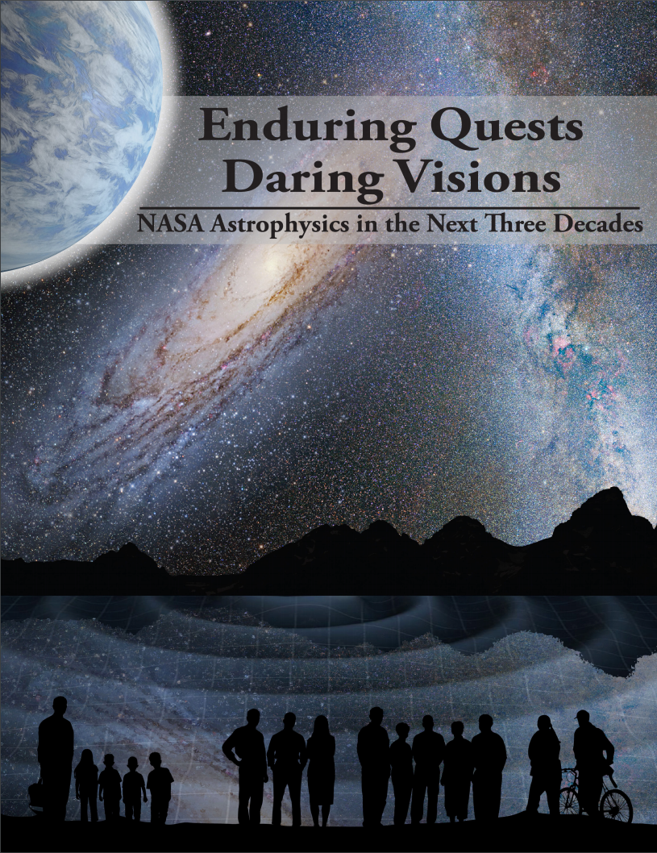

OST – NASA Decadal Study
NASA Mission concept for 2020 Decadal review; launch 2030ish
10 μm – 1000 μm (ish), Large aperture 8-15 m
Study Chairs: Margaret Meixner & Asantha Cooray
Comes from the NASA Astrophysics Roadmap, Enduring Quests, Daring Visions

Slide 3
OST – NASA Decadal Study
Community Chairs:
Margaret Meixner, STSCI, Asantha Cooray, UC Irvine
NASA Study Center:
Goddard Space Flight Center (GSFC): Ruth Carter, David Leisawitz, Johannes Staguhn, Michael Dipirro, Anel Flores, Joseph Howard, James Corsetti, Andrew Jones, Ed Amatucci, James Kellog, Louis Fantano
NASA Head Quarters (HQ) Program Scientists (non-voting):
Kartik Sheth and Dominic Benford
Ex officio non-voting representatives:
Susan Neff &, NASA Cosmic Origins Program Office; Susanne Alato, SNSB; Douglas Scott, CAS; Maryvonne Gerin, CNES; Itsuki Sakon, JAXA; Frank Helmich, SRON; Roland Vavrek, ESA; Karl Menten, DLR; Sean Carey, IPAC
Members appointed by NASA (> 90 applications):
Lee Armus, NASA IPAC; Cara Battersby, Harvard-Smithsonian CfA; Edwin Bergin, University of Michigan; Matt Bradford, NASA JPL; Kim Ennico-Smith, NASA Ames; Lisa Kaltenegger , Cornell; Gary Melnick, Harvard-Smithsonian CfA; Stefanie Milam, NASA GSFC; Desika Narayanan, University of Florida; Deborah Padgett, JPL; Klaus Pontopiddan, STSCI; Alexandra Pope, University of Massachusetts; Thomas Roellig, NASA Ames; Karin Sandstrom, UC, San Diego; ; Kevin Stevenson, STScI; Kate Y. L. Su, University of Arizona; Joaquin Vieira, University of Illinois, Urbana Champaign; Edward Wright, UC Los Angeles; Jonas Zmuidzinas, Caltech

Slide 4
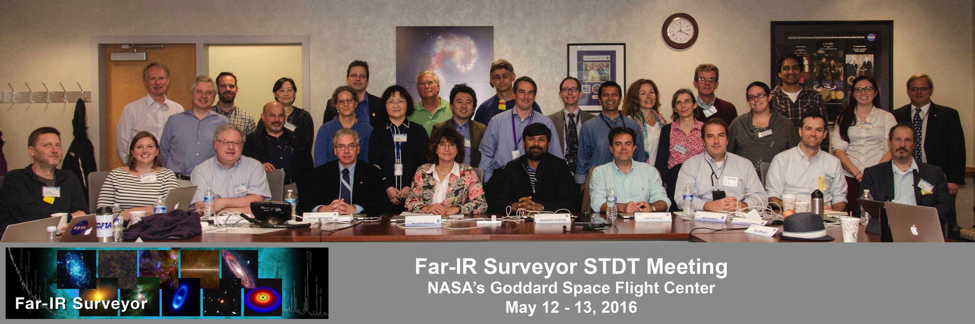
OST – NASA Decadal Study
Community Chairs:
Margaret Meixner, STSCI, Asantha Cooray, UC Irvine
NASA Study Center:
Goddard Space Flight Center (GSFC): Ruth Carter, David Leisawitz, Johannes Staguhn, Michael Dipirro, Anel Flores, Joseph Howard, James Corsetti, Andrew Jones, James Kellog, Louis Fantano
NASA Head Quarters (HQ) Program Scientists (non-voting):
Kartik Sheth and Dominic Benford
Ex officio non-voting representatives:
Susan Neff & Deborah Padgett, NASA Cosmic Origins Program Office; Susanne Alato, SNSB; Douglas Scott, CAS; Maryvonne Gerin, CNES; Itsuki Sakon, JAXA; Frank Helmich, SRON; Roland Vavrek, ESA; Karl Menten, DLR; Sean Carey, IPAC
Members appointed by NASA (> 90 applications):
Lee Armus, NASA IPAC; Cara Battersby, Harvard-Smithsonian CfA; Edwin Bergin, University of Michigan; Matt Bradford, NASA JPL; Kim Ennico-Smith, NASA Ames; Gary Melnick, Harvard-Smithsonian CfA; Stefanie Milam, NASA GSFC; Desika Narayanan, University of Florida; Klaus Pontopiddan, STSCI; Alexandra Pope, University of Massachusetts; Thomas Roellig, NASA Ames; Karin Sandstrom, UC, San Diego; Kate Y. L. Su, University of Arizona; Joaquin Vieira, University of Illinois, Urbana Champaign; Edward Wright, UC Los Angeles; Jonas Zmuidzinas, Caltech

Slide 5
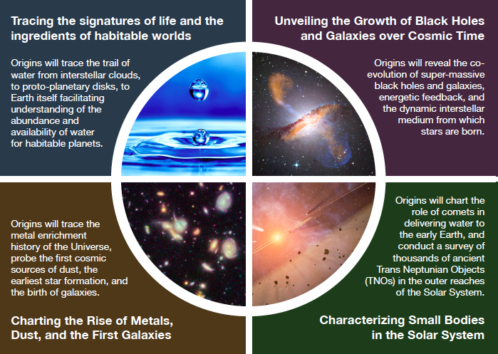
Science Themes for OST

Slide 6
Science Case for OST
Science coverage will be broad: highlight some of the goals
Galaxy and black hole Evolution
  Protogalaxies
  Galaxy and black hole evolution over cosmic time
  Rise of metals
Nearby Galaxies & Milky Way:
  Polarization
  Water transport
Planetary systems: formation
  Dust disks
  Gas disks
Exoplanets
  Atmospheres & biosignatures
  Direct detection
Solar systems
  Small body census (Planet IX?)

Slide 7
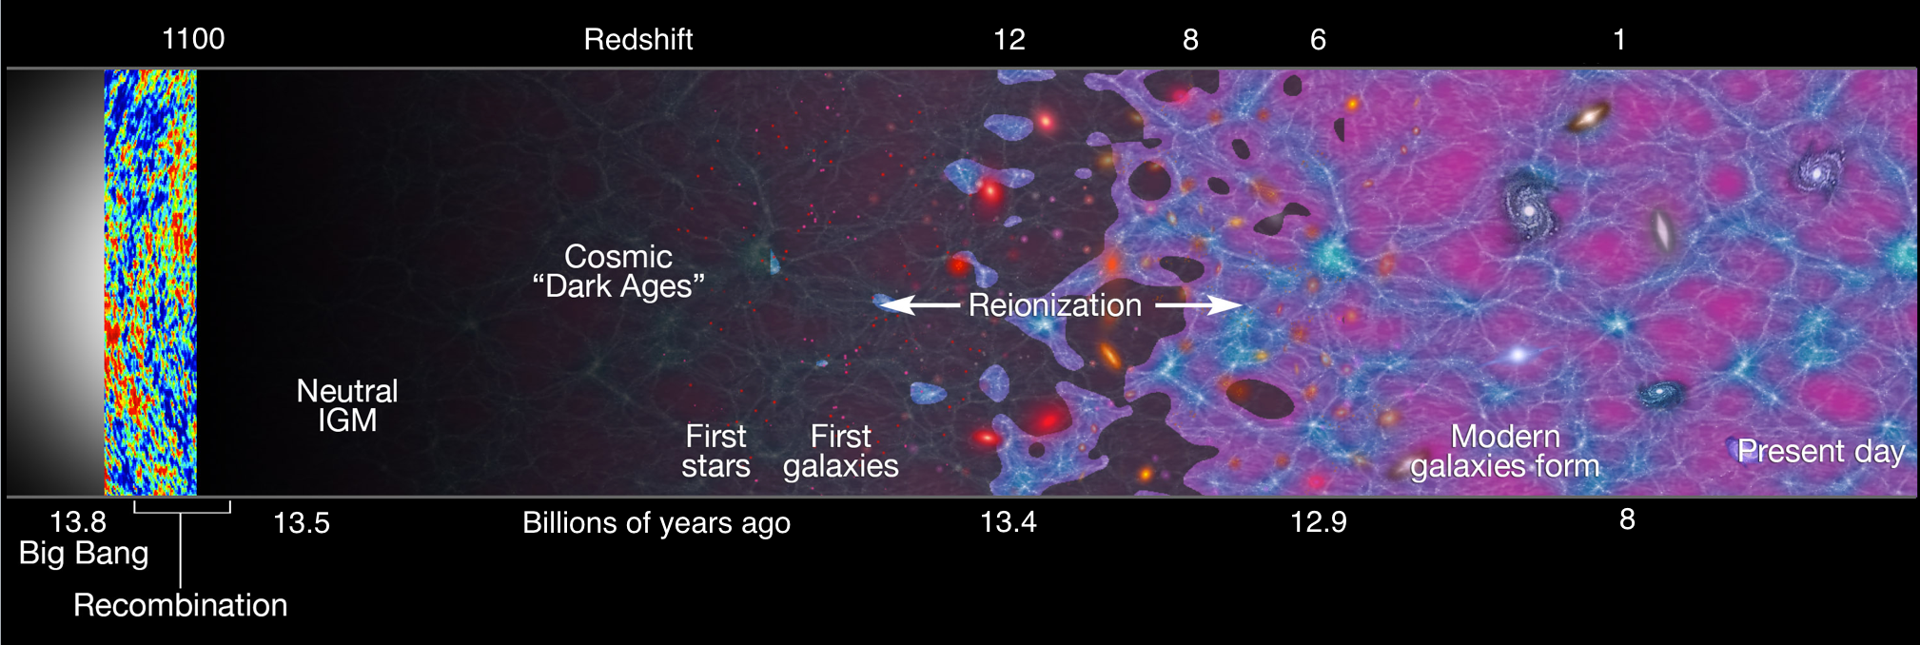
Cosmic dawn - early universe
Collapse to form first stars and proto-galaxies
      Primordial cooling via H₂ rotational lines
      seeds of super massive black holes
Vieira
Notes:
The science areas that will be touched by a FIR surveyor observatory are broad starting with the farthest reaches…
Cosmic Dawn Early Universe…
-interesting questions involve the formation of the first stars and proto-galaxies, primordial cooling by H2 rotational lines, the seeds of super massive black holes…
-Cosmic chemcial evolution: the epoch of dust formation and the rise of heavy elements
-porperties of reionizing galaxies: clustering and maps of the Universe…

Slide 8
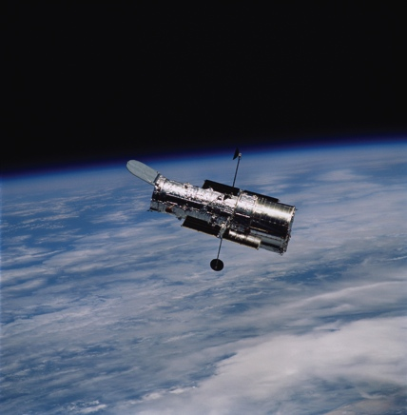
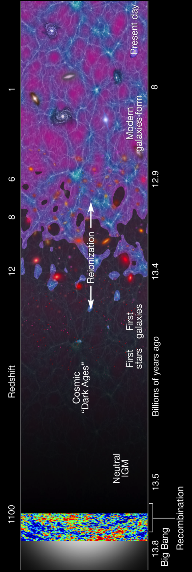
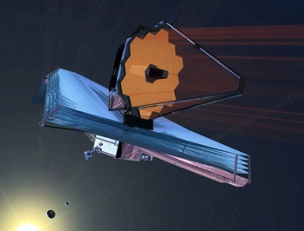
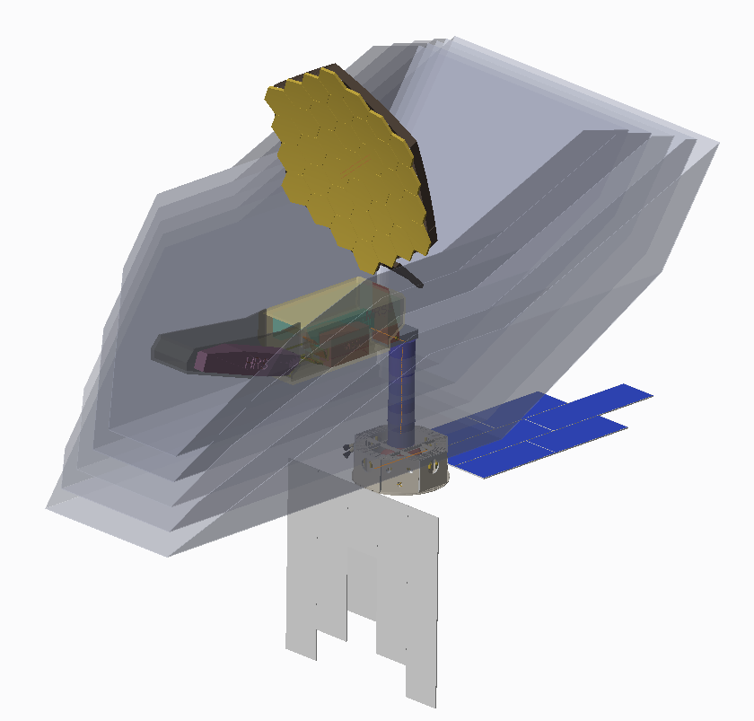
Galaxy Evolution
Hubble Space Telescope
  1990—2025+
  2.4 meter
  0.1—2.4 μm
  260 K
James Webb Space Telescope
  2018—2028
  6.5 meter
  0.7—28.3 μm
  50 K
Origins Space Telescope
2030?
  2020 Decadal study
  9.1 m single aperture
  5—660 μm
  ~4.0 K
Vieira
Notes:
To study the Cosmic Dawn problem, we have HST, we are about to get JWST but to really complete our understanding of the evolution of Galaxies, we need a FIR Surveyor ….
These pictures shown here for the FIR Surveyor are from prior studies such as SAFIR (large single aperture) and SPIRIT (interferometer)
this is visually nice, but with each observatory pointing to a single redshift, what is the
point here? The FIRS mock-ups don't point anywhere. Are the arrows meant to be the edge of
where these observatories can see? Since HST has already observed z=11 galaxies, I'm not
sure this is accurate. All will explore the full range in the cartoon on the right.

Slide 9
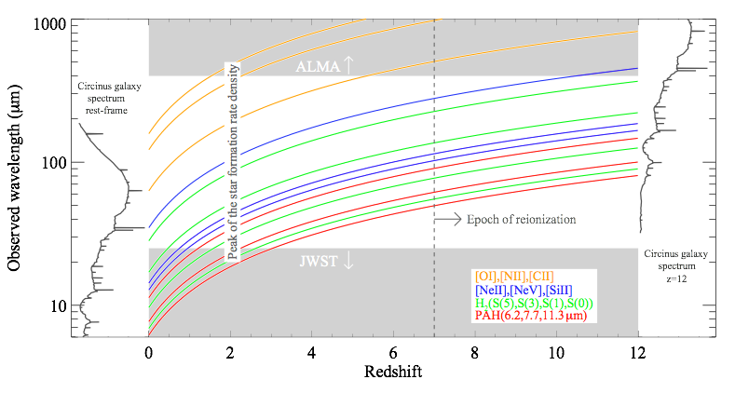
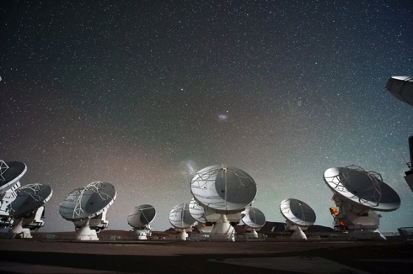

The Rise of Metals & Dust
OST provides the crucial link in wavelength coverage between JWST and ALMA to complete our view of the evolution of the universe.
ALMA
JWST
Pope
Notes:
Read title: This plot shows the observed wavelength on the left. The spectral energy distribution on the left is a rest frame measurement of an active star formation galaxy. On the right is the same galaxy red shifted to a z of 12. the colors lines connecting the two show how the key spectral lines of an active galaxy transfer over cosmic redshift… bodrdering the long wavelength is ALMA and at the short wavelength is JWST..
These wavelength boundaries are notional and show where there will be no coverage in the late 2020’s, we are exploring the wavelength range that overlaps with JWST, especially for exoplanets and expect a significant sensitivity gain with a cold telescope.
seems to indicate that FIRS will live in the 20-400um range
'to fill in the gap' but i thought that we're considering much wider range,
down to at least 10um (exoplanets CO2 feature at 15um, your slide 19) and
noting that Slide 13 only covers 500um, but realistically, there is FIR science
longward of 500um. perhaps a mention that the extent of the wavelength range is
larger than the gap.

Slide 10
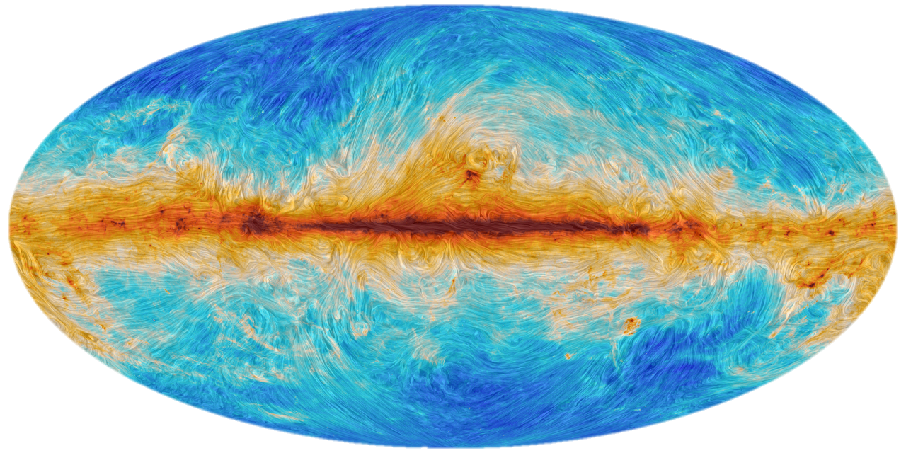
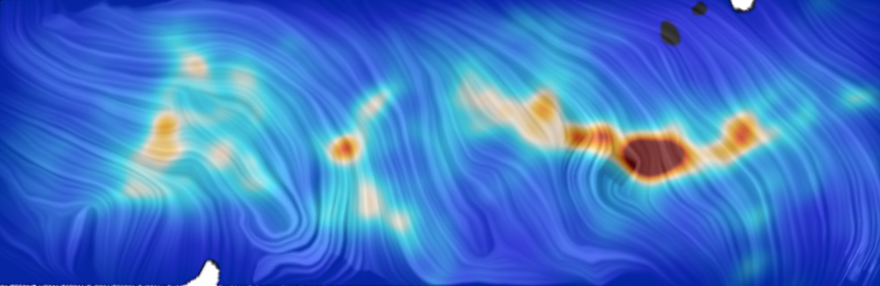
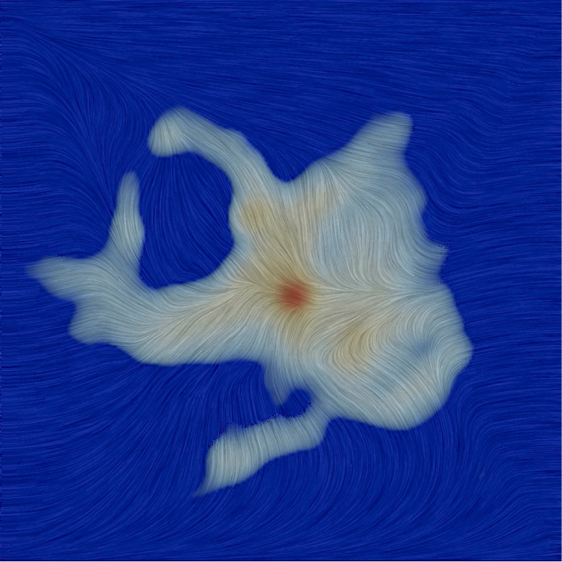
Magnetic fields and turbulence
The Origins Space Telescope will characterize magnetic fields and turbulence from molecular clouds to star-forming cores—with high resolution and a wide field of view
For joint analysis of turbulence & B-field structure, see, e.g., Heyer+2008
Planck: 15ʹ
BLASTPol: 2.5ʹ
Planck
Collaboration
ALMA: 0.3ʺ
OST: 2ʺ
?
Fissel+2016
Higher resolution
Image courtesy of
Phil Mocz
Hull+2016

Slide 11
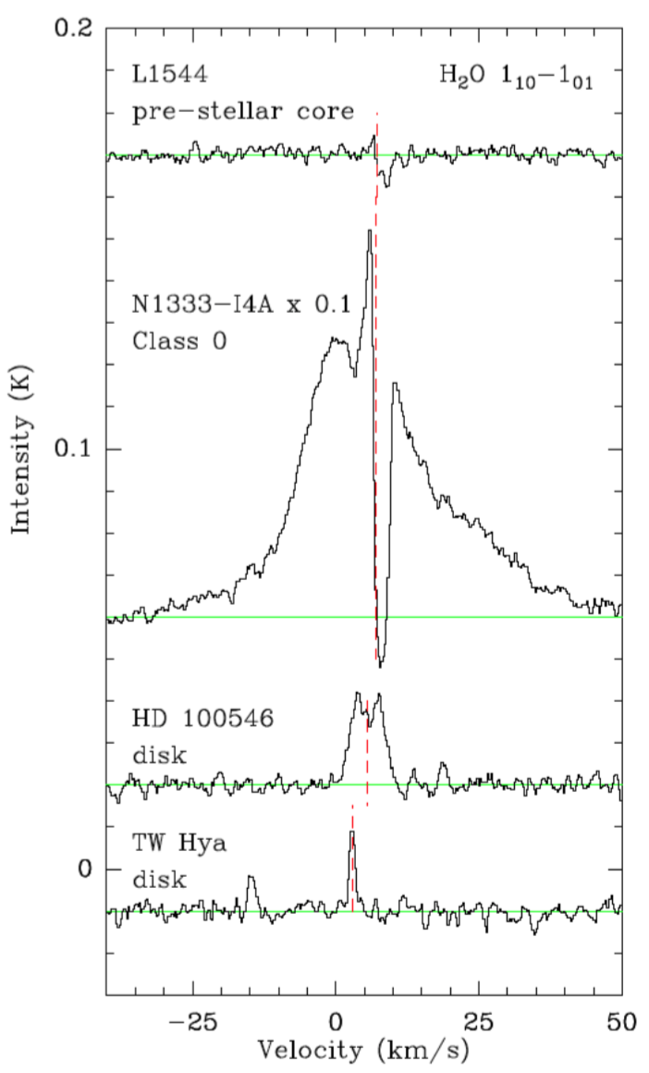
Water Transport to
Terrestrial Planetary Zone
Science Goal: Observe gas-phase water in interstellar clouds and dense star-forming cores to probe critical processes related to formation and transport of water to the terrestrial planet zone, as a key input to habitability.

Slide 12
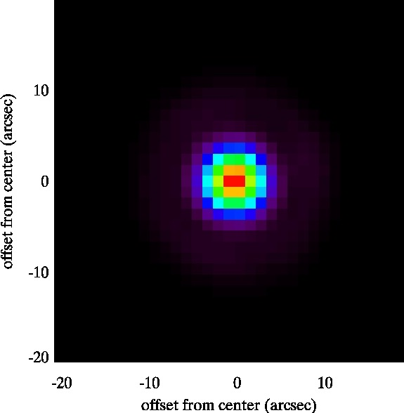
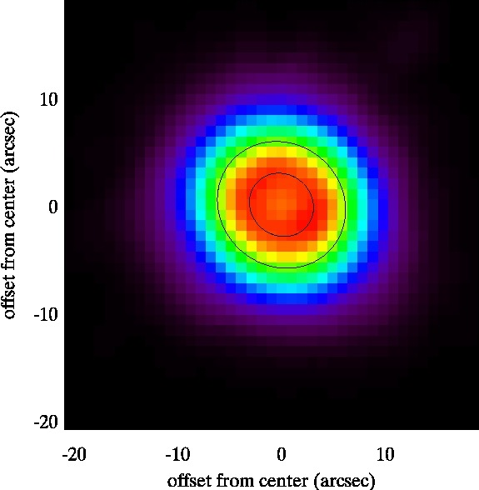
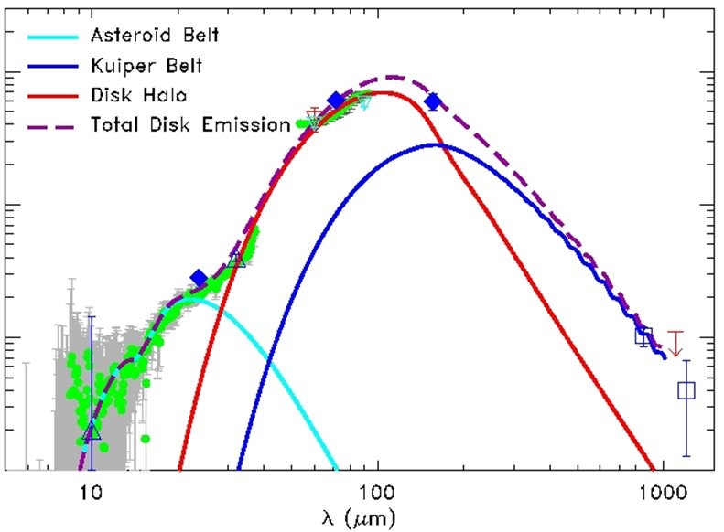
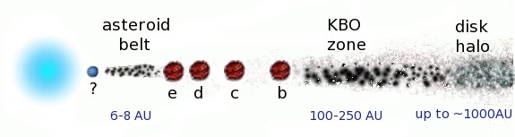
Debris Disks and Giant Planets
Spectral Energy Distribuion of HR8799
Su+ 2009
Matthews+ 2013
Spitzer 24 μm
Herschel 70 μm
70 μm
24 μm
unresolved
PA ∼60º, i ∼25º
Su et al. 2009
star
detect Oort clouds
around nearby stars
Marios+2008, 2010
Pontoppidan
Notes:
In the dust continuum measured by OST will measure the dusty debris disks and the Oort clouds, which are the distant reservoirs of comets in these solar systems.… These debris disks are shaped by giant planets as shown in the cartoon below.
This case of HR8799 shows how the wavelengths of a FIR Surveyor probe the dust from an entire solar system..

Slide 13

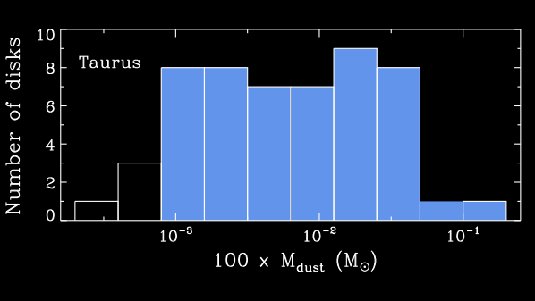
What are ProtoPlanetary disk gas masses?
HD is a million times more emissive than H2 at T ~ 20 K.
Atomic D/H ratio inside the local bubble is well characterized (~1.5 x 10⁻⁵)
HD will follow H2 in the gas
TW Hya disk mass
Mdisk ~ 0.05 M⨀
Bergin+ 2013
Williams and Cieza 2011
Pontoppidan
Notes:
The spectroscopic capabilities of a FIR Surveyor will measure important gas tracers like dueterated molecular hydrogen, HD which follows H_2 gas but easier to measure. Measurements of HD provide a direct measurement of the gas masses in these disks. For example Herschel measured HD in TW Hydra. These gas measurements will constrain when gas giants form in solar system evolution models

Slide 14
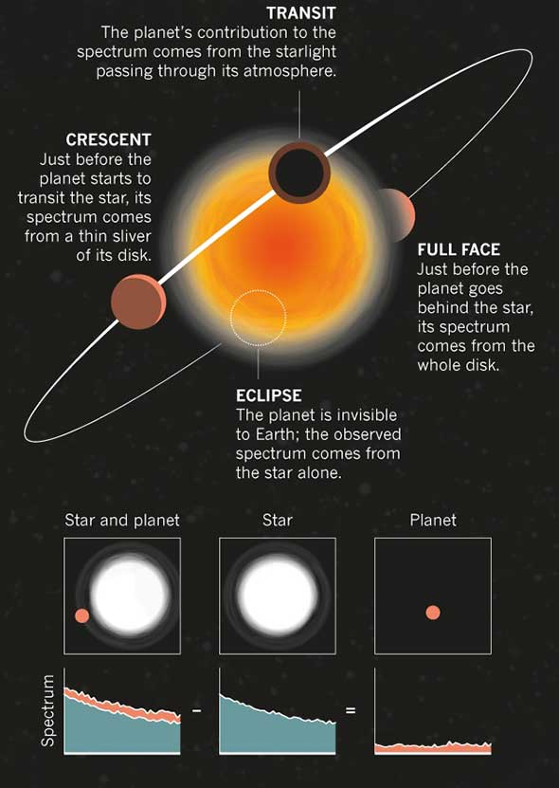
Exoplanets
- Transits
Transits for exoplanets
Primary transit (probes terminator)
Secondary eclipse (probes dayside)
Lightcurves can indicate further patterns (time consuming)
Atmosphere Characterization
Biosignatures
Reviews: Burrows (2014); Crossfield (2015)
Kaltenegger & Stevenson

Slide 15
Exoplanets - Coronagraph
    Main targets: Warm Gas Giants & Jupiters
    Interesting to help our view of whole Planetary systems
    - because of the large IWA, no HZ planets
    - Direct imaging doe not drive HZ planet case
    Ground-based ELTs searches can provide complimentary VIS/NIR data for such planets
Kaltenegger & Stevenson

Slide 16
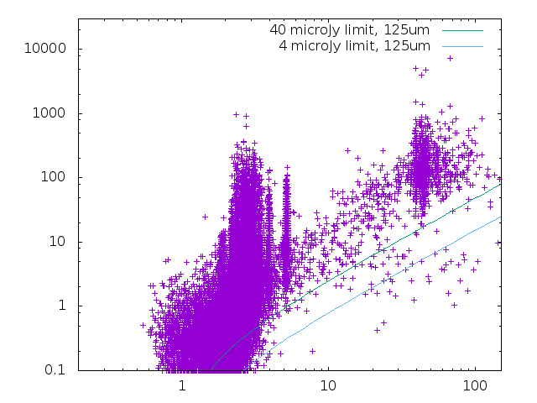
Revealing the Solar system in the far-IR
History and Evolution of the Solar System:
Measure the thermal emission (via Far-IR imaging) of small bodies in outer Solar System – 1000’s of targets
Moving Targets Not limited by confusion.
Characterize Planet IX?
Diameter (km)
From Bauer and Lovell
Heliocentric Distance (AU)
Milam
Notes:
Coming to our own solar system, the Far-IR Surveyor can allow us to probe the history and evolution of the solar system… The left diagram shows the diameter vs. heliocentric distance of all the small bodies in the solar system and the lines show the continuum flux limits needed to measure these bodies at 125 microns. In addition to the dust continuum the spectral line measurements of the volatiles as well as He and H_2

Slide 17
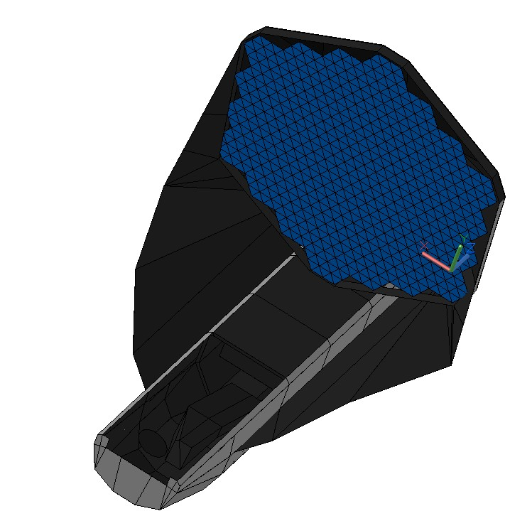

Notional Unobstructed, Off-Axis Field, Observatory
9.1-m Aperture Diameter Primary Mirror (~4 k), Three mirror, unobstructed, off-axis field
+Z
Deployed Observatory Configuration
Actively cooled (~4K) Baffle Assembly
(not shown on right, see inset below for concept)
Fixed (Deployable, Non-articulating) Optical Telescope Element (OTE)
Incident light
Sunshield
Five (5) Layers
0.75-m Spacing
Cold Side
+Y
+X
NOTE: Solar Array and Radiator need to be reversed in this image
Warm Side
Sun

Slide 18
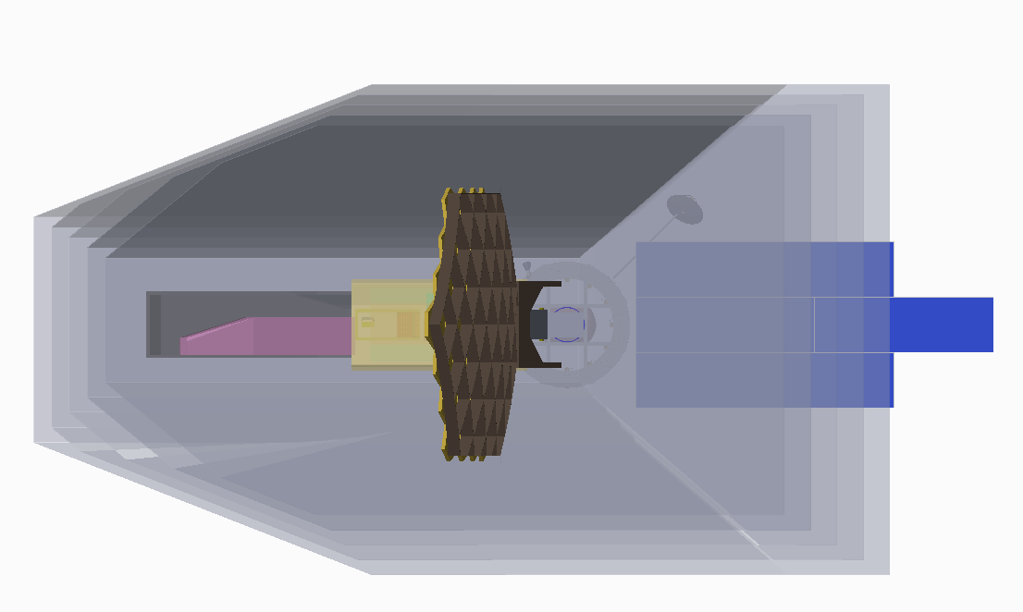
Unobstructed Observatory Top-View
Dimensions in Meters
28.9m
14.8m

Slide 19
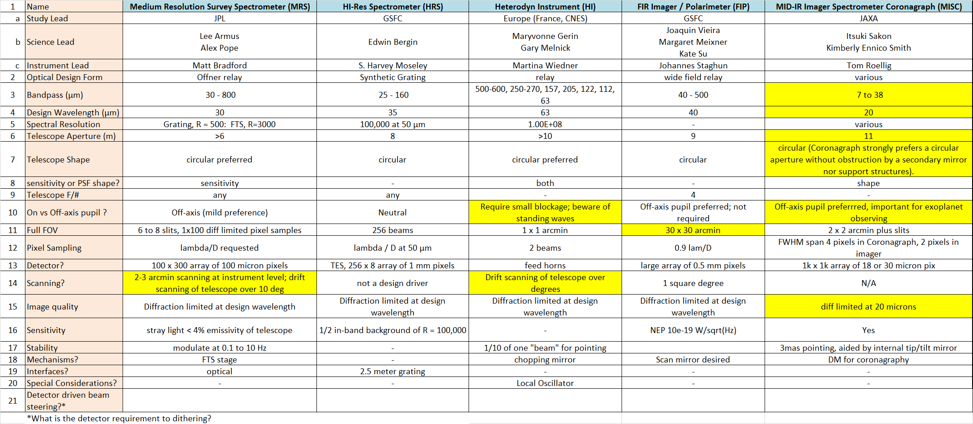
OST Instrument Optical Inputs Summary
Yellow cells highlight telescope design drivers

Slide 20
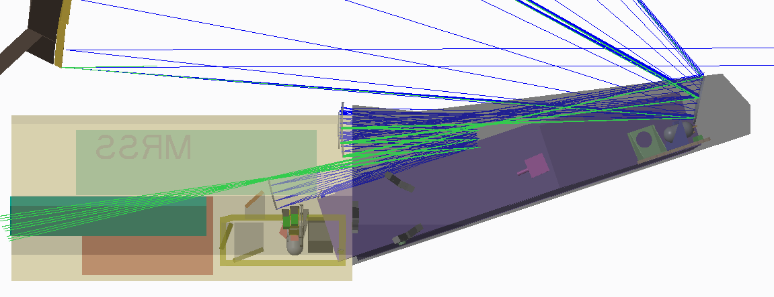
Instrument Accommodation Module (IAM)
Telescope Focal Surface
HRS
HERO
MISC
FIP
HRS Ray Trace (in blue)
MRSS
HERO Ray Trace (in green)

Slide 21
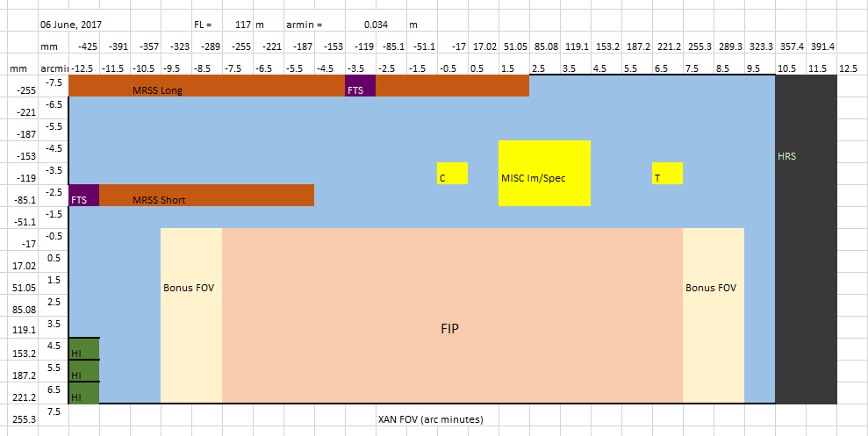
Field of View (FOV) layout

Slide 22
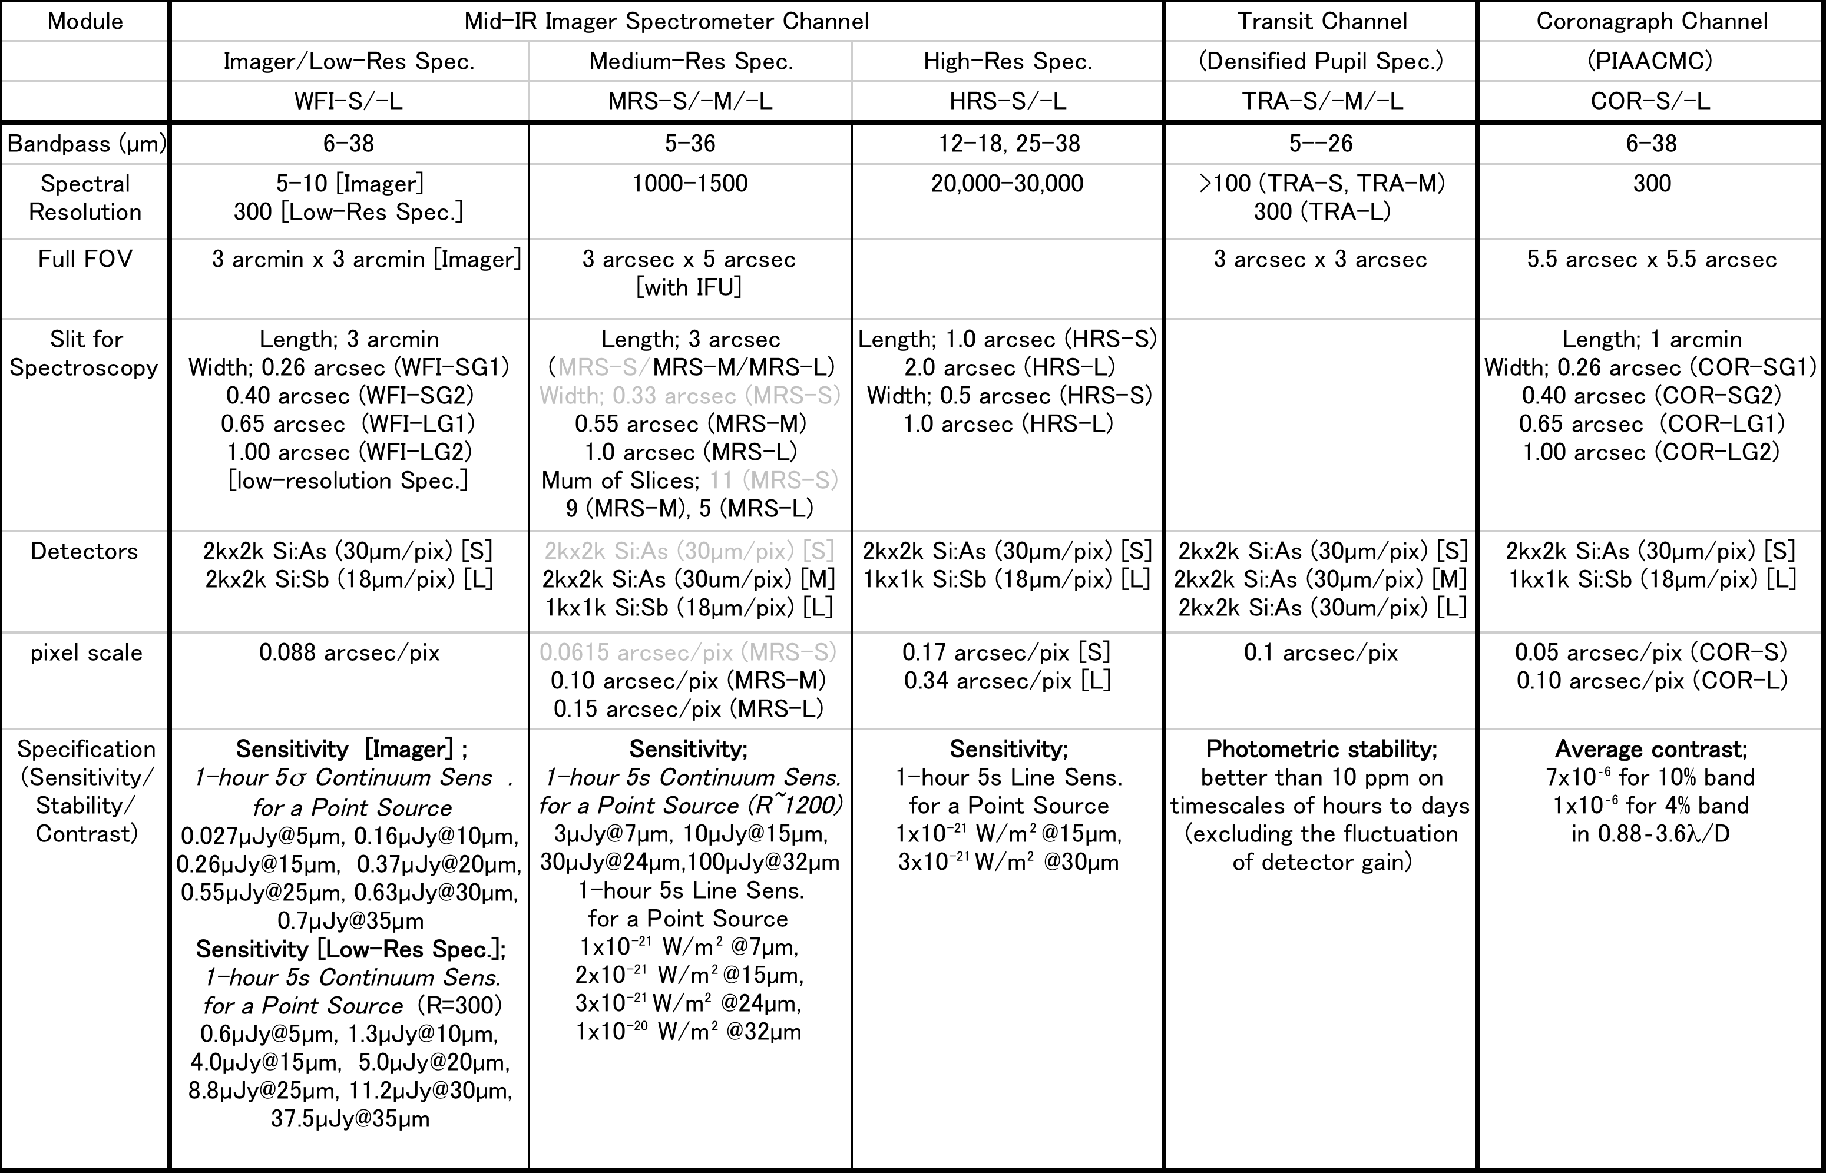
Mid-Infrared Imager, Spectrometer, Coronagraph (MISC)
Sakon (JAXA) et al., Roellig (NASA/Ames)

Slide 23
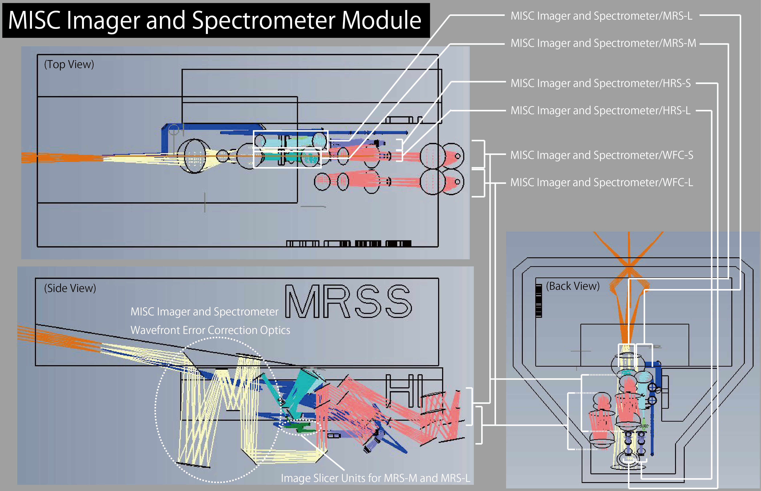
Mid-Infrared Imager, Spectrometer, Coronagraph (MISC)
Sakon (JAXA) et al., Roellig (NASA/Ames)

Slide 24
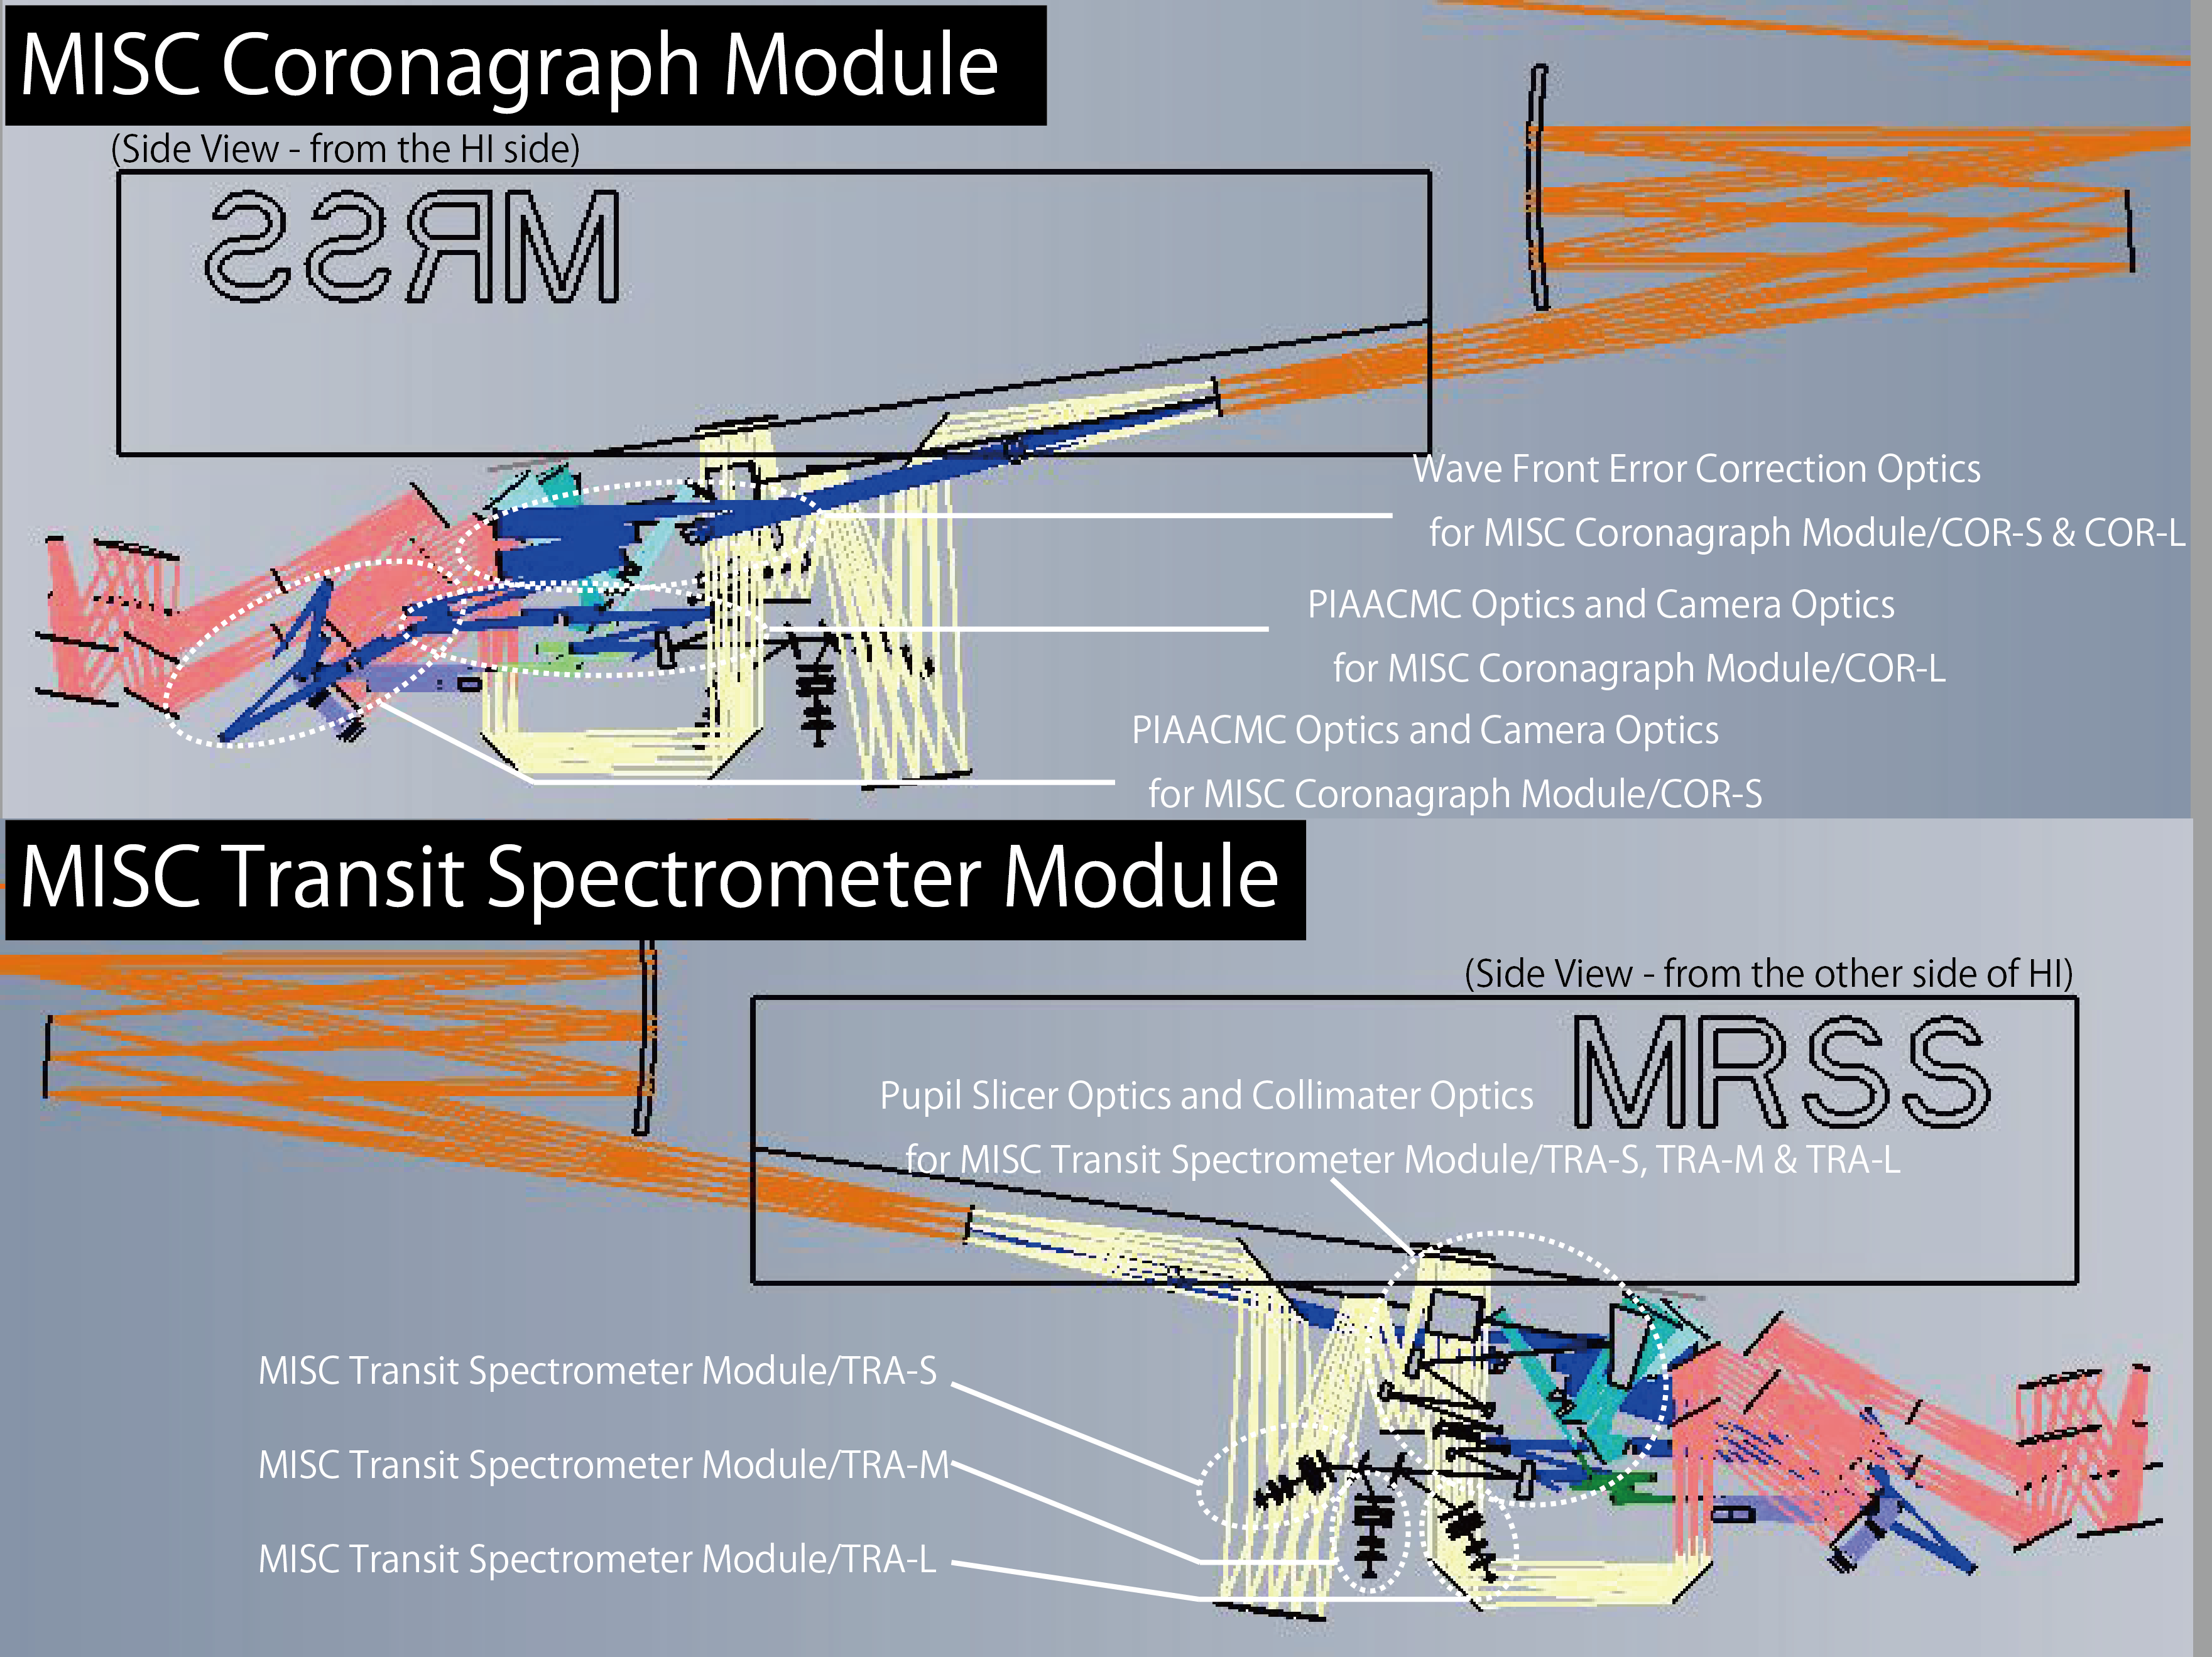

Slide 25
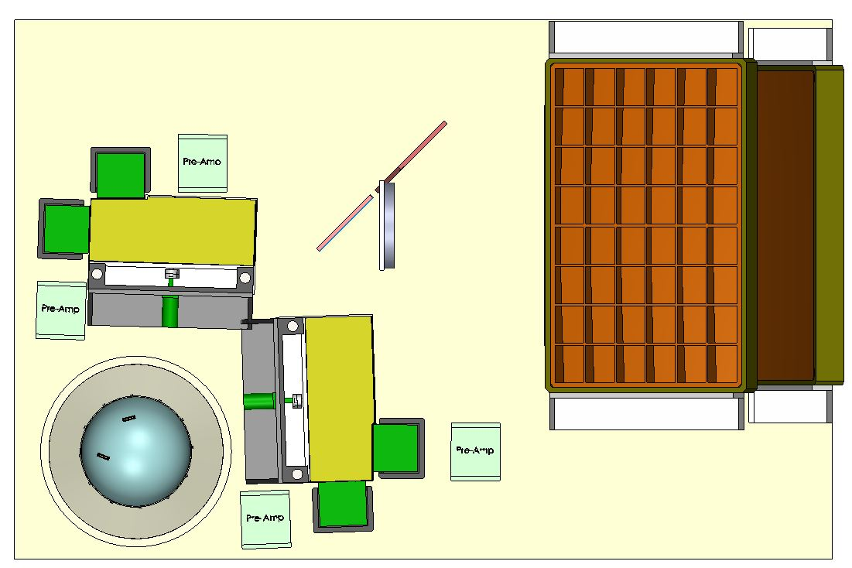
Far-infrared Imager Polarimeter (FIP)
Staghun (GSFC/JHU), Viera (UIUC)
4 bands simultaneously: 40, 80, 120 and 240 μm
Detector Modules
Fore Optical elements
(lightweighted aluminum
Half wave plate assy
LDF V
Optical Assy
LDF H
Detector Modules
Optical Bench
ADR Cooling System
(heat straps to detectors not shown)

Slide 26
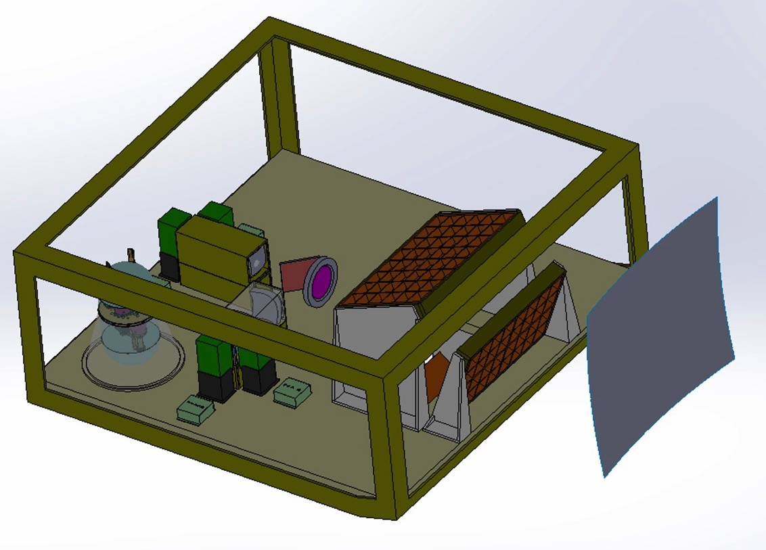
FIP Instrument Layout
Staghun (GSFC/JHU), Viera (UIUC)

Slide 27
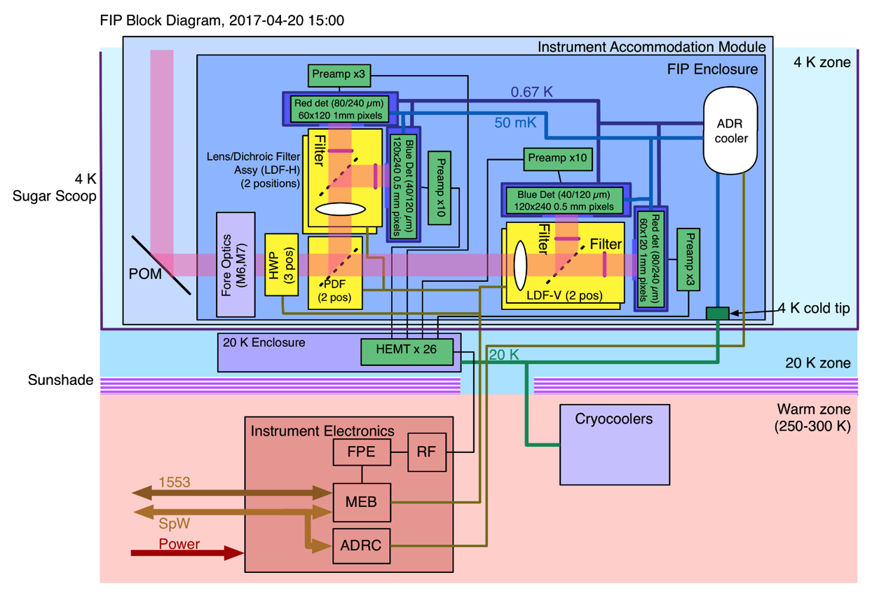
FIP System Block Diagram
Staguhn, Viera

Slide 28
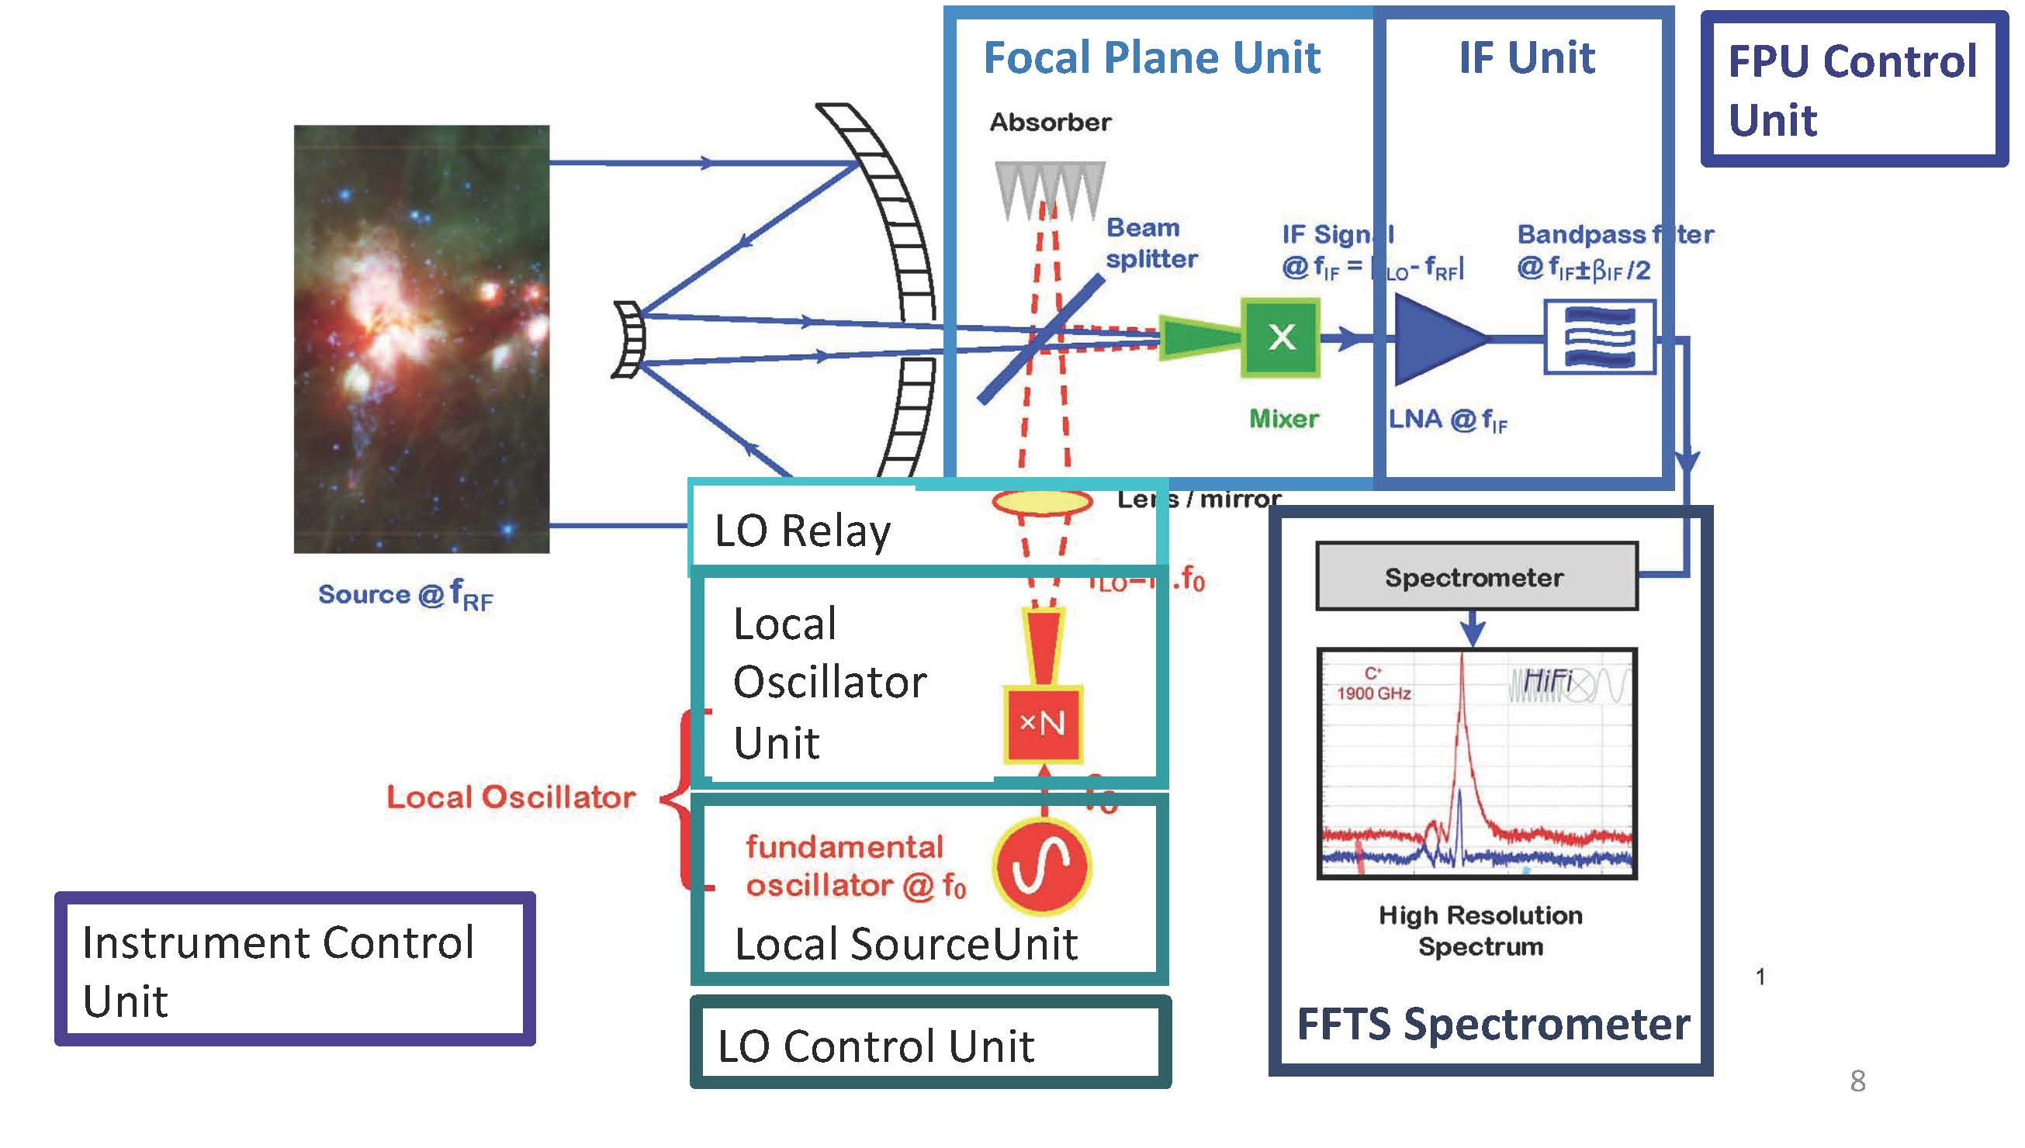
Heterodyne Receiver for OST
(HERO), Wiedner & Gerin
Spectral windows:
111 to 610 μm & 63-66 μm

Slide 29
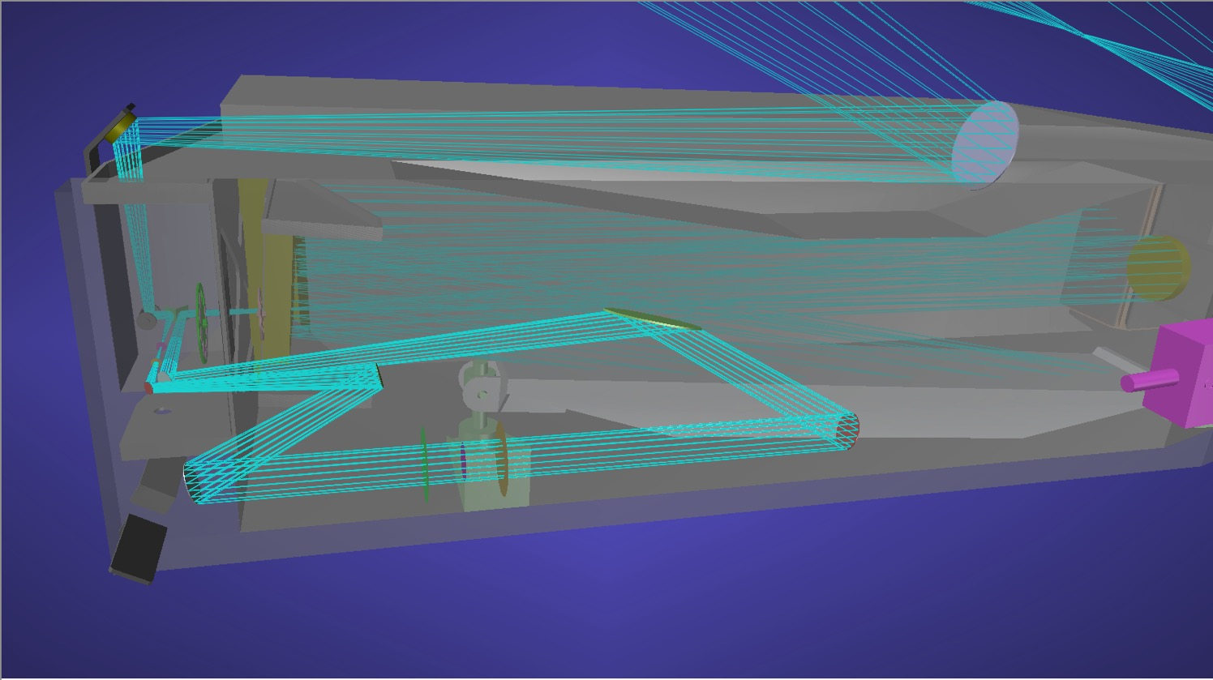
High Resolution Spectrometer (HRS)
Moseley, Staguhn, Bergin, Melnick
Beam pickoff and return
200 mm diameter Fabry-Perot Interferometer

Slide 30
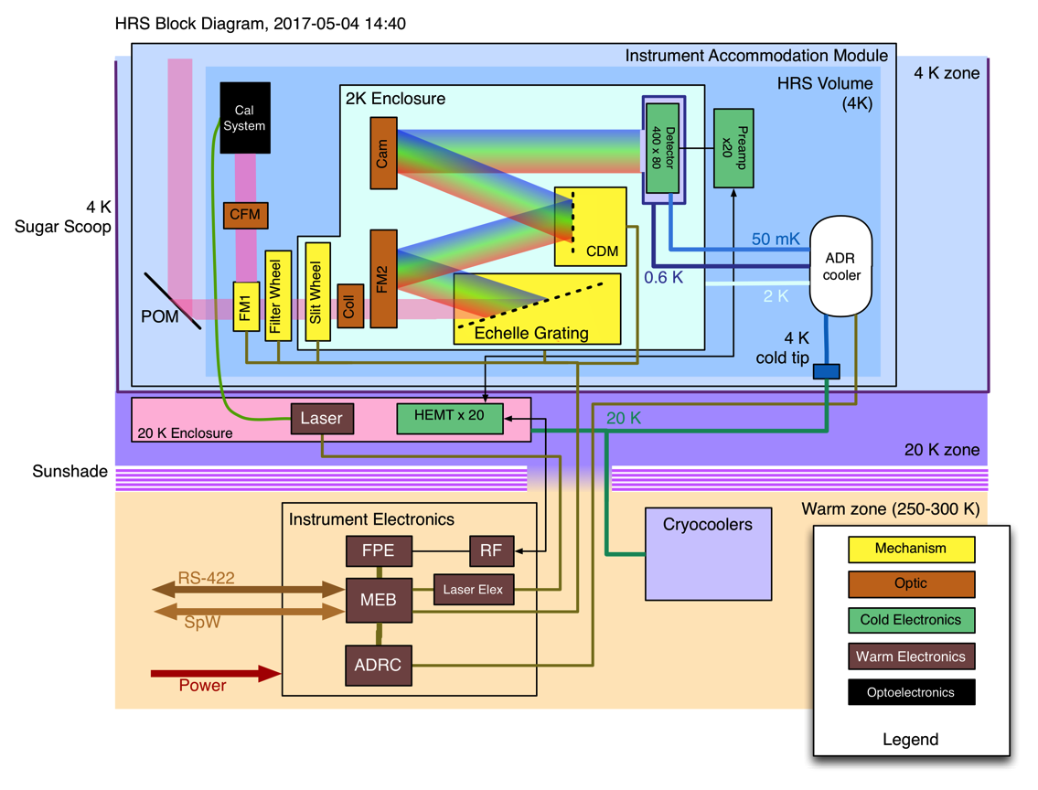
HRS Block Diagram
Moseley, Staguhn, Bergin, Melnick

Slide 31
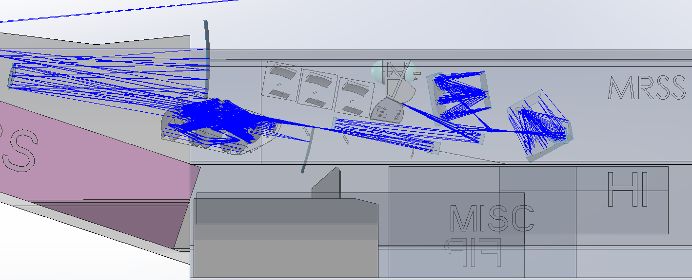
Medium Resolution Survey Spectrometer
(MRSS), Bradford (JPL/Caltech), Armus (IPAC/Caltech)
Long Wave & Short Wave Interferometers
Band 6 Waveguide Grating Spectrometer
ADR Cooler
Band 1, 2, 3 Spectrometers
Band 4, 5 Spectrometers
Additional optical elements required to deliver beams to Band 1,2,3 Spectrometers need to be designed.

Slide 32
MRSS Functional Block Diagram
Bradford (JPL/Caltech), Armus (IPAC/Caltech)
Short-wave interferometer
R=500 Grating Modules
Tel
Grid / dichroic
B1: 30-53
Beam-steering mirror
B2: 50-87
Interferometers engaged via sliding mirrors
B3: 83-145
4.4
Grid / dichroic
B4: 138-241
2.8
B5: 229-401
1.8
B6: 381-667
1.2
Long-wave interferometer
T_max for enclosure, assumes that 2 modes couple (i.e. horns) at 65%, and no bandpass filter leakage.
Two fields on the sky – short wave and long wave.
Each with 3 grating bands coupling the same position.
Interferometer engaged when desired -- serves central sub-field only

Slide 33
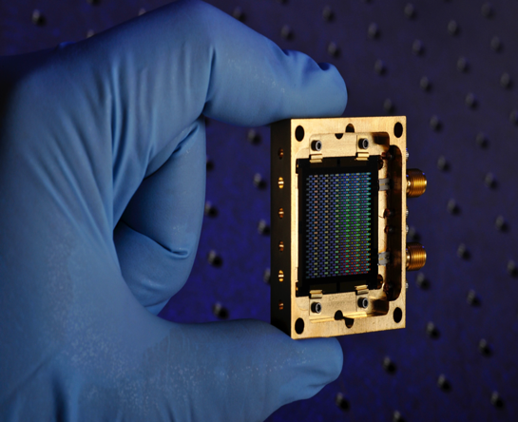
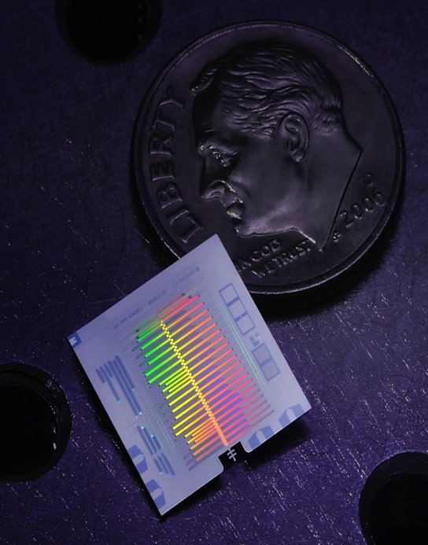
New Science Requires
New Technologies
New Technology | New Capability
Space | Wavelength coverage JWST<—>ALMA
Cold Mirror | Spectroscopic line sensitivity
Large Telescope | Spatial resolution and sensitivity
Large Detector Arrays | Wide field imaging
Compact Gratings & Integrated Spectrometers | 3D mapping
Mid-IR Coronagraph | Exoplanet+Disk Characterization
Bradford
Notes:
New science requires new Technologies Here are some quick pictures of some areas…
-going to space enables a wavelength coverage that bridges JWST and ALMA - the great observatories of 2020
-a cold mirror provides increased spectroscopic line sensitivity
-A large telescope whether single aperture or interferometer will provide the spatial resolution and sensivity
-large detecotrs arrays are needed for wide field imaging
-compact gratings and integrated spectrometers will provide 3D mapping
-a mid-IR coronagraphy can provide exoplanet and disk characterization

Slide 34
Schedule
Sept. 30, 2017 – Concept 1 complete
Dec. 15, 2017 – Interim Report complete
July 16, 2018 – Concept 2 (& 3?) complete
January, 2019 – Final Report complete
March 2019 + - Presentation to the Decadal Committee

Slide 35
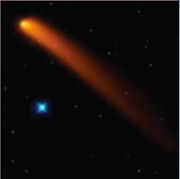
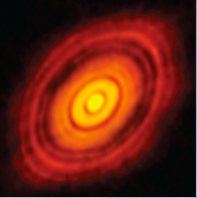
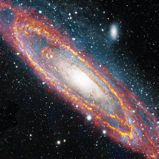
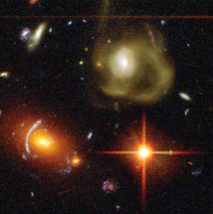
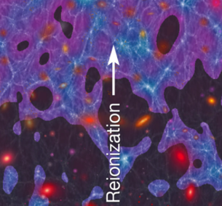
How do I get involved?
Visit our websites: asd.gsfc.nasa.gov/firs
origins.ipac.caltech.edu
Attend a biweekly telecon
Send email to:
ost_info@lists.ipac.caltech.edu
Join a Science Working Group:
Solar System: Stefanie Milam
Exoplanets: Lisa Kaltenegger & Kevin Stevenson
Planet Formation: Klaus Pontoppidan & Kate Su
Milky-Way, ISM and Local Volume of Galaxies: Cara Battersby & Karin Sandstrom
Galaxy and Black Hole Evolution Over Cosmic Time: Lee Armus & Alexandra Pope

