Slide 1
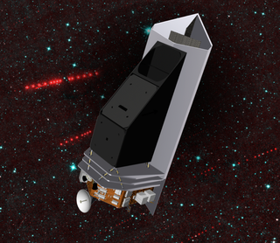
Development of Mid-Wave* HgCdTe Detector Arrays
* Industry refers to
SWIR (2.5 μm cutoff)
MWIR (5 μm cutoff) LWIR (10+ μm cutoff)
Judy Pipher
University of Rochester
(Team: Bill Forrest, Craig McMurtry, grad students Meghan Dorn, Mario Cabrera. Former students Candice Bacon and Jian Wu)

Slide 2
Jim’s Influence
Grad student 1966-1971 (Martin Harwit, advisor)
Jim was a postdoc with the group – technical lead for the rocket infrared astronomy group
Jim’s expertise included solid state physics and cryogenics, as well as pure engineering genius!!
Assumed leadership of the group in 1969-1970 academic year while Martin took sabbatical leave in Czechoslovakia (pre-calculator, pre-laptop, pre-internet and pre-digital camera days)
Taught both his and Martin’s students tricks of the detector trade – as well as many other useful things

Slide 3
Rocket Days with Jim
Martin and Jim designed and flew a small cryogenic telescope on Aerobee sounding rockets from White Sands Missile Range
Tom Soifer and I the first grad students on the program
We each had 3 single pixel detectors to make – mine covered the range 50 μm to submillimeter wavelengths
Neither the detectors nor the filters were commercially available
Jim was conflicted between responsibility for my welfare and the need to take risks to meet the goal
Thankfully, weekends were a time for me to complete the tasks with help from friends!! (No photos – very early times)

Slide 4
Foretold my future – never left detector work behind
When Alan Hoffmann was leaving UR to work at SBRC (later Raytheon) he asked what he could do
I said flippantly “send me an array”
Surprisingly he did, InSb arrays with a Si CCD multiplexer – I used it to entice Bill Forrest (a postdoc with Jim) to come to Rochester to work with our first array, the success of which led to membership on the IRAC and IRS proposal teams in 1983

Slide 5
Hg_{1-x}Cd_{x}Te (today’s subject)
HgCdTe a ternary compound: vary composition parameter x to vary cutoff wavelength – Hg fraction increases at longer wavelengths, makes material softer, increases the likelihood of defects
I was first introduced to SWIR HgCdTe on the HST “death march” – a competition among industries to produce the first NIR camera for HST
Rockwell Science Center won hands down with a 128 x 128 array – HgCdTe arrays became common astronomical tools

Slide 6
Rochester has been working on the development of LWIR HgCdTe arrays for 20 years
In early 90s we began development with Rockwell of LWIR HgCdTe arrays for space application at 30-40K focal plane temperatures
SUFFICIENTLY LOW DARK CURRENT AT ADEQUATE WELL DEPTHS WERE THE PRIMARY ISSUES.
First, investigated single pixel detectors of 10 μm HgCdTe and found that trap-to-band tunneling dominated dark current at focal plane temperatures ~30K
Found that reducing the doping by 30% from Rockwell/Teledyne’s standard at that time would potentially improve performance (Bailey et al. 1998; Wu 1997 )

Slide 7
LWIR Array Operability: Past
State of the art early 2000s: 0 mV
applied bias, 256 x 256 x 40 μm. White
corresponds to dark current <100 e-/s.
The rows correspond to pixels with
differing diode geometry. Doping modified
from earlier work to minimize trap-to-band
tunneling. Less than 30% pixels met spec.
State of the art 2003. First breakthrough. 512 x 512 x 36 μm array achieved 72% operability (white < 100 e-/s) but again essentially 0 applied bias.
(Series of papers by Bacon et al. )

Slide 8
Need for Passively Cooled LWIR Arrays
NEOCam , Near Earth Object Camera, PI Amy Mainzer (JPL), is a proposed mission designed to discover and characterize most potentially hazardous asteroids near the Earth >140m in size. It consists of a 50 cm telescope, and focal planes sensitive from 3-5 μm and 6-10 μm – passively cooled
The 2003 array was attractive to Amy, and in 2009 she funded some further tests and helped to spur development to larger formats, and smaller pixel size.
We also wanted to pursue it for a separate reason – the warm Spitzer mission, once cryogens expended, the focal plane equilibriated at ~28K, but only the IRAC 3.6 and 4.5 μm InSb channels were still operative. Had we had 10 μm HgCdTe arrays rather than the Si:As arrays for the 5.8 and 8.6 μm channels, all four IRAC channels would be alive and functioning – enabling more science.
NASA ROSES APRA program funded UR’s test and optimization of 10 μm arrays, and NASA Phase A and Extended Phase A to NEOCam project funded further Teledyne development. (2010 and beyond)

Slide 9
Why NEOCam?
Albedos 0.04-0.25
Measure diameters

Slide 10
Operability by 2012 of 1kx1kx18 μm LWIR arrays
McMurtry et al. (2013) reported on three 1k x 1k devices with λ_{cutoff} of 9.9 to 10.6 μm
Operability – defined by pixels with low dark current yet adequate well depth
These devices sustained substantial applied bias, so well depths of > 50,000 e- possible for first time for these 18 μm pixel devices

Slide 11
From 2003 to 2012– what changed?
In the 2003 lot, a 512 x 512 x 36 μm 9.2 μm detector array and a 10.3 μm array with 0 mV applied bias, and 45 ke- well depth, exhibited operabilities of 72% and 50% respectively (dark current < 200 e-/s)
Analysis of I-V and I-T curves of 2003 era hot pixels identified screw dislocations as root cause of high dark current pixels
What changed in 2012?
Similar HgCdTe material properties in growth (doping, mobility, EPD)
Far better processing and production included better lattice matching with CdZnTe substrate , improvement in cap layer designs , added metal to increase capacitance
Technique developed to minimize stress during bump bonding => far fewer defects
3 good arrays: 75% yield!!
(McMurtry et al. 2013)

Slide 12
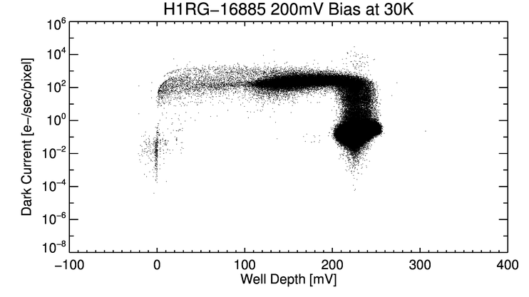
Results for 1k x 1k 10.5 μm array
Preponderance of good pixels at well depth > 200 mV = 55 ke-
NEOCam dark current requirement, < 200 e-/s. Operability > 95%

Slide 13
A 9.6 μm 2k x 2k array, 250 mV applied bias, 40K, 98.9% operability
2017

Slide 14
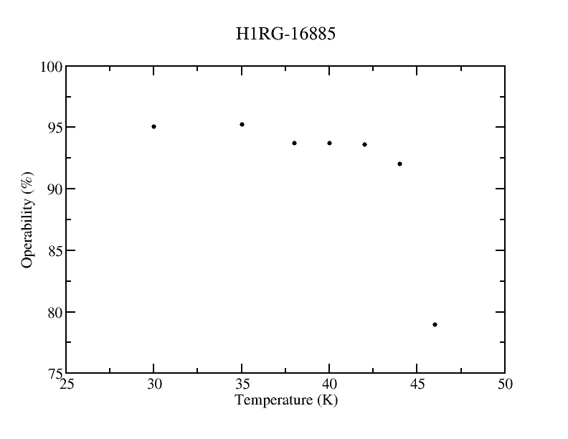
Passive Cooling?
Proposed to develop for space missions sister arrays to these – they are happy at somewhat higher temperatures. (Tests at ~35K)
Increase temperature while maintaining good operability
Focal plane temperatures as high as 42K possible

Slide 15
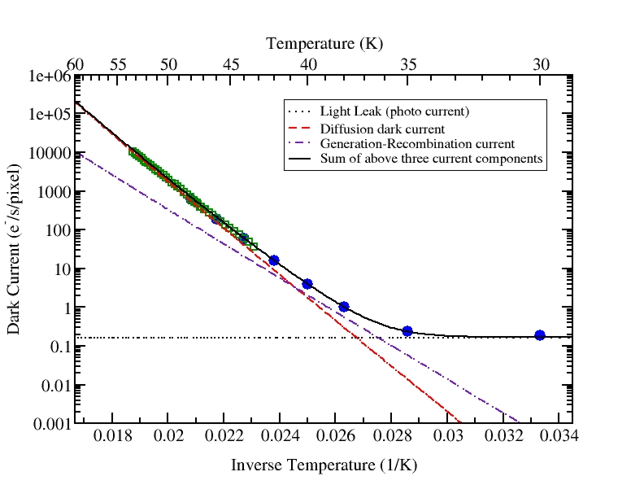
Arrhenius Plot
2012 1k x 1k array, 10.6 μm cutoff wavelength
Diode area ~4x smaller than 1997 pixel
Lower doping and smaller diode area
Modeled dark current contributions
Limited by dewar darkness – 0.2 e-/s
N.B. No evidence for tunneling in most pixels of the 10.6 μm array.

Slide 16
QE and uniformity
Good QE for non-AR coated device – 63 to 65% at 9.3 μm
Uniformity excellent
Maximum possible QE defined by reflectivity of backside CdZnTe layer and CdZnTe/HgCdTe interface – Maximum QE ~ 75%

Slide 17
Substrate Removal
The JWST HgCdTe arrays are substrate removed
Waczynski et al. (2005) had shown there was proton-induced luminescence of the CdZnTe substrate for SWIR devices
On one LWIR array, tried removing all the 800 μm CdZnTe substrate by the JWST formula (worked for SWIR and MWIR devices)
Yield low, irreproducible results on LWIR devices
Found that removing all but 30 μm substrate was a high yield process

Slide 18
Proton irradiation of arrays
Dorn et al. (2016) tested 3 arrays at Crocker Radiation Lab at 3 beam energy ranges – 63, 30, 12-18 MeV
One array with 800 μm substrate intact
One array with 30 μm substrate
One with zero substrate
Both lifetime doses and analysis of single proton hits

Slide 19
Single proton hits; recover after reset and next read (6s later)

Slide 20
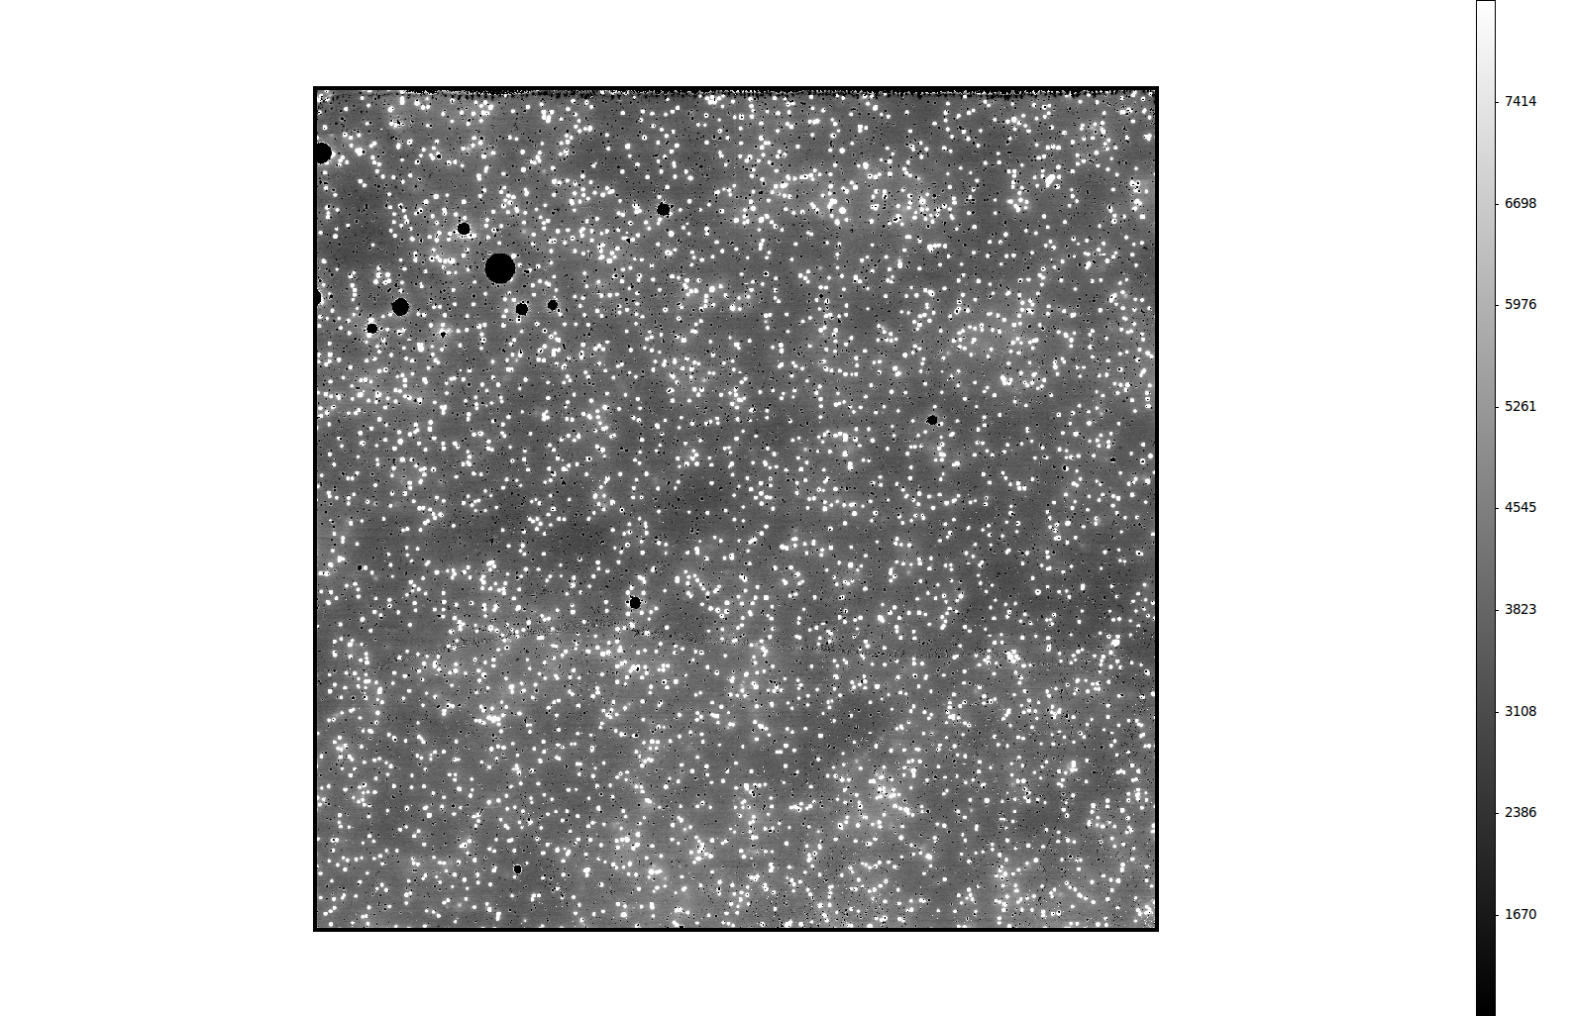
Luminescence of 700 e/s/pixel for 18 MeV flux 100 protons/cm²-s (full substrate only)

Slide 21
Larger formats
2k x 2k format
Although inferior readouts only ones available at time, one array performed with similar operability, QE and read noise as 1k x 1k arrays (dark current-well depth graph shown earlier)
Other two exhibited multiplexer issues

Slide 22
Extension to longer cutoff wavelengths – Forrest PI
GOAL: 15+ μm cutoff
Knowing that increasingly softer material is prone to more defects, attempted 13 μm first
1k x 1k x 18 μm
See poster by Mario Cabrera this conference for details
Cannot sustain as high applied reverse bias (150 mV) – dark current 1-10 e-/s
Evidence for trap-band tunneling
Cannot go to lower doping
At 15 μm will probably contend with band-band as well as trap-band tunneling

Slide 23
Use for ground-based
Dark current requirements much less severe than space
If use CTIA multiplexer rather than source-follower/detector like HxRG family, do not NEED high applied bias
Teledyne developing GEOSnap
Offered to Astronomy consortium detector arrays from best Rochester 13 μm wafer to bond to purchased GEOSnap (when available) to test feasibility for ground-based use e.g. METIS on E-ELT

Slide 24
Summary
Developed with Teledyne to our specifications, and proved 10 μm cutoff arrays for passively cooled space mission – NEOCam and possibly for OST
Extended cutoff to 13 μm – have tested 2 out of 3 deliverables
Wafers for 15 μm grown, several lot splits
Hope to show utility for ground-based use soon
13 μm work almost complete, will extend to 15+ μm – first wafers grown. Important for CO₂ detections (e.g. habitable exoplanet atmospheres)

