Slide 1
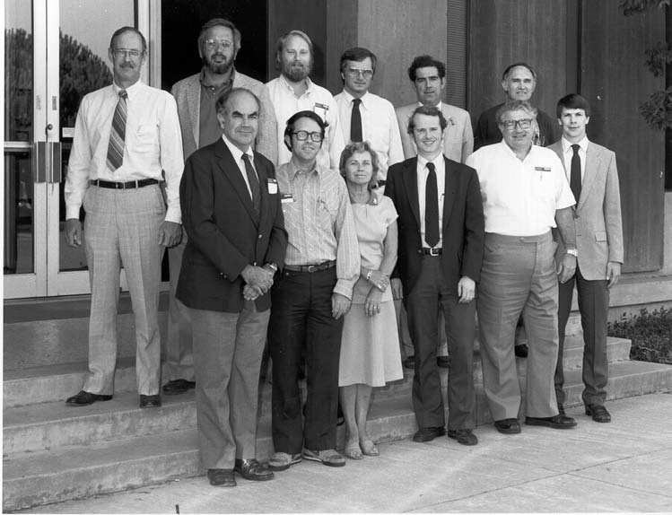
Looking Ahead in Infrared Astronomy
Michael Werner, JPL/Caltech
Houck Symposium
28 June, 2017
FIRST SPITZER SWG MEETING, 1984

Slide 2
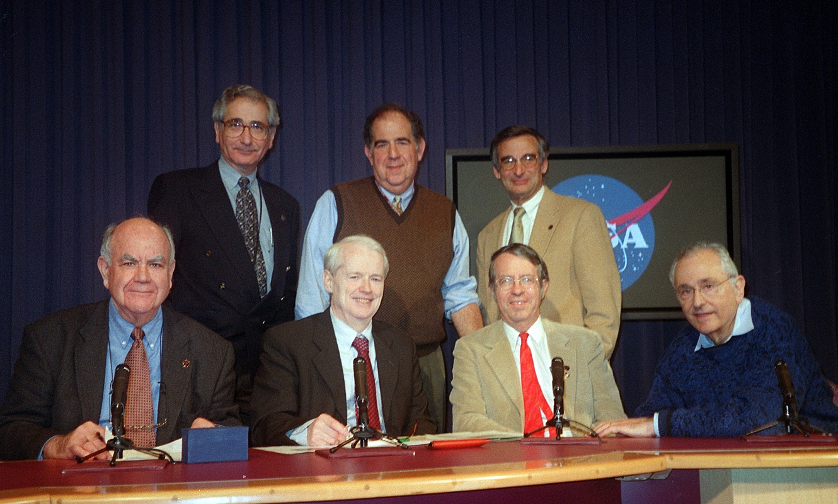
First Press Conference and Data Release
2003

Slide 3
My favorite IRS Spectra

Slide 4
Infrared Opportunities, 2017-2030
CERTAIN
  [Spitzer]
  SOFIA
  JWST
  Euclid
  WFIRST
  GUSSTO
  CCAT-prime
  Keck, VLT, Gemini
  Gattini-IR
  E-ELT

Slide 5
Infrared Opportunities, 2017-2030
LIKELY
  GSMT, TMT
POSSIBLE
  SPHEREx
  FINESSE
  SPICA
  OST
  LUVOIR
  HABEx
  …….[your favorite[s] go here]

Slide 6
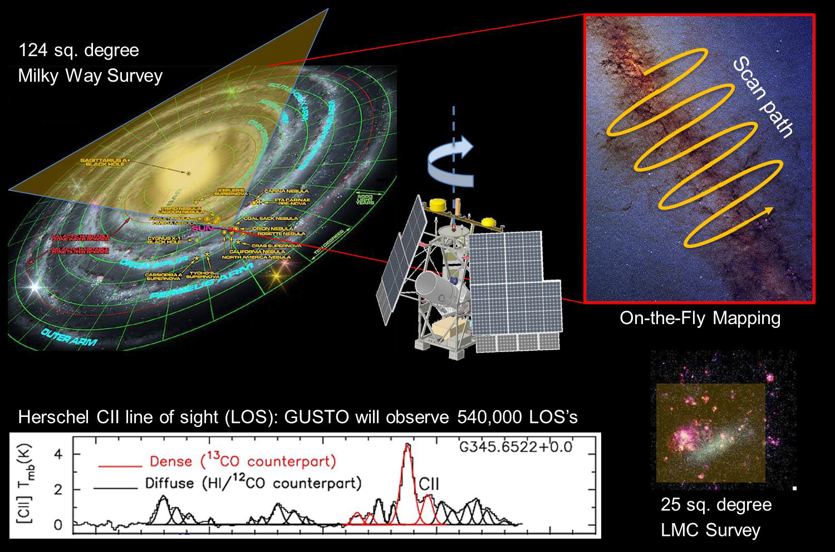
GUSTO Observational Objectives:
[CII], [OI], & [NII] Spectrally Resolved Surveys of MW and LMC
ULDB –
100 DAY
FLIGHT!
GUSTO Highlights
8 pixel heterodyne array for each line
24 digital spectrometers
80cm dia. telescope; star tracker
All data telemetered to ground in near real time
Anticipate total of 500,000+ spectra

Slide 7
New SOFIA instruments facilitate new science
HAWC Polarimetry
FIFI

Slide 8
Infrared does not mean cold
Werner et al, J. Astron. Telesc. Instrum. Syst. 2(4), 041205 (Jun 22, 2016). doi:10.1117/1.JATIS.2.4.04 1205 ; astro-ph 1605.04367
1 Rearth, M4 Star, 15 pc away, 9m LuVOIR, 120 hrs., 60 transits
Large, warm space telescopes like LUVOIR and HABEx have impressive capabilities for infrared studies. We should beat on the decadal committee about this, while also arguing in favor of OST.
On OST, watch for the design to cost $3B economy version from JPL

Slide 9
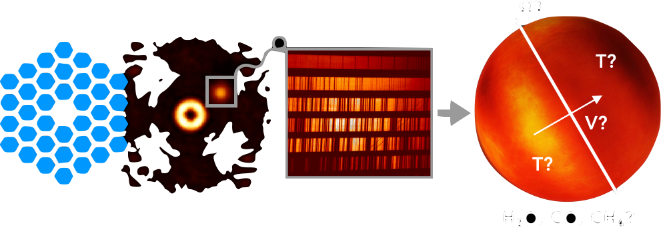
INFRARED INSTRUMENTS GET MORE COMPLICATED
Keck Planet Imager and Characterizer (KPIC) – Dimitri Mawet et al
High-resolution spectroscopic characterization of imaged and transiting planets
Direct imaging of young gas giant exoplanets
Imaging the formation of planets from the circumstellar dust and gas
Precision Radial Velocity exoplanet searches in the infrared

Slide 10
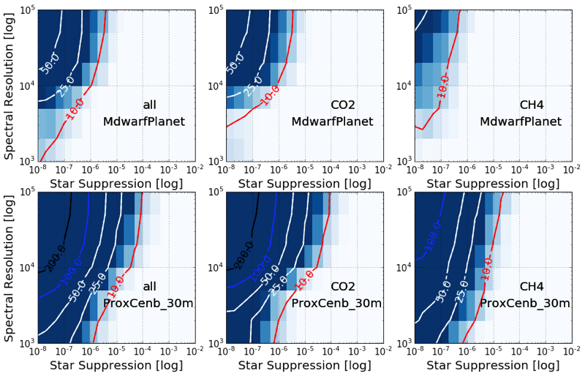
Detecting molecules with an ELT
Wang, Mawet, Ruane, Hu, Benneke, 2017
SNR contours for an Earth-like planet
around an M star at 5 pc
Spectral resolution vs starlight suppression trade space
SNR contours for an Earth-like planet
around Prox Cen B Spectral resolution vs starlight suppression trade space

Slide 11
GRAVITY – A NEW INSTRUMENT FROM REINHARD GENZEL ET AL, COMBINES ALL FOUR VLTS COHERENTLY TO PRODUCE VELOCITY RESOLVED IMAGES

Slide 12
GRAVITY – FIRST RESULTS
SGR A*
ETA CARINA

Slide 13
WHERE ARE THE JIM HOUCKS, DIMITRI MAWETS, AND REINHARD GENZELS OF THE FUTURE COMING FROM?
Problem may be particularly acute in era of bigger instruments
They self-identify, but should be nurtured and mentored as discussed by John Wilson
Their value should be recognized by fellowship selection committees, etc.
Perhaps an exchange program with NASA centers or other institutions with heavy emphasis on instrumentation would be useful

Slide 14
Science Opportunities, I – go after the Sprites

Slide 15
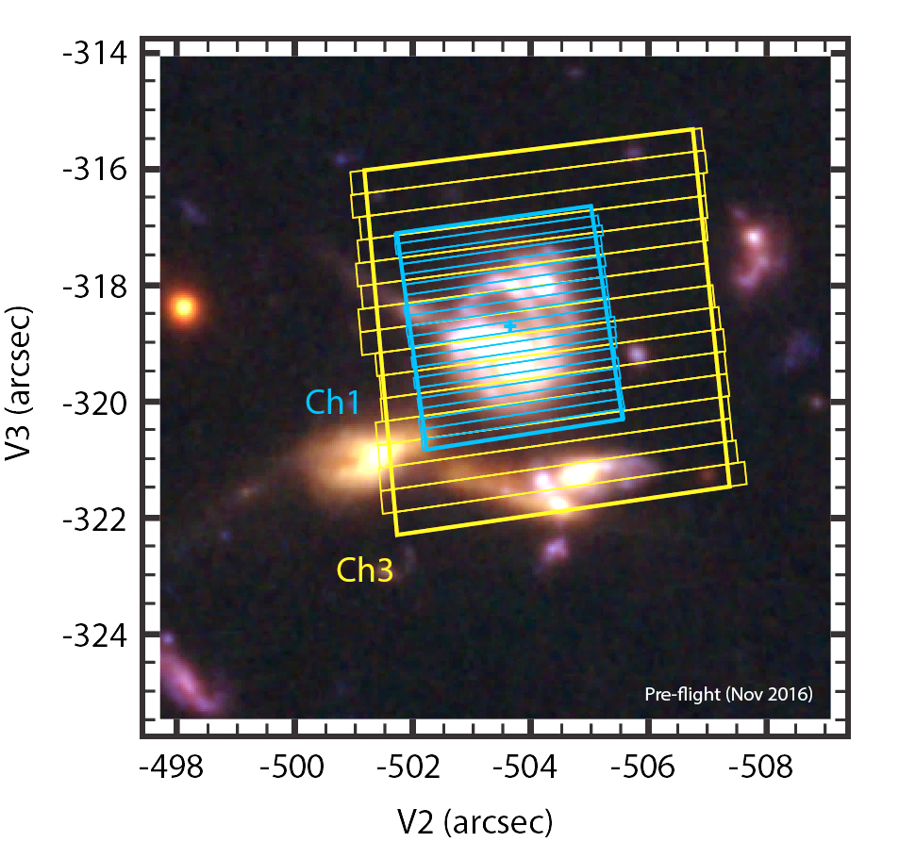
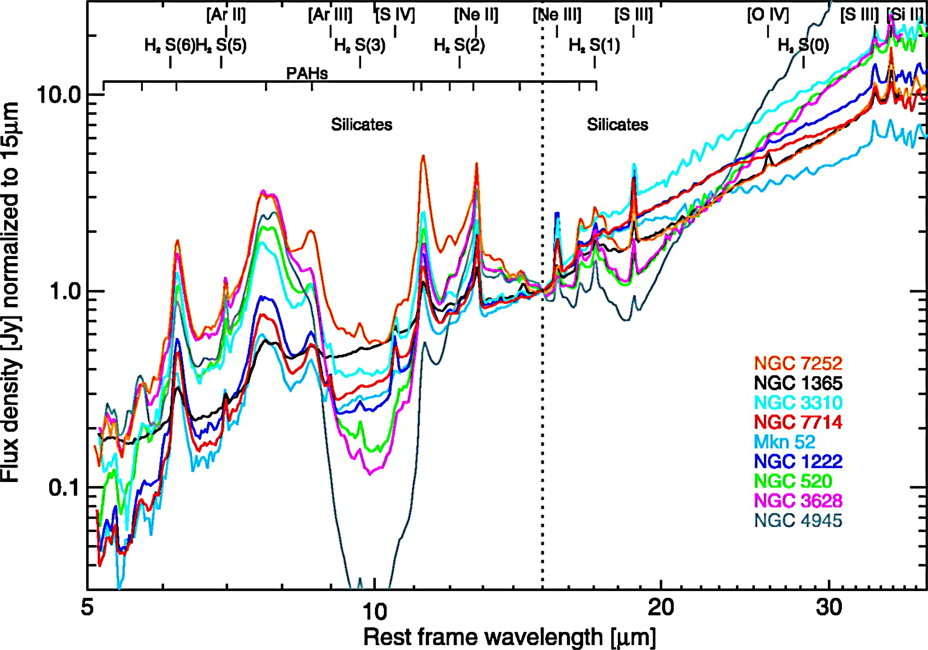
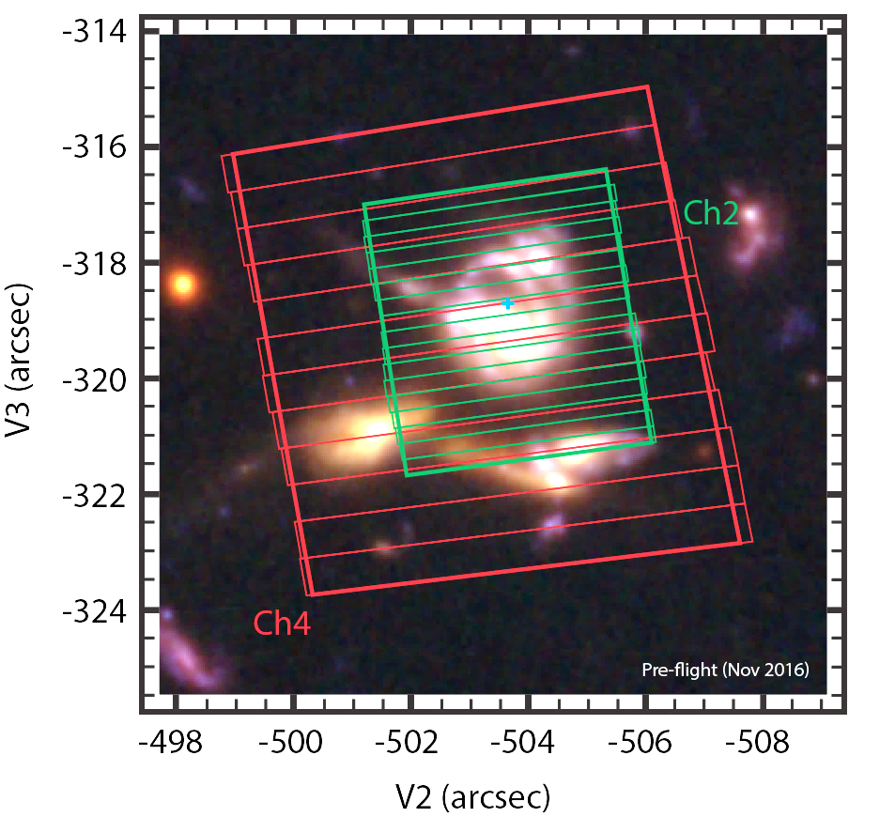
Science opportunity 2 – Less phenomenology, more physics
            Spatially resolved* studies of SF, AGN, ISM
            USE LOCAL TEMPLATES TO UNTANGLE MORE DISTANT SOURCES
            GET A THEORIST [E.G. PHIL HOPKINS]
Brandl et al. (2006)

Slide 16
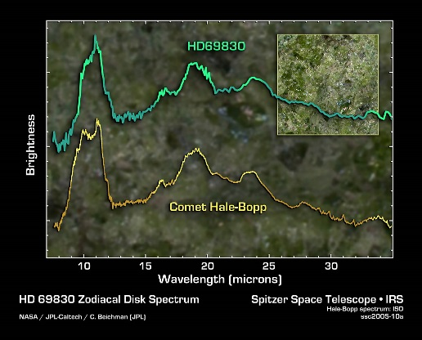
SCIENCE OPPORTUNITY #3 – LINK THE SOLAR SYSTEM TO EXOPLANET SYSTEMS

Slide 17
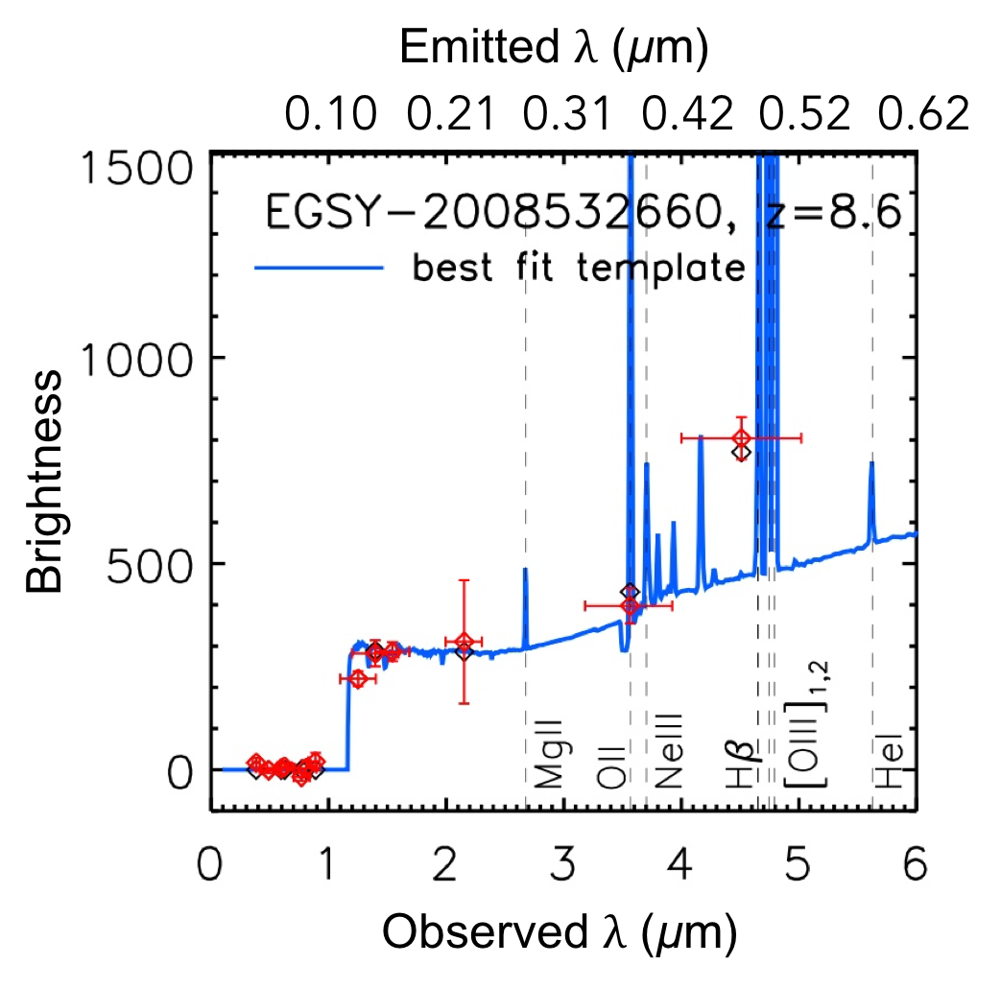
SCIENCE OPPORTUNITY #4 – SPITZER/EUCLID/JWST SYNERGISM

Slide 18
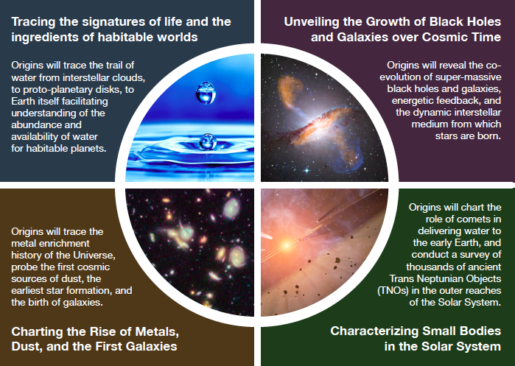
Science Themes for OST

Slide 19
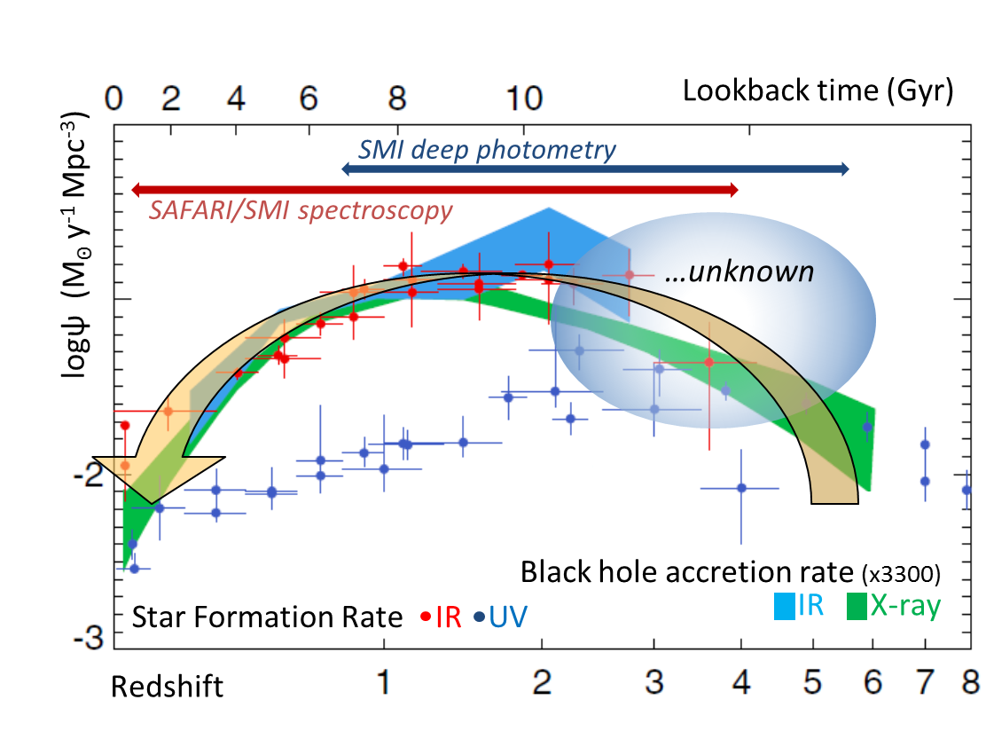
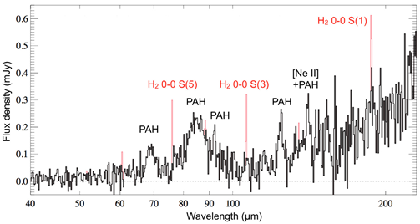
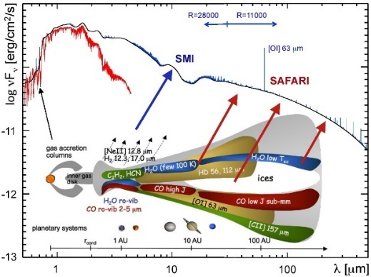
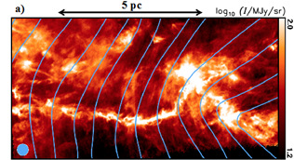
Science Objectives – mission design drivers - SPICA
What processes govern star formation
across cosmic time
- what starts it, controls it, and stops it?
  What are the major physical processes in the most
  obscured regions of the universe?
  How is this related to the enrichment
  of the universe with metals
What is the origin and composition of the first dust,
how does this relate to present day dust processing?
What is the thermal and chemical history of
the building blocks of planets?
What is the role of magnetic fields
in dust filaments?

Slide 20
Defining scientific programs for SIRTF
[Broomfield, 1993].
Where do we stand today and going forward?
Brown Dwarfs and Super Planets [EXOPLANETS]
  Major Growth Area
Protoplantetary and Planetary Debris Disks [STAR FORMATION]
  Synergism with ALMA and with Solar System Studies
Ultraluminous Galaxies and AGN [GALAXY EVOLUTION]
  Physics, not Phenomenology
The Early Universe [GALAXY FORMATION]
  Where will JWST take us?

Slide 21
When the Search Had Just Begun
“The excitement of today will be the ‘ho hum’ at the end of the 5 year Spitzer Mission”
Jim Houck—IRS PI
12/18/03
Notes:
Universe distant is stars and galaxies; immediate is human environment, solar system, etc
Music of the spheres: Visible is one octave, IR is 7 or 8 octaves; exploration has only begun, and SIRTF will take IR Astronomy from infancy to adolescence…

