Slide 1
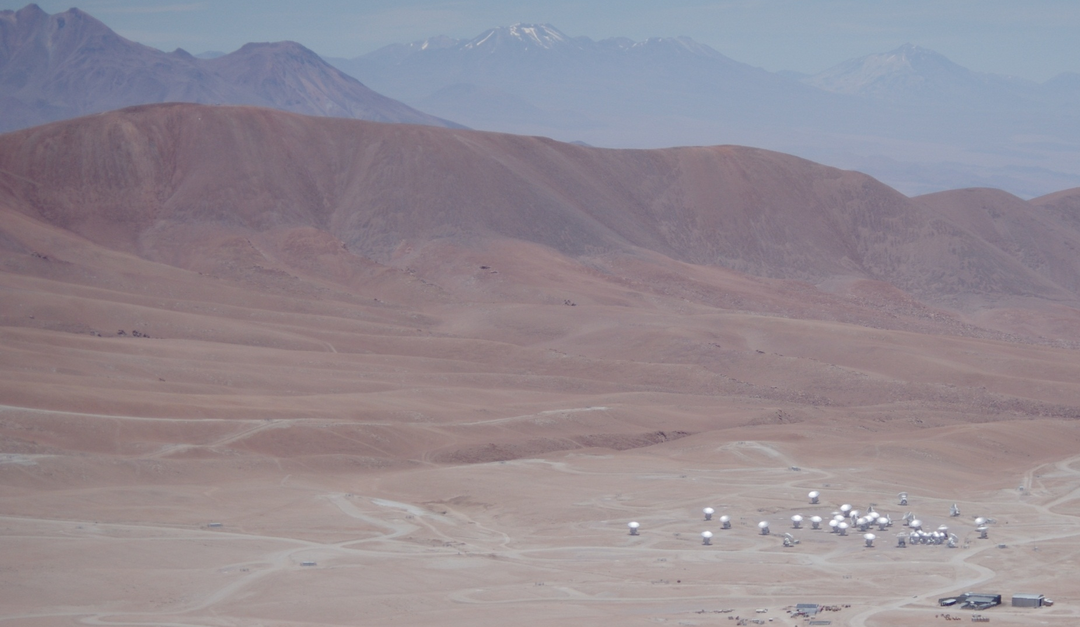
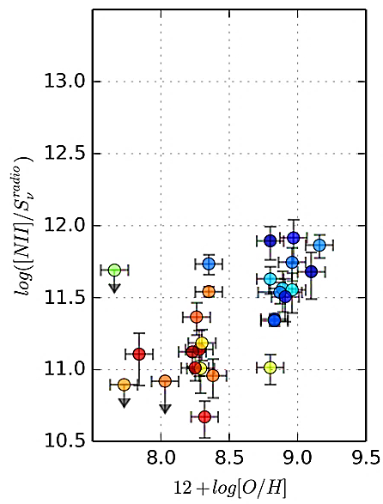
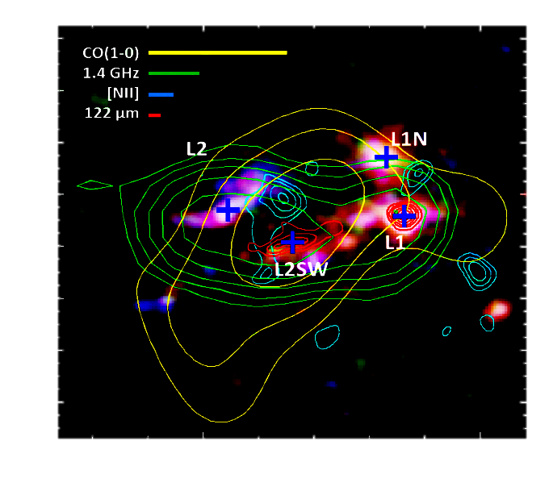
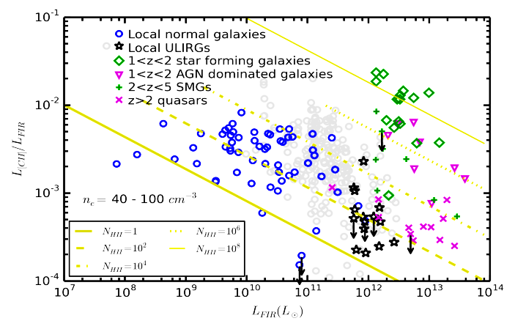
Far-infrared fine-structure line studies of early galaxies:
Where are we? Where do we need to go?
Carl Ferkinhoff
Assistant Professor of Physics
Winona State University
Science Enabled by Novel IR Instrumentation
June 25-27, 2017
Cornell U. Ithaca, NY

Slide 2
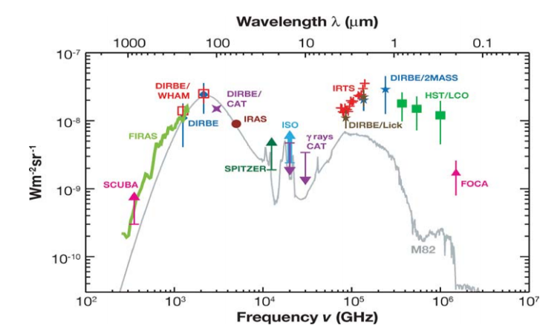
The cosmic infrared background is comparable to the optical background!
Notes:
There must be galaxies in the early universe undergoing predigeous star formation, and they must be dusty to convert stellar emission into IR.

Slide 3
Age of Universe (billions of years)
13.7
7.0
3.5
2.0
1.3
1.0
0.85
10
Star Formation Rate (arbitrary units)
1.0
Population of luminous IR galaxies (LIRGs, L_{IR} > 10¹¹ L) responsible for the near 10 fold increase in cosmic star formation rate!
Notes:
This recent version of the “classic” madau plot showing the specific starformation rate as function of red shift. 7 billion years ago, galaxies where forming stars much more readily than they do today. Infact since, the star mation rate has slowed steadily since then. What was different about galaxies and the universe then that supported such star formation? Even at z of 4 or 5 only a billion years or so after the big bang, galaxies were already forming stars quit rapdily and peaking somewhere between z of 1 and 2. Are these galaxies like local galaxies or are they completely different beasts.
Gray points – Hopkins 2004
Hatched is FIR 24 micron from Le Floc’h et al 2005
Green triangles FIR 24 micronPerez-Gonzalezet al. 2005
Open red star 1.4 ghz data
Fild red is Halpha estimate
Blue squares are Evdata.
Blue crosses are UDF estimates
Leflock, not used in fit, but used to obscuration correct the UV data.

Slide 4
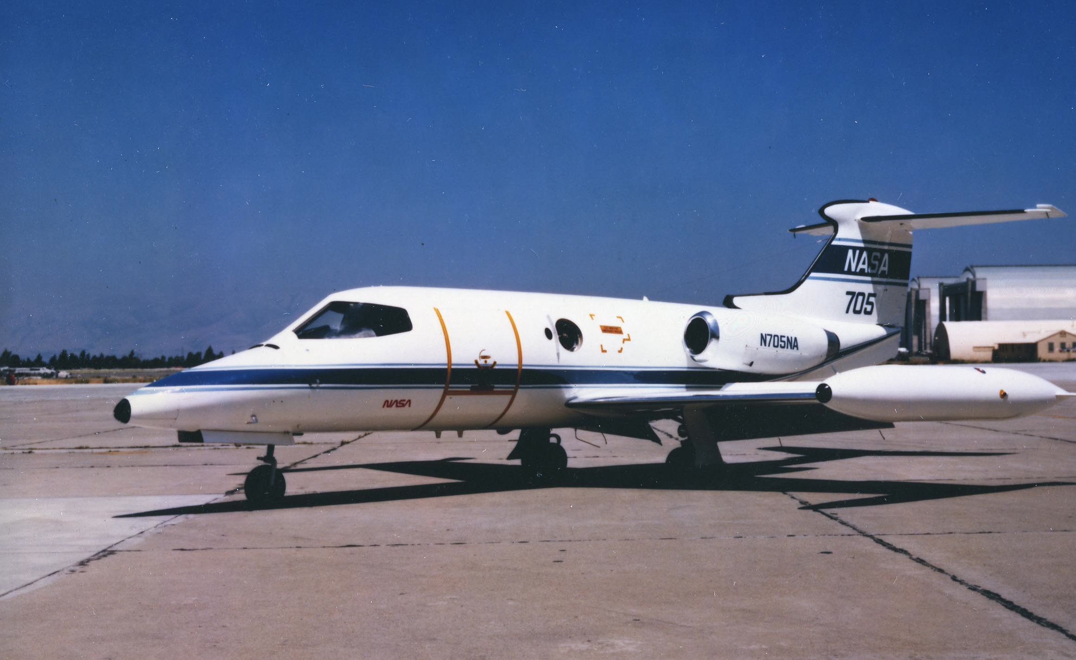
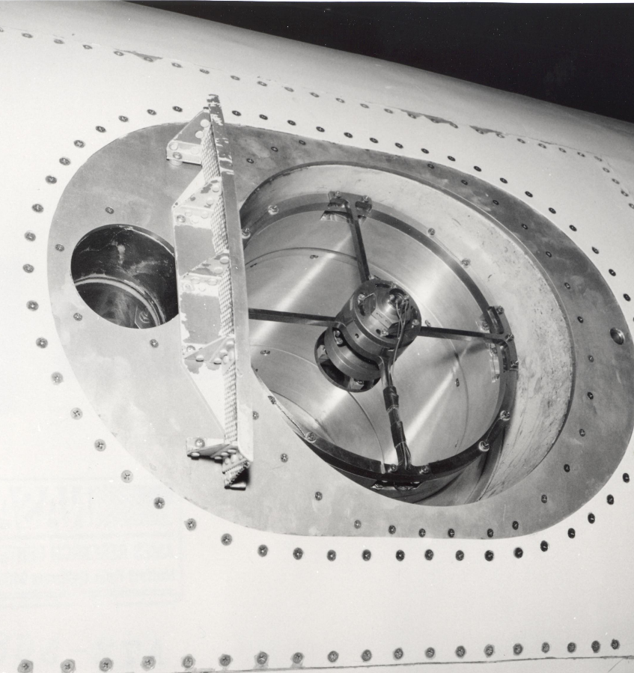
42 years ago with the NASA Learjet. . .
M. Harwit’s group, detected the [OIII] 88 micron line from M17. The first astrophysical detection of a far-IR fine structure lines.

Slide 5
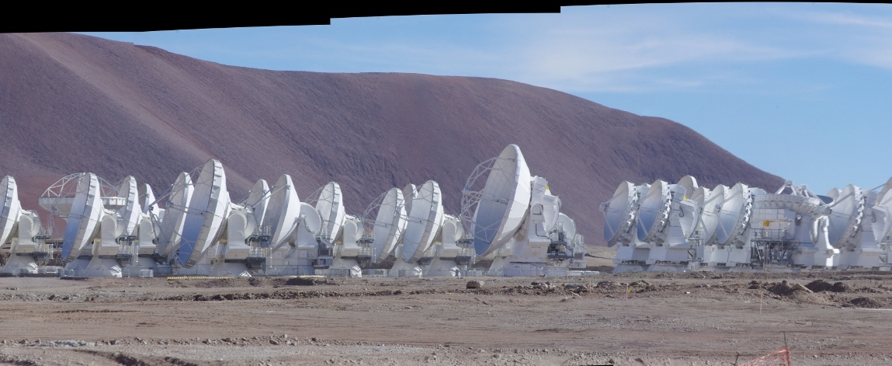
TODAY. . .
ALMA is detecting the FSLs in the first galaxies (z > 7) when the Universe is less then a billion years old.

Slide 6
Far-infrared fine-structure line studies of early galaxies:
Where are?
What are the lines and what do we know locally?
What have we learned from the first studies at high-z?
Where do we need to go?
What is there beyond the [CII] 158 micron line?
What can multi-wavelength studies reveal?

Slide 7
Collaborators
Winona State University:
Carl Ferkinhoff, Alex Franta, Alex Scrabeck, Sam Schutz, Daniel Maloney, Aubrey Kovacevich, Nathan Graetz
Georgia Southern University:
Sarah Higdon, Jim Higdon, Hannah Tidwell, Miguel Rangel
ZEUS-1 and 2 Instruments Cornell University:
Gordon Stacey, Thomas Nikola, Stephen Parshley, Justin Schoenwald, Drew Brisbin (NRAO, U. Diego Portales), Amit Vishwas, Jermey Hodis, Cody Lemarch
Max-Planck-Institute for Astronomy:
Fabian Walter, Roberto Decarli, Bram Venemans, Emanuele Farina, Laura Zschaechner, Eduardo Banados, Chiara Mazzucchelli
Others:
Gene Hilton, Johannes Hubmayr, Carl Reintsema (NIST); Kent D. Irwin (Stanford), Hsiao-Mei Cho (SLAC), Mike Niemack (Cornell), Mark Halpern, Matthew Hasselfield, Mandana Amiri, D. V. Wiebe (UBC); Peter Ade, Carole Tucker (Cardiff), Dominic Benford (NASA Goddard), Johannes Staguhn (NASA Goddard, JHU), Steve Hailey-Dunsheath (Caltech), Aprajita Verma, Dominik Riechers (Cornell), Karl M. Menten, Rolf Gusten, Axel Weiss (MPIfR), Thomas Phillips (Caltech), Edith Falgarone (LERMA)

Slide 8
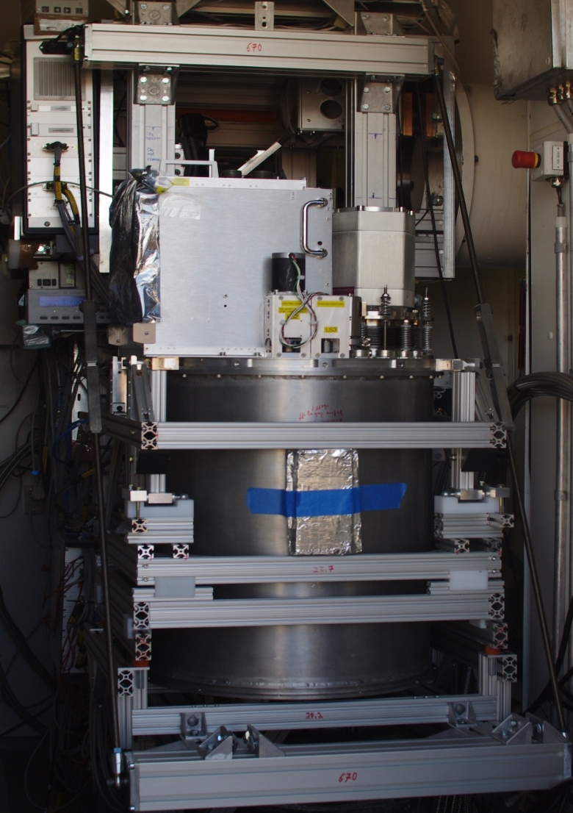
z(Redshift) & Early Universe Spectrometers
1st Generation (Hailey-Dunsheath 2009)
2nd Generation (Ferkinhoff 2014
Vishwas in prep)
Unique direct detection submillimeter grating spectrometers
200, 230, 290, 350, 450 645, 850 micron telluric windows. (350, 450 micron)
TES Bolometer Array (thermistor sensed bolometers)
Optimized for detection of lines from galaxies. R ~ 1000
ZEUS-1 on CSO
ZEUS-2 on APEX

Slide 9
1. What are the lines and what do we know locally?
Far-infrared fine-structure line studies of early galaxies:
Where are we?

Slide 10
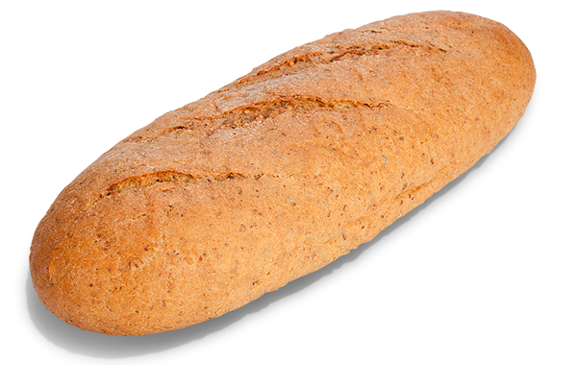
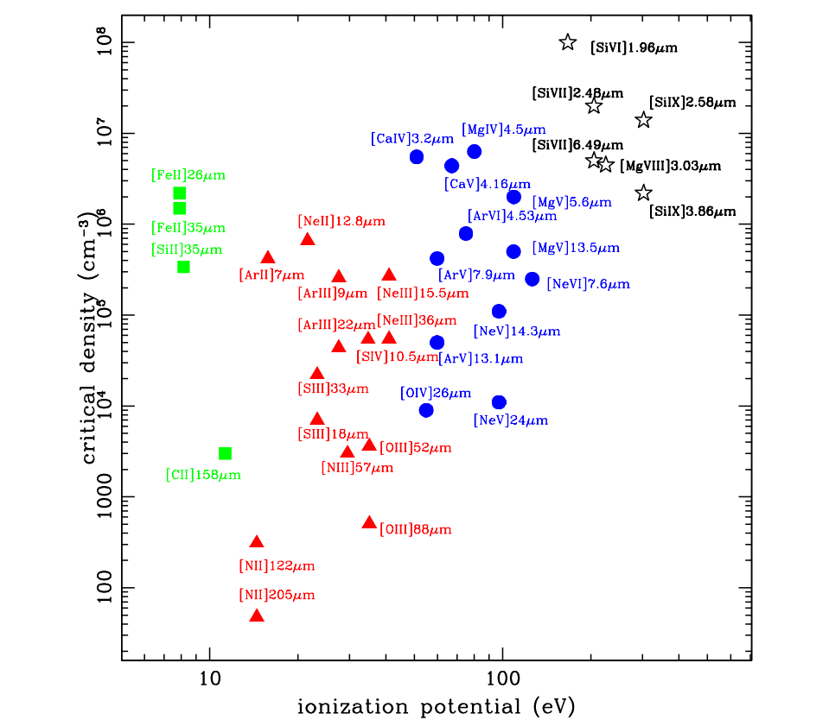
Far-IR Fine Structure Lines

Slide 11
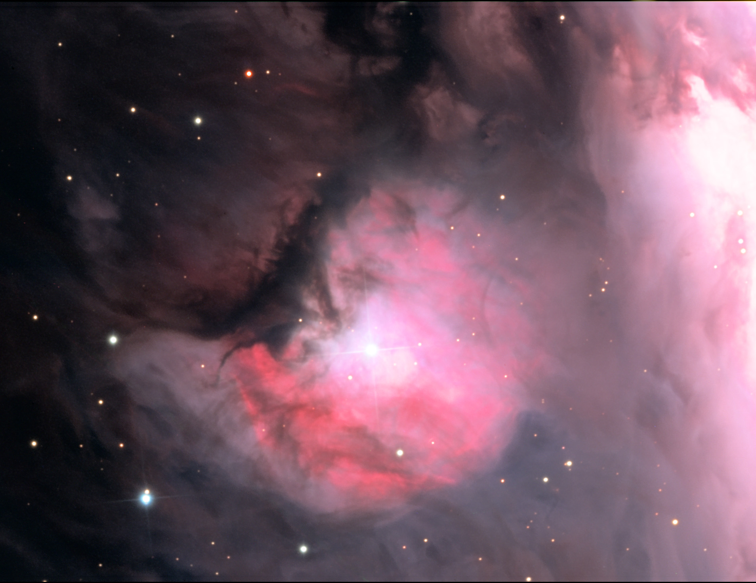
FIR
[OIII], [NII],
[NeII], [NeIII]
[SIII],[SIV]
ionized
[CII],[OI], [FeII],[SiII]
atomic
molecular
[CI], CO

Slide 12
Mid and Far-IR Fine-Structure lines
Atomic
HII
AGN
Emitted in low density limit
Low ionization potentials
Low energy emitting levels
Long wavelength
Bright!
Hardness of
ionizing radiation
N/O Abundance
Fraction of [CII]
from HII regions

Slide 13
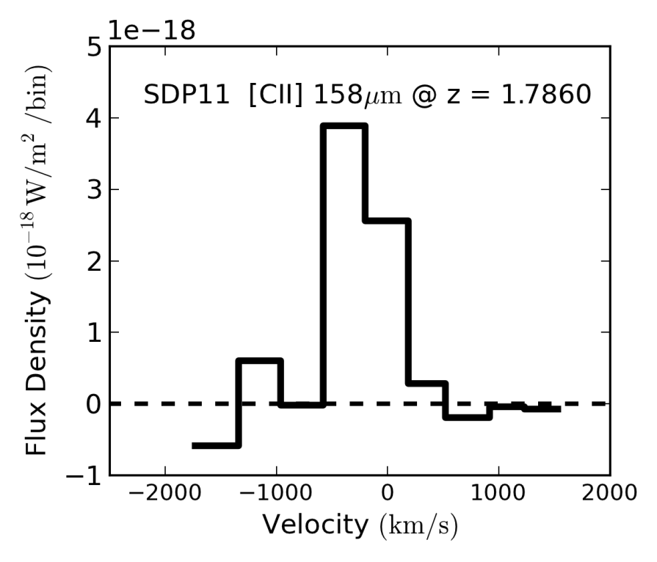
The same power
as the ENTIRE
Milky Way
Power emitted just
in the spectral line
is~3×10¹⁰ L
Notes:
ZEUS success include 3 firsts! The first extragalactice detection of 13CO(6-5) which is important for constraining the optical depth of CO emission, the frist detection of [CII] 158 micron line from a z ~ 1-2 galaxy that during the epoch were we believe SF rate in the universe peaked and the first dections of [OIII] 88 micron line from z > 0.05. Actually this detection is from z = 3.9 the same source Johannes showed us a GISMO detection of on Teusday and the 2nd detection was from z = 2.8. Working from this success of ZEUS it was proposed take advantage of maturing technology and push capilities further and that is how we got to ZEUS-2

Slide 14
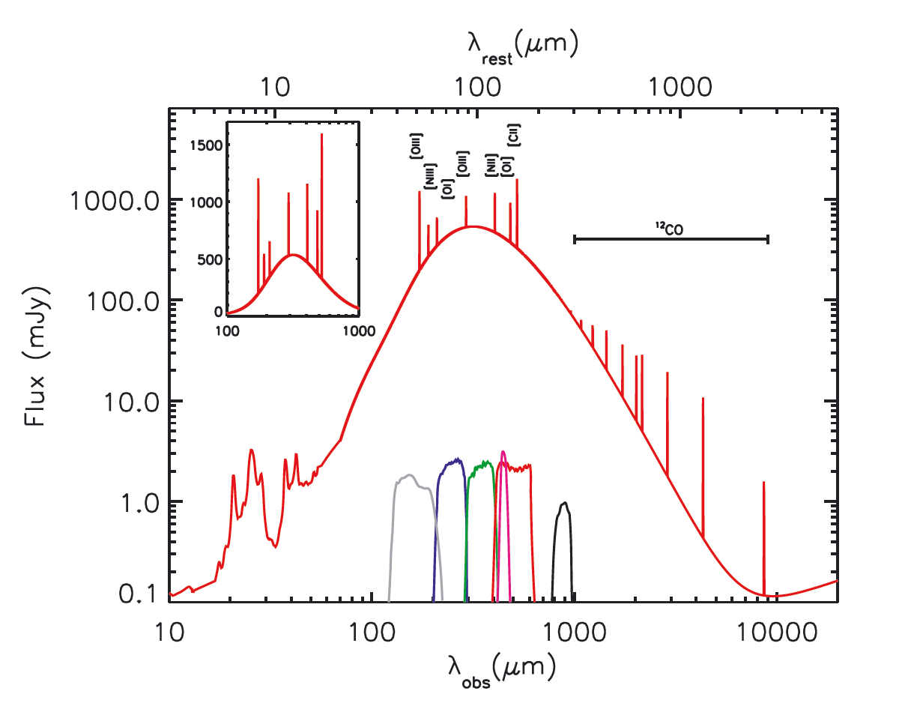
Model SED for SMMJ2135−0102 (z = 2.3259) based on observations

Slide 15
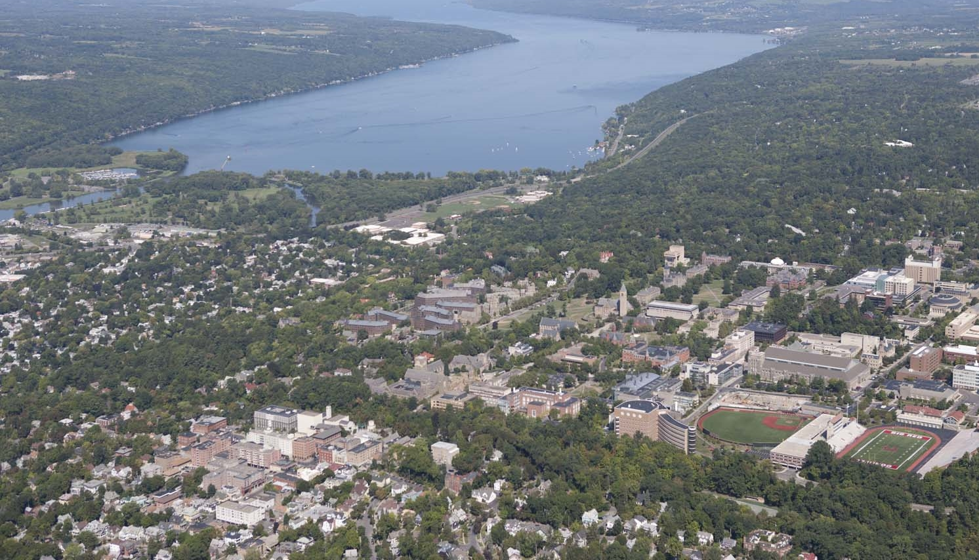
Just how bright is [CII] ?
[CII] Line: Burj Kahlifa
830 meters
~680 meters
Above Space Sciences!!!
Continuum: Ithaca, NY
120 meters

Slide 16
[CII]/CO(1-0)
~ 4100
Model SED for SMMJ2135−0102 (z = 2.3259) based on observations

Slide 17
[CII] Detections with ZEUS-1 & 2

Slide 18
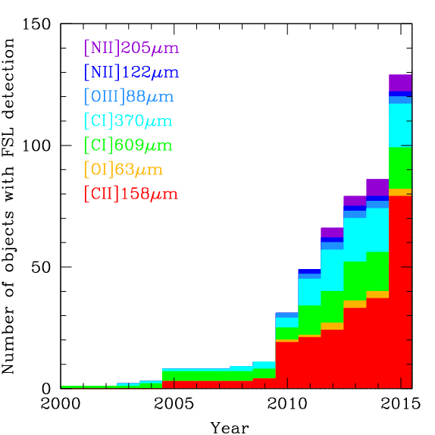
High-z detections of other far-IR fine structure lines?

Slide 19
3. What is there Beyond the [CII] 158 micron line?
Far-infrared fine-structure line studies of early galaxies:
Where do we need to go?

Slide 20
[OI] 63 micron Line
Highest redshift detections of the

Slide 21
[OI] Compliments [CII]
Arises in PDR
Traces higher density and radiation fields
Combined with [CII] provides a unique solution to PDR properties

Slide 22
High-z observations
[OI]/FIR shows similar variation
Until recently, limited to z < 2.3

Slide 23
[OI] at z ~ 4.6
ZEUS-2/APEX Detection
W2246-0526
WISE HotDOG
Highest redshift detection.
~2 hours on source
20x brighter than [CII]

Slide 24
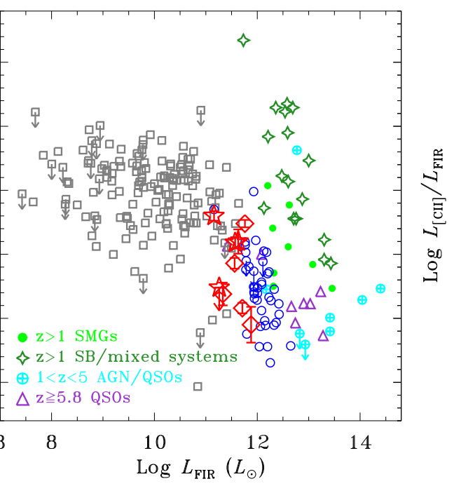
z~6 QSO
ALMA proposal
Target [OI] 63 micron
Existing [CII] observations
Better understand nature of star-formation < 1 billion years after Big Bang
P036
J2310
J2045

Slide 25
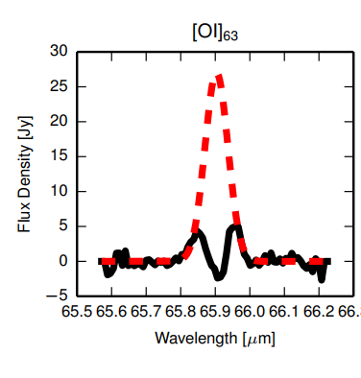
[OI] in SDSSJ2054 at z ~6
ULIRG
IRAS F17207–0014, Rosenberg et al. 2015
New Record!
Observed March 2017
ALMA Band-9
Outflow’s or absorption in [OI]?

Slide 28
4. What can multi-wavelength studies reveal?
Far-infrared fine-structure line studies of early galaxies:
Where do we need to go?

Slide 29
When & how was the universe enriched with metals?
But optical metallicity indicators have degeneracies and are absorbed by dust, so using them high-z is a challenge.

Slide 30
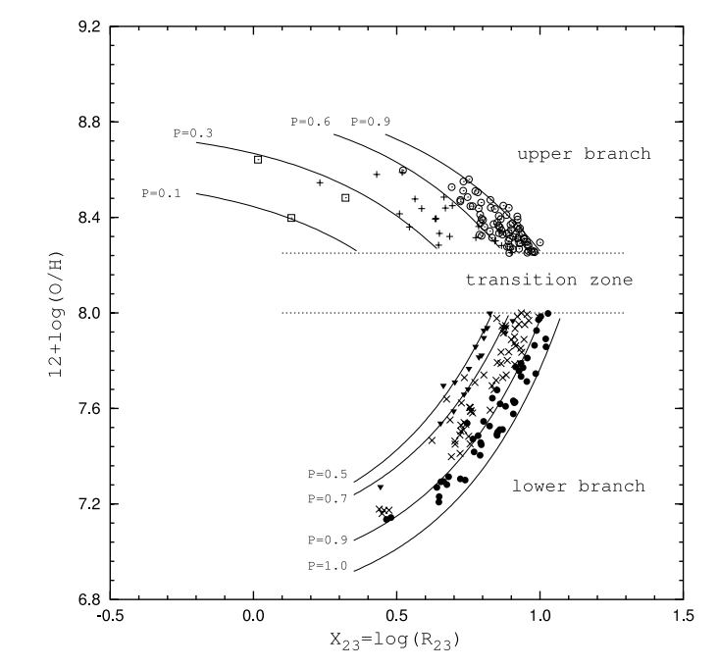
A. Optical diagnostics have significant degeneracies!
R₂₃ optical diagnostic
Ratio of to optical ([OII]+[OIII])/ Hβ
Double valued
Strong excitation effects

Slide 31
B. Huge variation between different optical tracers!
~0.7 dex variation between indicators
Can be corrected for nearby galaxies
Difficult for high-z systems, many unknowns
Is it a true “absolute” measurement?

Slide 32
Use [OIII] 88 to constrain temperature

Slide 33
Optical lines are absorbed by dust.

Slide 34
Mid & Far-IR Metallicity Indicators

Slide 35
NextGen FIR Mission
Cryogenic ~8-15 meter aperture
Utilize the mid- and far-IR fine structure lines

Slide 36
OST sensitivity will be transformative

Slide 37
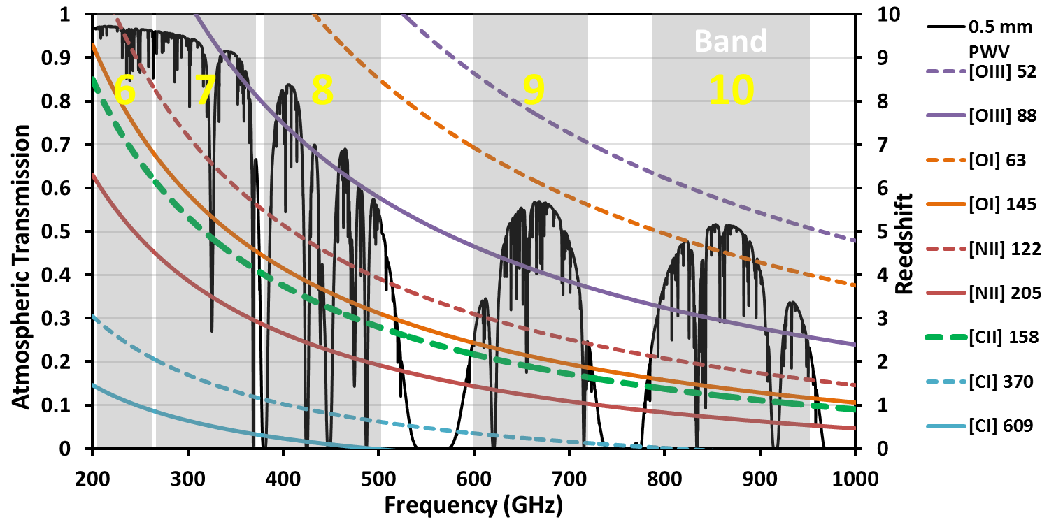
All sources at high-z have 1 or 2 lines accessible, and many have 3, but very few with >4

Slide 38
Ne/S and O/N are relative abundances

Slide 39
Thermal free-free radio continuum
Combined with [NII] 122 micron line.

Slide 40
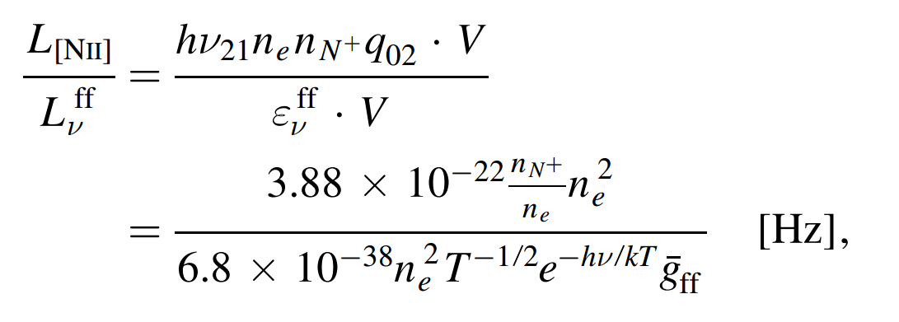
What does the ratio of [NII] 122 micron to Free-Free emission depend on?
~Gas phase nitrogen abundance

Slide 41
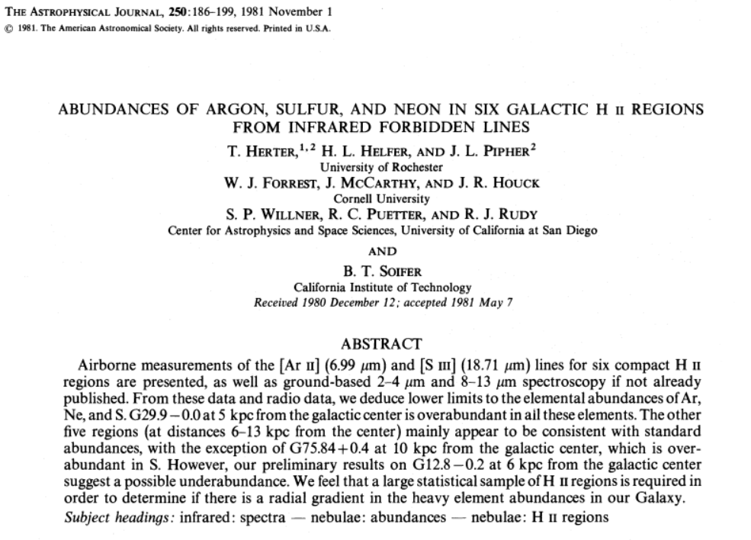

Slide 42
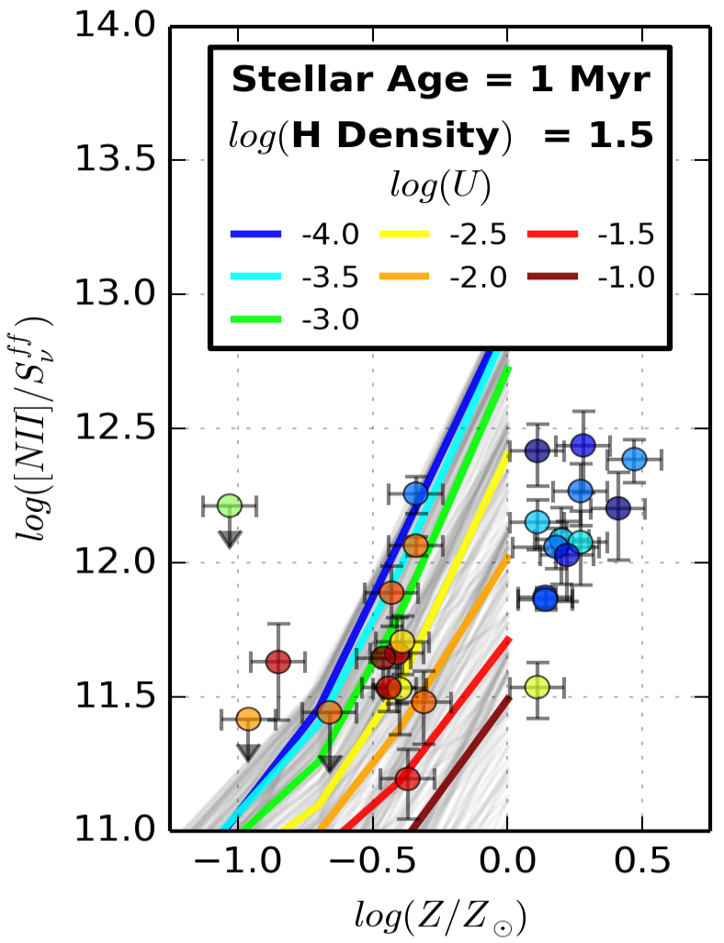
From data & models . . .
Points (Colored by [OIII] 88/[NII] 122 ratio)
Fine structure data from Brauher et al. 2008, Cormier et al. 2015
Radio: 5 GHz observations from literature, assuming ~30% arrises from Free-Free
[O/H]: From Cormier et al. 2015 and literature
Lines (Cloud Models)
Grid of stellar ages, densities, ionization parameters (U) and metallicities.
Models the ionized, atomic and molecular phase

Slide 43
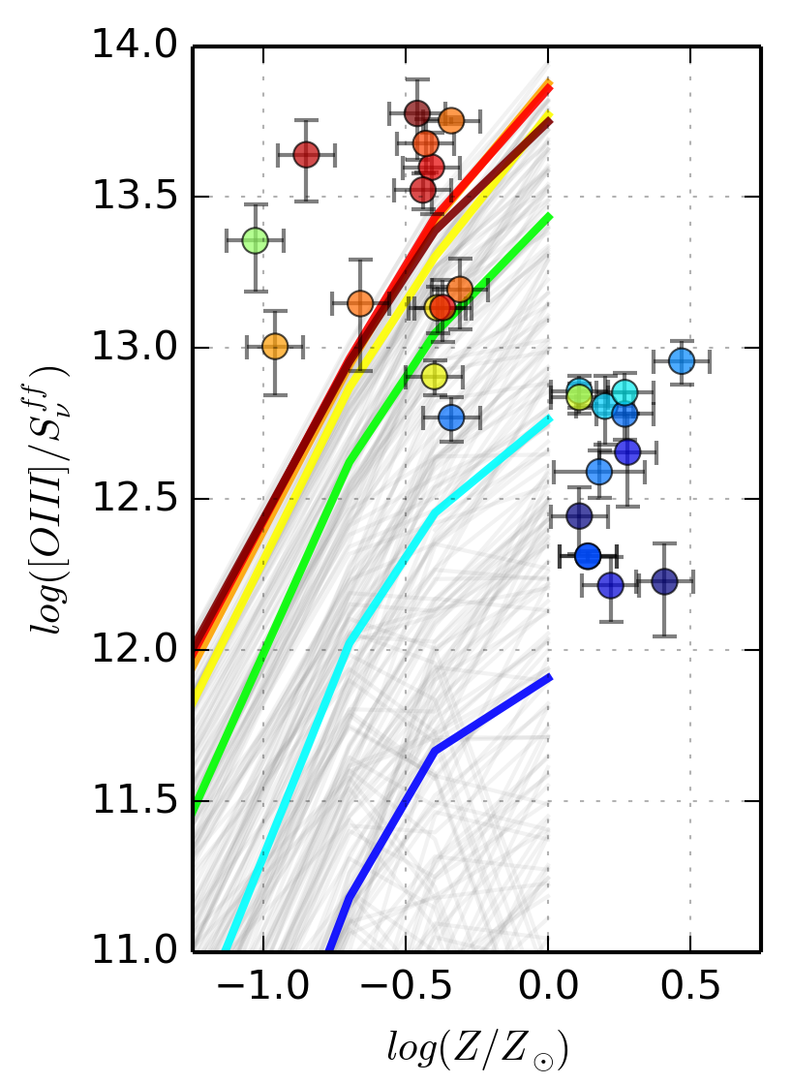
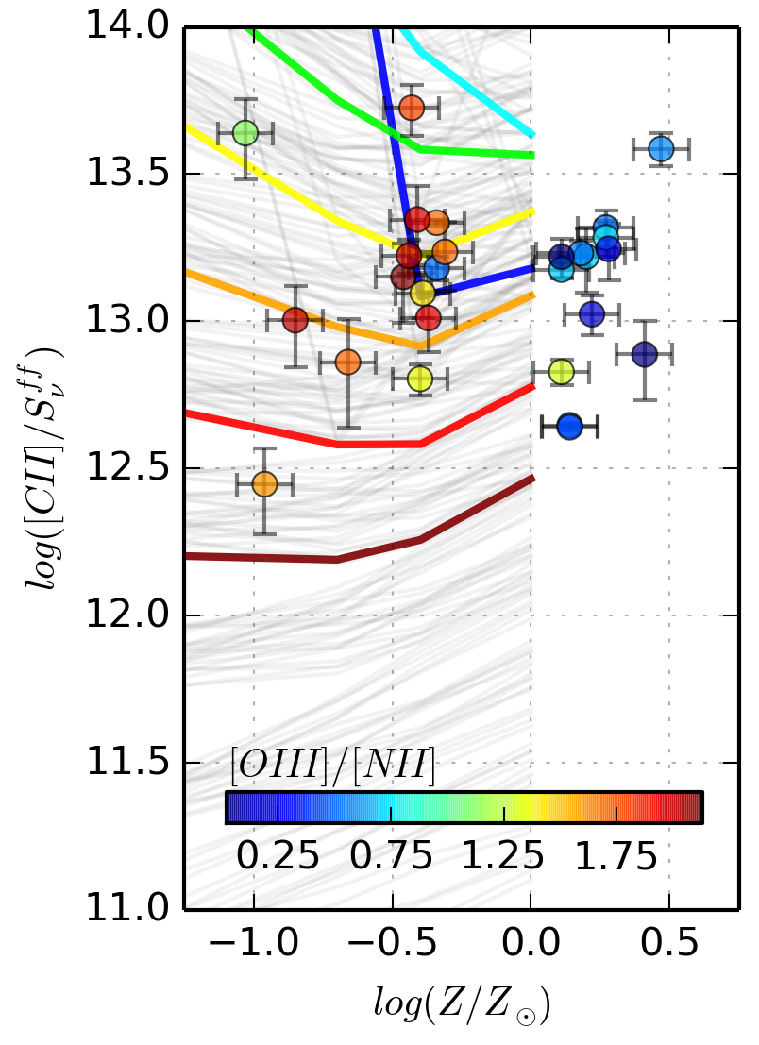
. . . we find . . .
[NII]/FF has strong dependence on metallicity
[OIII]/FF is dominated by stellar age and U
[CII]/FF traces the ionization parameter, U

Slide 44
ZINGRS Radio Survey

Slide 45
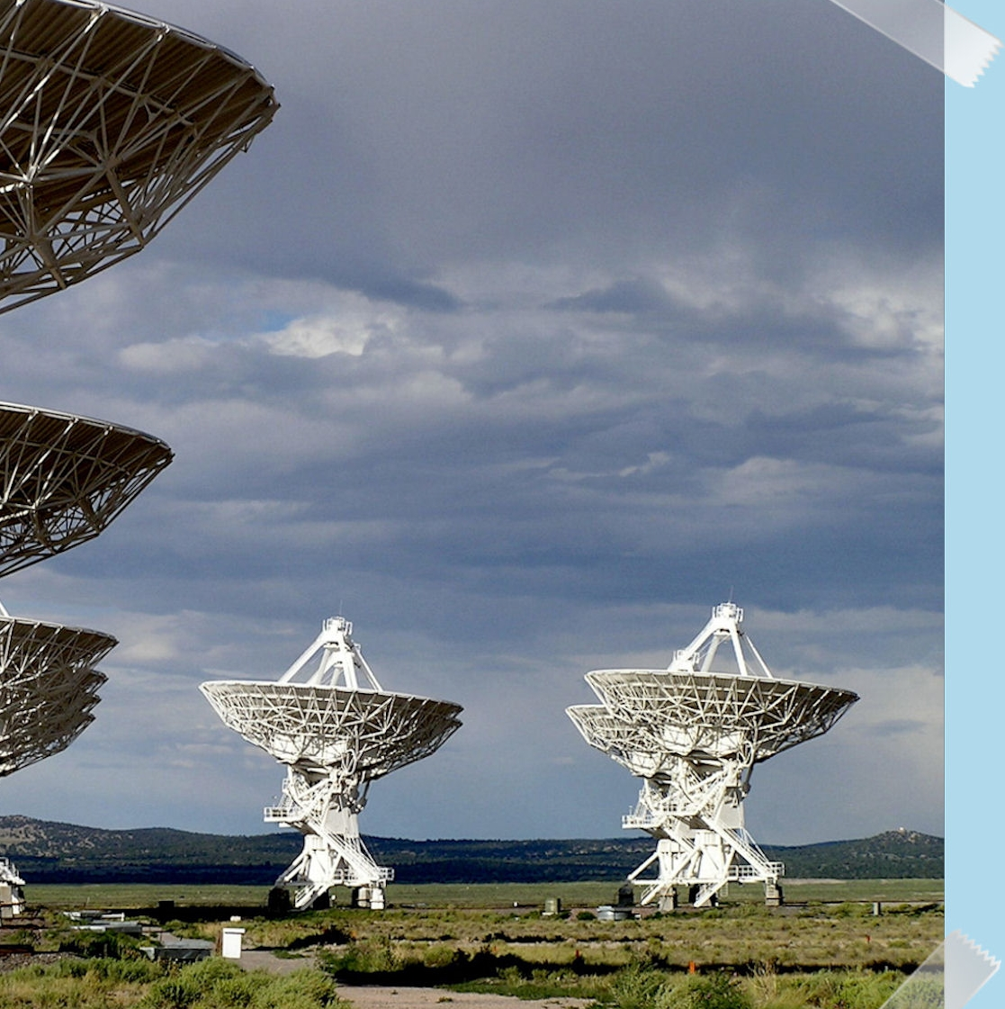
ZINGRS RADIO SURVEY
On going (~80 hours) JVLA program to observe radio continuum in ZINGRS
ZEUS 1 & 2 INestigated Galaxy Reference Sample
C and Ku band radio continuum observations of in ~30 galaxies at z ~ 1-4.6
Provide rest frame 12-24 GHz and 30 - 60 GHz detections to decompose Free-Free from non-thermal
Goal: Demonstrate use of diagnostic for studying metallicity at high-z and better understand radio continuum at high-z

Slide 46
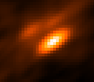
Preliminary Results: HLS0455
JVLA C-Band
z =2.927
ULIRG from Hershel Lensing Survey
4x magnification
ZINGRS:
[OIII] 88: 3.7 x 10⁻¹⁸ W m⁻²
[NII] 122: 1.9 x 10⁻¹⁸ W m⁻²
Radio Survey:
430 µJy (Main), 240 µJy (NE)
1 “
Image: Spitzer 3.6 micron (30” square)
Contours: Scuba 850 micron (green) and AzTEC 1.1 mm (red) in 1.5 sigma

Slide 47
Initial Results from HLS 0455
If from main component, > 4 Myr starburst with low metallicity
If from NE component, need > 2 Myr stellar population, and solar metallicity
Notes:
Oi/cii in w2246 20 +/- 9
W2246 83.9 +/- 9.9 uJy
companion? or field object :34.9 +/- 5.5 uJy
CII luminosity is 6.1 x 10^9
Oi is 3x10^-18
[CII]/ff = 11.24 to 11.74, which requires very high hydrogen densities 10^3 /cm^3 or higher, which is consistent with the very strong [OI] emission we have detected from the source.
Oiii is 3.6 x 10_18 W/m^2
[OIII]/ff = 12.6 to 13
HLS0433 = 3.7 x 10^-18 W m^2
FF = main component 490 uJy
NE = 233 uJy
{oiii/ff = 11.87 to 11.35 main
Oiii/ff – 12.2 to 11.6 if NE component

Slide 48
Far-infrared fine-structure line studies of early galaxies:
Where do we need to go?
Need to move beyond the [CII] line to oxygen and nitrogen lines for high-z studies to probe stellar populations, ionized gas, and metallicities.
[OI] 63 micron observations are capable with ALMA at < 1 billion years after the Big Bang
Consider other observations (like radio continuum) that combined with the fine-structure lines can provide new diagnostic.
[NII] and Radio continuum can be used as a metallicity tracers and the ZINGRS radio survey is performing the initial tests at high-z

Slide 49
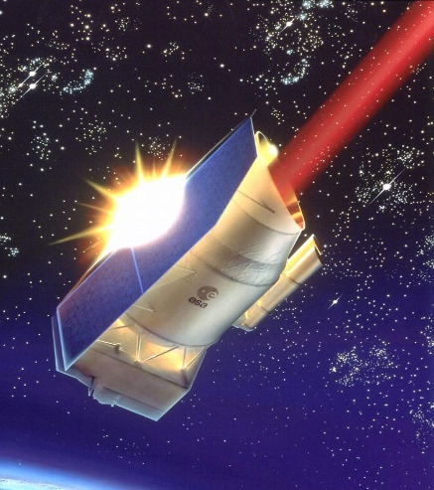
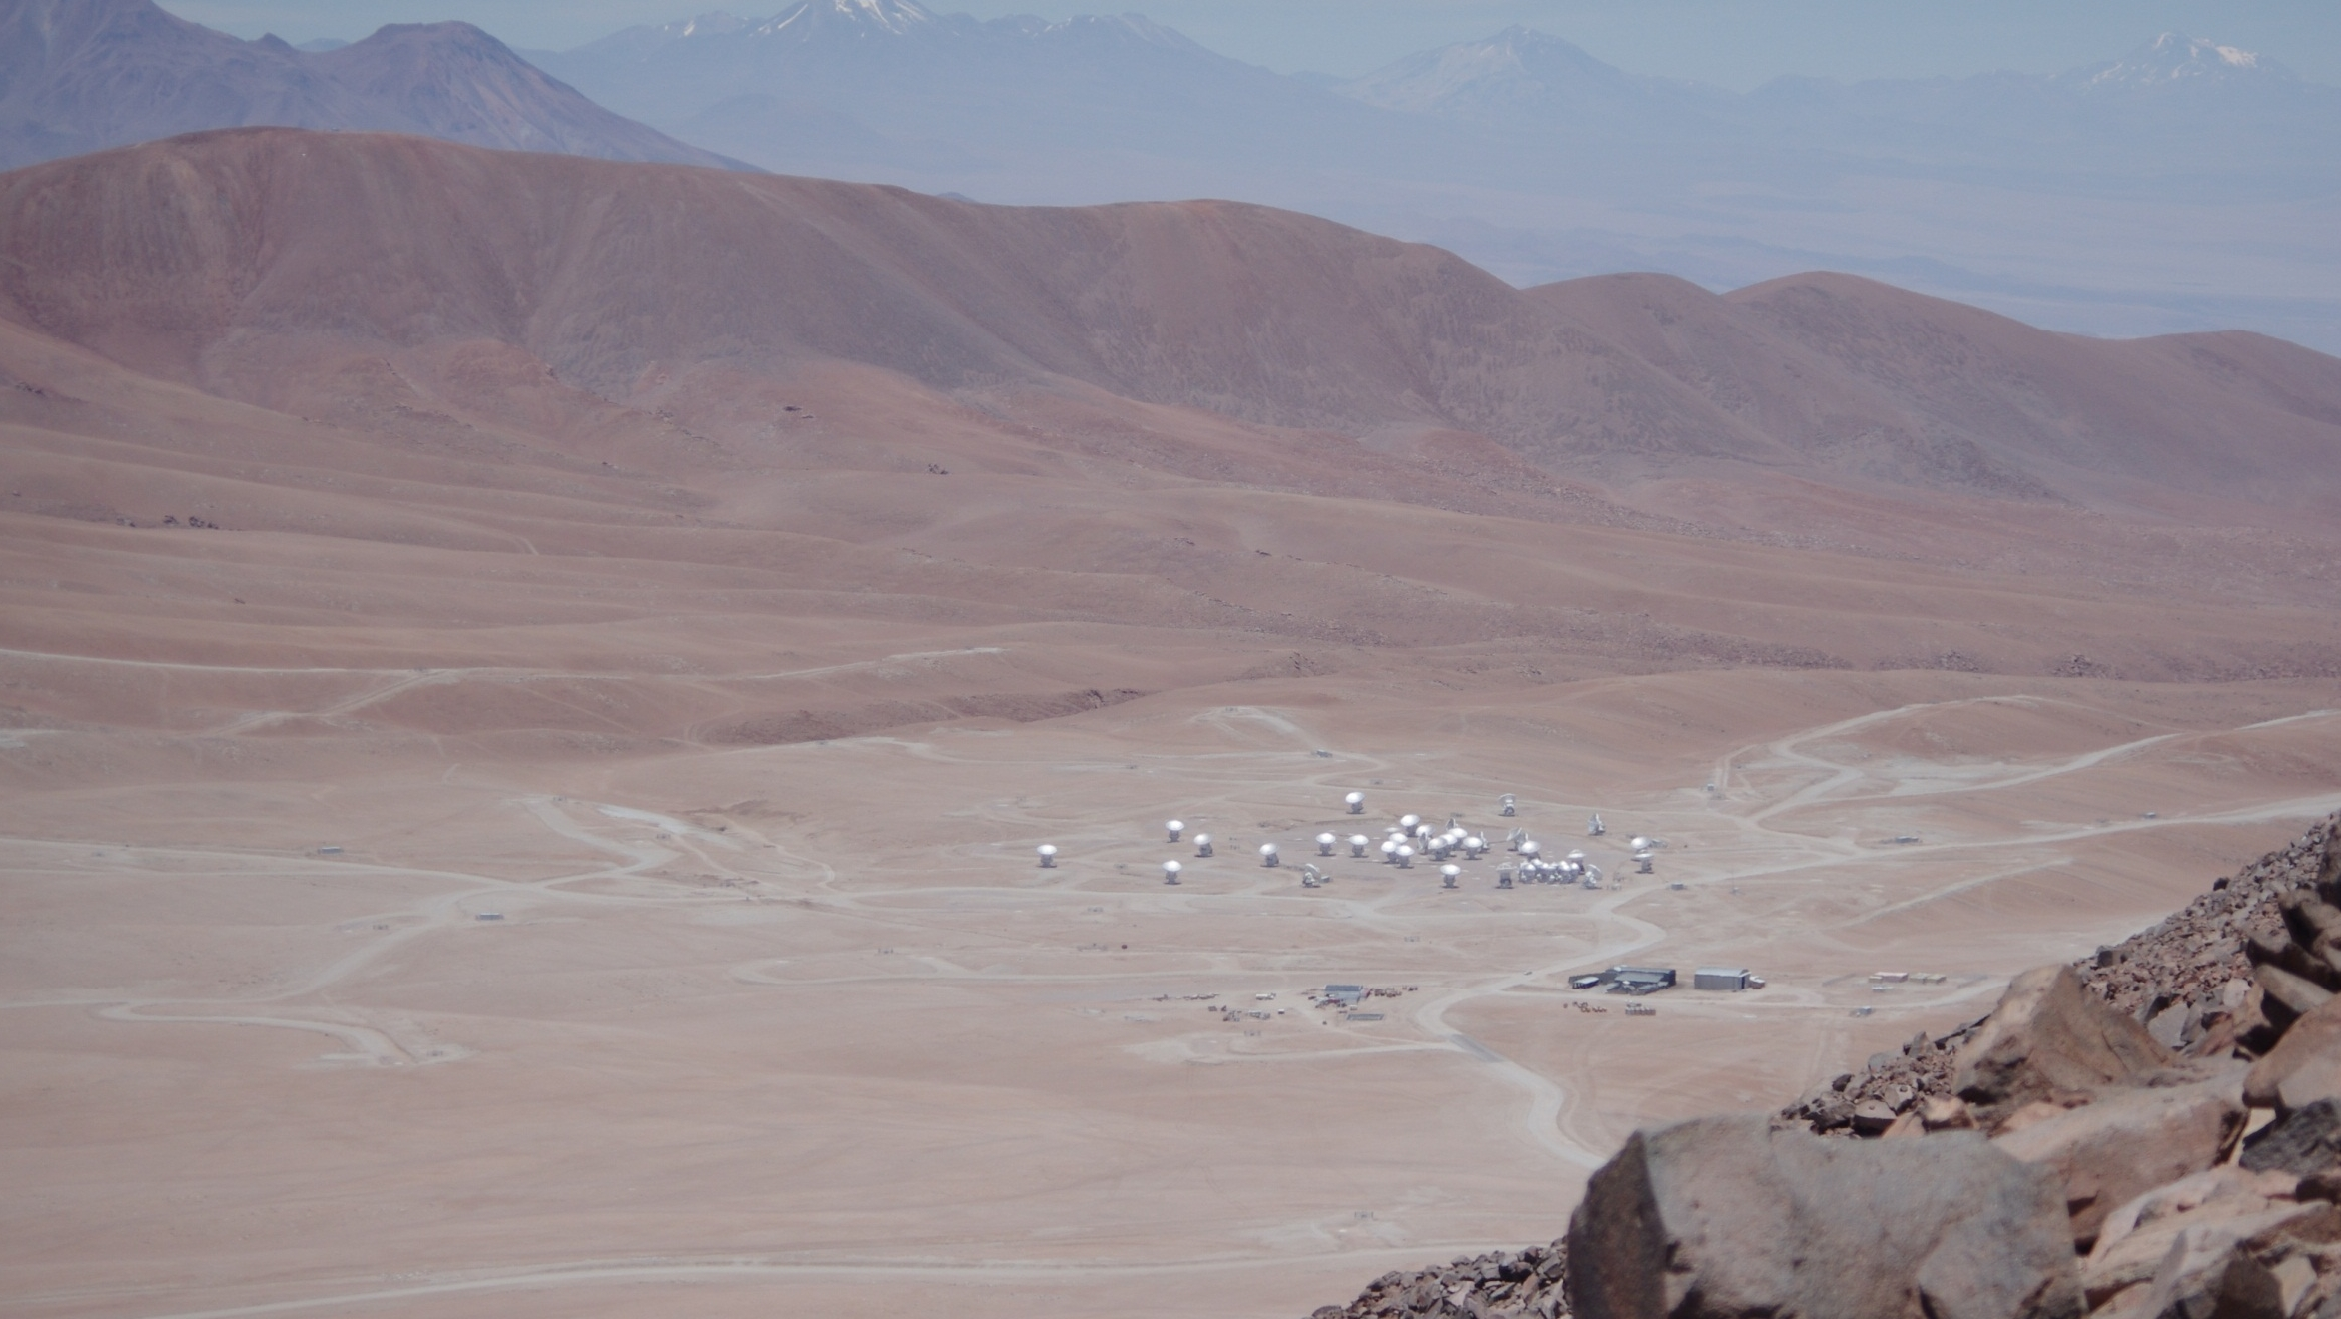
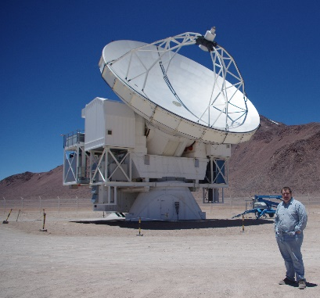
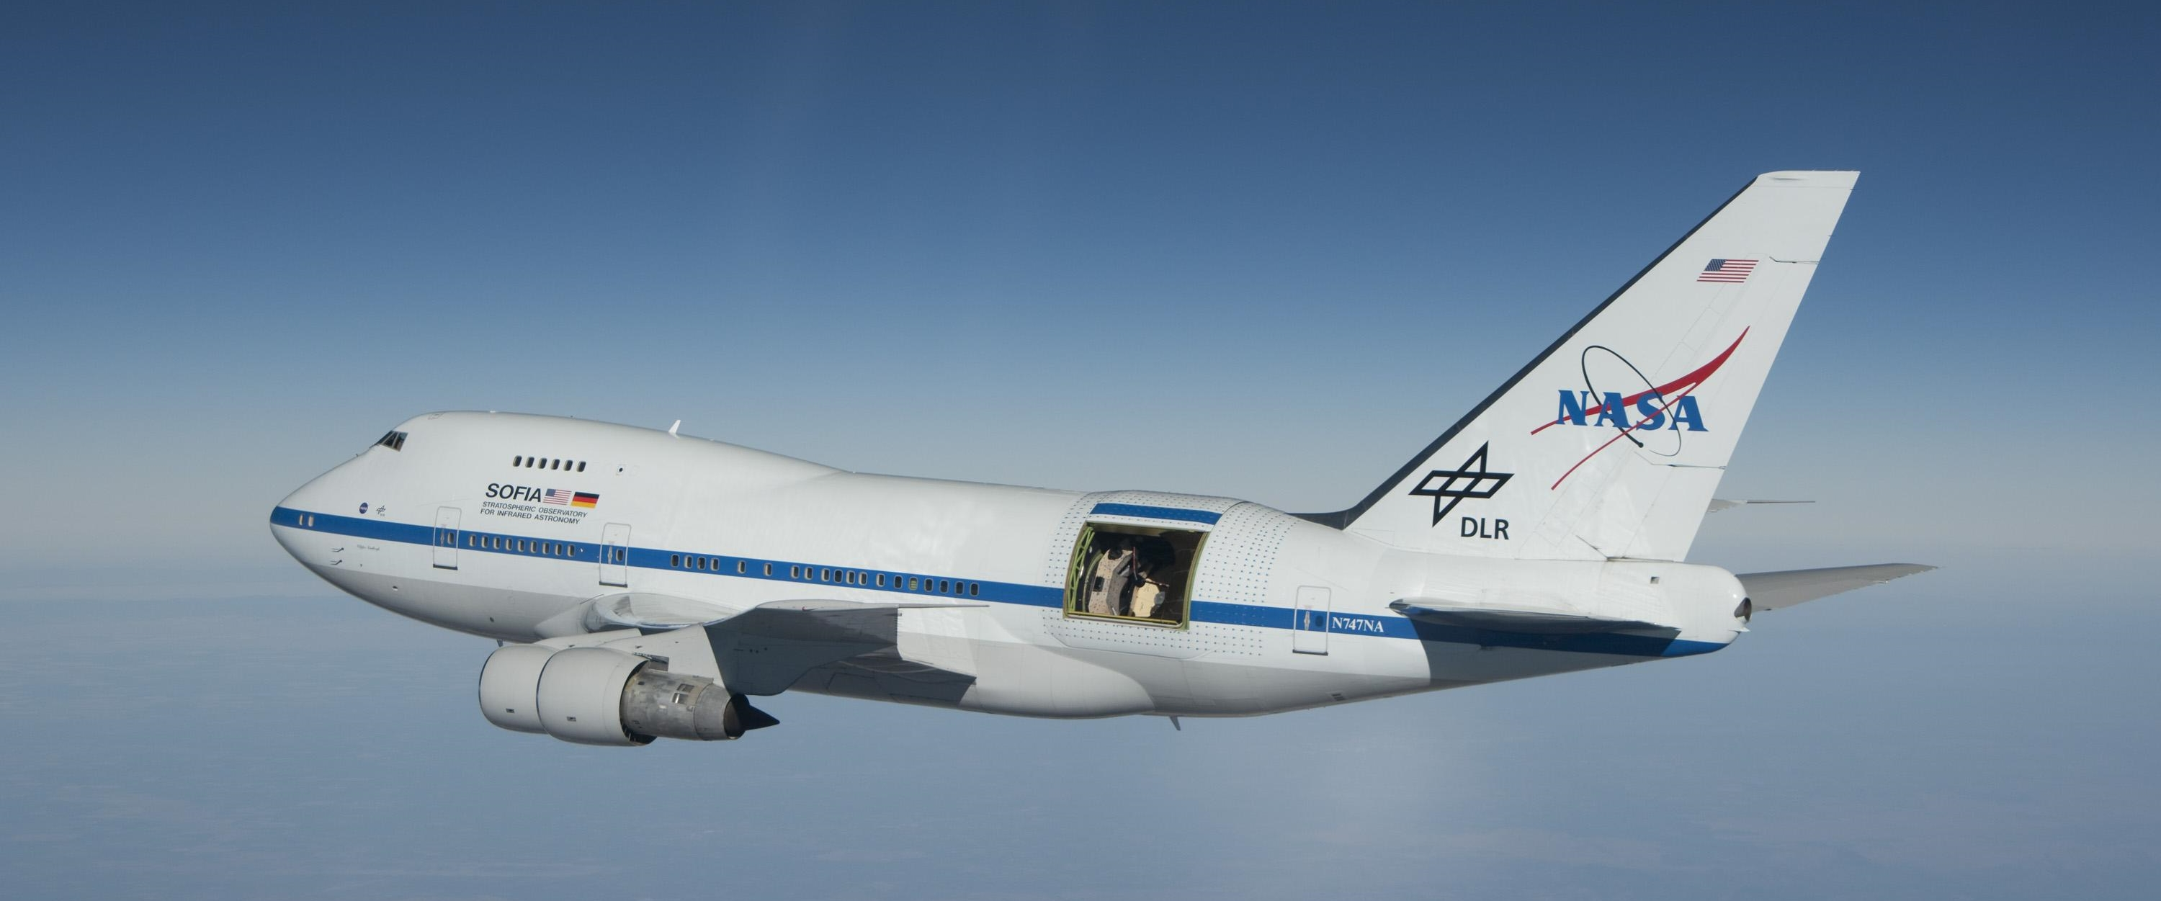
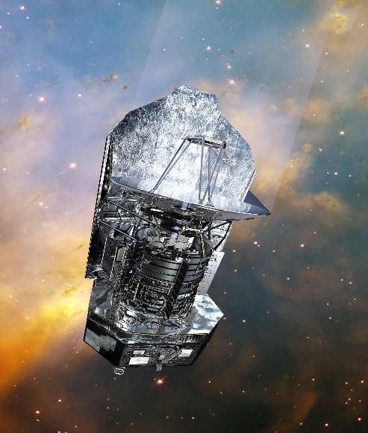
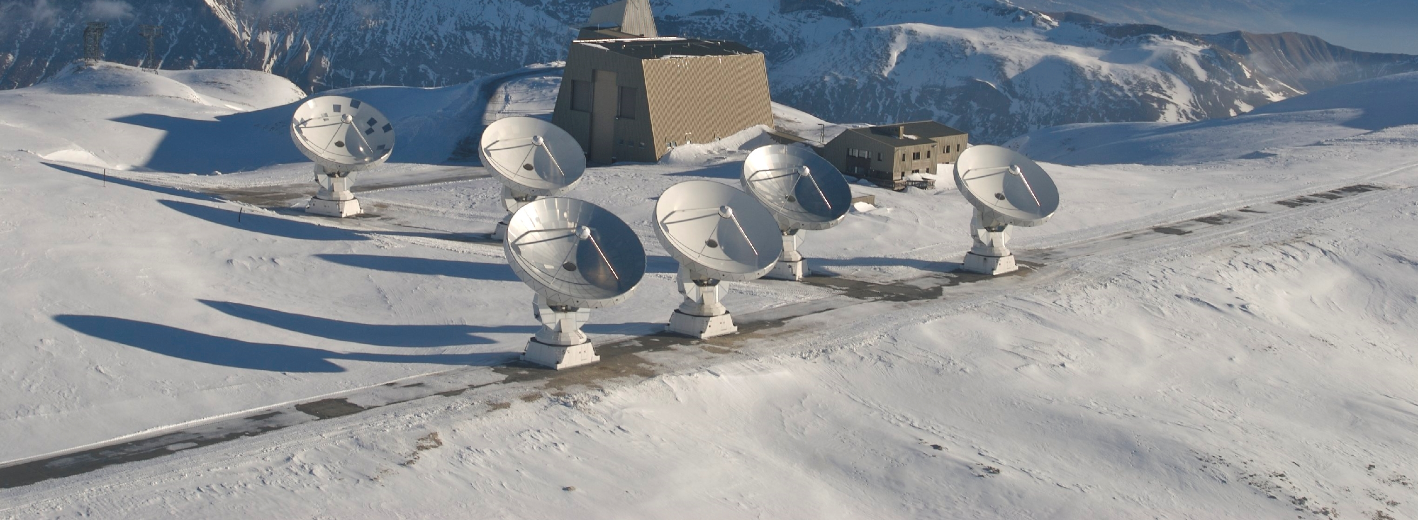
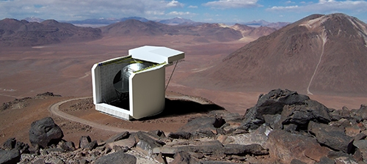
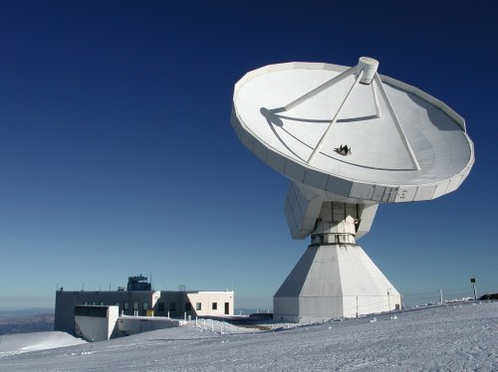
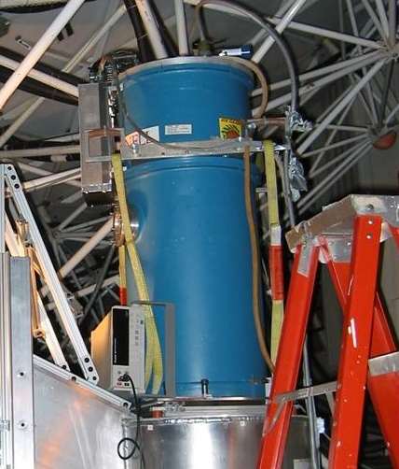
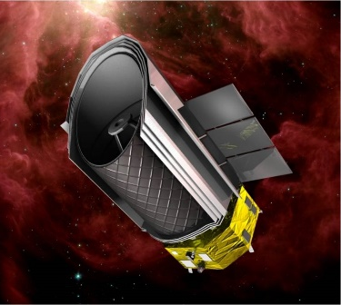
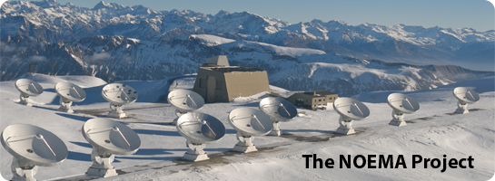
Learjet
SMA
In past 40 years until today we have made great progress.
it is exciting to see where we will be in the next 40 years
KAO
ISO
KAO
Sofia
ZEUS2
APEX
PdBI
Herschel
CCAT
ZEUS-1/CSO
30m
NOEMA
Questions?
SPICA

Slide 50
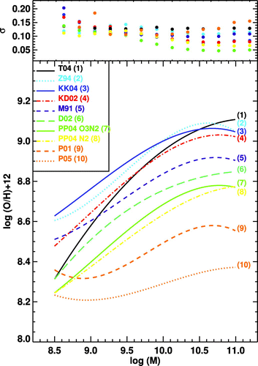
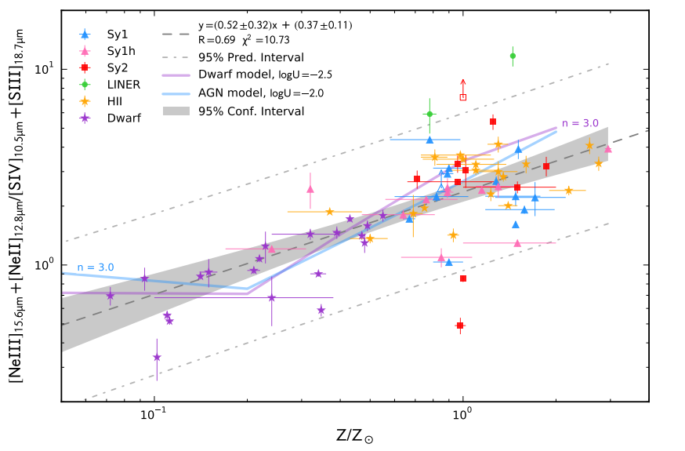
The Rise of Metals
Tracing the metal enrichment history of the Universe
At what rate was the Universe enriched with metals? In what types of galaxies did the bulk of this enrichment happen? When were galaxies suitably enriched to support the development of life?
The mid- and far-IR fine structure lines do not suffer from dust extinction or the degeneracies of common optical indicators. A survey of the IR lines in thousands of galaxies from 1 < z < 8 with OST will accurately trace the rise of metals across cosmic time.
Mid-IR Ne and S abundance indicator for OST vs optical metallicities (Fernández-Ontiveros +16). The IR indicators can accurately trace metal abundance from 0.05-3x Solar values.
Mass-metallicity relation (Kewley +08) for ten optical O/H indicators. Note the 0.7 dex variation. The mid- & far-IR indicators do not exhibit this large a variation, providing a more robust metallicity measure.

