Slide 1
The Dynamic Infrared Sky
Mansi M. Kasliwal
California Institute of Technology

Slide 2
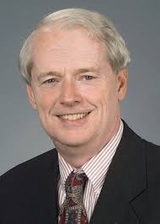
Professor James R. Houck
1940 - 2015

Slide 3
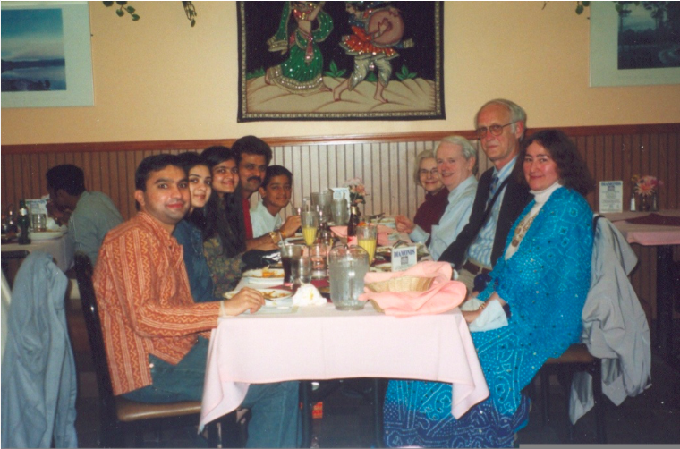

Slide 4
The Dynamic Infrared Sky
is Pristine

Slide 5
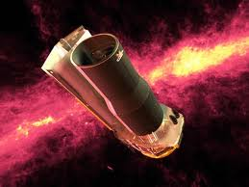
SPIRITS:
SPitzer InfraRed Intensive Transients Survey
Cycles 10-14 (5 years):
194 Galaxies x 12 epochs
1410 hours of Spitzer mid-IR
Every Year:
110 nights of near-IR imaging
66 nights of optical imaging
33 nights of spectroscopy
Gap?
40+ transients/year
1200+ variables

Slide 6
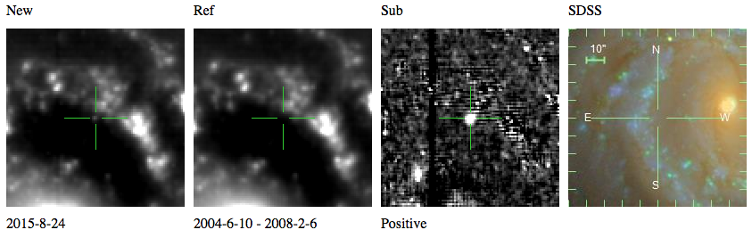
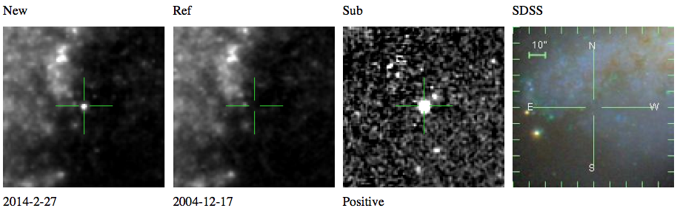
40+ infrared transients annually
(21 supernovae, 4 novae, 15 mysteries)

Slide 7
Cold: Nothing in Optical
Optical
Upper limits
from Keck &
Hubble
Kasliwal et al. 2017a

Slide 8
Kasliwal et al. 2017a

Slide 9
Kasliwal et al. 2017a

Slide 10
Kasliwal et al. 2017a

Slide 11
What are SPRITEs?
Formation of a Massive Star binary
Stellar Mergers
Extinguished Supernovae
Birth of Stellar-mass Black Holes
e-capture Supernovae in extreme AGB stars

Slide 12
“Spectrum is Truth”: SPIRITS14ajc
Kasliwal et al. 2017a

Slide 13
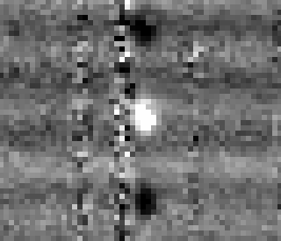
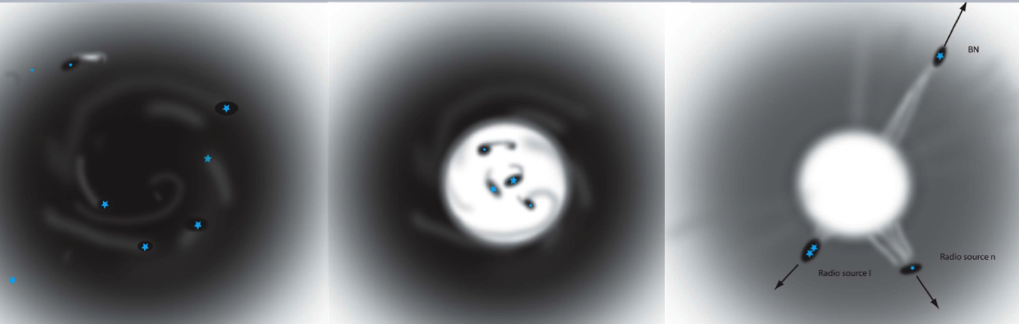
I. A slow SPRITE:
SPIRITS14ajc in M83
Shock-Excited Molecular Hydrogen Emission!!
Kasliwal et al. 2017a
Birth of a massive star binary?
Supernova behind molecular cloud??

Slide 14
“Spectrum is Truth”: SPIRITS15c
Jencson et al. 2016

Slide 15
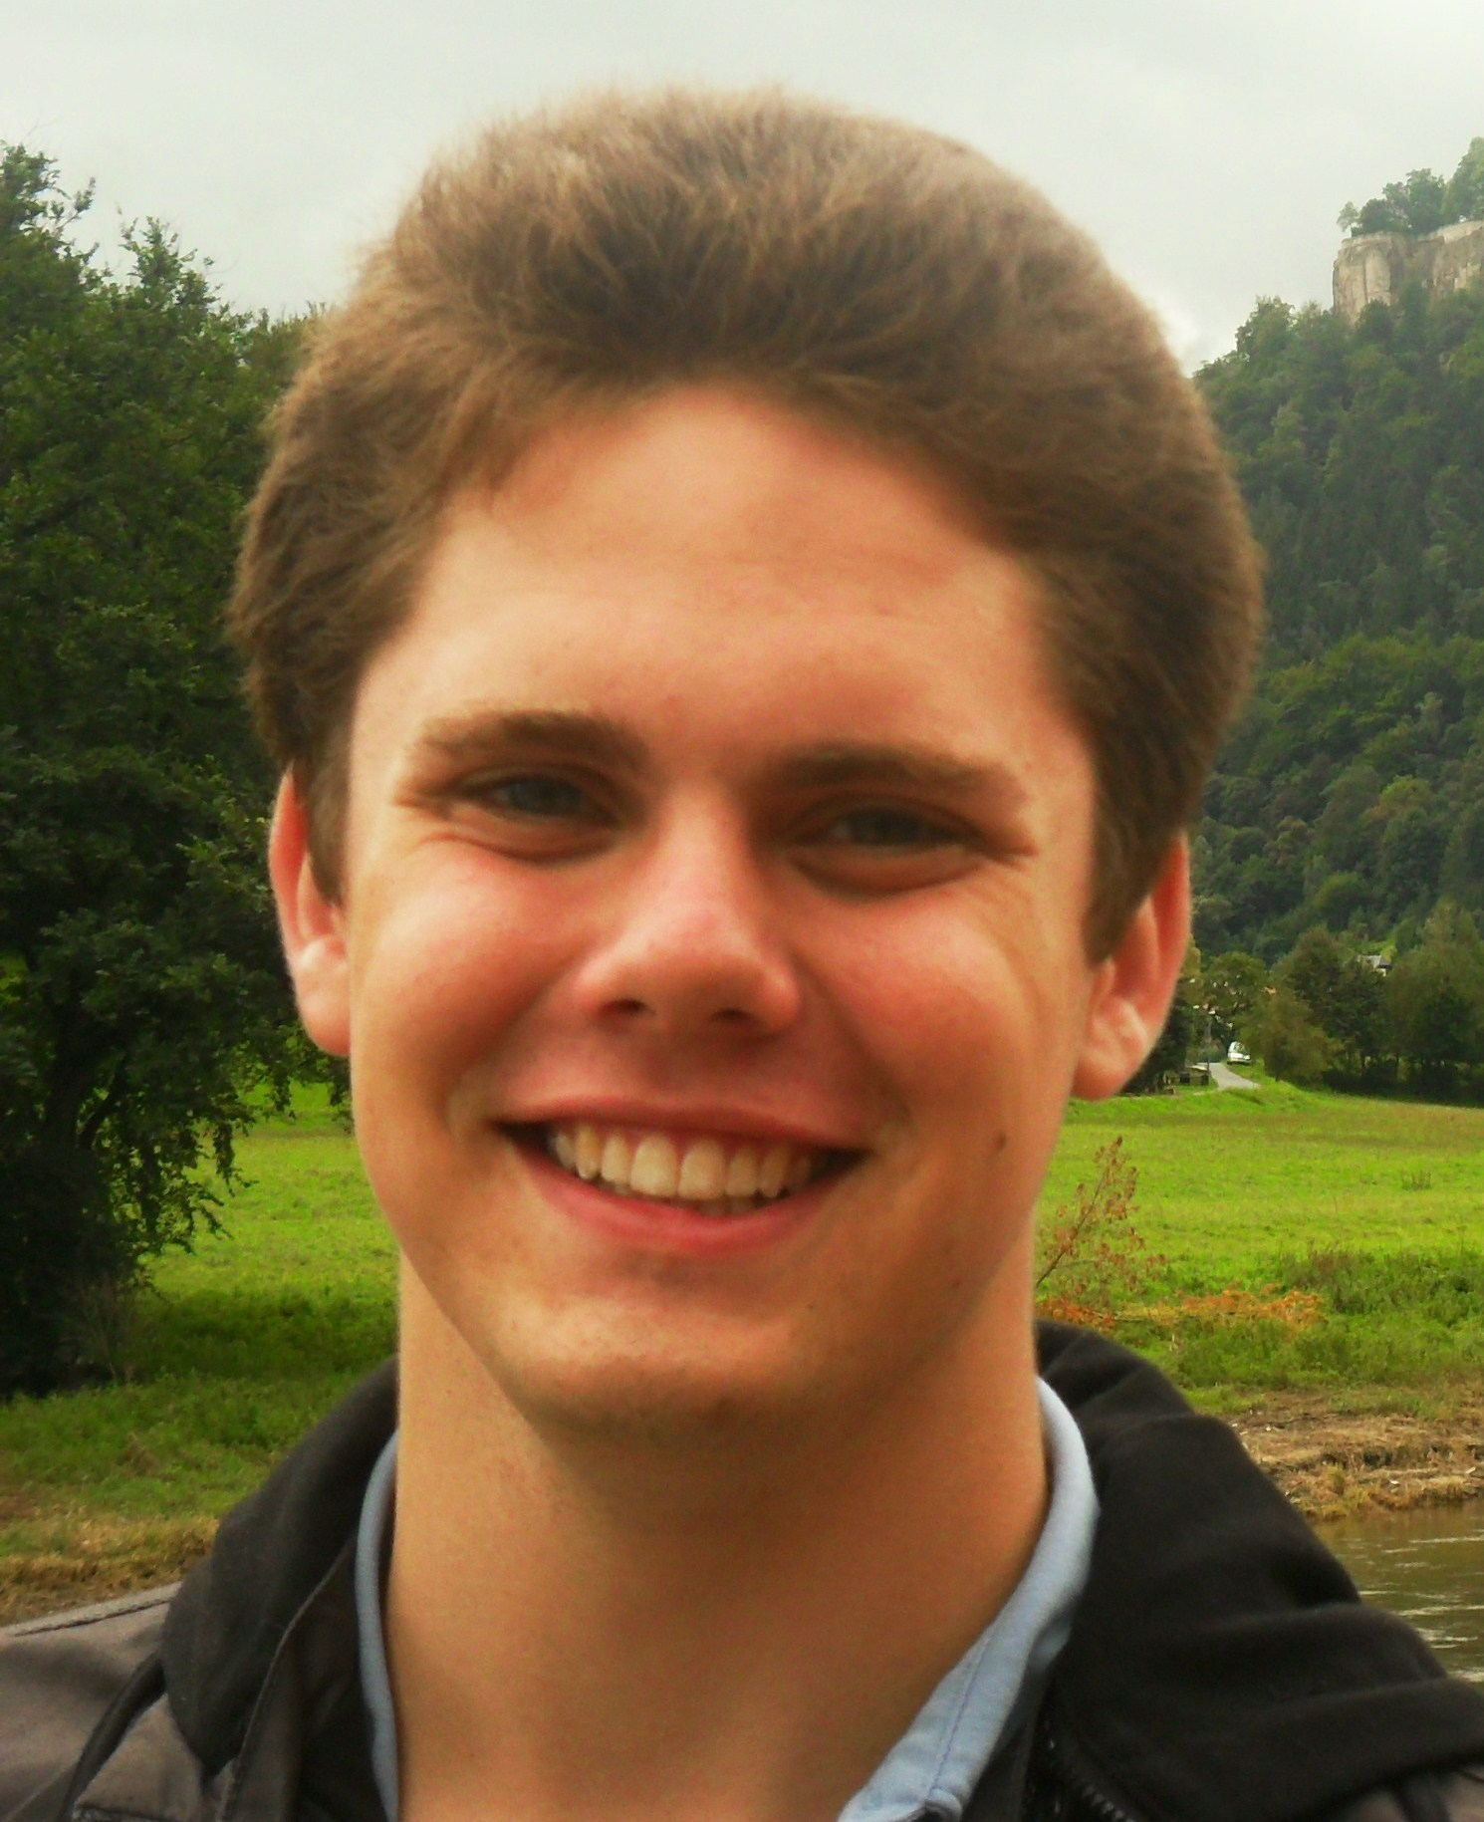
II. Extinguished Supernovae
Jacob Jencson
(Grad, PhDT)
Jencson et al. 2016, 2017

Slide 16

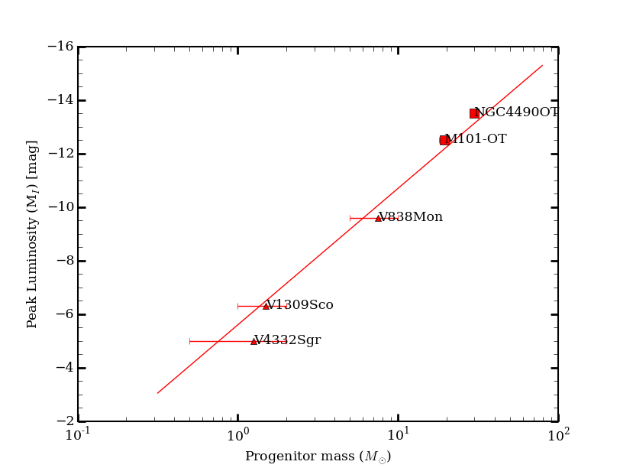
III. Stellar Mergers:
Luminosity-Mass Correlation
Nadia Blagorodnova
Smith et al. 2016
Blagorodnova et al. 2016
Correlation from
Kochanek et al. 2014

Slide 17
EM-GW: Neutron Star Mergers
Kasliwal et al. 2017b

Slide 18
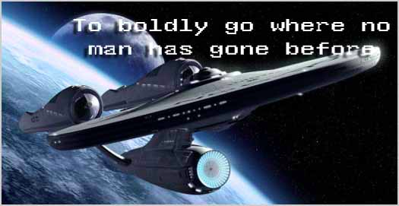
The Dynamic Infrared Sky
Is Ripe for Exploration!

Slide 19
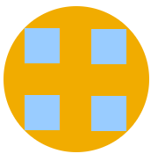
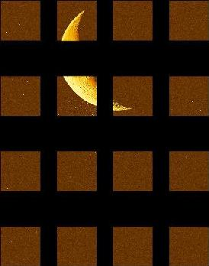
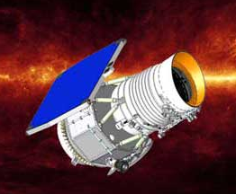


No Wide-Field IR cameras?
Space
WISE
WFCAM on UKIRT
0.2 deg² on 4m
VIRCAM on VISTA
0.6 deg² on 4m
WIRCAM on CFH
0.13 deg² on 4m

Slide 20
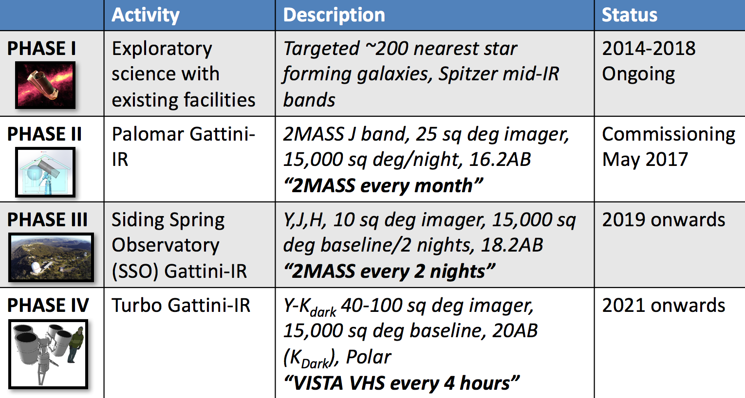
I have a dream…

Slide 21
Palomar Gattini-IR:
Commissioning Fall 2017
With
Anna
Moore
(ANU)
15,000 sq deg in J-band every night to 16.2 mag.

Slide 22
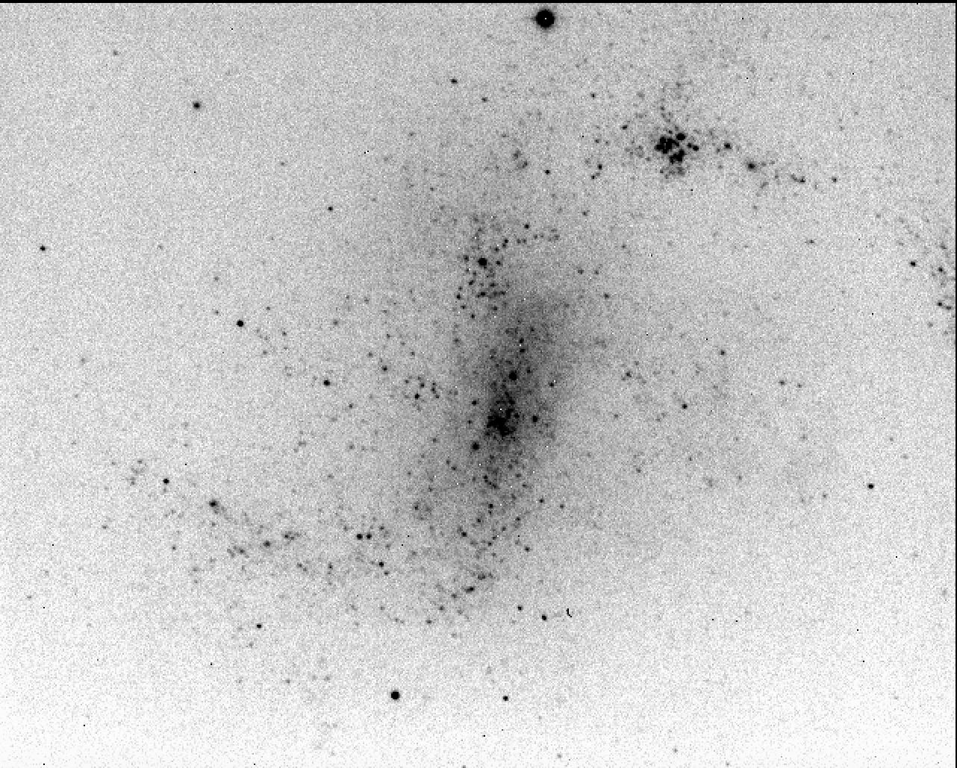
Alternative Semiconductors: Effort Led by Rob Simcoe (MIT)
Simcoe, MMK et al. 2017 in prep
Successful On-Sky Test!

Slide 23
A 100 deg² infrared camera on the South Pole!

Slide 24
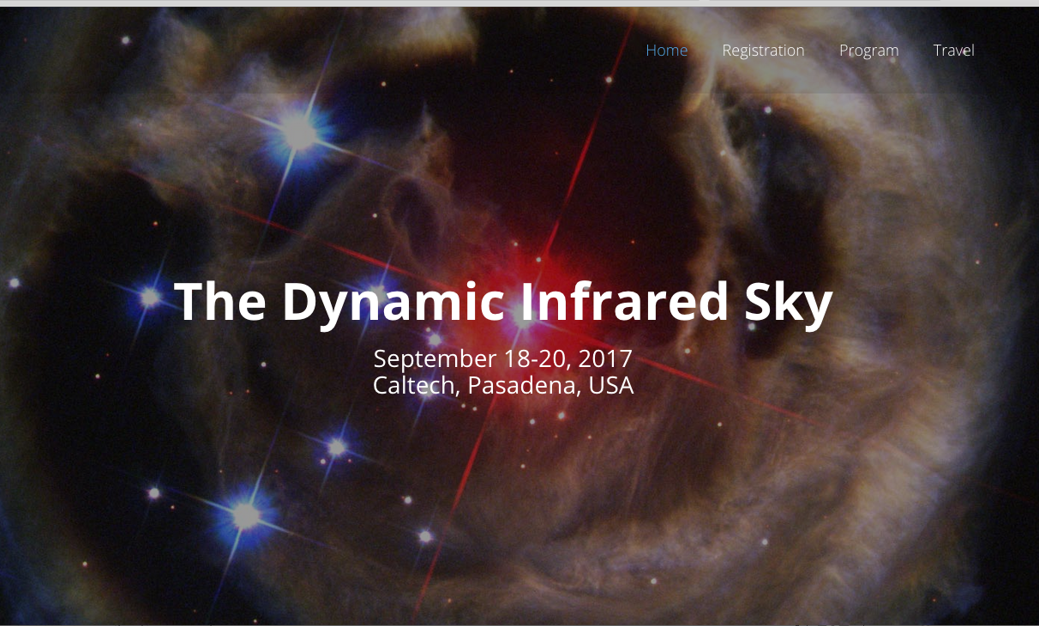
Workshop: Cool ideas welcome!
Please
let me know
if you are interested in joining us!

Slide 25

Thank You

Slide 26
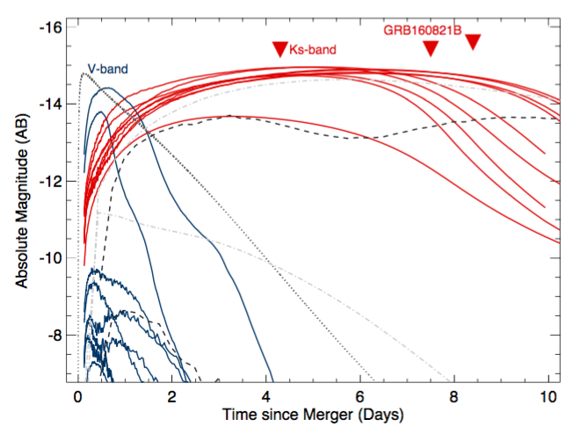
Kasliwal et al. 2017b
Models: Wollaeger et al. 2017, Metzger et al. 2015, Barnes et al. 2016, Rosswog et al. 2016

Slide 27
Color Evolution:
Shallow-Slow IR = Deep-Fast Optical?
Kasliwal et al. 2017b

Slide 28
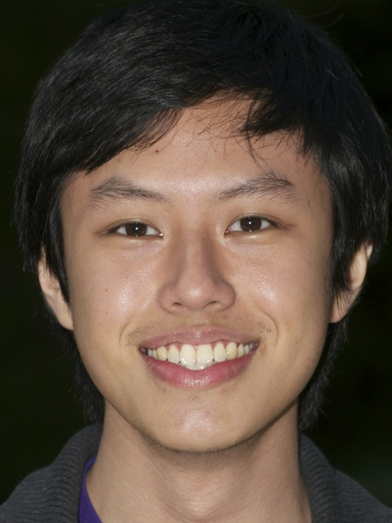
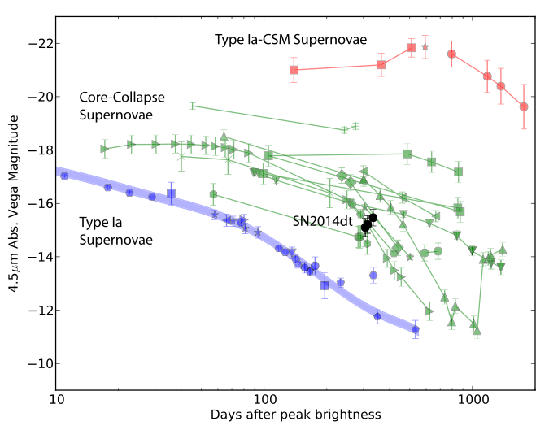
Samaporn
Tinyanont
Tinyanont et al. 2016, Fox et al. 2016
Johansson et al. 2016

Slide 29
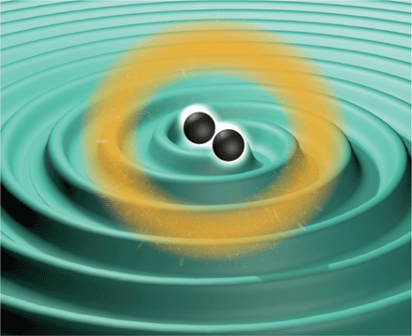
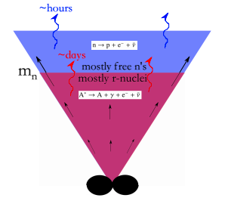
Isotropic Predictions:
Blue Flash (~hrs/days) & Red Transient (~days/wk)
e.g. Metzger at al. 2015
e.g. Barnes & Kasen 2013
Also, Li & Paczynski 1998, Kulkarni 2005, Roberts et al. 2011, Nakar & Piran 2011,
Barnes et al. 2013, Kasen 2013, Grossman et al. 2013, Tanaka et al. 2014…

Slide 30
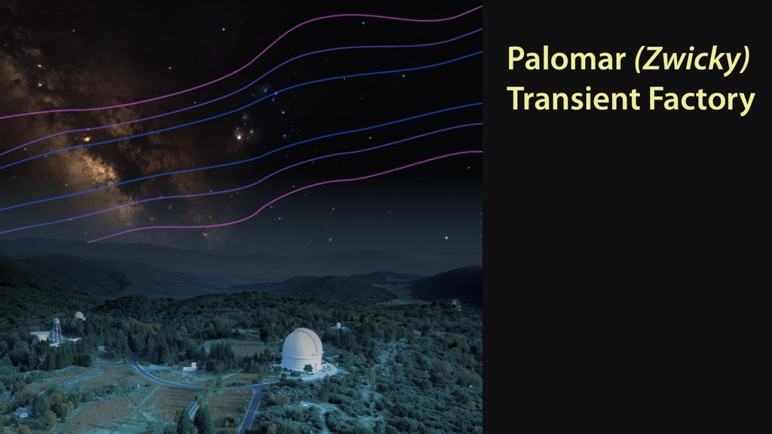
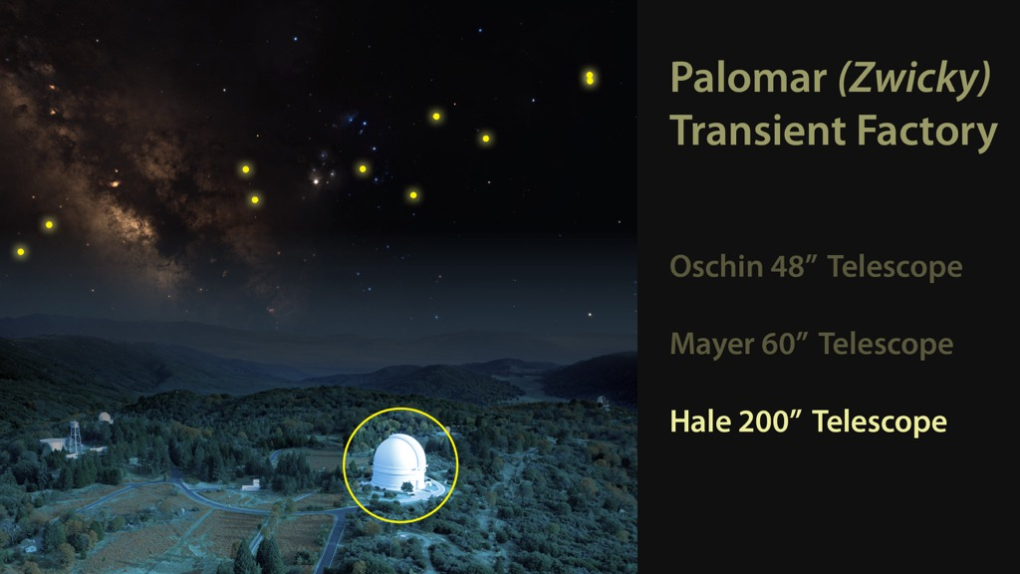
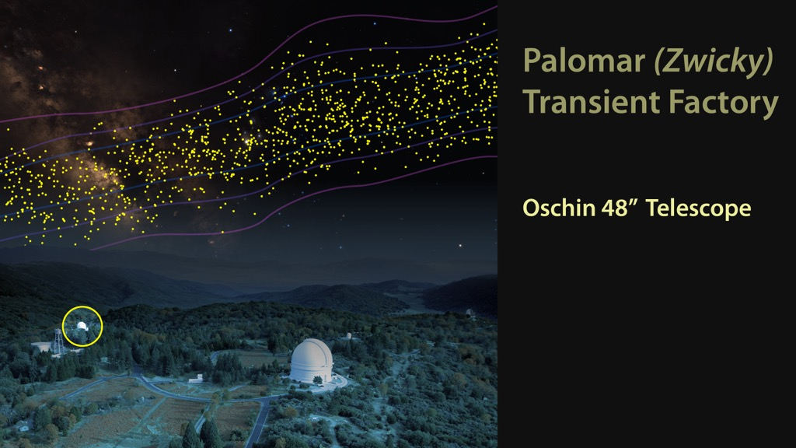
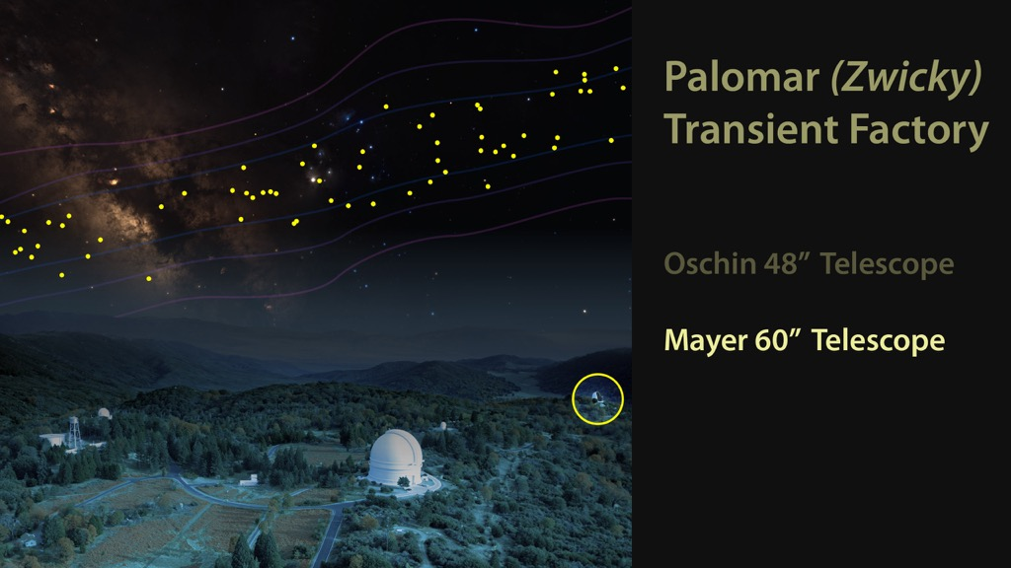

Slide 31
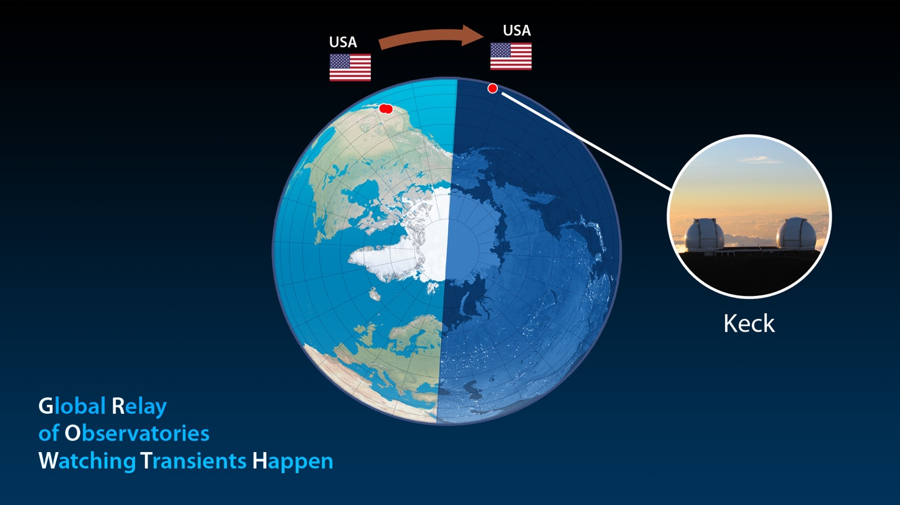
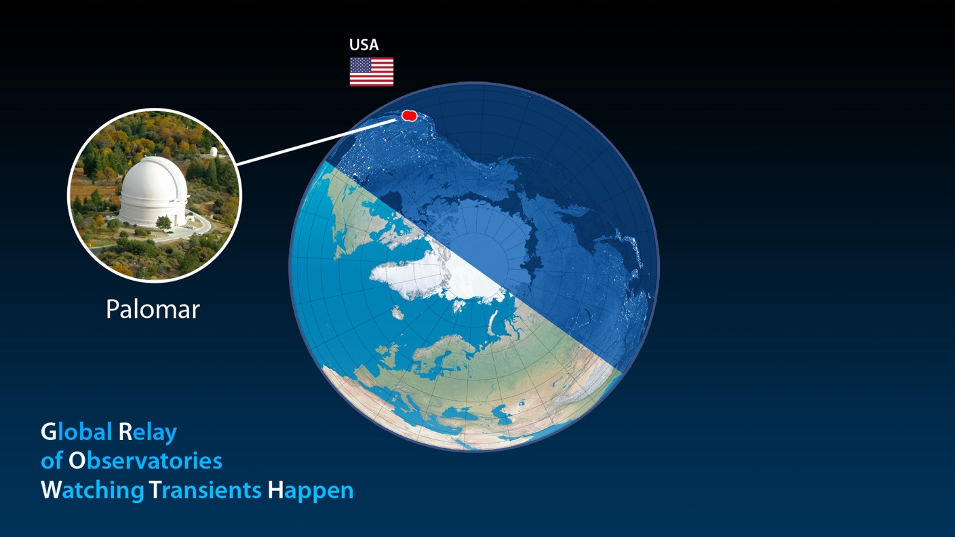
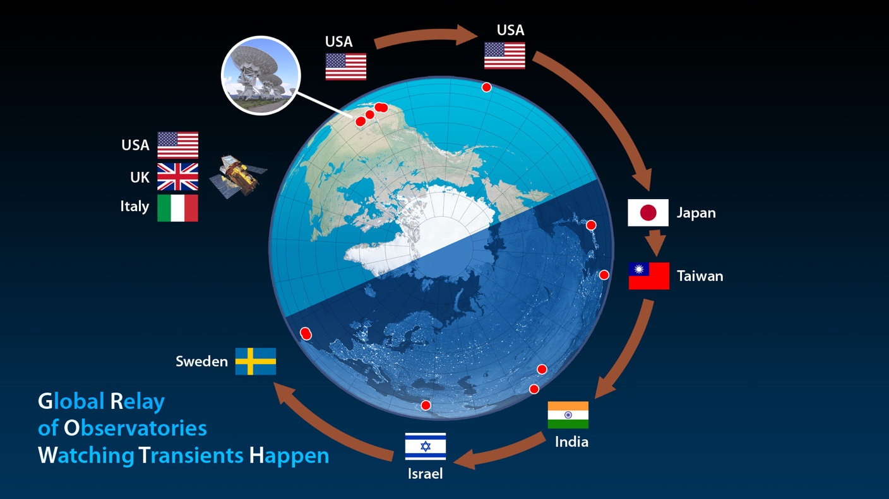

PI Kasliwal

Slide 32
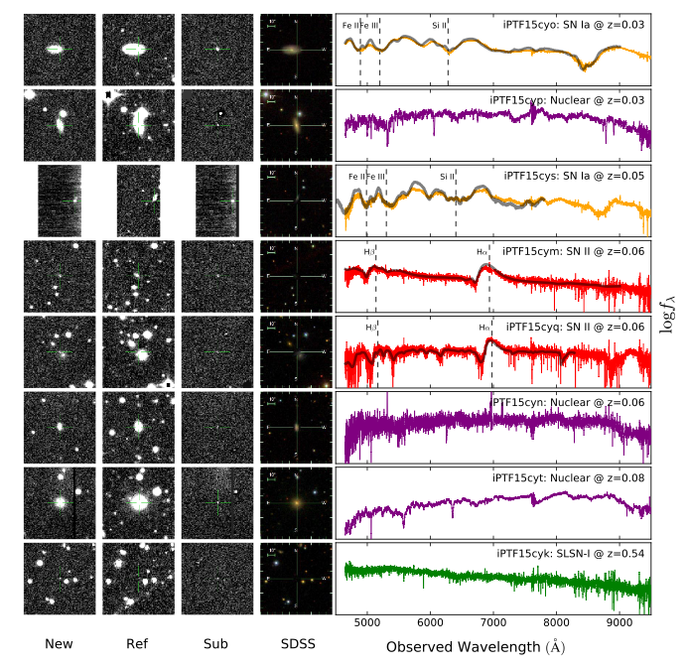
GW150914:
All candidates classified in 2 hours!
Kasliwal et al. 2016

Slide 33
Needle in haystack
127676 candidates in subtraction images
78951 do NOT have a quiescent stellar source
15624 are detected twice and NOT asteroids
5803 pass our machine learning threshold
1007 are coincident with a nearby galaxy
13 were vetted by human scanners
8 were scheduled for follow-up spectroscopic observations
0 were associated with the gravitational wave
Kasliwal et al. 2016

Slide 34
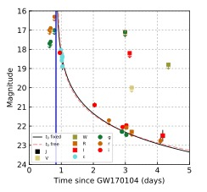
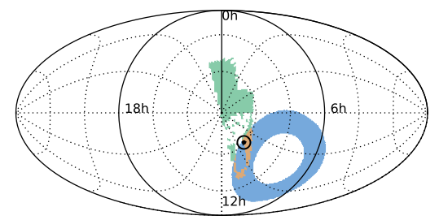
ATLAS17aeu:
A fast-fading optical transient
Bhalerao et al. 2017, Stalder et al. 2017
Afterglow of an Unrelated Gamma-Ray Burst that occurred 21 hr after GW170104!

Slide 35
iPTF17cw:
An optical+radio transient
Corsi et al. 2017

Slide 36
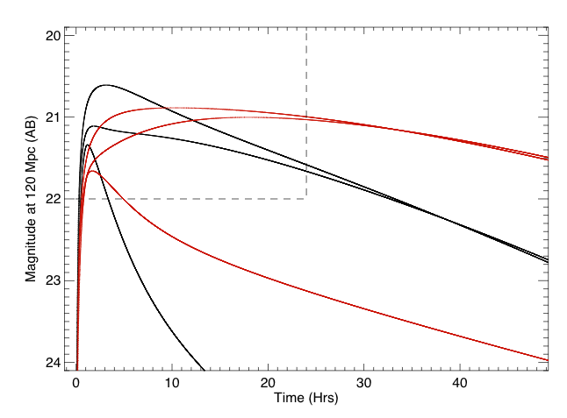
GROWTH
ZTF
Models by Metzger et al. 2015

Slide 37
Caution is the better part of valor
It could be temporally coincident
It could be spatially coincident
It could be fast
It could be red
It could be next to a nearby galaxy
  BUT unrelated!
“Spectrum is Truth”

Slide 38
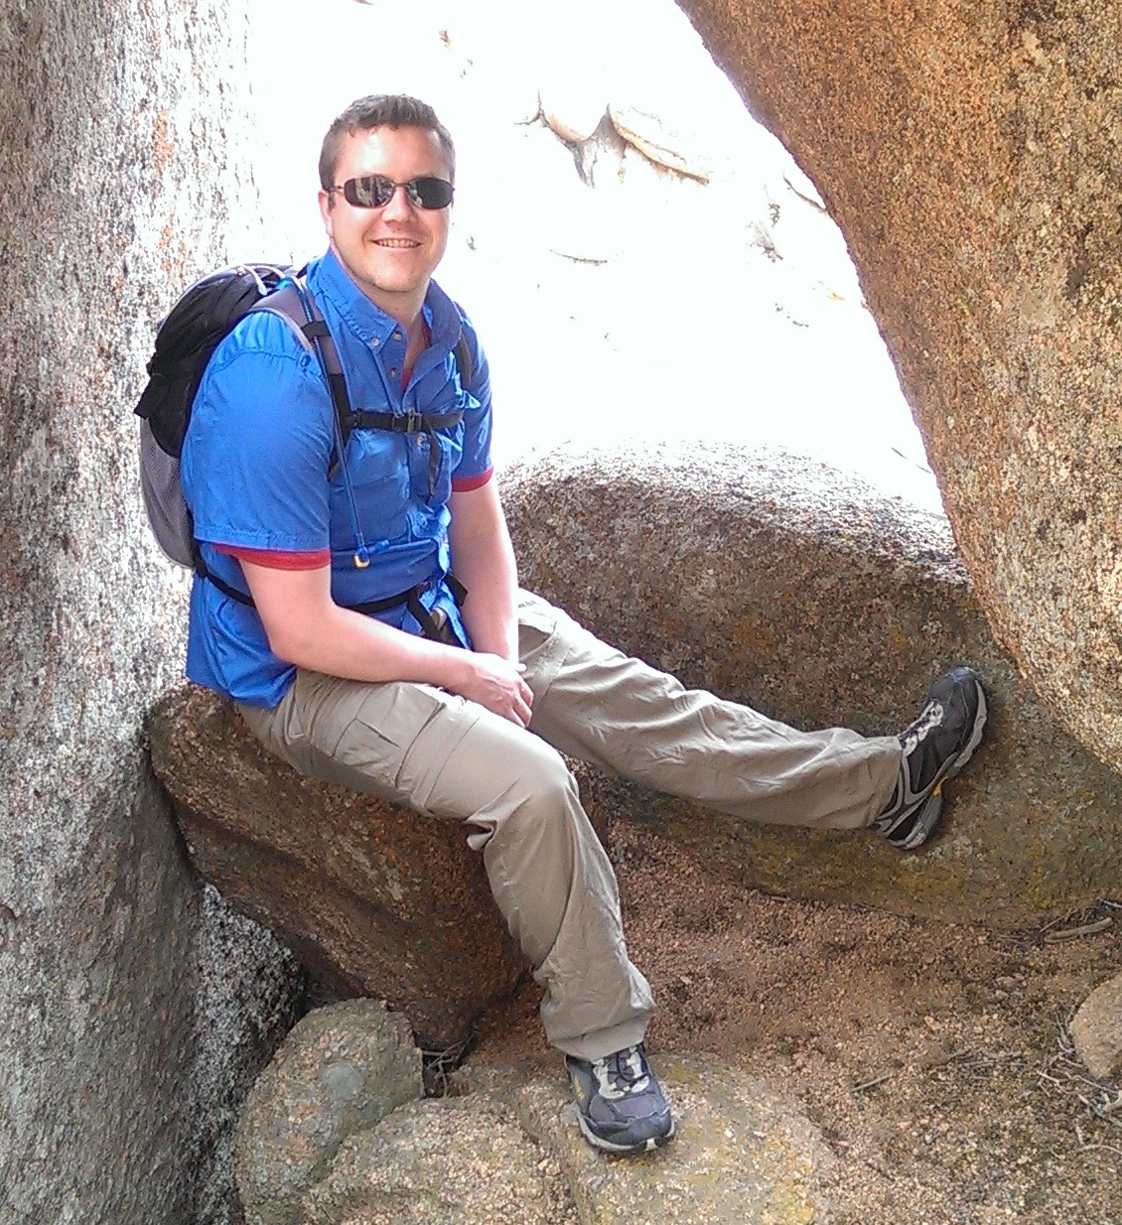
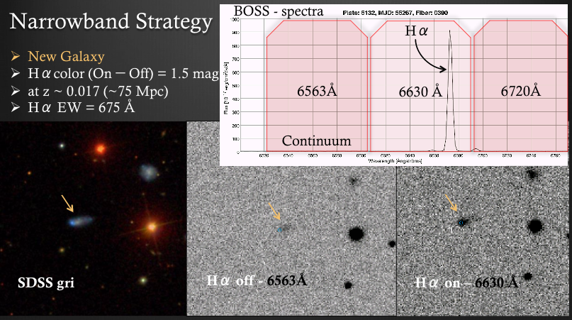
Census of the Local Universe
(CLU Galaxy Catalog)
Dave Cook

Slide 39
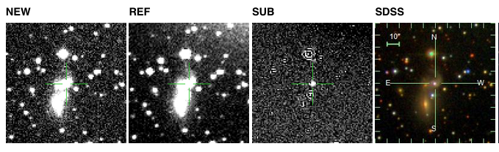
Ongoing LIGO run:
Top 20 galaxies in Error Volume
Three new CLU galaxies were in this top 20 list by star formation/stellar mass
One of them is a triplet galaxy and even hosted a supernova!

Slide 40
Completeness
Star-Formation
Halpha
B-band
Stellar Mass
CLU @ 200 Mpc

Slide 41
Filter?

Slide 42
The Early Years of Coarse GW Localizations
e.g. Kasliwal & Nissanke 2014, Singer et al. 2014

