Slide 1
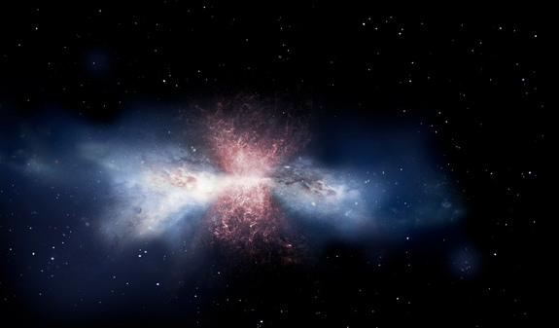
Dusty Starbursts and Quasars - Past and Future
How the InfraRed Spectrograph revolutionized our understanding of galaxy assembly across the history of the Universe
Duncan Farrah
Virginia Tech

Slide 2
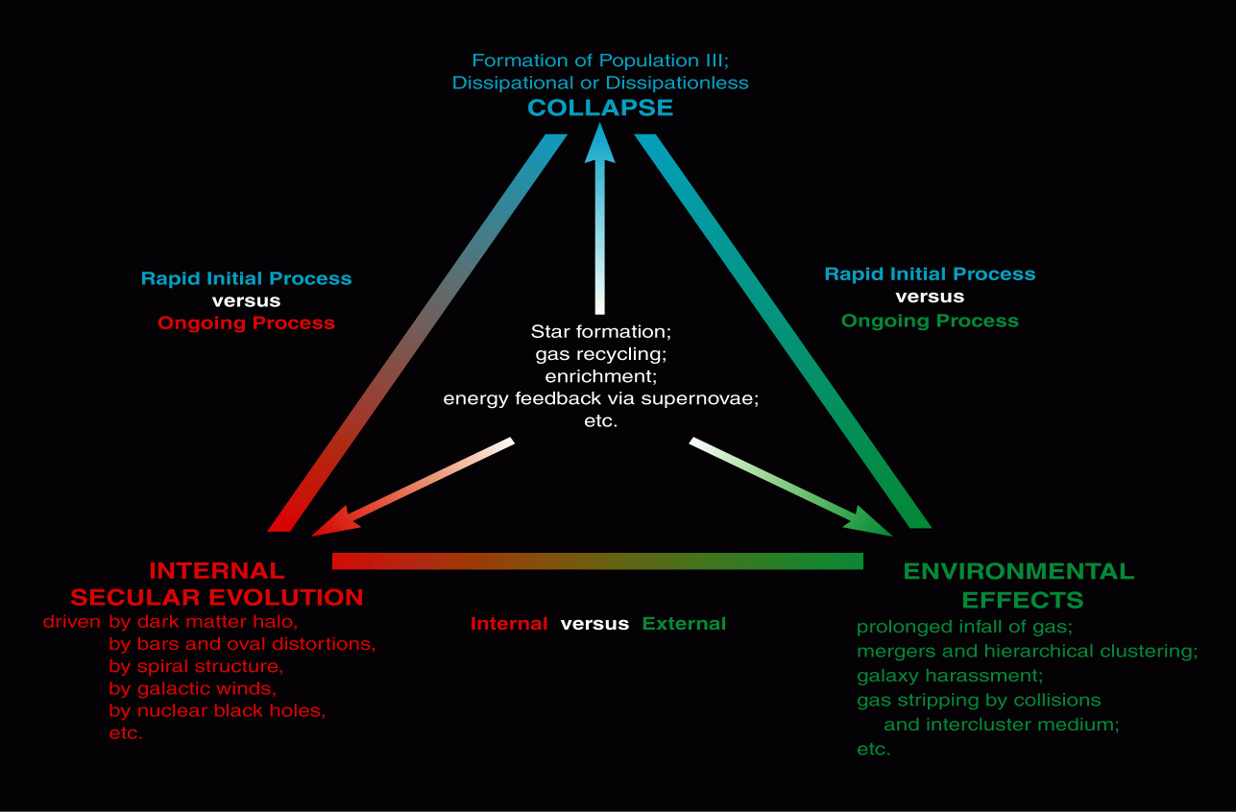
Setting the scene
Why study starbursts and quasars?
Image credit: John Kormendy

Slide 3
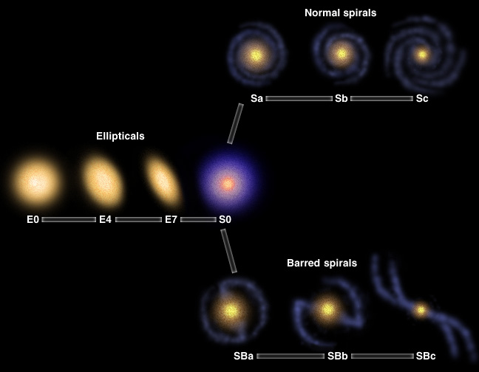
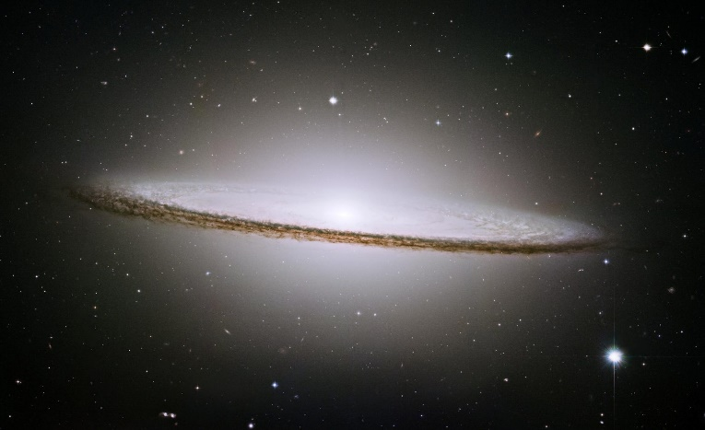
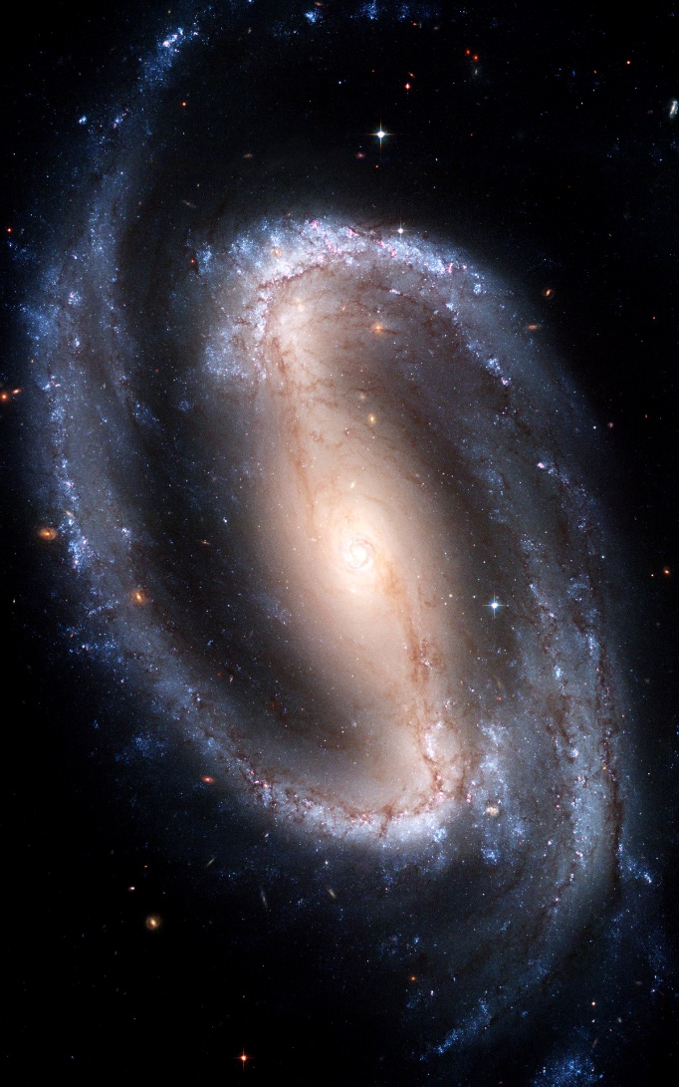
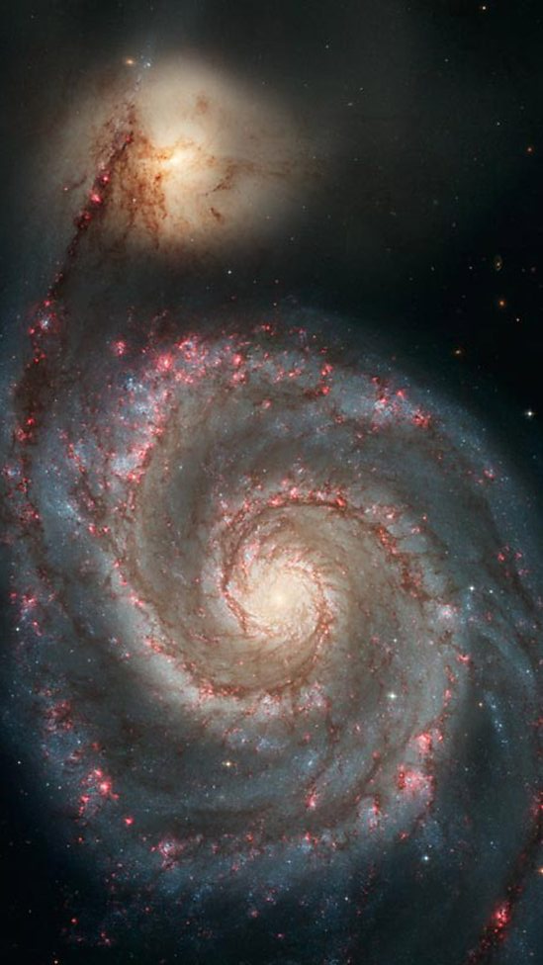
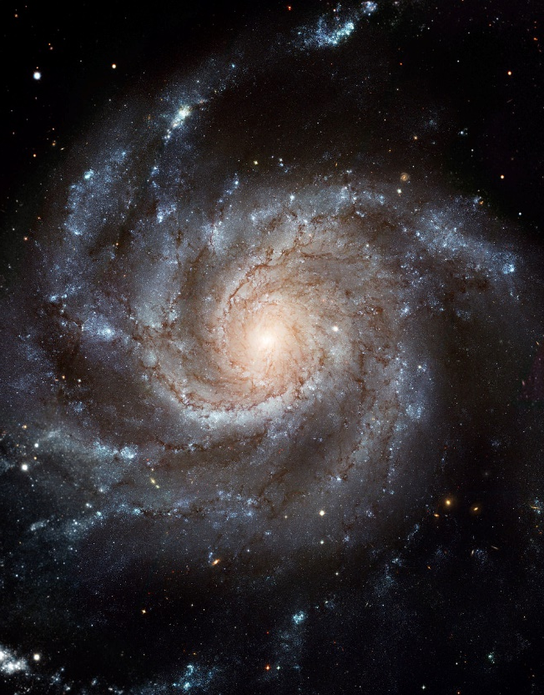
Galaxies in the local Universe
The Hubble Sequence
Notes:
So what do we know about galaxy assembly? Starting locally - Galaxies in the local universe are often large, quite structured systems – some striking examples shown here, e.g. barred spiral, grand design spiral, elliptical – understand their taxonomy in terms of the traditional hubble sequence

Slide 4
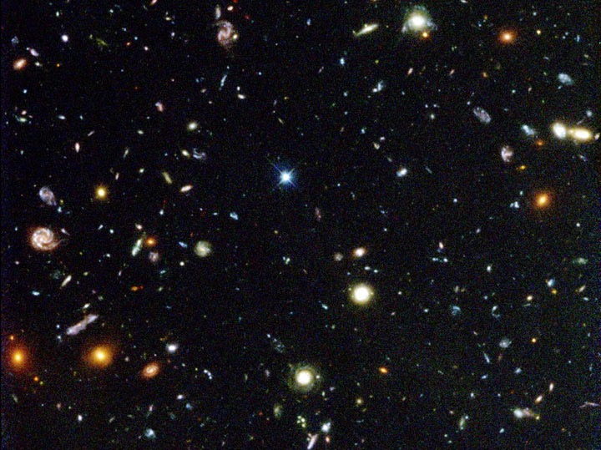
Galaxies in the distant Universe
Smaller, less structured, less massive
Notes:
However, galaxies in the distant universe don’t look like this at all – tend to be smaller, more irregular, less structured, as seen here in the HUDF – In fact when we reach about z=1.5, the hubble sequence we see locally really doesn’t exist anymore.
So the grand challenge is how we get from this to that

Slide 5
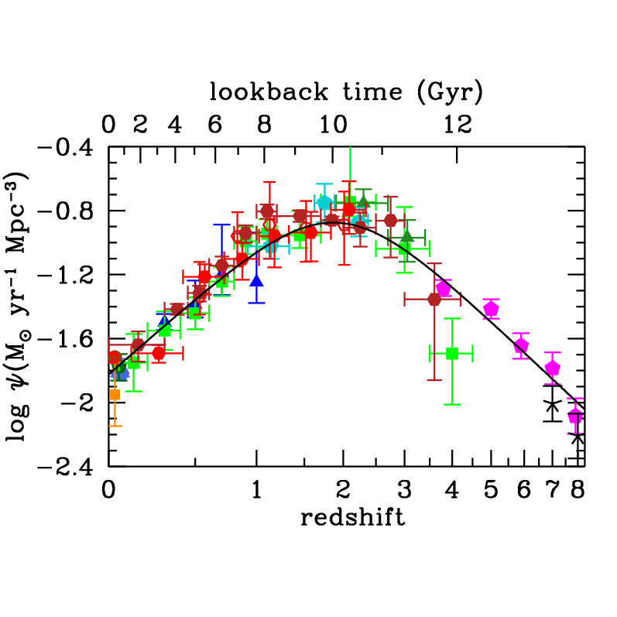
The cosmic history of star formation
An approximately lognormal relation that rises with redshift to about z~2, and then declines
Madau & Dickinson 14
Notes:
Another important one – Comoving space density of star formation with redshift, closely follows a lognormal relation, rising from lowish levels today to a peak SFR dens around 10 Gyr ago, then declining quite quickly at higher redshifts

Slide 6
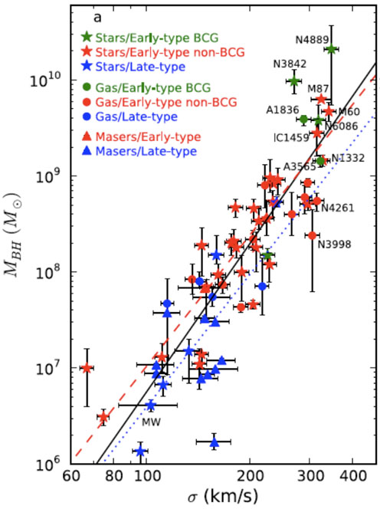
The M_{bh}-σ relation
Relationship between the mass of the black hole and the mass, or velocity dispersion, of baryons in the galaxy
Seen in:
Stars and gas
Early and late types,
Active and quiescent systems
McConnel et al 11
Notes:
We also observe several important scaling relations between galaxy properties. Show a few examples - Here the M-sigma, relation between BH mass and mass of baryons in the host With a large scatter, seems remarkably universal – seen in stars and gas, Spirals and ellipticals, active and quiescent systems

Slide 7
Star formation rates in luminous quasars at 2<z<3
Harris et al 16
Pitchford et al 16
For quasars at z>0.5, a higher SFR means a more luminous quasar – up to an SFR of ~500 M_{sun} yr⁻¹. Beyond that there is no evidence for a correlation
Notes:
Work is starting to establish specific scaling relations at high redshift – here some recent work from my group showng that sfrs in luminous quasars at high redshift approxiately scale with quasar luminosity, up to some maximum.

Slide 8
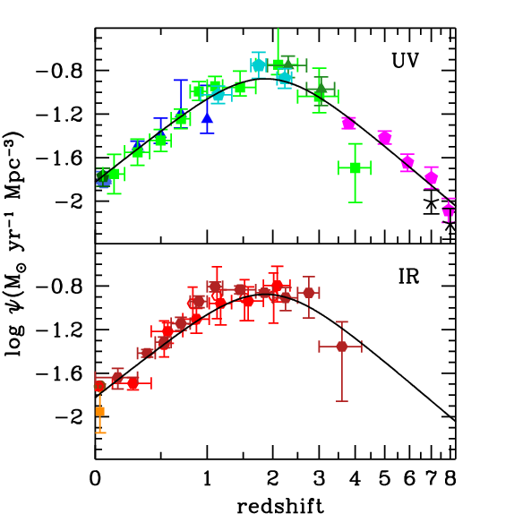
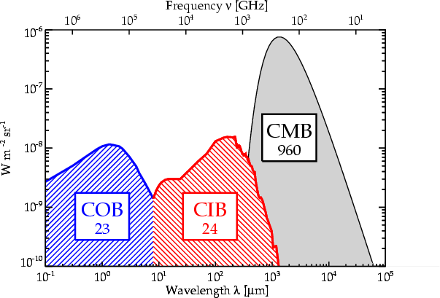
Madau & Dickinson 14
Obscured Assembly of Galaxies

Slide 9
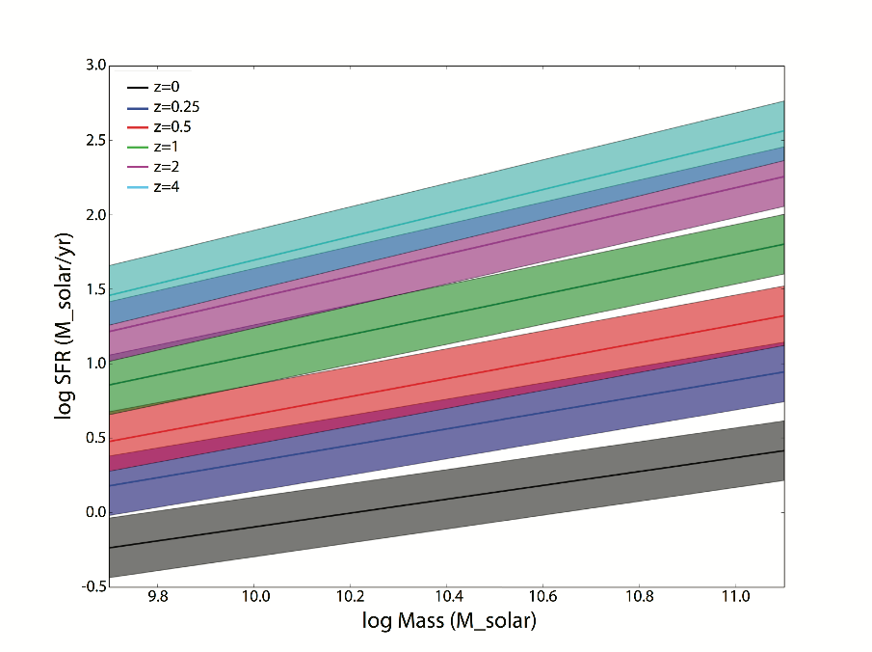
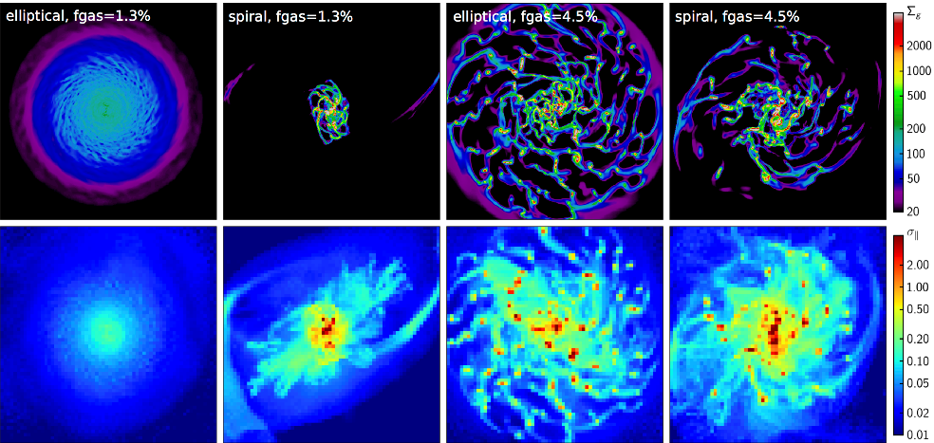
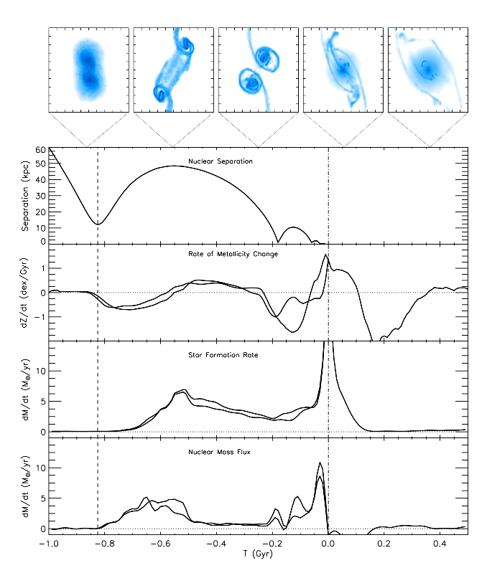
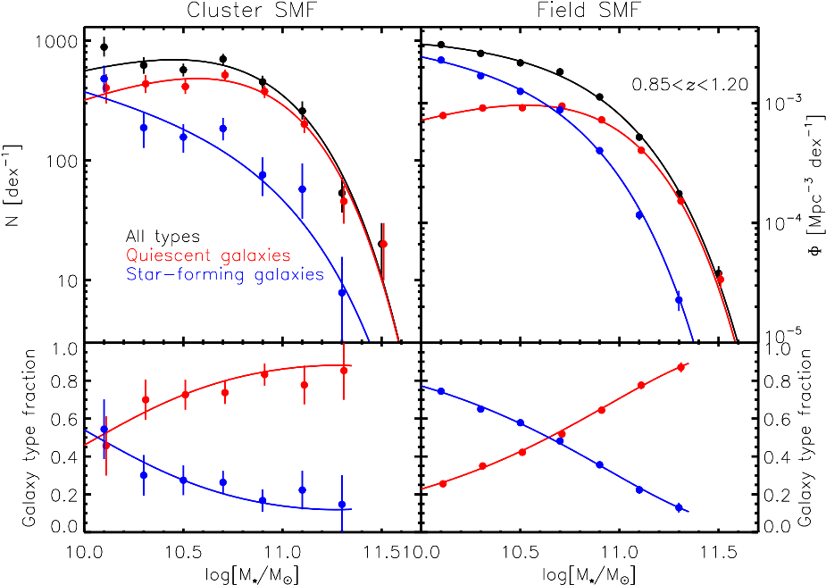
An extremely subtle problem
Gas surface density
In-plane velocity dispersion
Morphology Martig et al 13
Redshift Speagle et al 14
Mergers Torrey et al 12
Accurate characterization of obscured power sources is essential
Environment Van der Burg et al 13
Notes:
First redshift – known to have a profound effect – we observe that the SFR of a `typical’ galaxy rises dramatically with redshift, from only 1-2 solar masses per year at z=0, to tens or even hundreds of solar masses per year at z=2
One driver behind this is thought to be that at high redshift there is just more free gas available, in general, for star formation, making it much easier to sustain higher SFRs

Slide 10
What did the IRS do for extragalactic science?
The first detection of several new mid-infrared features – crystalline silicates, ices, some faint fine-structure lines, other hydrocarbons
Development of the first comprehensive suite of obscured power source diagnostics
The first robust characterization of candidate `primeval’ galaxies in the local Universe
Evidence for low level, but important, star formation in some Early-type galaxies
The first systematic study of mid infrared power source as a function of luminosity in local galaxies
Deep imaging observations of treasury extragalactic survey fields
The first comprehensive mid-infrared spectral maps of low-redshift systems
The first accurate characterization of 24 and 70 micron sources found by MIPS across a wide range in redshift
The detection of dust in absorbers along quasar sightlines
The first exploration of `normal’ dusty galaxies outside the local Universe
The first mid-infrared spectroscopic detection of sources at z>5
The evolution of silicate dust in active galaxies
The first reliable studies of the obscured power source in high redshift galaxies
An expansive archive of observations that is still actively mined today
The first unambiguous view of the power sources in ultraluminous infrared galaxies
Strong support for (some flavor of) AGN unified schemes
The first evidence for correlation/decoupling of star formation rates and AGN properties in some classes of quasar
Evidence that star-formation in galaxies may change systematically with redshift
Evidence that SMGs are not pure starbursts, but instead a heterogeneous population that harbors large amounts of cold dust
The first robust evidence for star formation quenching in other classes of AGN

Slide 11

The first detection of several new mid-infrared features – crystalline silicates, ices, some faint fine-structure lines, other hydrocarbons
Development of the first comprehensive suite of obscured power source diagnostics
The first robust characterization of candidate `primeval’ galaxies in the local Universe
Evidence for low level, but important, star formation in some Early-type galaxies
The first systematic study of mid infrared power source as a function of luminosity in local galaxies
Deep imaging observations of treasury extragalactic survey fields
The first comprehensive mid-infrared spectral maps of low-redshift systems
The first accurate characterization of 24 and 70 micron sources found by MIPS across a wide range in redshift
The detection of dust in absorbers along quasar sightlines
The first exploration of `normal’ dusty galaxies outside the local Universe
The first mid-infrared spectroscopic detection of sources at z>5
The evolution of silicate dust in active galaxies
The first reliable studies of the obscured power source in high redshift galaxies
An expansive archive of observations that is still actively mined today
The first unambiguous view of the power sources in ultraluminous infrared galaxies
Strong support for (some flavor of) AGN unified schemes
The first evidence for correlation/decoupling of star formation rates and AGN properties in some classes of quasar
Evidence that star-formation in galaxies may change systematically with redshift
Evidence that SMGs are not pure starbursts, but instead a heterogeneous population that harbors large amounts of cold dust
The first robust evidence for star formation quenching in other classes of AGN

Slide 12
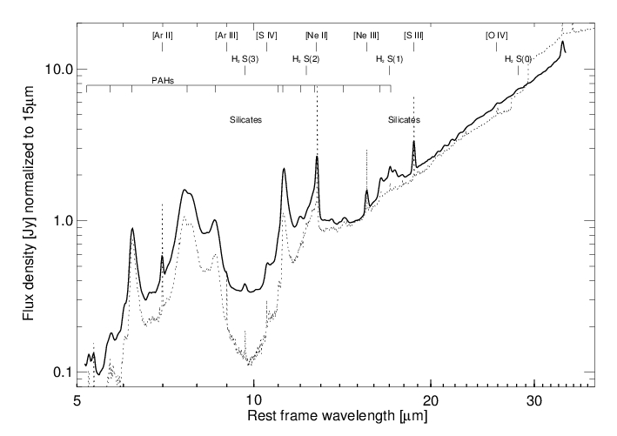
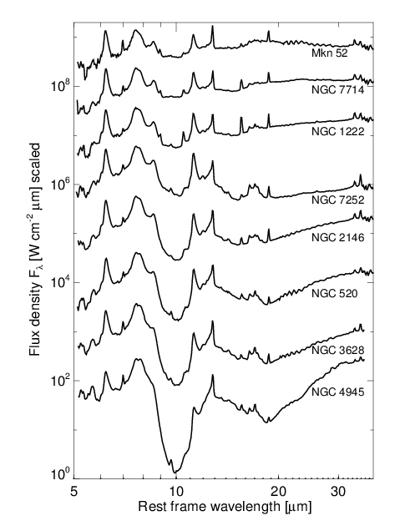
Low-redshift star-forming galaxies
The dotted line is the ISO spectrum of M82 for comparison
Strong PAHS and varying Silicate absorption
PAH luminosity, but not EW, correlates with total infrared luminosity
Brandl et al 2006
Notes:
Gave the first idea of the range of spectral shapes in SF gals

Slide 13
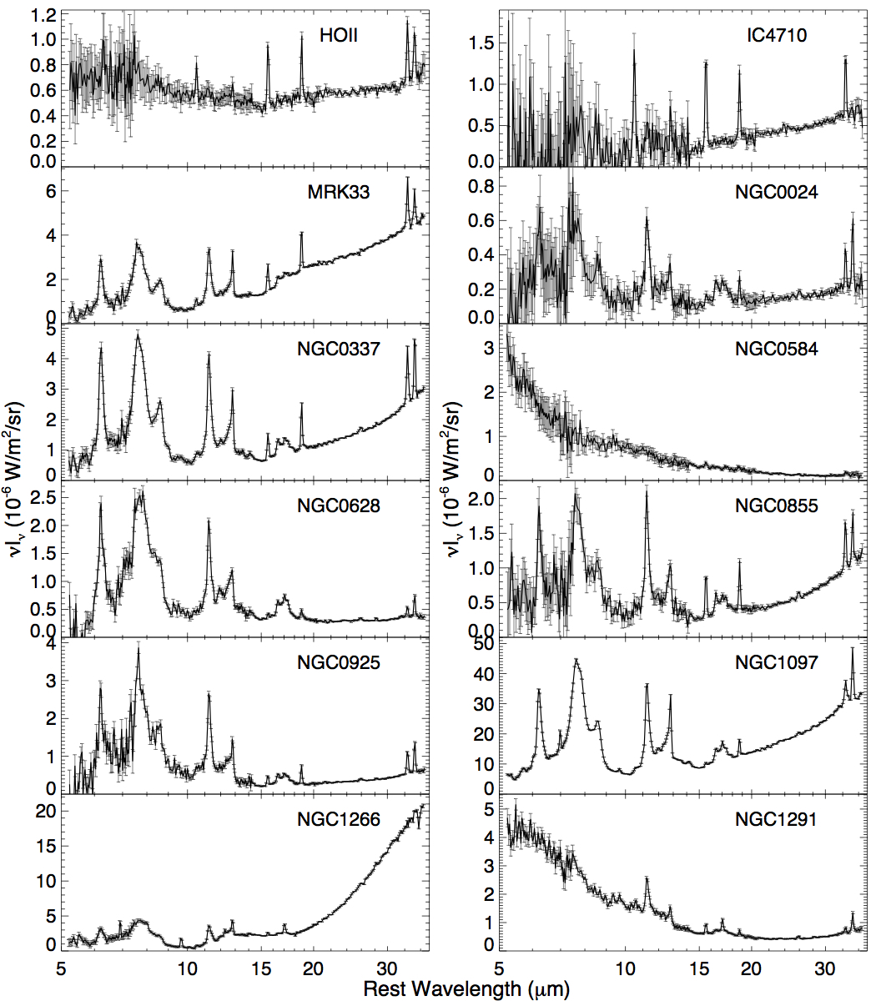
Low-redshift star-forming galaxies
Smith et al 2006
PAHs:
Vary in strength significantly from system to system
Are suppressed in low metallicity and low-luminosity AGN environments
Notes:
Looked at PAHs in more detail, how they may vary wiith other gal properties

Slide 14
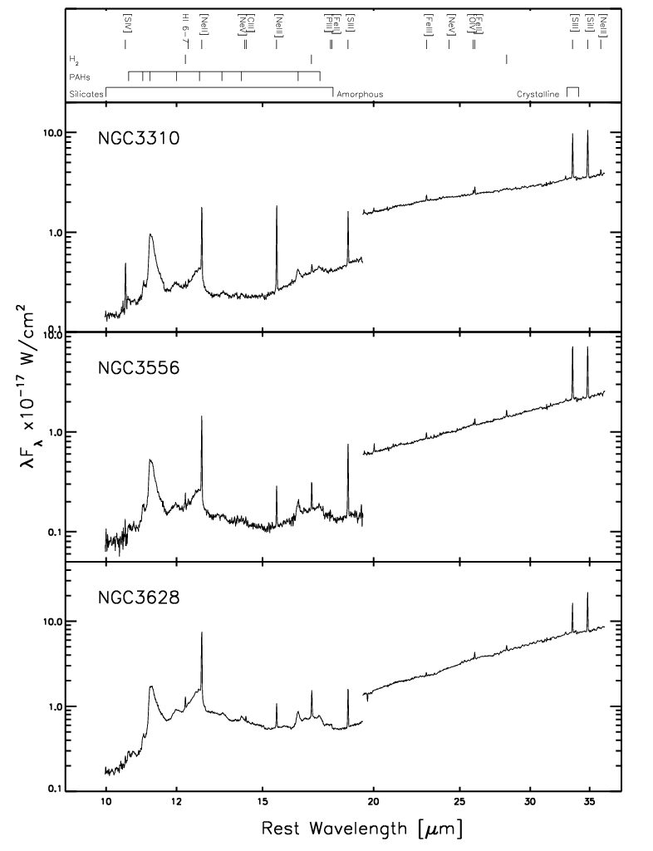
Low-redshift star-forming galaxies
At high resolution:
Prominent fine-structure lines
Weak hydrocarbon features
Some unidentified emission & absorption features
Bernard-Salas et al 2009
(Hunt et al 10, Treyer et al 10)
Notes:
We present an atlas of {\em Spitzer}/IRS high resolution (R$\sim$600) 10-37$\mu$m spectra for 24 well known starburst galaxies. The spectra are dominated by fine-structure lines, molecular hydrogen lines, and emission bands of polycyclic aromatic hydrocarbons. Six out of the eight objects with a known AGN component show emission of the high excitation \ion{[Ne}{5]} line. This line is also seen in one other object (NGC\,4194) with, a priori, no known AGN component. In addition to strong polycyclic aromatic hydrocarbon emission features in this wavelength range (11.3, 12.7, 16.4~$\mu$m), the spectra reveal other weak hydrocarbon features at 10.6, 13.5, 14.2~$\mu$m, and a previously unreported emission feature at 10.75$\mu$m. An unidentified absorption feature at 13.7$\mu$m is detected in many of the starbursts. We use the fine-structure lines to derive the abundance of neon and sulfur for 14 objects where the HI 7-6 line is detected. We further use the molecular hydrogen lines to sample the properties of the warm molecular gas. Several basic diagrams characterizing the properties of the sample are also shown. We have combined the spectra of all the pure starburst objects to create a high S/N template, which is available to the community.

Slide 15
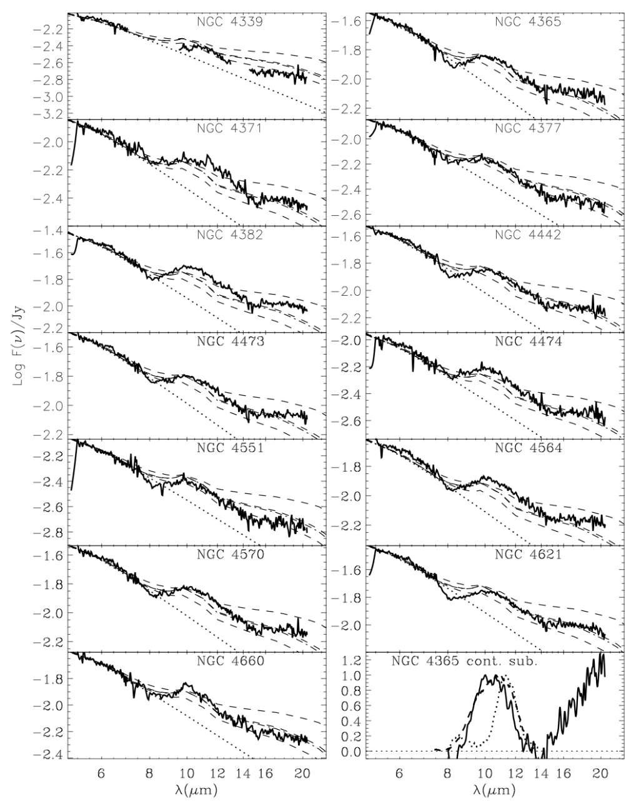
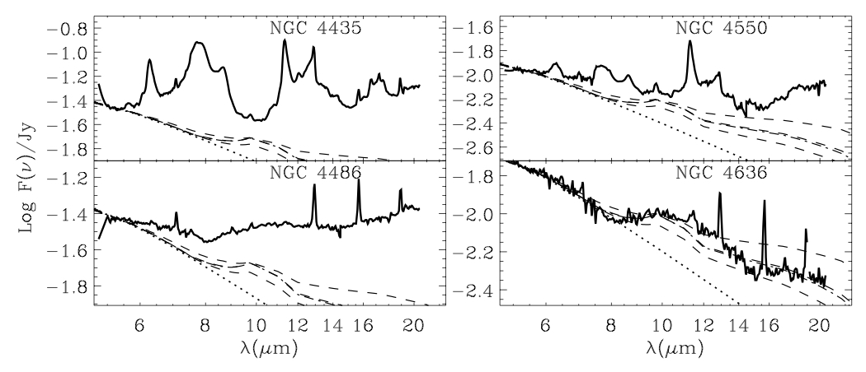
Early-type galaxies
Panuzzo et al 2006
(Kaneda et al 10, 11, Appleton et al 14)
However, about 25% show signs of activity – star formation and/or AGN
Most are quiescent, with a broad Silicate feature consistent with a stellar origin
Notes:
Not all etgs are totally red and dead – and this is seen in the ir

Slide 16
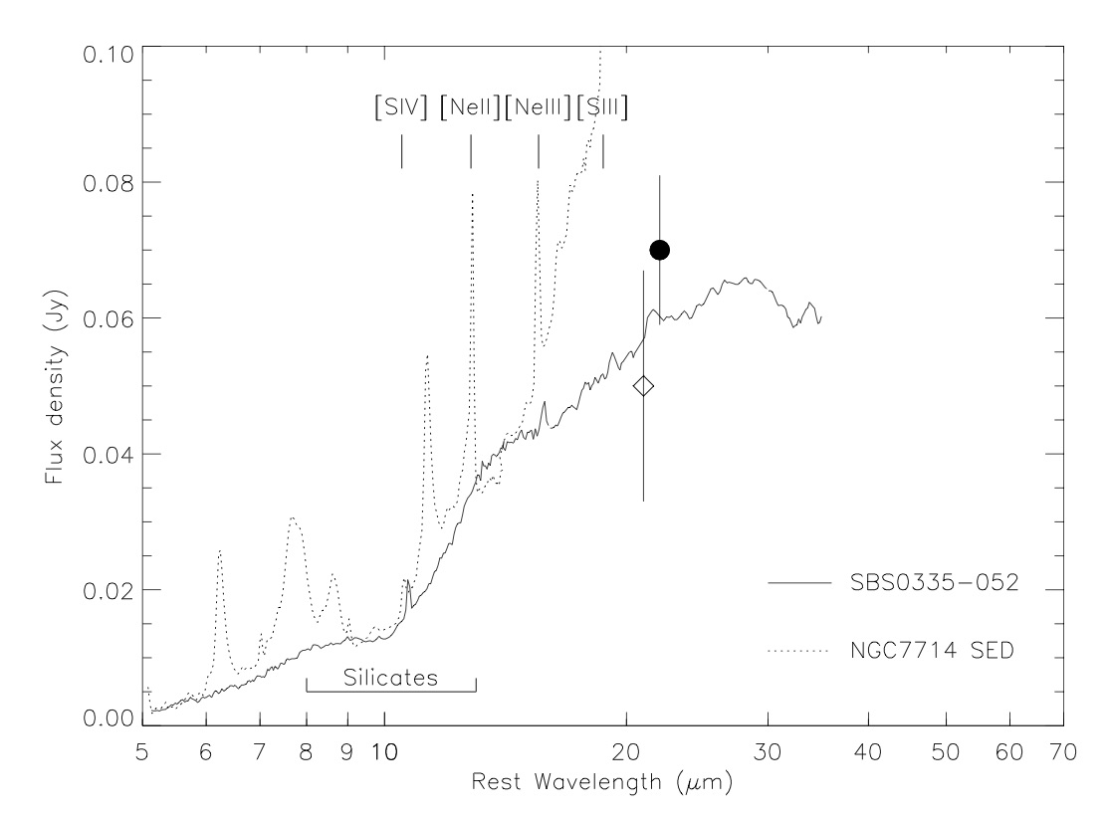
Blue Compact Dwarfs
Houck et al 2004
SBS 0335-052 is a blue compact dwarf galaxy with one of the lowest known metallicities (less than 5% of Solar)
It is an excellent template of the primeval galaxies at z>6 that may have reionized the Universe
The IRS spectrum shows silicate absorption features, emission lines of [SIV] and [NeIII], and puts strong upper limits on the PAH emission features.
Notes:
Switch gears to BCDs – long thought of as local analogues of building blocks in the hierarchical paradigm
Lack of PAHs consistent with behavior seen in more luminous starbursts, but this objects spectrum is really the best mid-ir view we have of the systems that JWST will discover in large numbers at z>6
Mention this integrated apectrum is instrumental in understanding resolved emission from e.g. ALMA

Slide 17
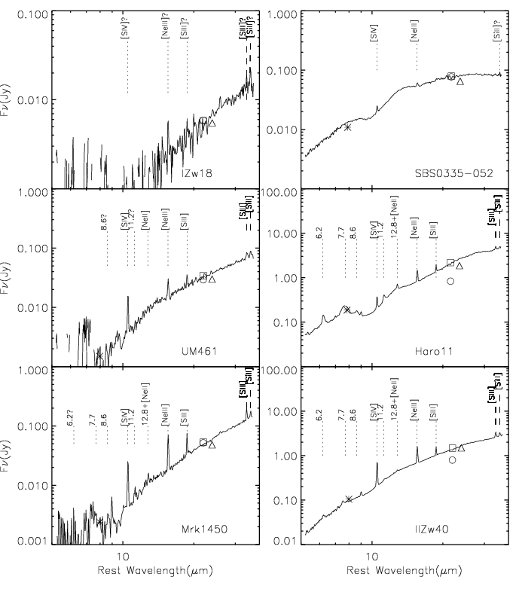
Blue Compact Dwarfs
Larger samples:
PAH EWs are weaker in BCDs than in typical starbursts
[NeIII]/[NeII] has a weak anti-correlation with PAH EW.
Stronger anti-correlation between PAH EW and the product of [NeIII]/[NeII] and the UV luminosity density divided by the metallicity.
PAH EW in metal-poor high-excitation environments is determined by PAH formation and destruction effects
Wu et al 2005
(Hao et al 09)

Slide 18
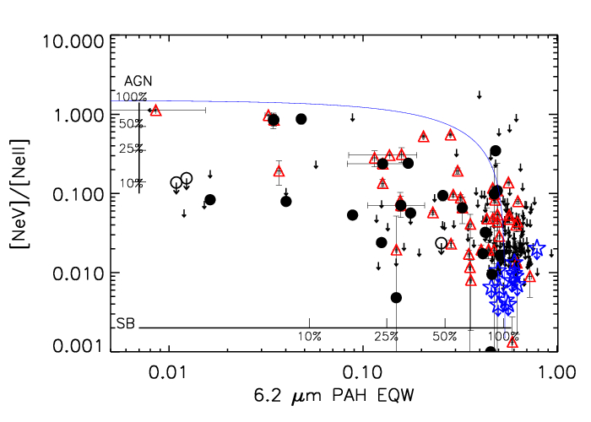
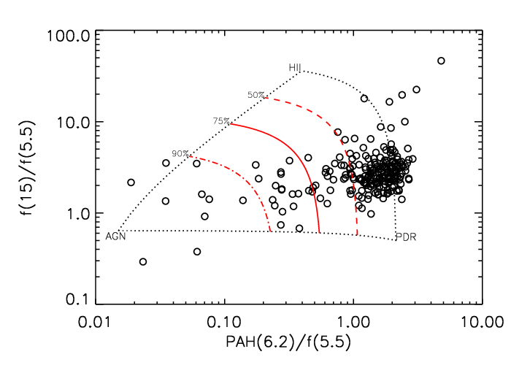
Luminous Infrared Galaxies
18% of all LIRGs contain an AGN
In 10% of sources the AGN contributes more than 50% of the total IR luminosity
LIRGs with an AGN resemble sources without an AGN, but with lower PAH emission and flatter MIR continua
LIRGs with an AGN have higher IR luminosities, warmer MIR colors and are found in interacting systems more often than pure starburst LIRGs
Petric et al 2011
(Brandl et al 09, Willett et al 11, Donahue et al 11, Inami et al 13)
Notes:
Spitzers first major thing – AGN and star formation behavior in LIRGs… RELATIONSHIPS

Slide 19
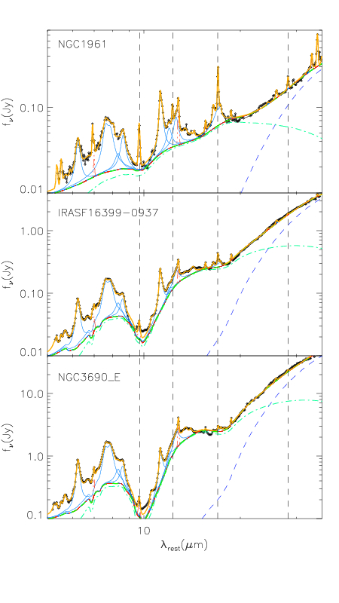
Luminous Infrared Galaxies
Later studies:
LIRGs are remarkably consistent in their mid-infrared spectral properties
Lower 6.2um EW correlates with greater dispersion in spectral shape
Crystalline silicates are present in the extremely obscured LIRGs
Ices are present over a range in obscurations
A small fraction of LIRGs may have molecular Hydrogen heated by shocks, or AGN
Stierwalt et al 2014
Notes:
Later studies larger samples

Slide 20
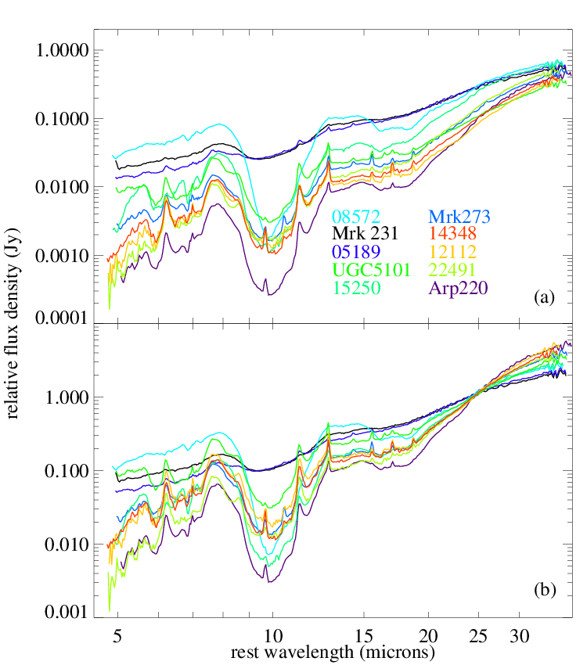
Armus et al 07, Farrah et al 07
(Spoon et al 09, Imanishi et al 10, Wang et al 11, Ruiz et al 13, Hurley et al 14)
Ultraluminous Infrared Galaxies
Wide diversity in spectral features
PAHs range from strong to weak/absent
Silicates from deep absorption to mild emission
Wide range in continuum shapes
A plethora of fine-structure lines

Slide 21
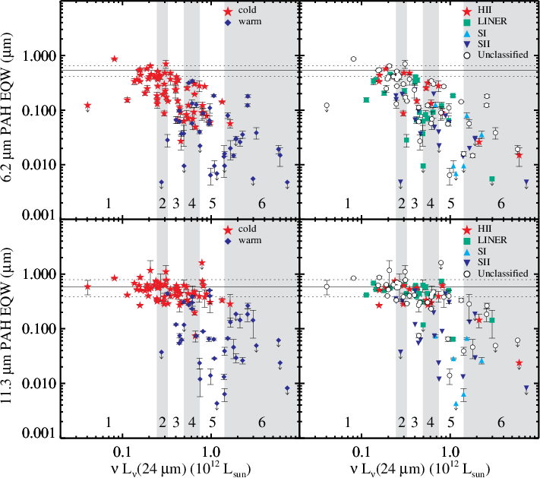
Ultraluminous Infrared Galaxies
Desai et al 07
PAH EWs span more than 2 orders of magnitude
ULIRGs with HII optical spectra or steep FIR spectral slopes have PAH EWs half that of lower luminosity starbursts
Far-infrared spectral slope is correlated with PAH EW, but not with silicate optical depth
High-redshift sources have a much larger range in PAH EW than in local ULIRGs

Slide 22
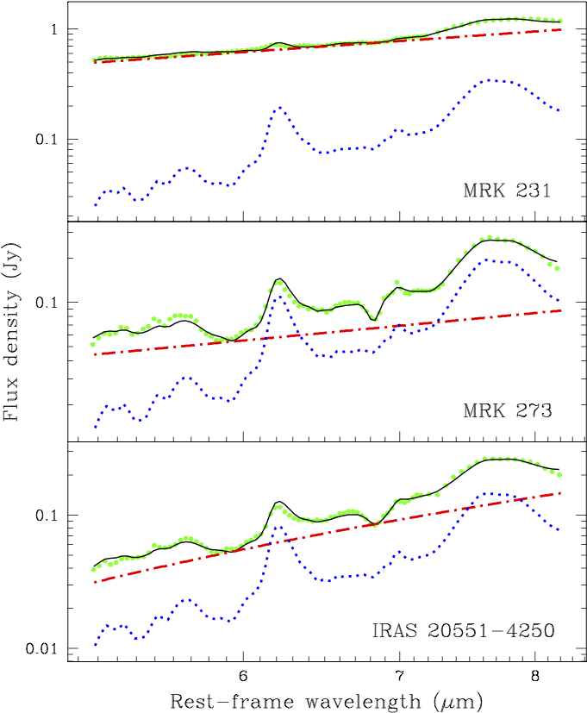
Ultraluminous Infrared Galaxies
Nardini et al 09
5-8um spectral decomposition:
AGNs are 30 times brighter at 6um than starbursts with the same bolometric luminosity
Star formation events are confirmed as the dominant power source for extreme infrared activity
Nonetheless an AGN is present in the majority of sources.

Slide 23
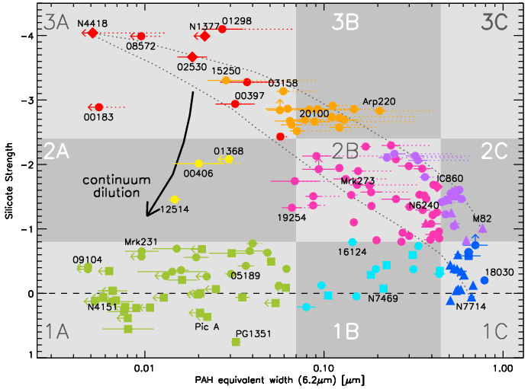
Ultraluminous Infrared Galaxies
Spoon et al 07
Evolutionary pathways and classifications based on mid-infrared spectral features

Slide 24
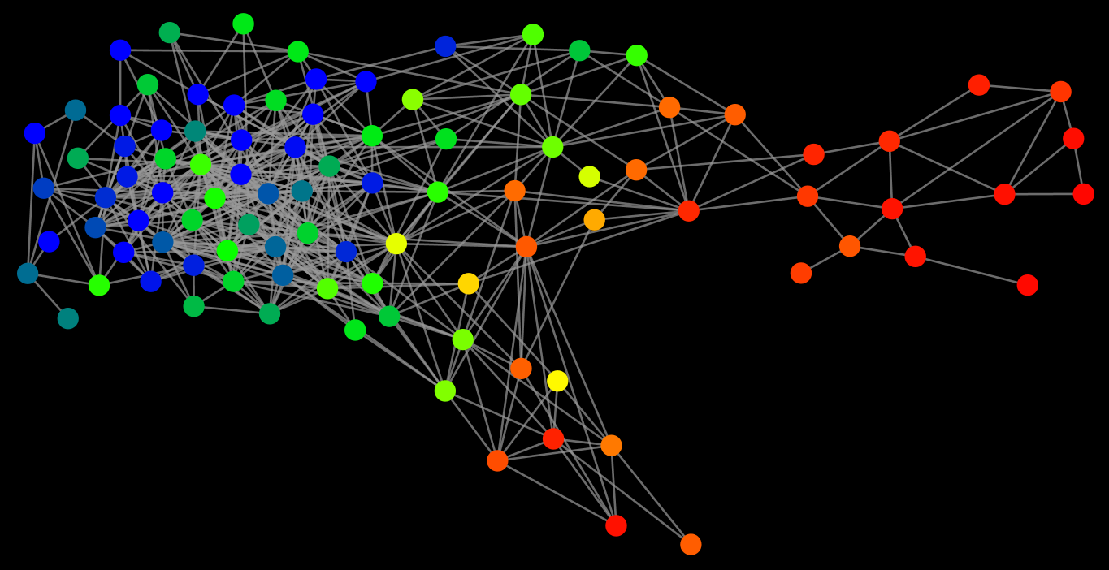


Ultraluminous Infrared Galaxies
Using IRS spectra to determine evolutionary pathways
Two possible end points
a luminous, unobscured AGN
a less luminous, dusty AGN
both ending in a quiescent system
A common starting point in a merger triggered starburst
Farrah et al 09
Colour-coding is by PAH 11.2um EW, from low (red) to high (blue)
Notes:
Briefly describe some work ive done applying analytical methods from outside physics to problems in astronomy.
What we did here was take 102 mid-ir spectra of local ulirgs, and determine ‘connections’ between pairs of objects based on a similarity threshold determined from the whole spectrum simultaneously.
Then plot these connections as a network, layout deterimned via methods from graph theory (commonly used in bio and social sciences)
Looked for communities of sources
Ive here color coded the graph by star formation rate, can see that three distinct communities are present, high sfr homogeneous, then two lower sfr, more heterogeneous.

Slide 25
Quasars
Hao et al 05
Sturm et al 05
Keremedjiev et al 09
Weaver et al 10
Diamond-Stanic et al 10
Lyu et al 14
Hatziminaoglou et al 15
Xie et al 17)
First detection of 10 and 18 micron silicate dust emissions in PG quasars and low-luminosity AGN
Consistent with expectations from unified schemes

Slide 26
Quasars
Detection of hot dust, weak/absent PAHs, bright fine-structure lines including [NeV], [OIV]
Weedman et al 05
(Pereira-Santaella et al 10, Hony et al 11, Dasyra et al 11, Urrutia et al 12, Sargsyan et al 12, Weedman et al 12, Wei et al 13, Hill et al 14, Zakamska et al 16)

Slide 27
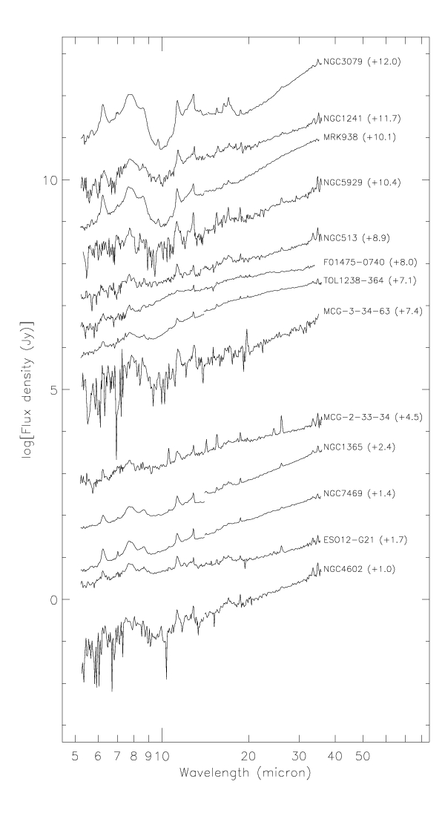
Seyfert Galaxies
Seyfert galaxies show a wide range in spectral shapes:
Red continua plus PAHs
Smooth, power-law continua
Silicates in absorption
Silicates in emission (albeit rarely)
Buchanan et al 06
(Baum et al 10, Gallimore et al 10, Kraemer et al 11, Sazonov et al 12, Ruschel-Dutra et al 14, Chen et al 14, Mendoza-Castrejon et al 15)
Notes:
Range in shapss

Slide 28
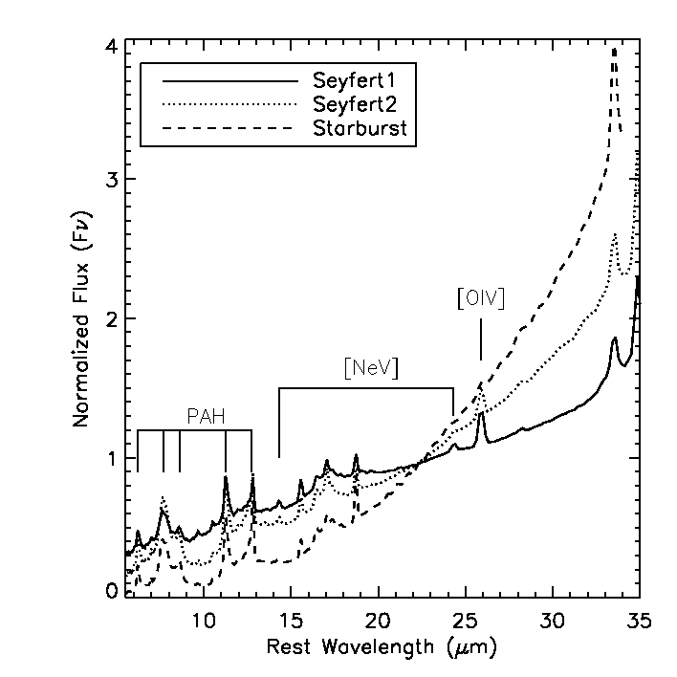
Wu et al 09
(Garcia-Bernete et al 15, Audibert et al 17)
Seyfert Galaxies
Larger samples:
Steeper 15-30μm slope in Sy2’s than in Sy1’s (-1.53±0.84 vs. -0.85±0.61)
32% of Sy1’s and 9% of Sy2’s, display a peak at 20μm, attributed to an extra hot dust component
The PAH EW decreases with increasing dust temperature. However, no difference in PAH EW is seen between Sy1’s and Sy2’s of the same bolometric luminosity
The silicate features at 9.7 and 18μm are stronger in Sy2’s than in Sy1’s
A comparison among the average mid-IR spectrum of Sy 1s (solid line) and Sy 2s (dotted line) of the 12 μm sample, as well as the starbursts (dashed line) of Brandl et al. (2006). All spectra have been normalized at 22μm. Note that the high-ionization fine- structure lines of [OIV]25.89μm are present in all three spectra, while [NeV]14.3/24.3μm are only present in the average spectra of the two Seyfert types.
Notes:
Behavior and trends in mid-ir shapes – how to understand them together

Slide 29
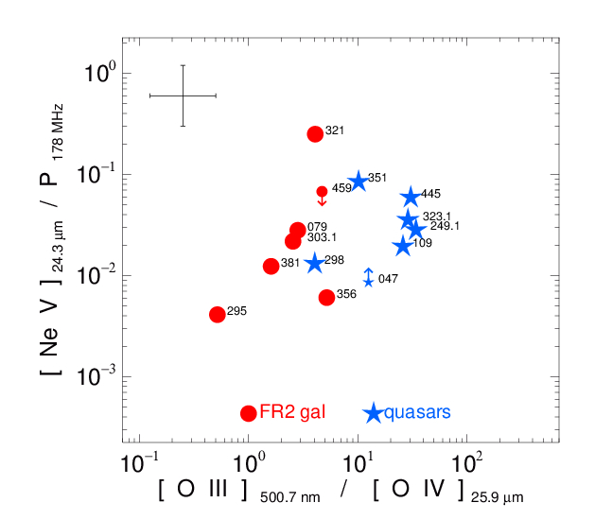
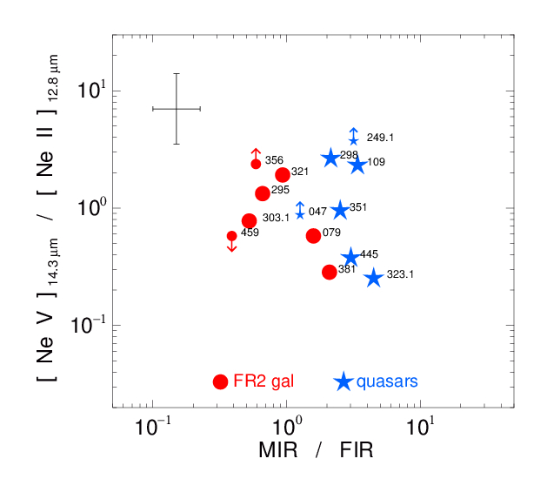
Radio-loud objects
Tests of radio galaxy/quasar unified schemes
Haas et al 05
(Leipski et al 10, Landt et al 10, Ogle et al 10, Rawlings et al 13)
Similar distributions in ([NeV]14.3μm /[NeII]12.8μm) and in [NeV]24.3μm / P178 MHz.
Favors orientation-dependent unified schemes.
[OIII]500.7nm / [OIV]25.9μm of galaxies is 10x lower than that of the quasars, suggesting that the optical emission from the NLR is absorbed in the powerful FR 2 galaxies
Notes:
IRS contrib was alternative and powerful tests of unified schemes – here from From FS lines

Slide 30
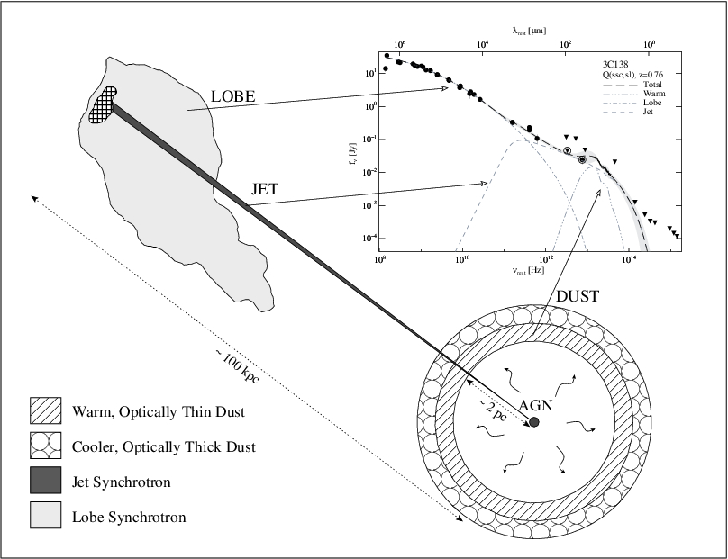
At 15μm, quasars are 4x brighter than radio galaxies with the same isotropic radio power
Half of this difference is due to non- thermal emission in the quasars but not the radio galaxies. The other half is consistent with dust absorption in the radio galaxies but not the quasars
The median optical depth at 9.7 μm for objects with core-dominance factor R > 10−2 is ≈ 0.4; for objects with R ≤ 10−2, it is ≈ 1.1.
Quasars are more luminous in the mid-infrared than galaxies because of a combination of Doppler-boosted synchrotron emission in quasars and extinction in galaxies, both orientation-dependent effects.
Radio-loud objects
Cleary et al 2007
Notes:
From continuum shape, silicate absorption

Slide 31
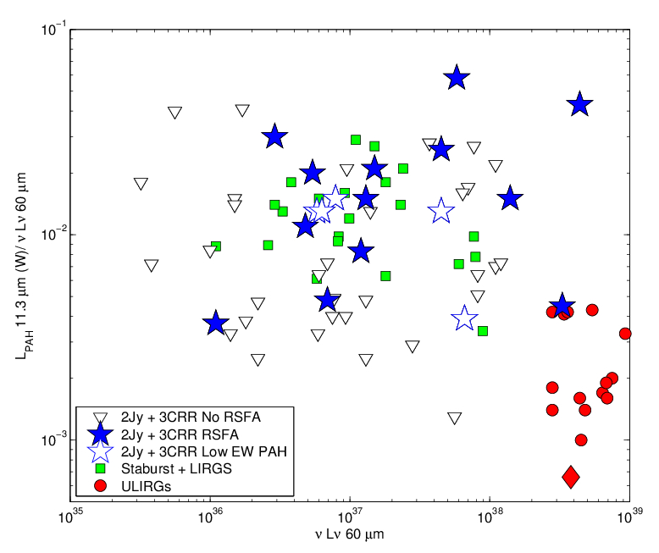
Radio-loud objects
Dicken et al 12
But… no evidence for a strong connection between star formation and AGN activity in radio-loud objects
Notes:
Also very interesting, PoV of gal assembly, was this

Slide 32
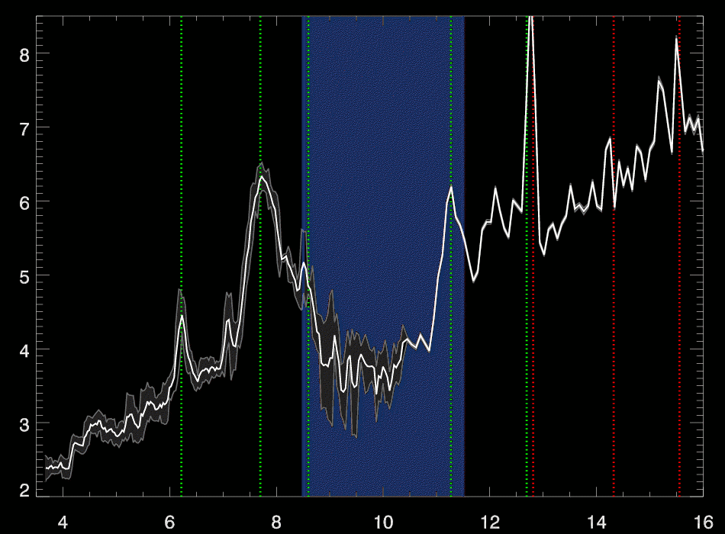
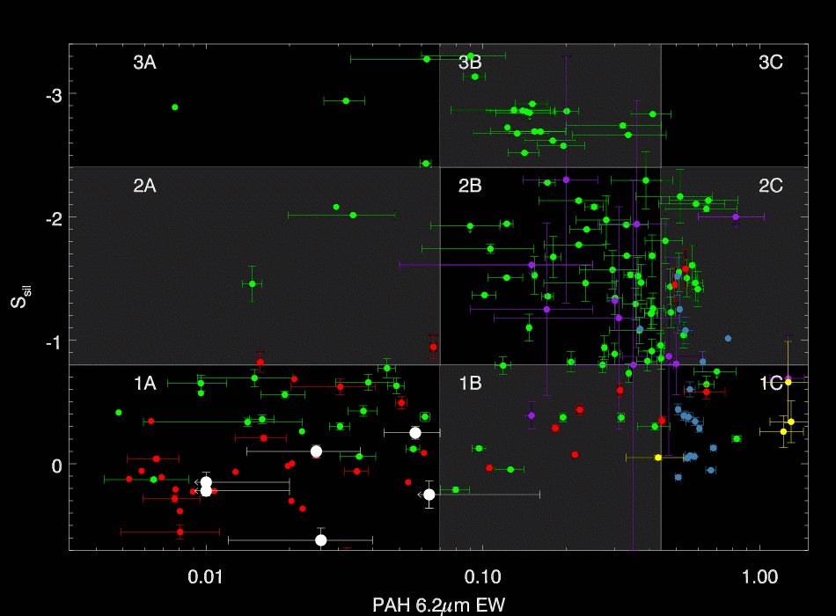
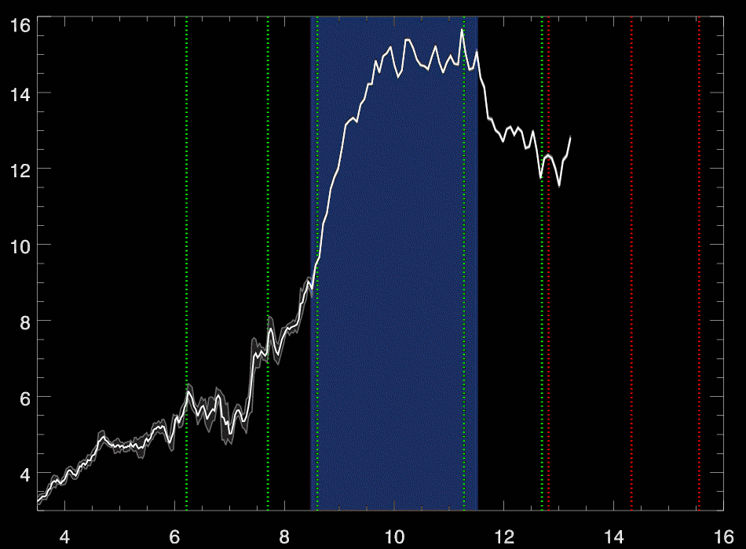
Broad Absorption Line Quasars
Farrah et al 2009
(Lazarova et al 12)
The FeLoBAL quasars have among the most diverse spectral shapes in any class of quasar, marking them as potentially an important transition phase
Notes:
6/27/2017
32
32

Slide 33
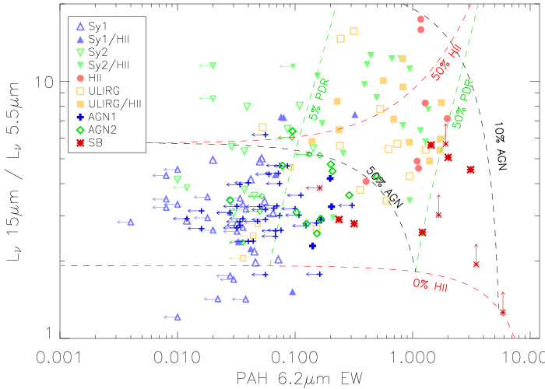
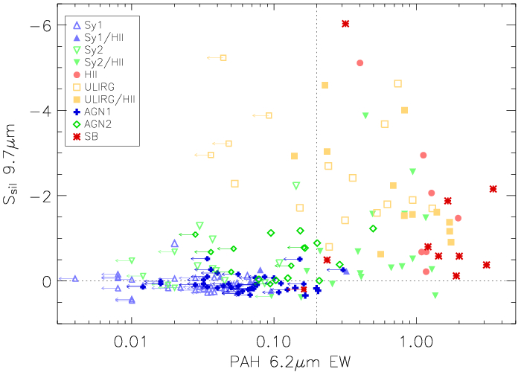
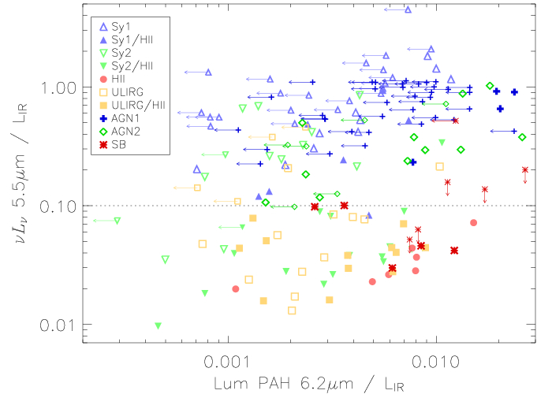
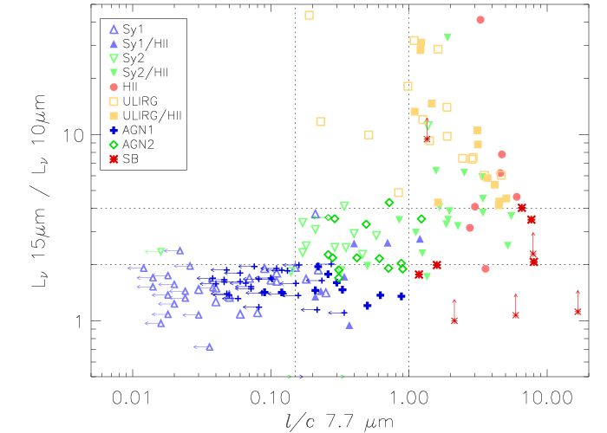
High redshift galaxies
Hernan-Caballero et al 09
Finn et al 10
Teplitz et al 11
Ogle et al 12
Feltre et al 13
Magdis et al 13
15um selected sources from the ISO-ELAIS survey
A heterogeneous mix of AGN, both unobscured and obscured, and starburst dominated systems. About half are AGN dominated
A link between obscuration and star formation rate, independent of luminosity?

Slide 34
High redshift galaxies
Kirkpatrick et al 12
Desai et al 09
Fadda et al 10
Melbourne et al 12
24um selected sources in the GOODS-Herschel fields at 0.5<z<4
25% of sources are AGN dominated
The IR SEDs have similar cold dust temperatures, regardless of the mid-IR power source, but display a marked difference in the warmer dust temperatures
Local templates do not accurately reproduce their mid-IR features and dust temperatures
High redshift IR luminous galaxies contain significantly more cool dust than their local counterparts

Slide 35
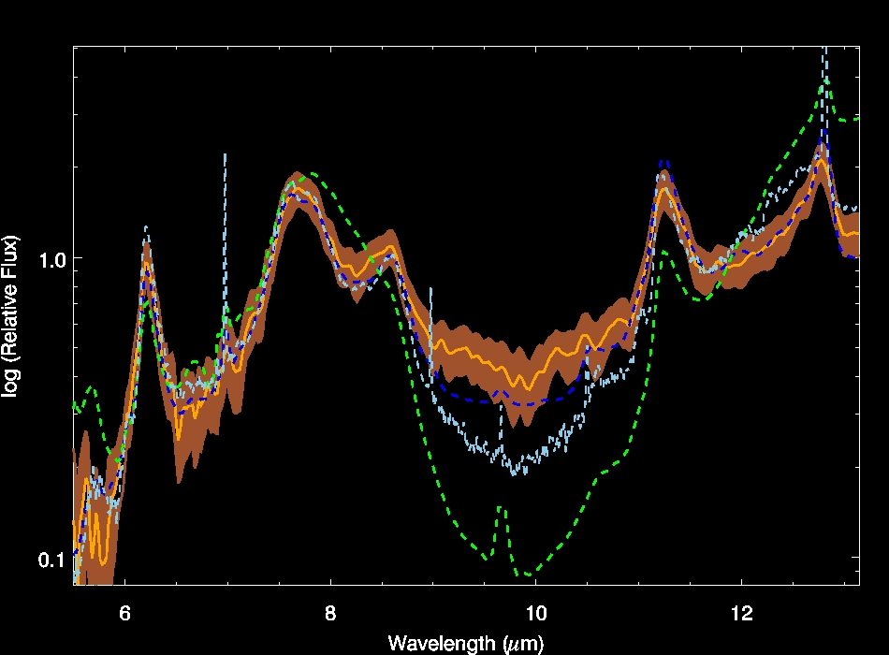
High redshift galaxies
Farrah et al 08
Composite spectrum of luminous, mid-infrared selected starbursts at z~2
Does not resemble comparably luminous objects at z=0, but instead `ordinary’ local starbursts
Evidence for evolution in starburst properties with redshift

Slide 36
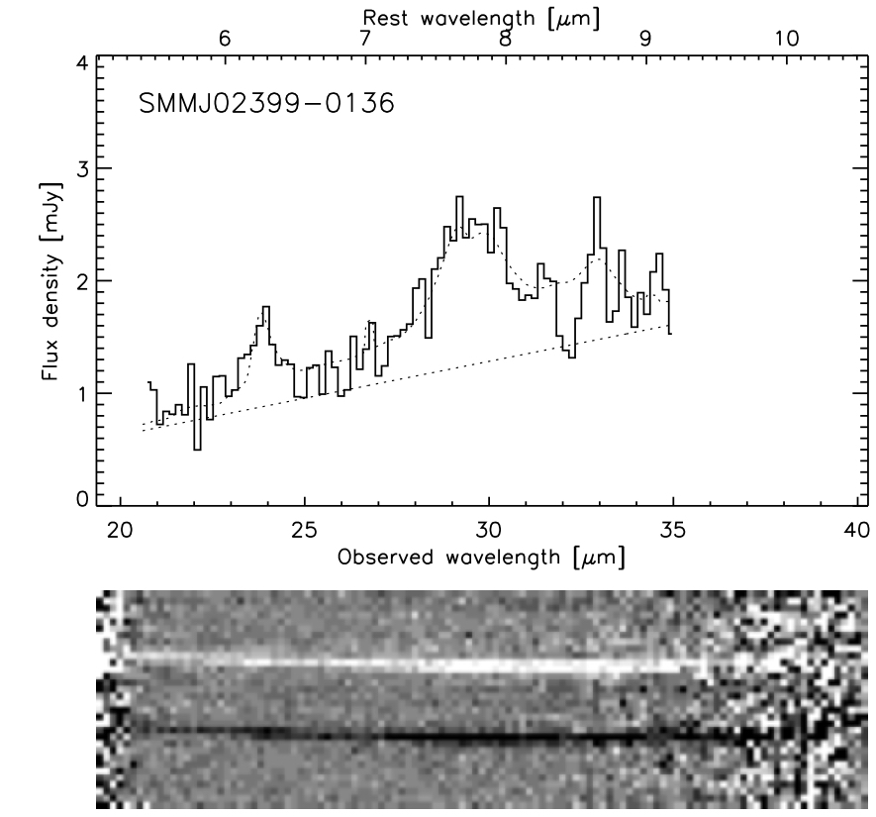
Sub-millimeter galaxies
Lutz et al 05
Charmandaris et al 04
Coppin et al 10
Early pilot study of two objects:
#1: roughly equal contributions to bolometric luminosity from star formation and from Compton-thick AGN
#2: a starburst dominated system

Slide 37
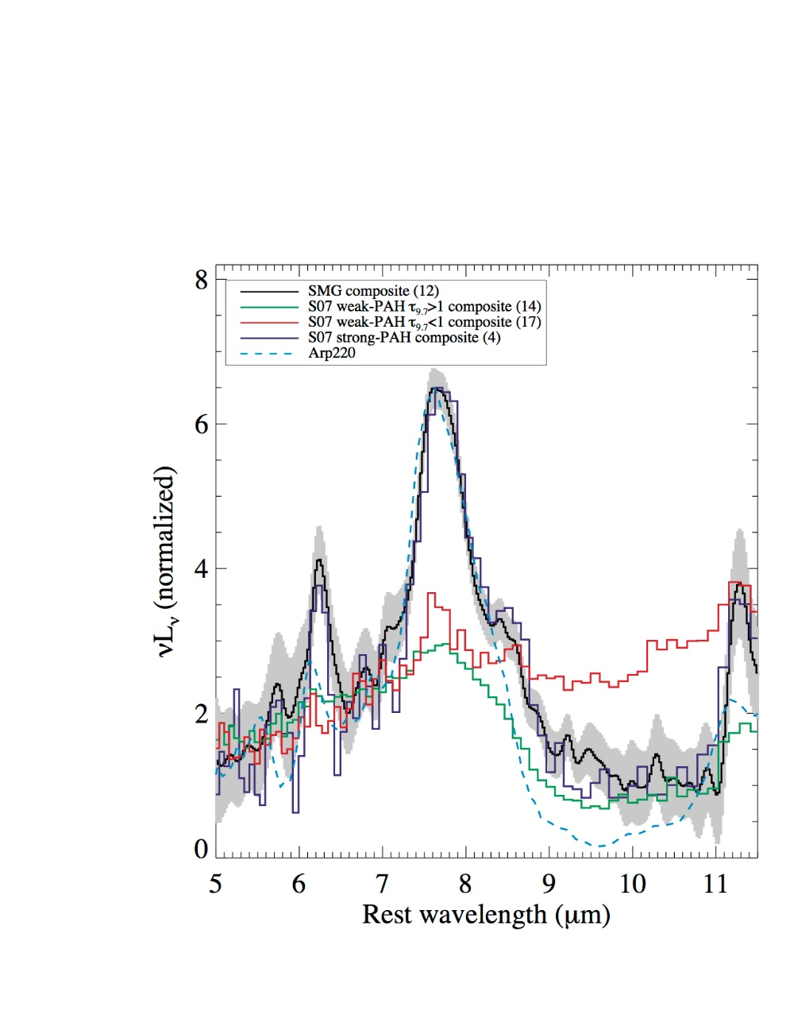
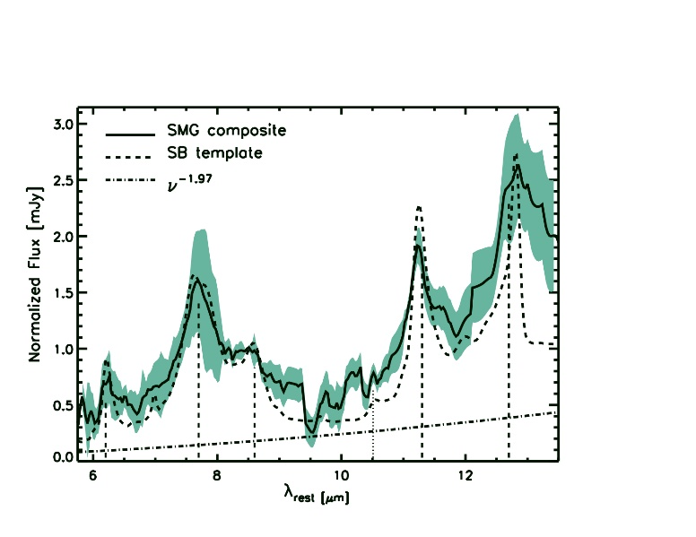
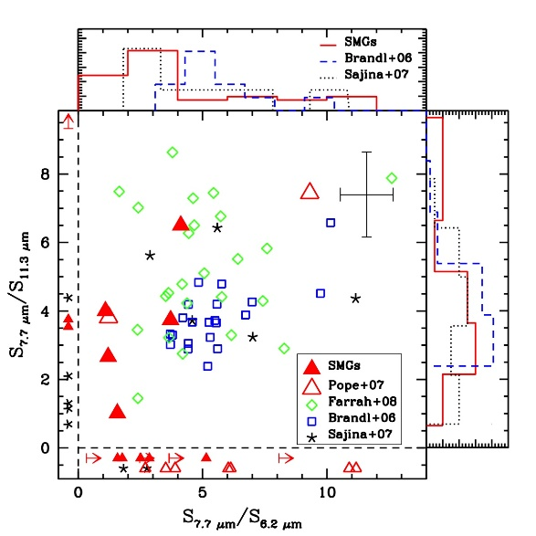
Sub-millimeter galaxies
Pope et al 08, Menendez-Delmestre et al 09
Strong polycyclic aromatic hydrocarbon (PAH) emission in all targets
Hot dust continua from AGN contributes at most 30% of the mid-IR luminosity.
Only ~15% of SMGs have continuum emission dominating the mid-infrared luminosity
High redshift SMGs have mid-IR spectra resembling those of local starburst galaxies, not local ULIRGs

Slide 38


Gravitationally lensed systems
Rigby et al 08
Probe z=1 sources near the MIPS confusion limit
Starburst and AGN systems
Evidence for systematic evolution in starburst mid-IR spectral properties with redshift? Changing 24 micron flux-SFR calibration?

Slide 39

The future – James Webb Space Telescope

Slide 40
The JWST Users Committee
James Bullock University of California, Irvine
Kat Barger Texas Christian University
Natalie Batalha NASA-Ames
Saida Caballero-Nieves Florida Institute of Technology
Stephane Charlot Institute d'Astrophysics, Paris
Duncan Farrah Virginia Polytechnic Institute and State University
Tom Greene NASA-Ames
Amanda Hendrix Planetary Science Institute
Kelsey Johnson University of Virginia
Heather Knutson California Institute of Technology
David Lafreniere Universite de Montreal
Mario Mateo University of Michigan
Els Peeters University of Western Ontario
Laura Pentericci INAF
Mike Ressler NASA-JPL
Johan Richard Universite de Lyon
Tommaso Treu University of California, Los Angeles
Alistair Glasse University of Edinburgh
“Provide user advice to the observatory to ensure that the observatory operations maximize its scientific performance”
https://jwst.stsci.edu/science-planning/user-committees/jwst-users-committee-jstuc

Slide 41

The Future – Origins Space Telescope
https://asd.gsfc.nasa.gov/firs/
understand water transport in protoplanetary disks
detect previously unknown extrasolar planets based on their sculpting effects on debris disks
unveil the dark side of galaxy evolution at z>4
have a three order of magnitude gain in sensitivity over Herschel
The Origins Space Telescope (OST) is the mission concept for the Far-IR Surveyor study

Slide 42

The Far-InfraRed Science Interest Group
The Far-Infrared Science Interest Group works with the COPAG to collect community input and address long-term objectives of the far-infrared astronomy community
https://www.cfa.harvard.edu/~mmacgreg/FIR_SIG/index.html
We are recruiting new members to the FIR SIG! Please contact
Duncan Farrah (farrah@vt.edu)
JD Smith (JD.Smith@utoledo.edu)
for details

Slide 43
What the IRS did for extragalactic science!
The first detection of several new mid-infrared features – crystalline silicates, ices, some faint fine-structure lines, other hydrocarbons
Development of the first comprehensive suite of obscured power source diagnostics
The first robust characterization of candidate `primeval’ galaxies in the local Universe
Evidence for low level, but important, star formation in some Early-type galaxies
The first systematic study of mid infrared power source as a function of luminosity in local galaxies
Deep imaging observations of treasury extragalactic survey fields
The first comprehensive mid-infrared spectral maps of low-redshift systems
The first accurate characterization of 24 and 70 micron sources found by MIPS across a wide range in redshift
The detection of dust in absorbers along quasar sightlines
The first exploration of `normal’ dusty galaxies outside the local Universe
The first mid-infrared spectroscopic detection of sources at z>5
The evolution of silicate dust in active galaxies
The first reliable studies of the obscured power source in high redshift galaxies
An expansive archive of observations that is still actively mined today
The first unambiguous view of the power sources in ultraluminous infrared galaxies
Strong support for (some flavor of) AGN unified schemes
The first evidence for correlation/decoupling of star formation rates and AGN properties in some classes of quasar
Evidence that star-formation in galaxies may change systematically with redshift
Evidence that SMGs are not pure starbursts, but instead a heterogeneous population that harbors large amounts of cold dust
The first robust evidence for star formation quenching in other classes of AGN

Slide 44


Slide 45
BELOW HERE IS SPARES

Slide 46

A cosmic X-ray “Background”
XRB well explained by a combination of obscured and unobscured AGN
(e.g. Madau et al. 1994, Comastri et al. 1995, Gilli et al. 2001, Treister & Urry 2005, Gilli et al. 2007)
Frontera et al. (2006)
Notes:
46
We know now that the X-ray background is just collective emission from previously unresolved sources,
90% of them AGN.
The X-ray background spectrum is very steep, with a peak at ~30 keV.
This is good indication that obscured AGN should outnumber the unobscured ones.

Slide 47

Star formation rates in luminous type 1 quasars evolve in approximately the same way with redshift as the comoving star formation rate density
Caveats:
This is compared to the average, not individual populations
This only applies to Delta t>0.1Gyr timescales – longer than the AGN duty cycle

Slide 48

Ongoing feedback in FeLoBAL quasars
Farrah et al 2012
All Objects:
P(Starburst>25%): 51% +/- 5%
Weak Outflows:
P(Starburst>25%): 63% +/- 4%
Strong Outflows:
P(Starburst>25%): 18% +/- 5%
Weak Outflows means a much greater chance
of seeing a large starburst contribution than strong outflows

Slide 49

The importance of mergers
The evolution in merger fraction with redshift is uncertain, and may depend on merger type
Man et al 2016
Notes:
Understanding of merger evo with redshift is not great
This is state of the art, divides mergers into two cats
Seems to be evidence for rising merger fractions with redshift but errors are large – still have a lot to do here

