Slide 1
S³AGA: Spitzer SDSS Spectral Atlas of Galaxies and AGNs
Lei Hao (Shanghai Astronomical Observatory)
Jianwei lyu (University of Arizona)

Slide 2

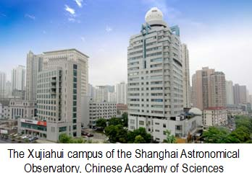
Background
In Jim’s IRS group from Nov, 2003-Feb, 2008
SHAO, Shanghai, 2010 --

Slide 3
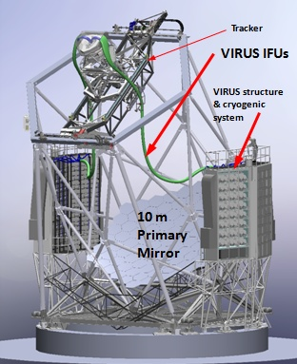
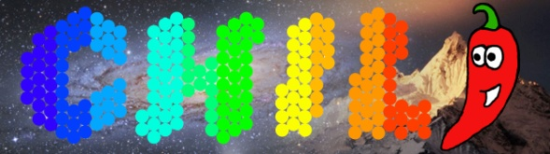
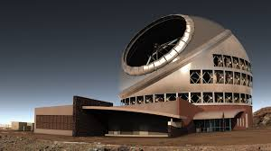
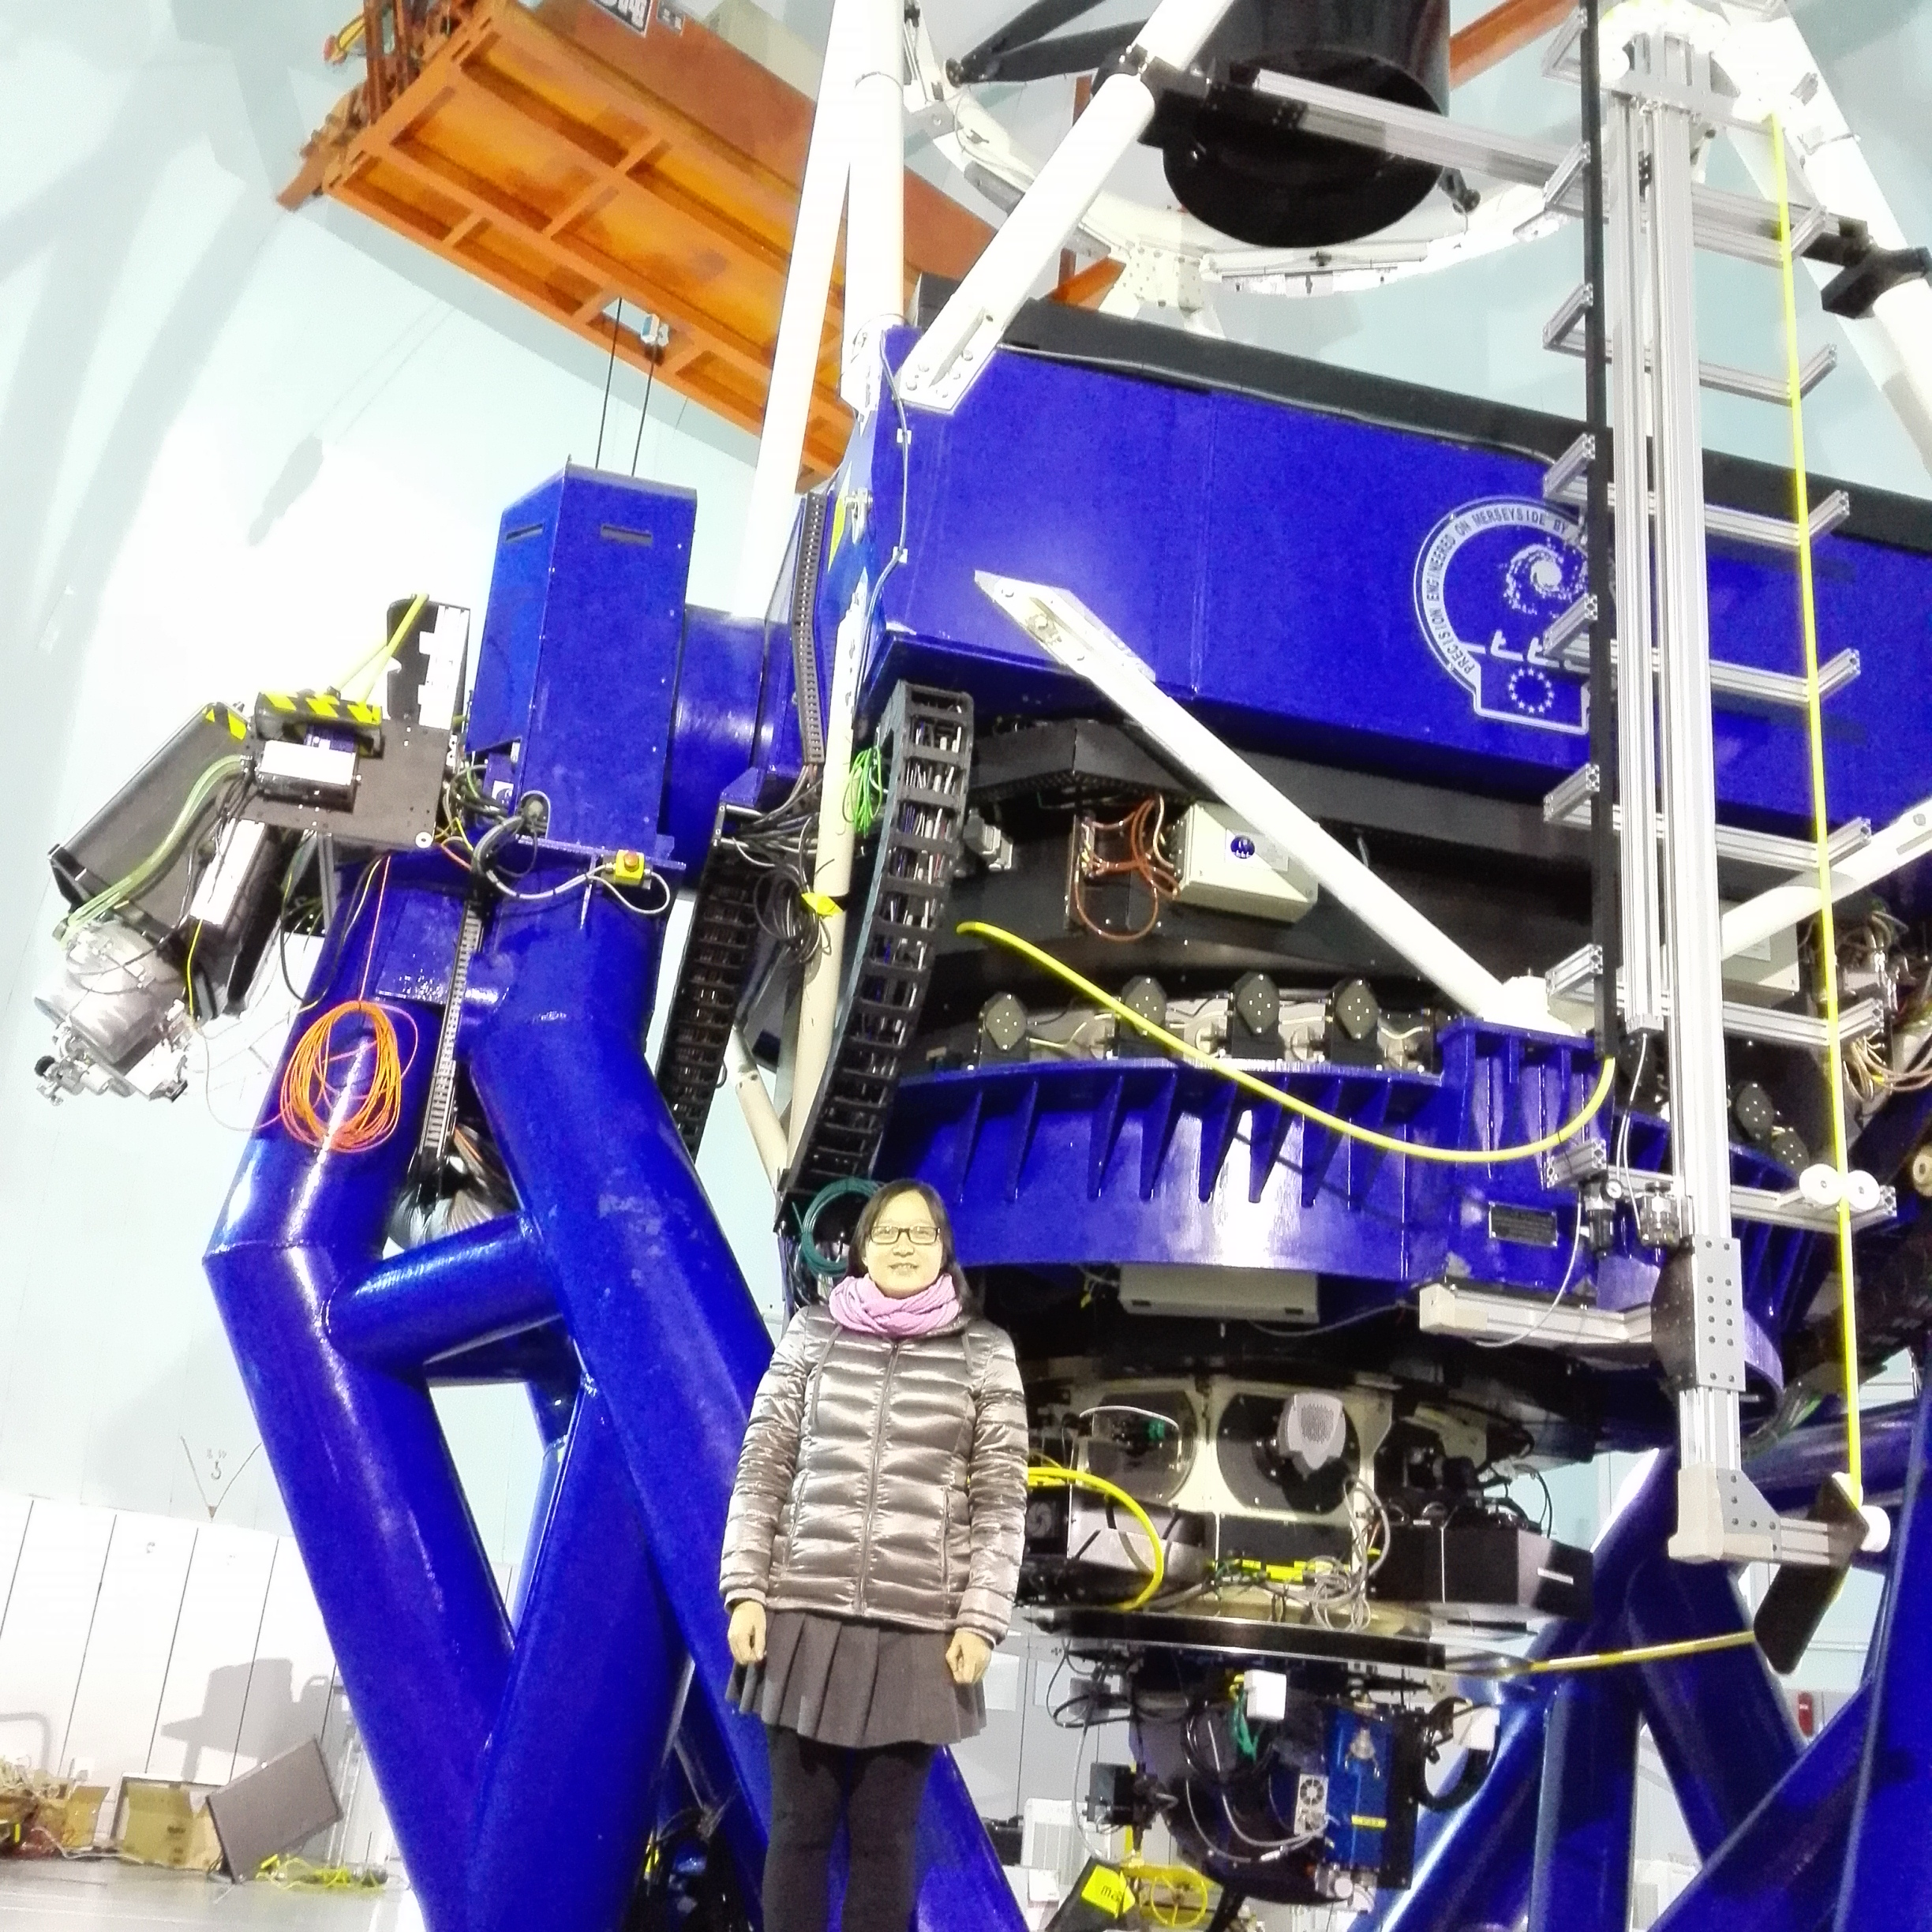
Background
In Jim’s IRS group from Nov, 2003-Feb, 2008
SHAO, Shanghai, 2010 --
Thirty Meter Telescope
Large Optical/Infrared Telescope (LOT, 12m)
HET Dark Energy Survey
China Lijiang IFU
& IFU surveys like MaNGA (SDSS-IV) and VENGA

Slide 4
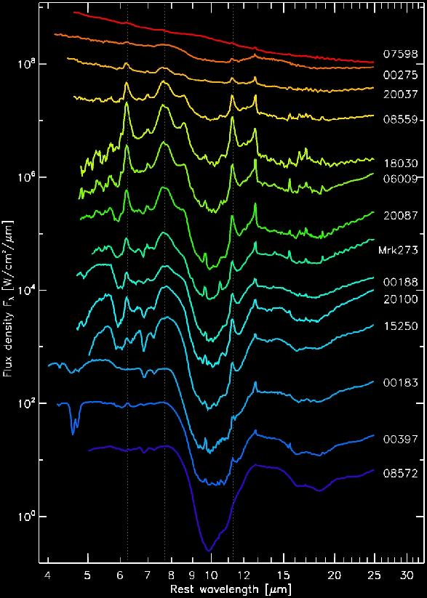
A side project: continuing on the infrared excitement
Infrared emission of ULIRGs
Molecular emissions
  Dust:
    Silicates
    PAHs
  Gas:
    H2 emission
    Other molecules
Atomic emissions of gas
  [NeII], [NeIII], [SIII], [SIV], [NeV], [OIV], etc.
Credit: Henrik Spoon

Slide 5
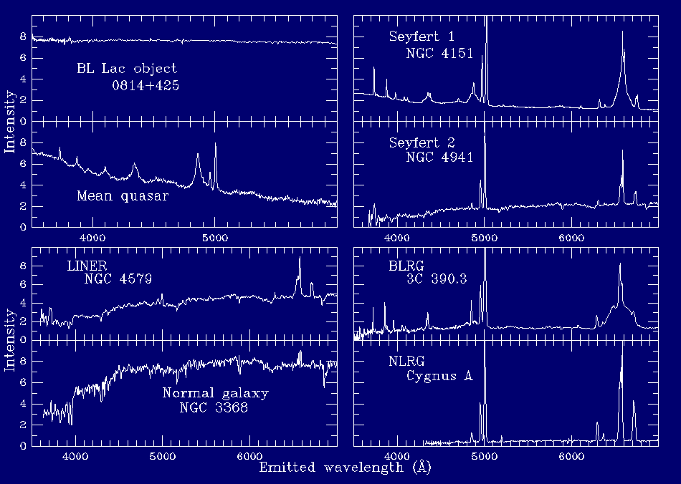
A side project: continuing on the infrared excitement
ISM GAS: atomic
AGNs
STARS

Slide 6
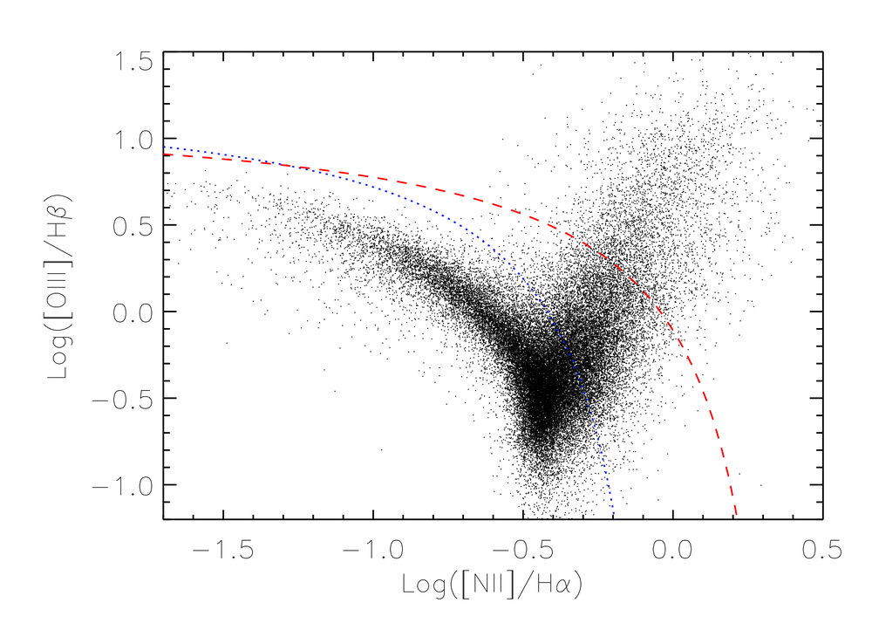
A side project:
continuing on the infrared excitement
Surveys like the SDSS can link millions of galaxies together. For example: diagnostics BPT Diagram
AGNs
Kewley et al. 2001
Kauffmann et al. 2003
A+S
SBs
Hao et al. 2005

Slide 7
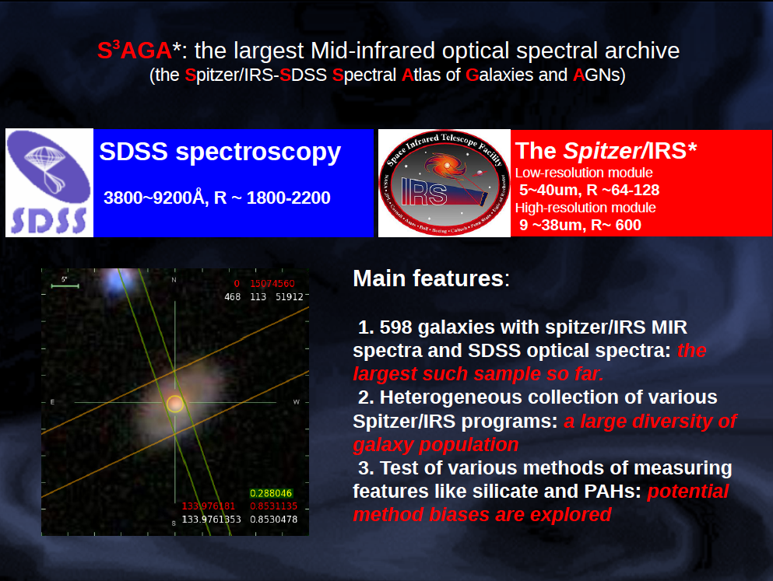
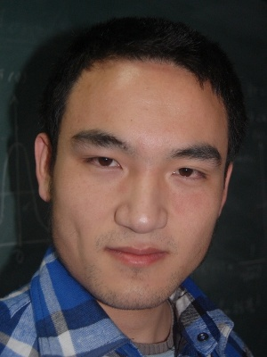
Jianwei Lyu (UA)
S³AGA:
The Spitzer/IRS-SDSS Spectral Atlas of Galaxies and AGNs
AGN extinction, Extreme Starburst,
AGN diagnostics, AGN host galaxy properties

Slide 8
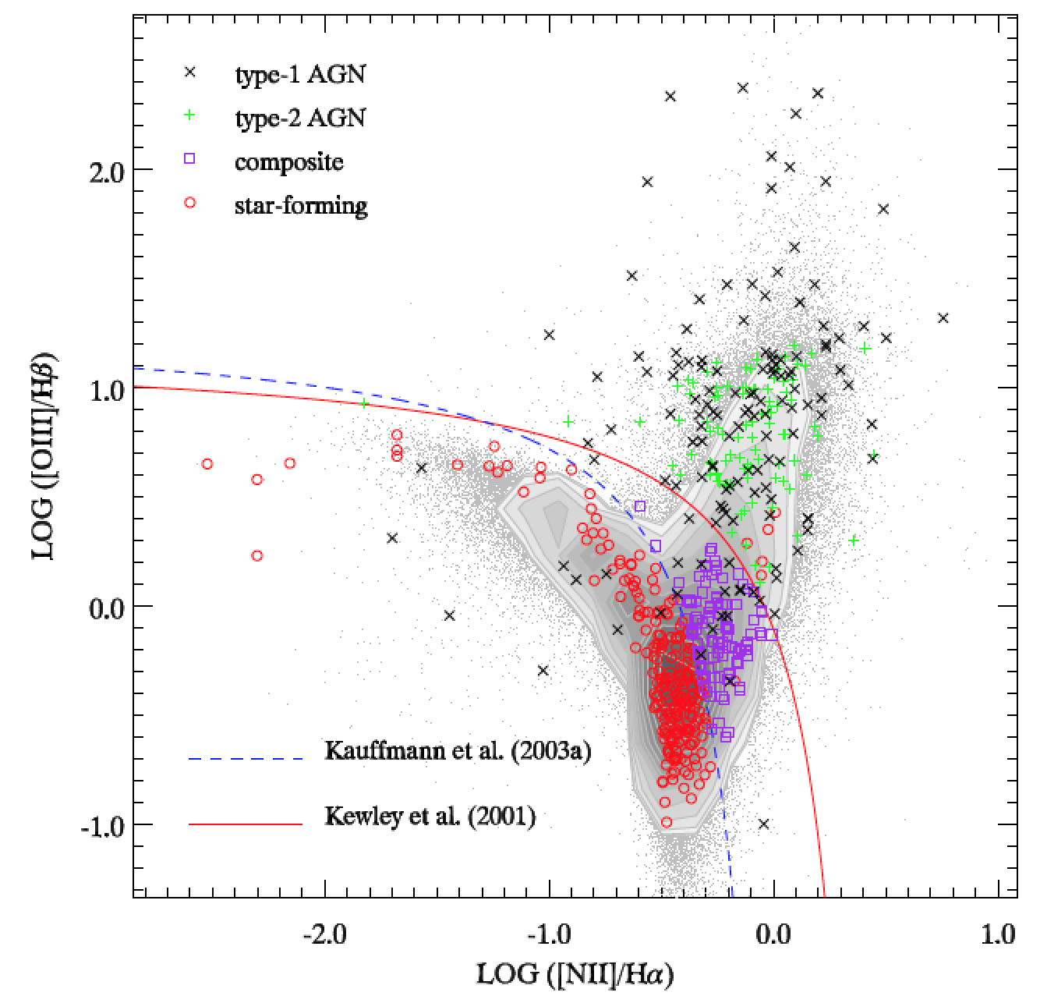
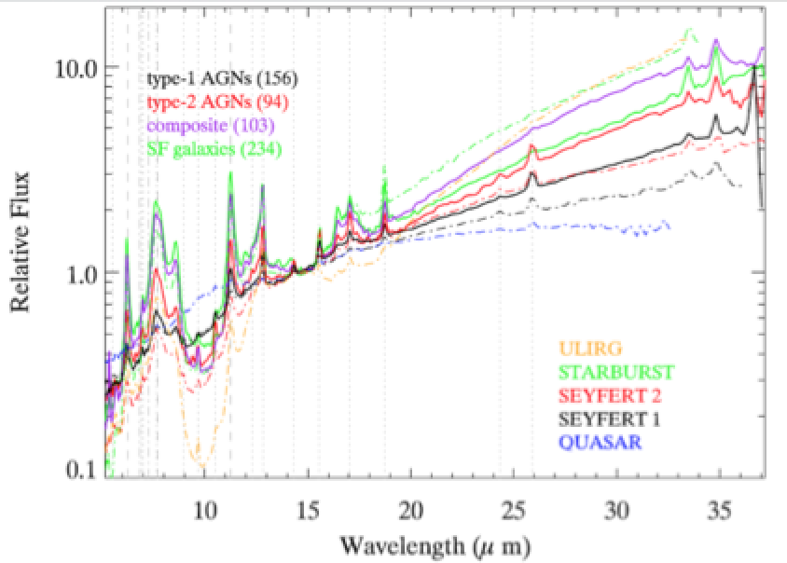
Spectra Overall
switch red and green

Slide 9
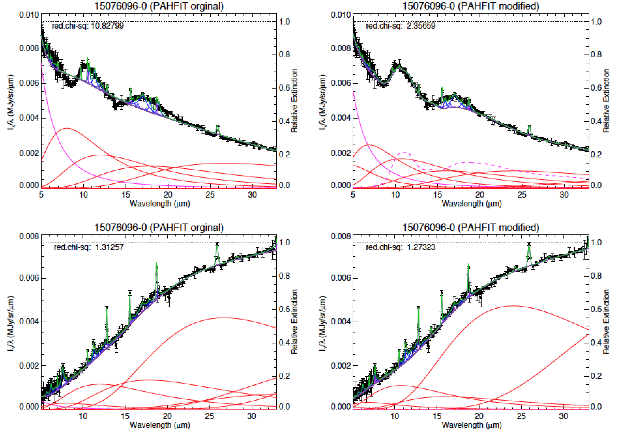
Measurements
Features are measured two ways:
PAHFIT (with some modifications)
Continuum obtained from interpolations

Slide 10
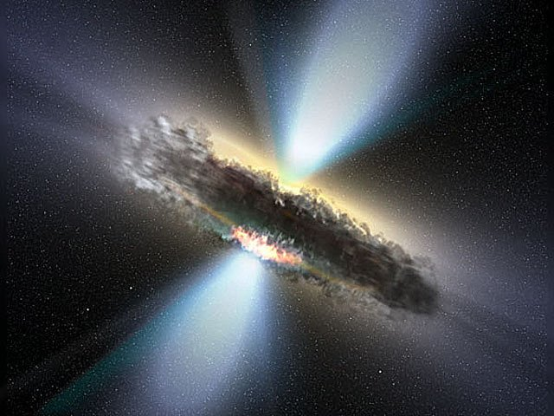
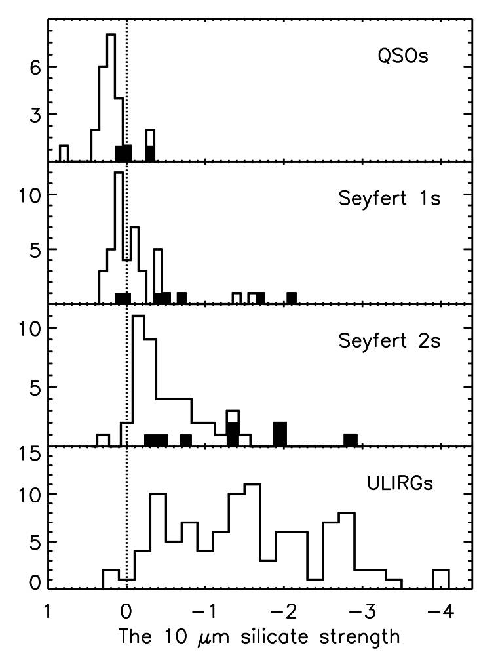
SE
SA
Seyfert1s, Quasars, Type I
Seyfert2s, Type II
Hao et al. 2007, ApJ, 655, L77

Slide 11
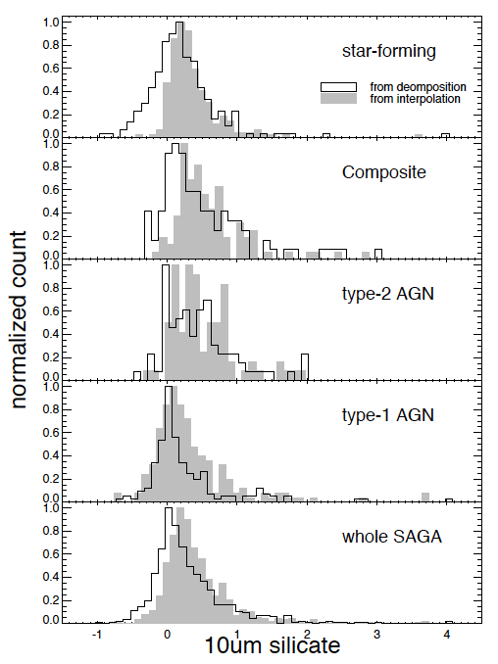
Updates from S³AGA

Slide 12
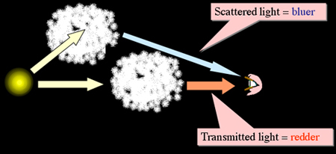
AGN Extinction
Scatter and absorb

Slide 13
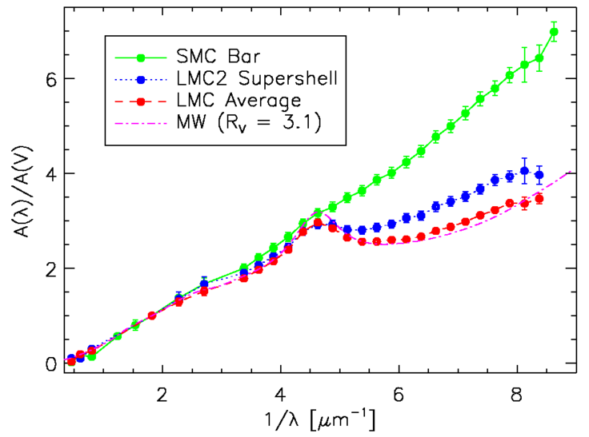
Dust Extinction Curve
2175 feature
Optical depth in UV ~10 x in optical
Redenning:
  E(B-V)=A_{B}-A_{V}
  R_{V}=A_{V}/(A_{B}-A_{V})
  =A_{V}/E(B-V)

Slide 14
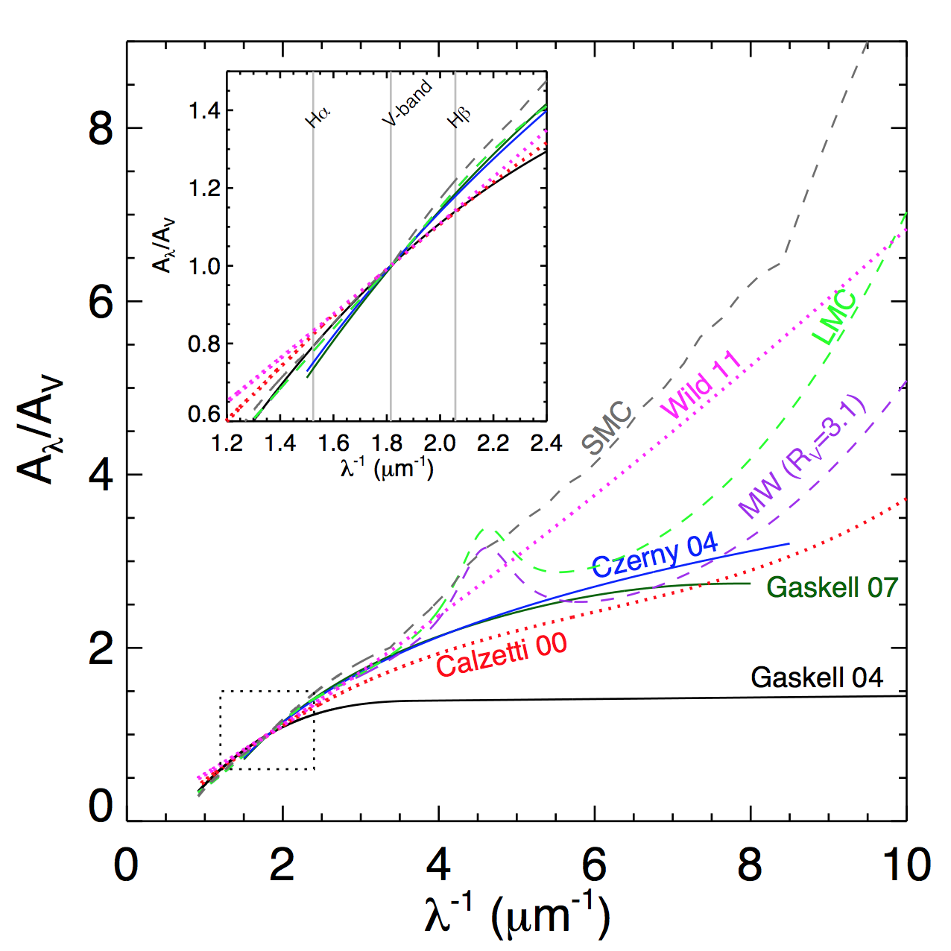
AGN Extinction Curve
very controversial
almost no measurements on A_{v}/A_{IR}

Slide 15
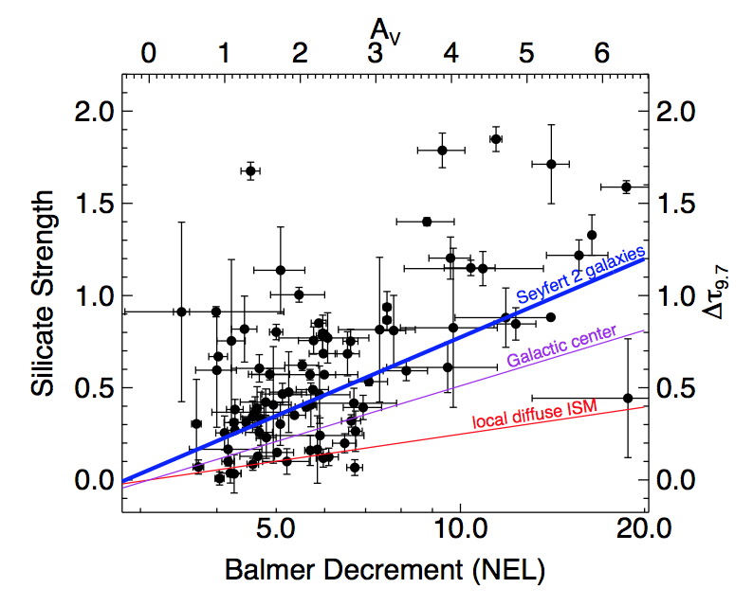
AGN Extinction Curve
AGNs: larger dust grains
(Lyu, Hao* & Li, 2014, ApJL, 792, 9)
A_{v}/A_{9.7}=5.5
Type-II AGNs
A_{v}/A_{9.7}=9
Galactic Center
A_{v}/A_{9.7}=18
Diffused ISM

Slide 16
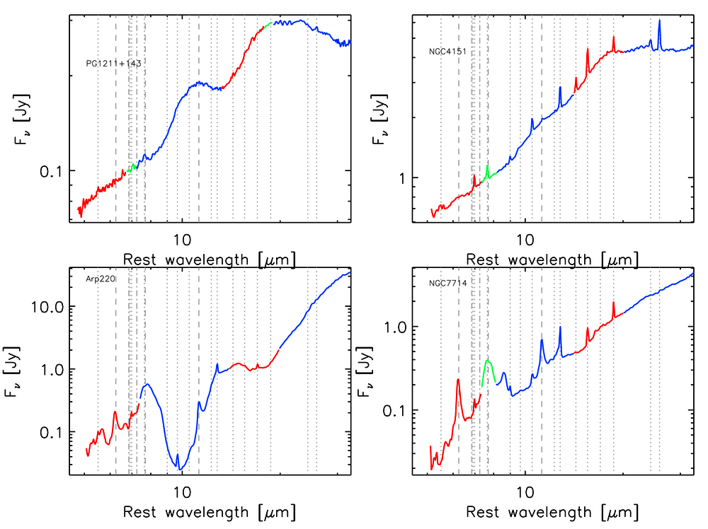
Galaxies that are unusual
QSO
Seyfert
ULIRG
Starburst

Slide 17
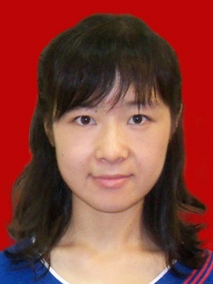
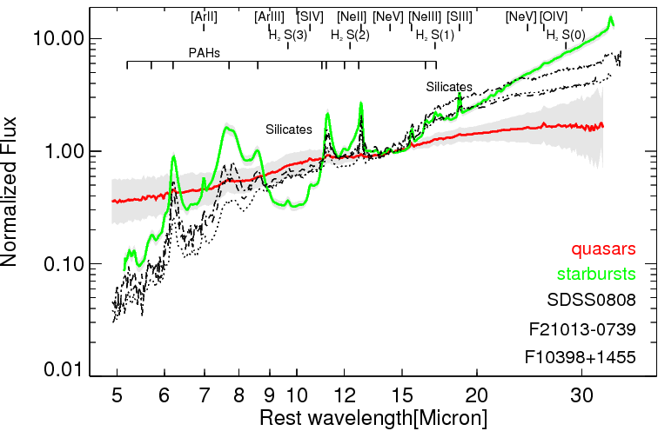
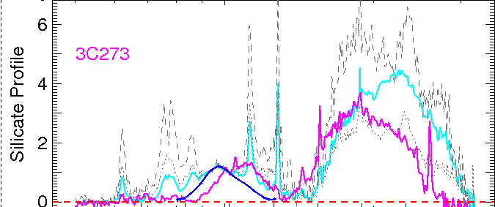
Galaxies that are unusual
Low 5-8μm continuum
Xie, Hao*, Li, 2014, ApJL

Slide 18
Dust Modeling
cold car.
cold sil.
(Xie, Li, Hao & Nikutta 2015, ApJ, 808, 145)
warm car.
warm sil.
Low carbonaceous dust temperature ~200-400 K (~650K for quasars).
Sub-micrometer-sized grains (a ≤ 1.0μm. a>1.5μm for quasars).
The temperature and grain size are insensitive to composition.

Slide 19
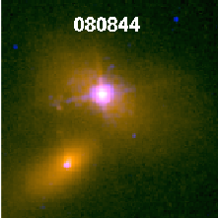
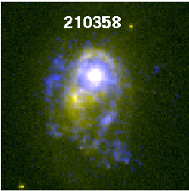
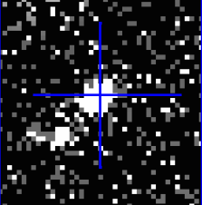
Galaxies that are unusual
Lyman Break Analogues(LBAs) and compact UV size
F10398+1455
DCO
DCO
Intensive Starformation and very compact
UV+OPT
UV+OPT
L_{FUV} > 2×10¹⁰ L, I_{FUV} > 10⁹ Lkpc⁻²
GALEX NUV image
Unresolved in 5”
L_{FUV,} I_{FUV,} M*, SFR, sSFR, σ_{gas} ,etc
Rare: 35, z < 0.3, 10⁻⁶ Mpc⁻³
Heckman (2005)
Hoope et al. (2007)
Overzier et al. (2009b)
6 DCOs, 0.4”, f(UV) ~50%

Slide 20
Galaxies that are unusual
large log([N II]/[S II] ) >0.5
log([[O III]/H β) < 0.3
  Compact extreme Starbursts: outflow > 1500km/s (Heckman et al., 2011)

Slide 21

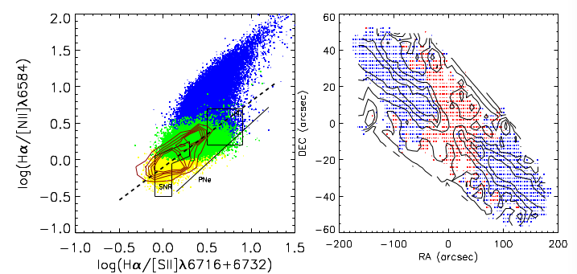
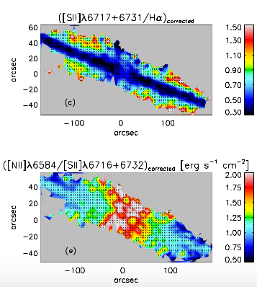
Outflows and DIGs in an edge-on galaxy
Minnie Lam Lin
NGC4013

Slide 22
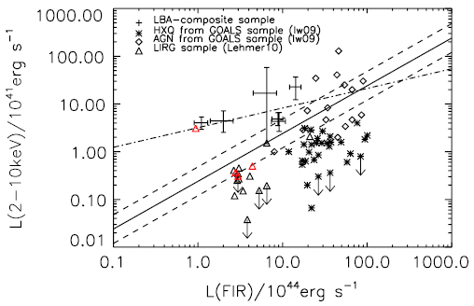
The three galaxies: AGN?
Unusual
  Compact, intensive starbursts
  Strong outflows seen in UV absorption spectra
  Strong [NII]/[SII] emission
  Silicate emission may come from pure starburst activity in its extreme case
  Low 5-8um continuum
  Crystallized silicate emission
No evidence of AGN in almost all bands, except maybe in hard X-ray. Could the hard X-ray also from pure SB?
Jia et al. (2011)
s

Slide 23
Galaxies that are unusual
If [NII]/[SII]>0.5 can be used to find galaxies that are in the intense SB phase, estimate the duty cycle
large log([N II]/[S II] ) >0.5
log([[O III]/H β) < 0.3

Slide 24
The three galaxies: AGN?
Unusual
  Compact, intensive starbursts
  Strong outflows seen in UV absorption spectra
  Strong [NII]/[SII] emission
  Silicate emission may come from pure starburst activity in its extreme case
  Low 5-8um continuum
  Crystallized silicate emission
No evidence of AGN in almost all bands, except maybe in hard X-ray. Could the hard X-ray also from pure SB?
May shed light on dust processes at high-redshift universe
Jia et al. (2011)
s

Slide 25
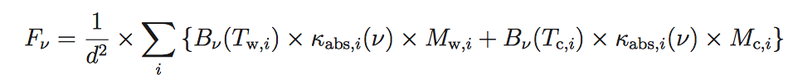
AGN silicates
Dust modeling of AGN silicate emissions (Xie et al., 2017)
  Dust grains much larger than the Galactic ISM grains
  9.7 from dust at T~270K, while the 5-8um mainly from dust at T~640K
Crystallinities for Quasars with silicate emissions (Collaboration with Ciska Kemper (ASIAA)’s group, Srinivasan et al., 2017)
  Mean crystallinity is 8±6%, larger than that for the Galaxy

Slide 26
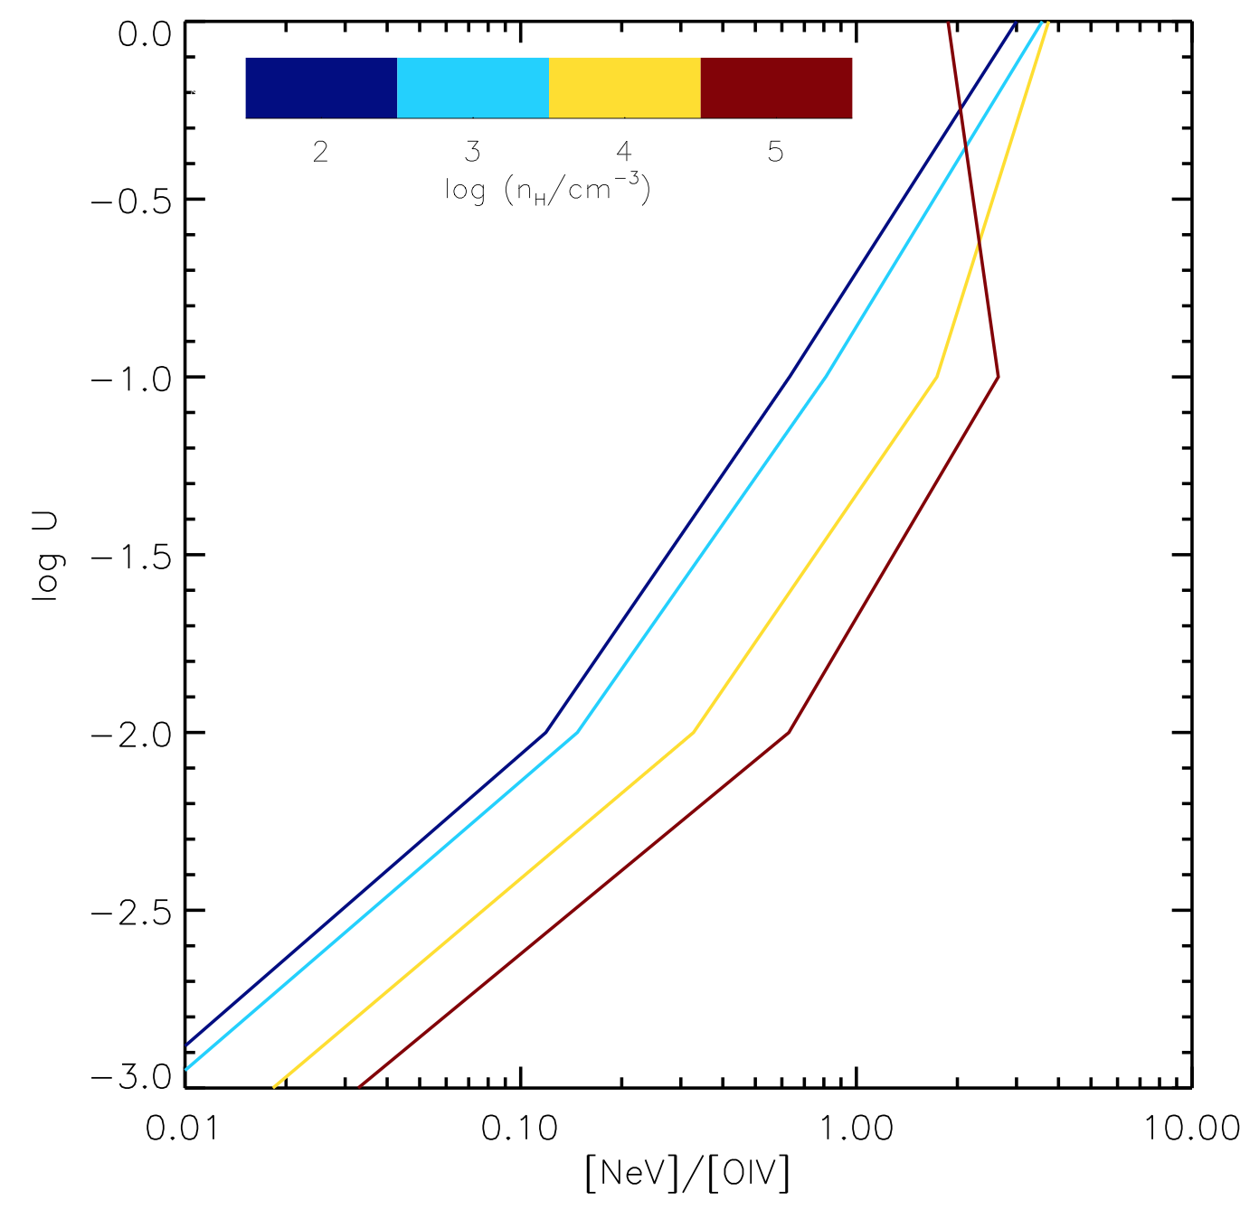
Next with S³AGA
AGN host SF estimation from the optical
  Using [NeV]/[OIV] (infrared lines) and the CLOUDY model to calibrate how good the [OII] (optical lines) can be used for SF indicator for AGNs.
H₂ emissions in galaxies

Slide 27
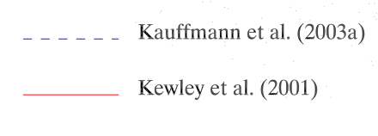
Shocks?

Slide 28
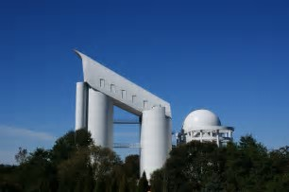
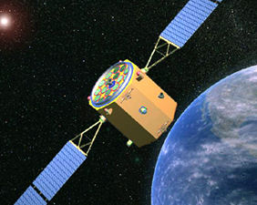
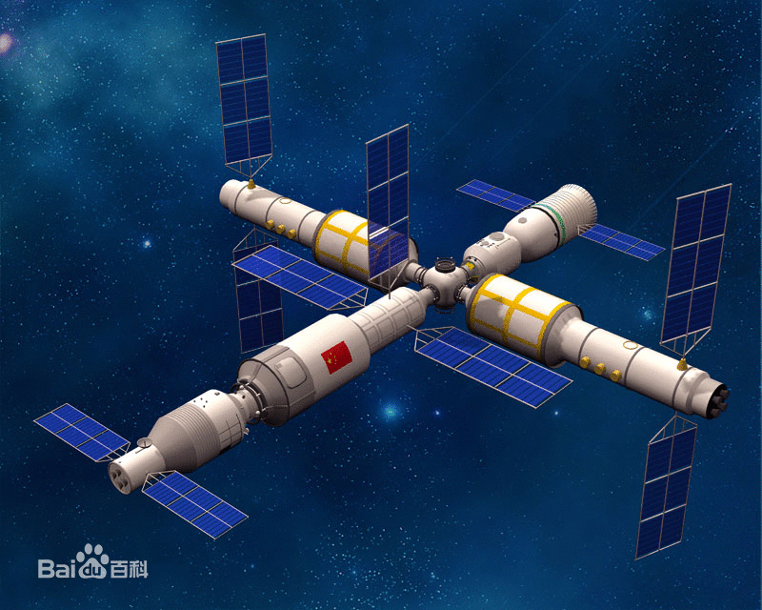
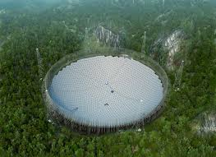
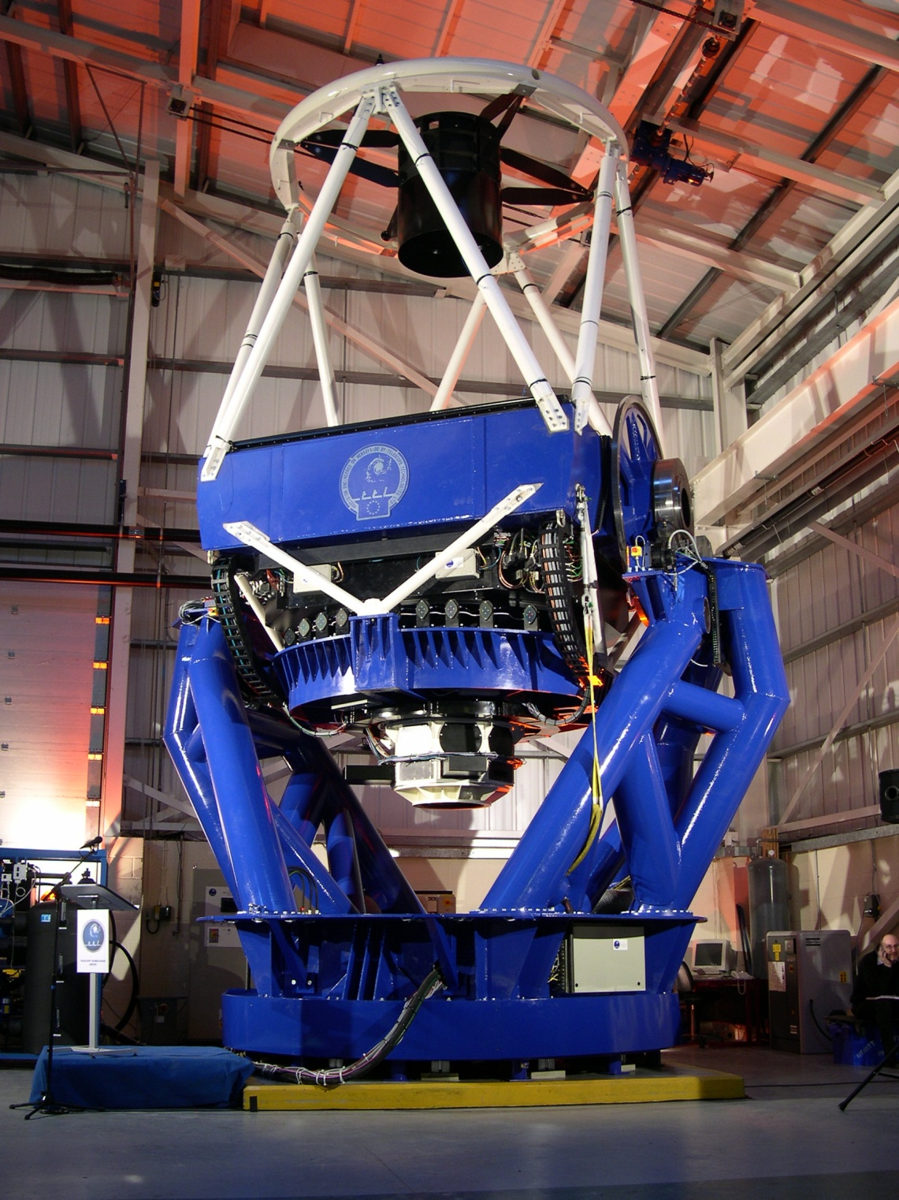
Astronomy in China
Rapid progress in producing sciences using archival data
Community is still small, yet a lot of activities
Facilities:
  Optical telescopes, LAMOST, 2.4m telescope etc., CSST (2m space station telescope), TAP
  Dome-A astronomy (a 2.5m survey optical/IR telescope and a 5m submm telescope), JCMT
  FAST (500m radio), SKA
  DAMPE (gamma-rays, etc), HXMT (X-ray)
  TMT, LOT(12m Chinese optical/IR telescope)

Slide 29
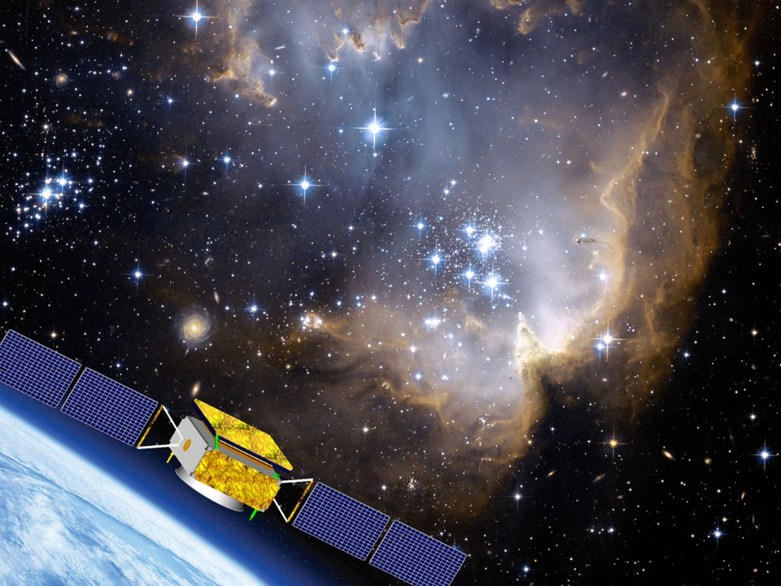
Astronomy in China
Rapid progress in producing sciences using archival data
Community is still small, yet a lot of activities
Facilities:
  Optical telescopes, LAMOST, 2.4m telescope etc., CSST (2m space station telescope), TAP
  Dome-A astronomy (a 2.5m survey optical/IR telescope and a 5m submm telescope), JCMT
  FAST (500m), SKA
  DAMPE (gamma-rays, etc), HXMT (X-ray)
  TMT, LOT(12m Chinese telescope)

Slide 30
IR in China
Developments are very limited due to zero access to sensitive IR detectors
A barrier that has become unbearable
  There are institutes that are trying hard to make developments, but slow
  TMT: preliminary collaborations on the IRMS: cryogenic cooling optics, cooling systems, etc.
  LOT (12m): IR definitely needed

