Slide 1
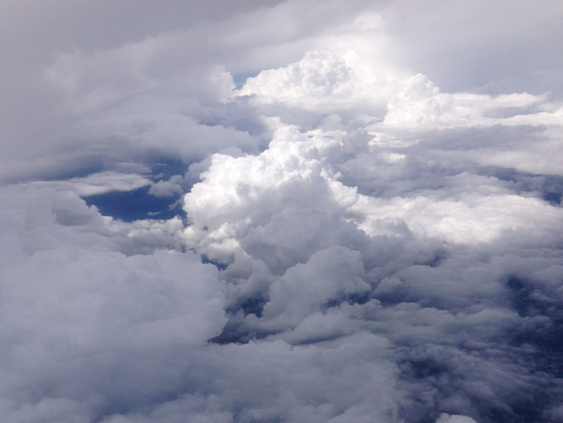
Congregation of Vapors: Towards a Synoptic View of Water Vapor in Support of Airborne IR Astronomy Jeffrey E. Van Cleve^{1,2}, Tom Roellig¹, Allan Meyer³, Dale Hurst^{4,5}, Emrys Hall^{4,5}, and Allen Jordan^{4,5} ¹NASA Ames Research Center, ²SETI Institute, ³USRA-SOFIA Science Center, ⁴CIRES CU Boulder, ⁵NOAA ESRL GMD Boulder
this most excellent canopy the air, look you, this brave o'er hanging firmament, this majestical roof, fretted with golden fire: why, it appeareth no other thing to me, than a foul and pestilent congregation of vapours –Hamlet, Infrared Astronomer of Denmark
(Atmospheric) Science Enabled by Novel Infrared (Astronomical) Instrumentation: 6/26/2017

Slide 2
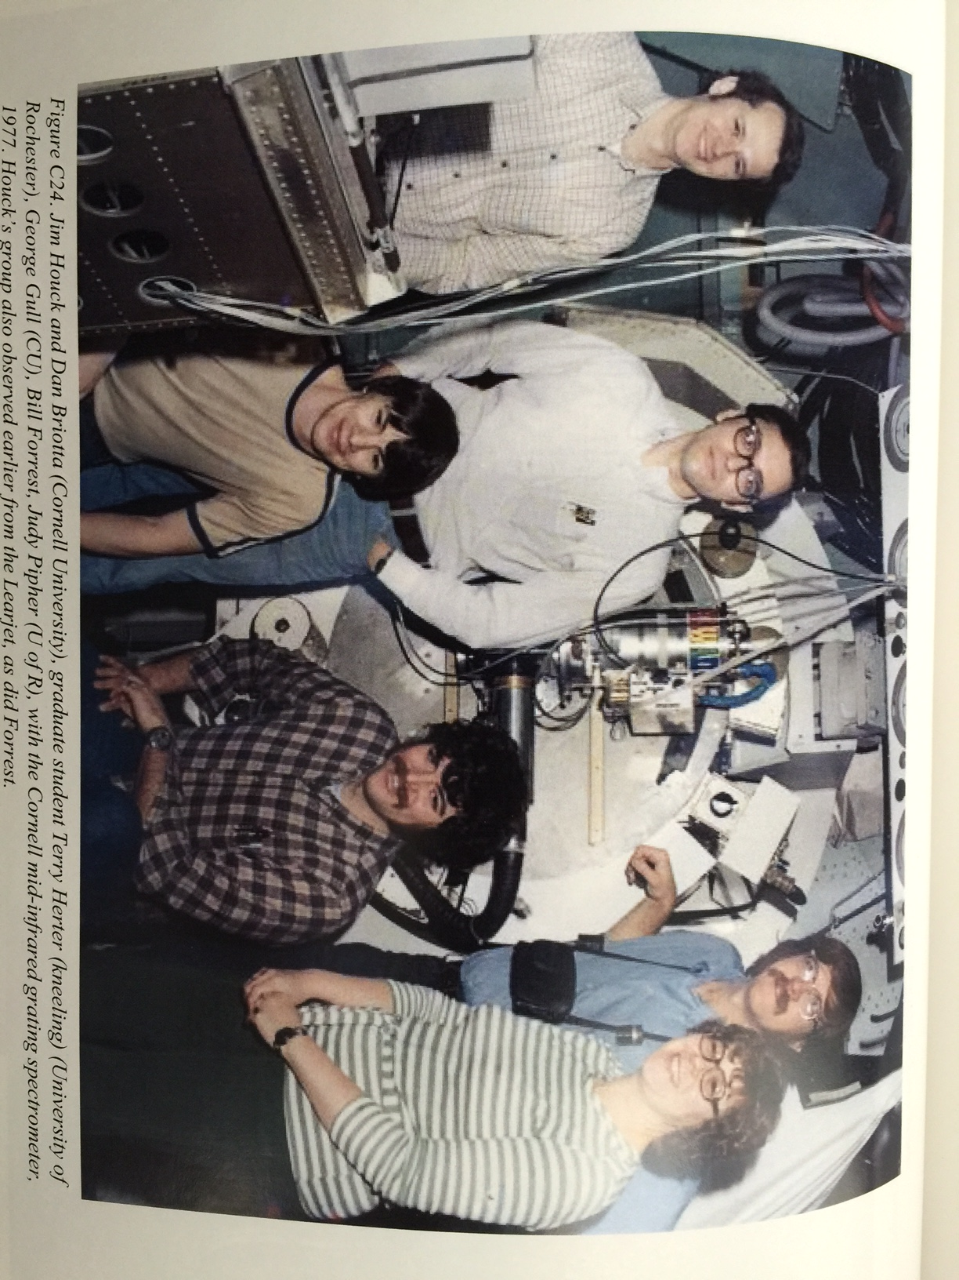
Generations
This picture, taken 40 years ago and shown in Ed Erickson’s and Allan Meyer’s KAO history, illustrates why we are gathered here today
Jim built a community of smart, decent, and humorous people
He told me many stories about adventures on the KAO, and even though 22 years passed before I went airborne, those yarns were part of why I joined SOFIA
On SOFIA, one of my jobs was flight planning, which got me interested in atmospheric science -- in particular, wind and water vapor near the tropopause

Slide 3
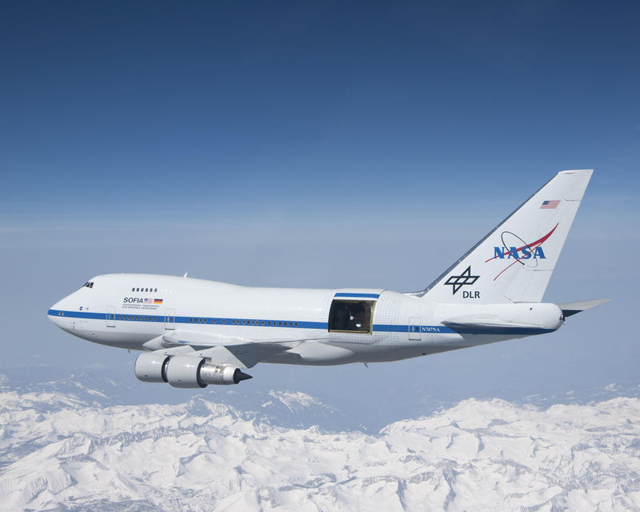
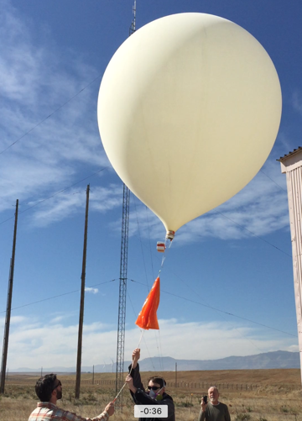
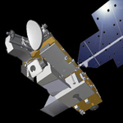
Atmospheric Science and IR astronomy Meet in the Study of Water Vapor above 9.1 km
SOFIA Water Vapor Monitor (WVM), used to calibrate IR astronomical data
AURA-Microwave Limb Sounder (MLS)
NOAA Frost Point Hygrometer (FPH)
FPH measures water vapor in-situ up to 28 km with a vertical sampling of 250 m
Accuracy <0.5 ppm or 10% H2O mass mixing ratio (MMR) under upper troposphere/lower stratosphere (UTLS) conditions
“Gold standard” for calibrating satellite data
Monthly launches from Boulder, Lauder NZ, and Hilo under mostly clear conditions
Public data https://www.esrl.noaa.gov/gmd/ozwv/wvap
This talk focuses on connecting these; there are many other platforms and methods in atmospheric science

Slide 4
Overview: the “Astro-Atmo” Boundary of Two Sciences
SOFIA needs total precipitable water (TPW) above the aircraft and an atmospheric model that can convert TPW into absorption at IR wavelengths for calibration
While WVM measures TPW, direct use of WVM data for IR calibration has fallen short of expectations
We are investigating whether in-situ measurement of WV mass mixing ratio (MMR) is a useful adjunct to WVM and calibration models
A commercial, cryogen-free aircraft instrument exists which can measure the low MMRs (3-50 ppm) corresponding to the low TPWs (4-20 um) relevant to SOFIA
Atmospheric science would like to have more aircraft which measure WV and O₃ in-situ while going about other missions
IAGOS-CARIBIC package for commercial airliners
We presented a poster at the NOAA ESRL Global Monitoring Annual Conference 2017 to interest atmospheric scientists the mutual benefits of putting an atmospheric science package on SOFIA

Slide 5
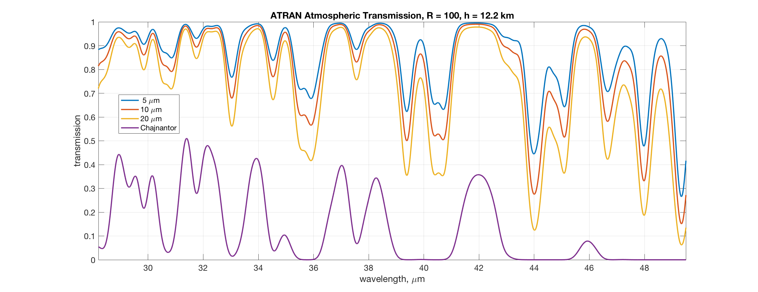
Why Even the Last 20 μm of Water Vapor Matters
If the water vapor near the top of the troposphere could be seen, it might appear to the pilot or passenger of an aircraft flying just above the tropopause like the top of a fog bank – Meyer (2013)
Maximum JWST λ
Atmospheric transmission to the zenith at an altitude of 12.2 km (40 kft) with varying amount of TPW smoothed to a spectral resolution R = λ/Δλ = 100, compared to TPW = 400 um (1st quartile winter) at the driest non-Antarctic ground-based site, the ALMA-APEX site in Chajnantor, Chile. Calculations from ATRAN (S. Lord 1992)
More advanced models which also include collision-induced absorption (Guan et al, 2012, S. Paine 2011) are used in attempts at model-based calibration.

Slide 6
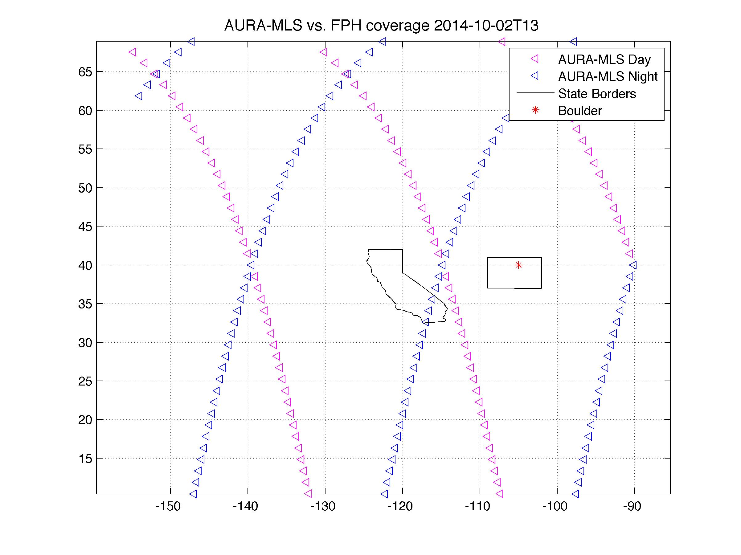
Why Not Use Other People’s Weather Data?
Satellites cannot simultaneously provide the sensitivity and temporal, spatial, and vertical resolution required to calibrate SOFIA data
WV scale height is 1.3 +/- 0.1 km (Haas & Pfister, 1998 – HP98; our FPH results in a later slide) so <650 m sampling is required to integrate TPW
WV correlation time and length at these altitudes TBD but less than several hours/few 100 km (Hurst et al., 2014)
Most of the WV is below 9.1 km so nadir sensors (GOES) have a hard time seeing what’s above 9.1 km
Radiosondes are too sparse in space and time, and their standard hygrometers are not sensitive enough
Global Forecasting System (GFS) analysis products, which assimilate a finite set of imperfect, irregularly distributed observations onto a regular grid in space and time may be helpful, but have poor vertical sampling and wet bias at SOFIA flight levels
Initial investigation gave factor of two agreement with WVM, not good enough for calibration.
AURA-MLS is too sparse spatially and temporally, and the vertical resolution is ~3 km

Slide 7
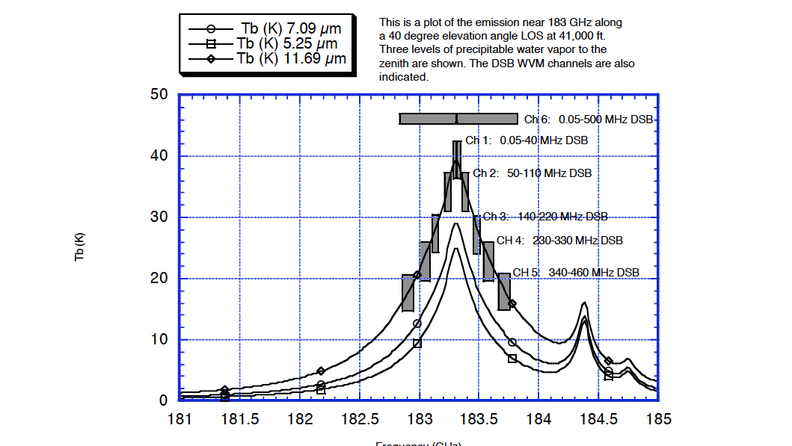
Introducing the SOFIA Water Vapor Monitor
In order for SOFIA’s science instruments (SIs) to spend most of their time observing science targets instead of calibrator targets, SOFIA’s WVM continually measures TPW using the 183 GHz WV absorption line while the astronomical instruments are collecting data.
Looks out same side of aircraft as the telescope, at a fixed elevation angle of 40 degrees
Not mounted to moving mass of telescope as in some other observatories
Software calculates TPW and WV along telescope line-of-sight to write into FITS headers of science data and engineering housekeeping archive
TPW is usually called Zenith Water Vapor (ZWV) by SOFIA but not by atmospheric science
Developed by SOFIA instead of commercially purchased because of unique airworthiness, sensitivity, and accuracy requirements

Slide 8
Something is Lacking in the WV “Rosetta Stone”
Using atmospheric models to convert WVM TPW to IR absorption corrections has not lived up to expectations.
Even cross-calibration between different bands of the same SOFIA instrument (GREAT) give inconsistent results (Guan et al., 2012).
In search of new data or model insights, look for correlations between MMR and TPW in FPH data
Example Astro-Atmo Question: How well can we predict Total Precipitable Water (TPW) above an altitude given only H₂O mass mixing ratio (MMR) measurements at that altitude, using NOAA FPH data?

Slide 9
How the NOAA FPH Works
Feedback loop adjusts mirror temperature to maintain constant signal = frost on mirror in equilibrium with MMR
Buck CR-2 aircraft FPH is cryogen-free but otherwise uses the same physics
https://www.esrl.noaa.gov/gmd/ozwv/wvap/instrument.html

Slide 10
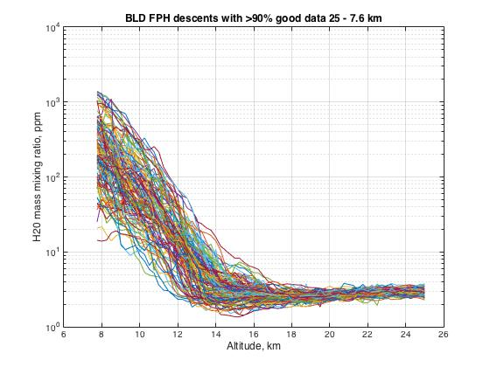
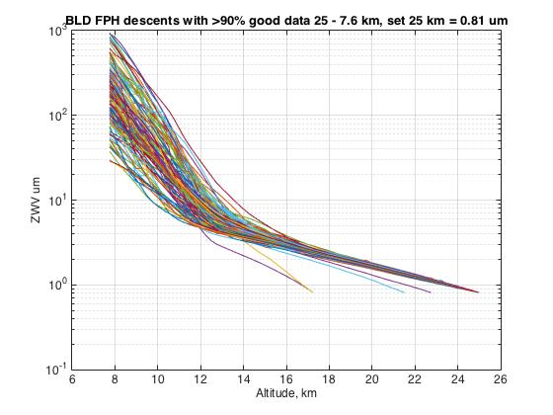
Example FPH Data
Integrate this → to get this
Then index data by altitude to get TPW vs MMR over set of flights

Slide 11
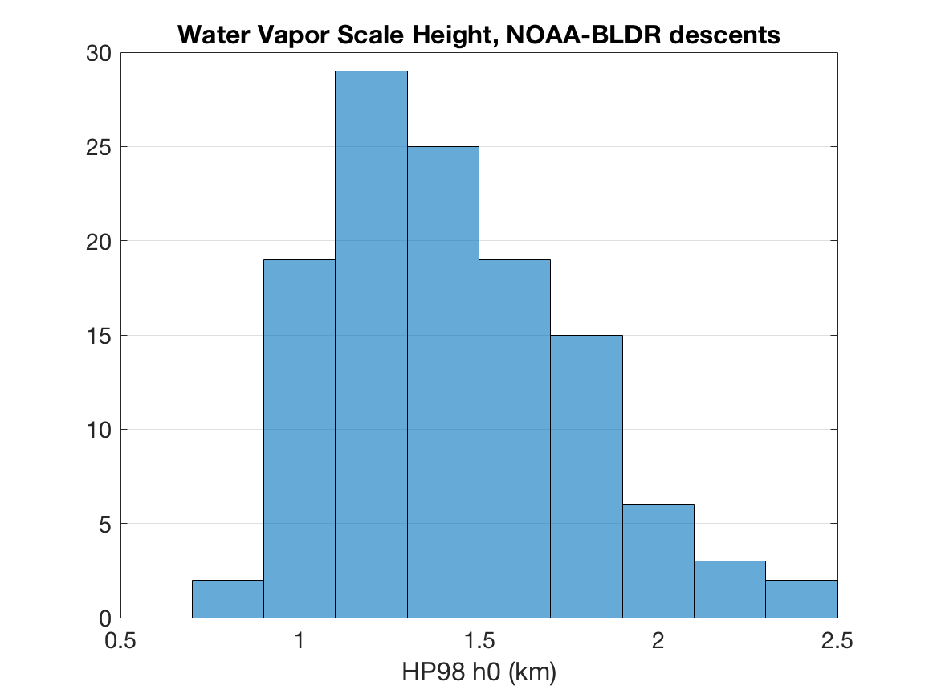
Universal WV Model For Initial Analysis
Haas & Pfister (HP 98) present a simple and universal model of MMR which we used as our starting point :
$$q(h)= max(q_{0}e^{−h/{h_{0}}}, 2.5)$$
Where
q = mass mixing ratio (MMR) in ppm
h = altitude
h₀ = WV scale height
While this form is too simple to fit all the FPH data in detail – in particular the tropopause minimum – it is an economical approximate description of the data.
We were able to validate and extend HP98’s finding that h₀ = 1.3 +/- 0.1 km in SAGE II data by fitting the equation above to the set of all Boulder FPH flights (results at right)

Slide 12
Detailed Analysis Method
Select descent data with <10% gapped data (code -999), no gaps >= 1 km, and good data up to at least 23.5 km
Linearly fill gaps
At each altitude in a flight, integrate MMR over pressure between the pressure at that altitude and 25 mbar and add a constant 0.8 um TPW above 25 km/25 mbar
For each altitude, select the MMR result at that altitude from each flight and plot TPW vs. MMR on a log-log scale.
After seeing that the universal HP98 model did not work well at higher altitudes, empirically fit the data to a power law (straight line on log-log plot)
Where HP98 gives a greater TPW at a given MMR then the power law, use HP98
Iterate the power law fit, excluding the points for which the power law was replaced by HP98 in the previous step
Fit the power low exponent and prefactor themselves to a linear function of altitude (uber fit)
Regression against ozone, tropopause pressure height, and temperature did not improve the results.

Slide 13
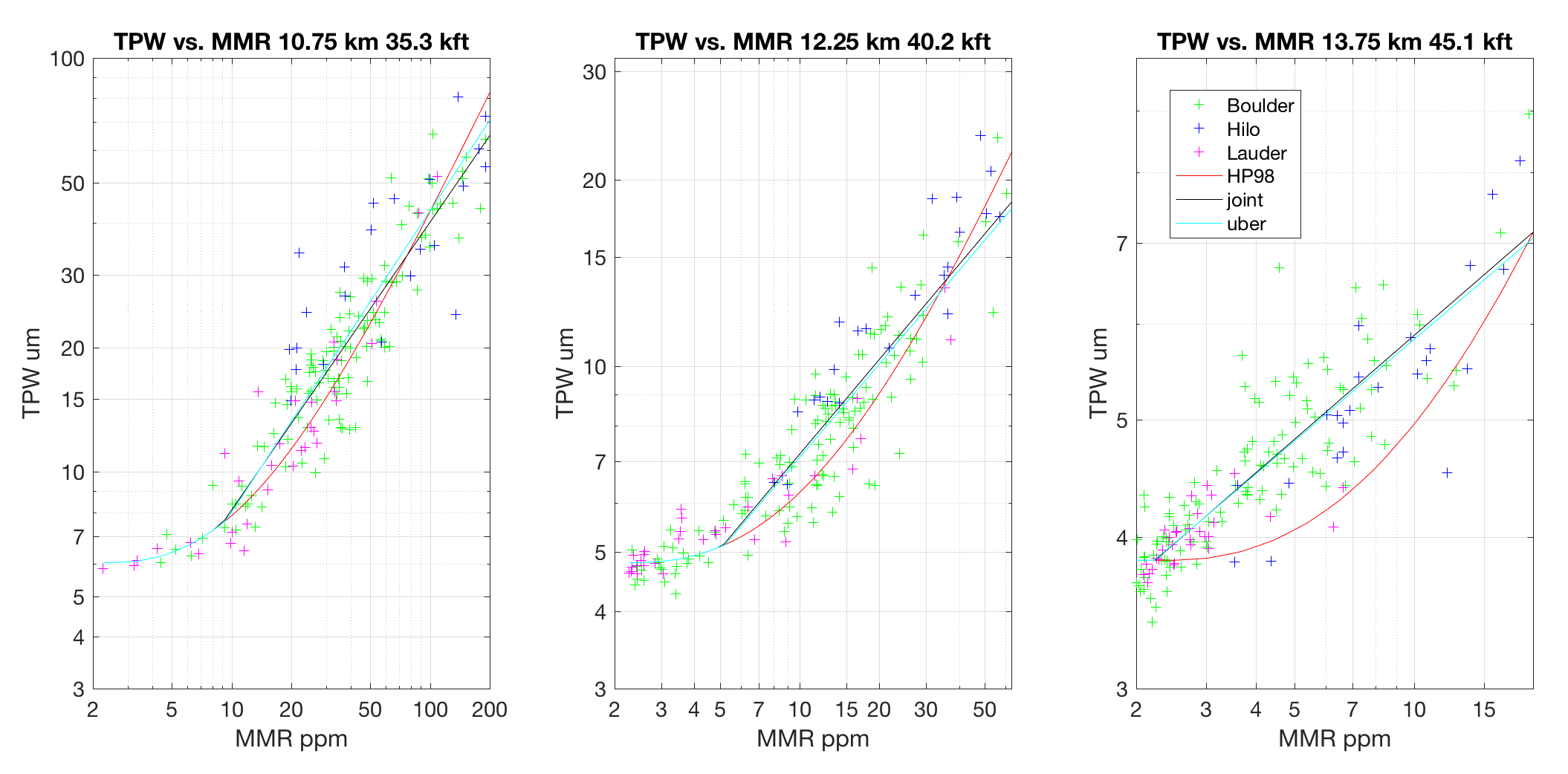
Result: In clear skies or above light cirrus, TPW can be predicted from MMR and altitude to an accuracy from 9% at 13.8 km to 24% at 10.8 km (rms error)
Example plots for various altitudes showing correlation of TPW vs. MMR at fixed altitude for all FPH descent data from all 3 stations. The joint fit is the maximum of HP98 and a power-law fit to the data at fixed altitude.. At the lowest MMRs, the uber, joint, and HP98 fits are indistinguishable and appear as the cyan line.

Slide 14
Application to SOFIA
An aircraft FPH (Buck Instruments http://www.hygrometers.com CR-2) instruments, as used the successful IAGOS-CARIBIC package (Brenninkmeijer, 2007) for commercial airliners, would allow SOFIA to serve atmospheric science as well as astronomy.
CR-2 uses a Ricor K548 rotary Stirling-cycle tactical cryocooler
CR-2 can measure frost point down to -100 °C. Required minimum for SOFIA is -80 °C, corresponding to 2.3 ppm MMR at 13.7 km/148 mbar (http://www.michell.com/us/calculator)
CR-2 lists for $55K + cost for Buck to modify TAT probe + cost to install in SOFIA and certify
While the CR-2 is automated, scientific and engineering skill is needed to design a clean sampling system and start the instrument at the right time to nucleate a frost layer without getting too much water in the system
Andreas Zahn of IAGOS-CARIBIC has this experience
Recommend installing on upper deck (like WVM) so human in-flight oversight and access possible
The CR-2 could serve as a backup and cross-check on the WVM microwave measurements
Having CR-2 and WVM data from the same flight could test atmospheric models to be used for calibration

Slide 15
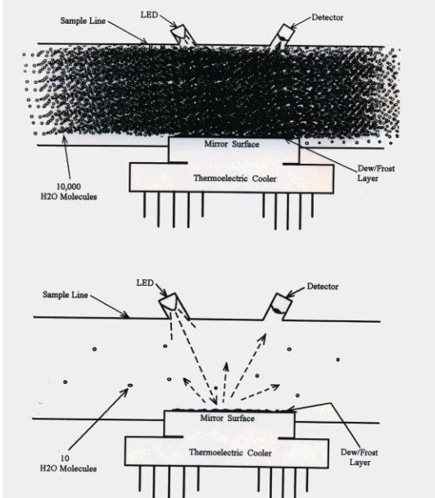
Dynamic Range – Keep Inlet Tubes Dry! (from John Barrick, LaRC)
Planetary Boundary Layer and
Lower Troposphere
Upper Troposphere
Lower Stratosphere.
Leaks from cabin and wet air on ascent can dominate signal of interest → keep tubes tight, clean, and warm

Slide 16
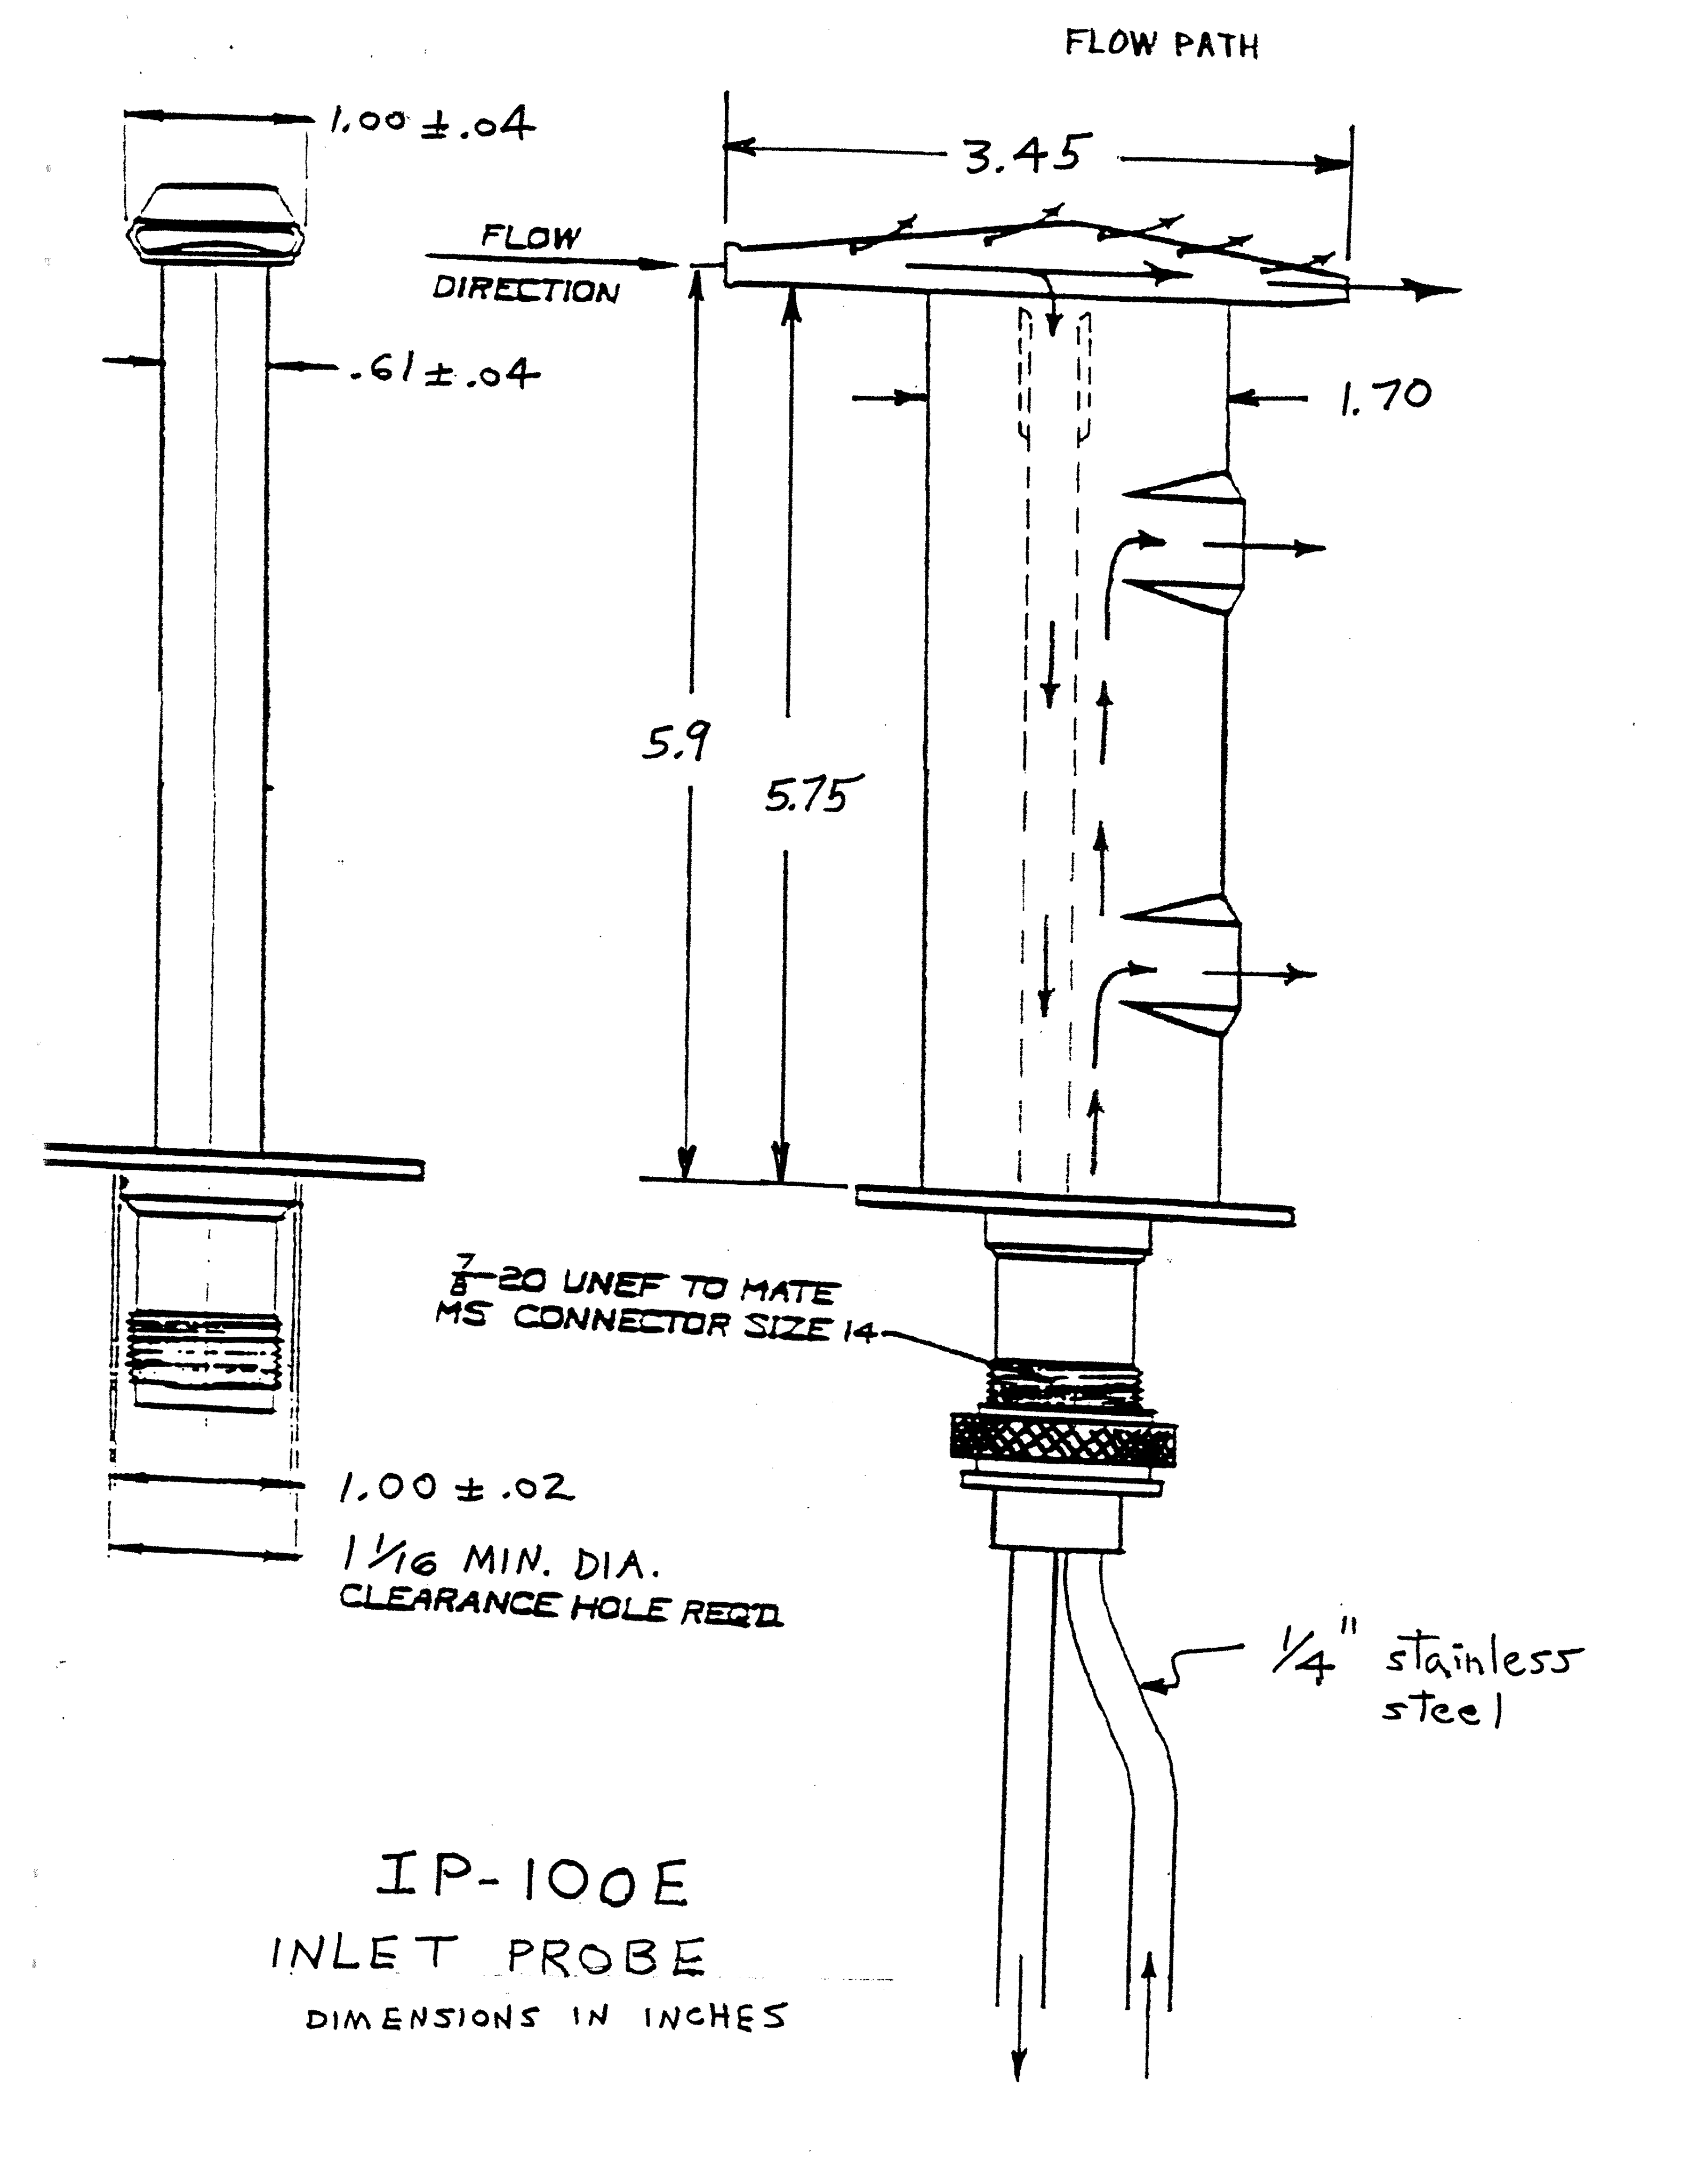
The CR-2 and other FPHs have been flown on other research aircraft, including the NASA DC-8
Detail of droplet-excluding inlet probe made for CR-2 by Buck from Rosemount housing

Slide 17
Future Astro-Atmo Questions
How is the distribution of WV above clouds at FPH vertical resolution different from its distribution under hitherto typical FPH launch conditions (clear or light cirrus)?
What is the correlation length and time for WV between 10.7 and 13.7 km? Under what circumstances could AURA-MLS data be useful for calculating TPW above SOFIA?
Can WV Raman backscatter LIDAR facilities at Edwards and JPL Table Mountain provide a useful complementary data for the WVM during SOFIA takeoffs and landings?
Can GFS-FNL products be used to calculate TPW to 25% accuracy or better?
Would monitoring O₃ column density on-board be of value to SOFIA for precise optical and 9-10 μm observations?

Slide 18
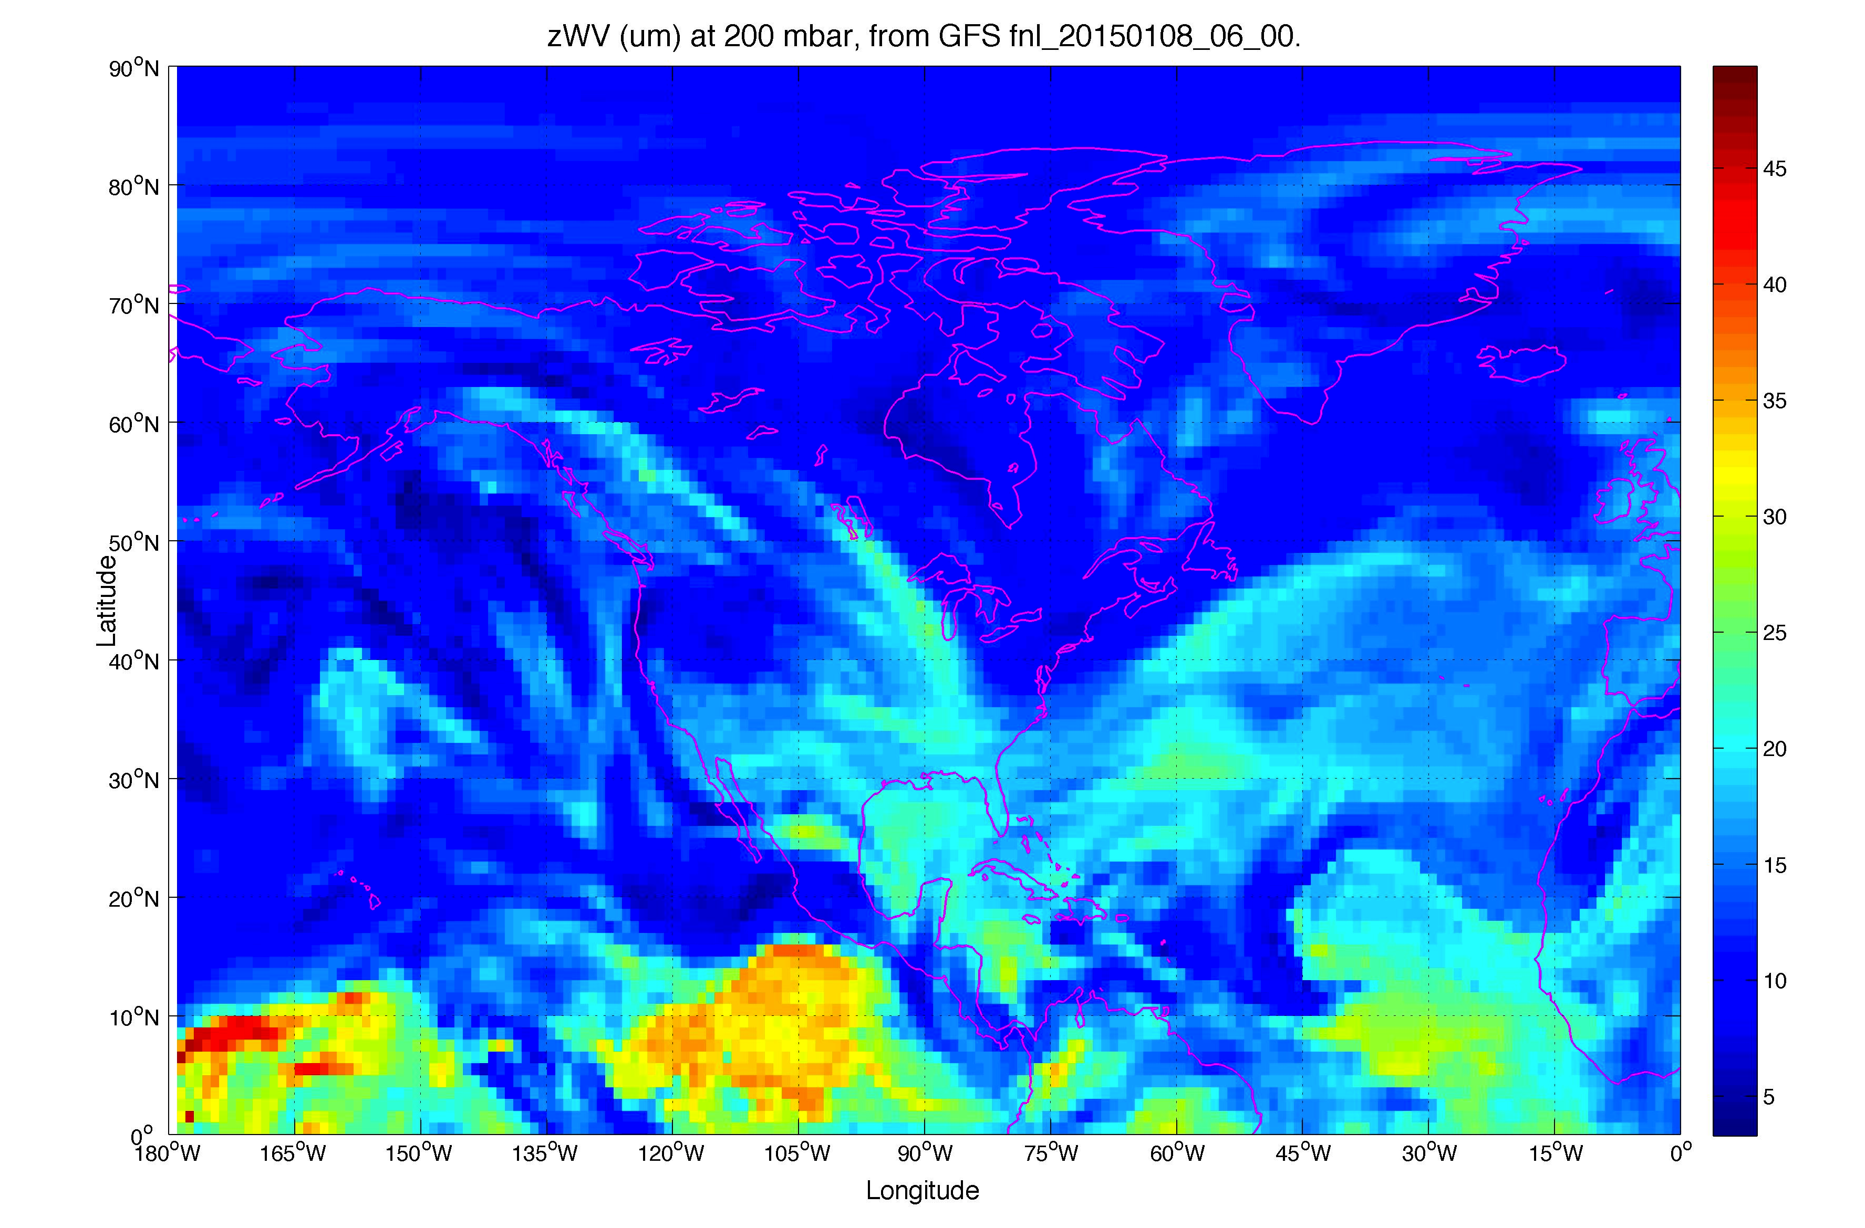
Example “Final Analysis” Converted to TPW

Slide 19
References
Brenninkmeijer, C. A. M., et al., 2007, Atmospheric Chemistry and Physics 7, 4953
Erickson, E. F., 1998, PASP 110, 1098
Guan et al., 2012, A&A 542, L4
Haas, M., and Pfister, L., 1998, PASP 110, 339
Hurst et al. 2014, JGR-A 119, 1612
Meyer, A. W. (2013) “Airborne Astronomy: an Assessment of Some Aspects of the First Year of SOFIA Science Operations” Dr. der I. dissertation, U. Stuttgart
Roellig, T., Yuen, L., Sisson, D., and Meyer, A. 2010, SPIE 7733, 773339

