Slide 1
New Detectors and Techniques for (Far)-IR Spectroscopy
Matt Bradford
28 June 2017

Slide 2
Why Far-Infrared?
Cooray, adapted from Dole et al, 2006
Madau & Dickinson, 2014
~Half of the remnant electromagnetic light from stars and galaxies is in the far-IR.
  Far-IR background is a cosmological background, not a low-redshift phenomenon.
Most of energy from star formation and accretion activity emerges in the far-IR.
  Young stars and accreting black holes are obscured by their very fuel.
Mechanisms driving these transformative processes, and the results are inaccessible in the optical / NIR.
Reionization epoch in particular – vital historically but leaves little in backgrounds.
Notes:
Origin of optical and near-IR background not completely clear. Some evidence for a portion being cosmological, but also indications of

Slide 3
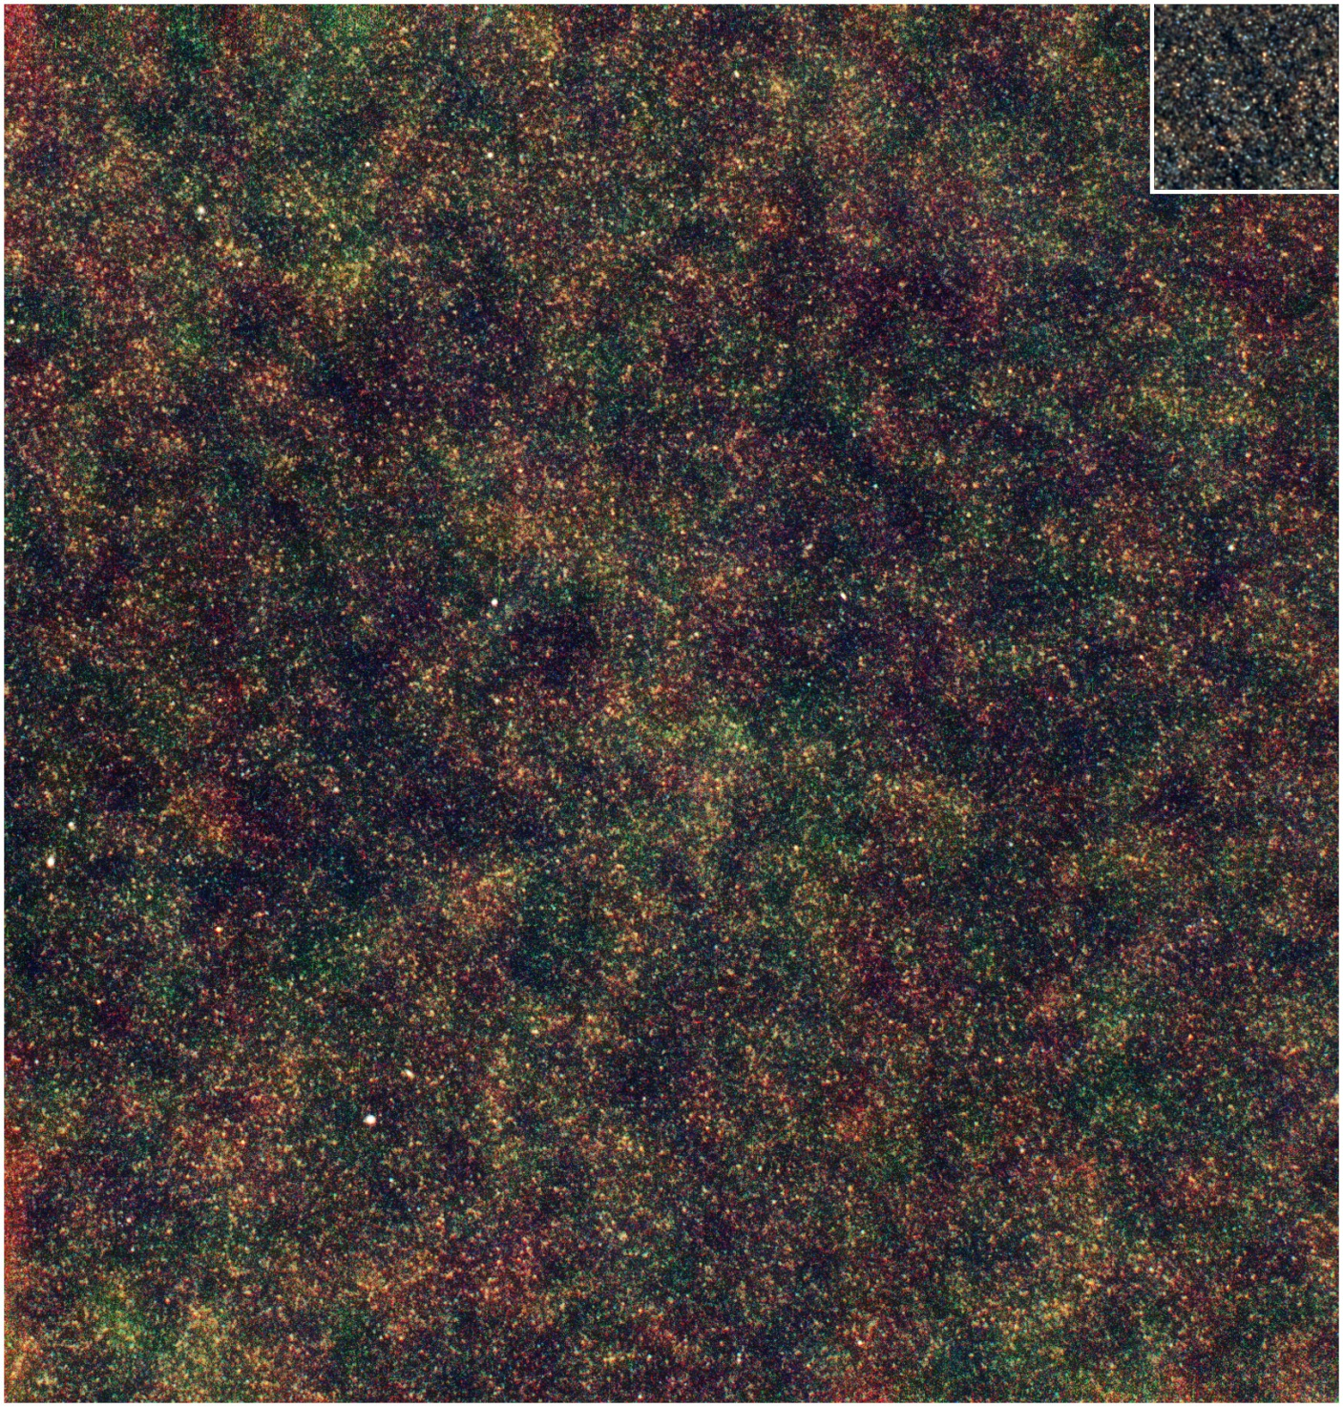
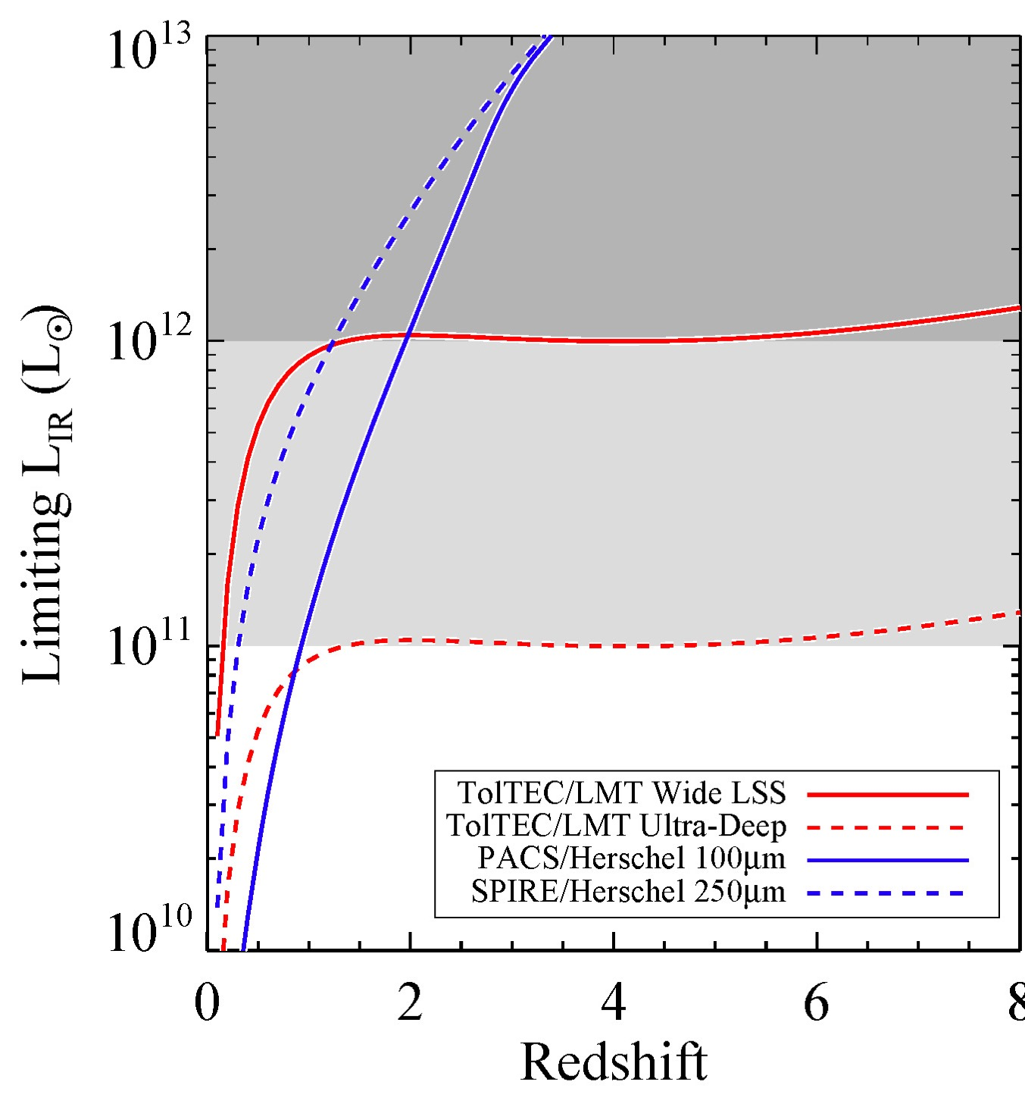
2-D Imaging well-underway
A carpet of star-forming galaxies from the Universe’s historical peak.
Herschel SPIRE 250, 350, 500 microns
TolTEC mm-wave camera on LMT.
Alex Pope et al.
Herschel confusion limited at L>1e12 Lsun
But coming submm / mm surveys with large ground-based telescopes will go much deeper, and with uniform redshift sensitivity.
3.6°

Slide 4
Spectroscopy Decodes the Far-IR Universe
Circinus ISO
Rest-frame mid to far-IR accesses ionized, neutral atomic, and molecular material. The intersection of energy sources and their fuel.
Suite of lines measures physical features such as:
  Ionization state -> stellar effective temperature or AGN (via Ne, O, N ratios between ionization levels)
  Degree of stellar processing (via O/N in a given ionization zone).

Slide 5
Far-IR Spectroscopy Remains a Bottleneck
(and scientific frontier)
OST
OST
Origins Space Telescope (OST) (and to some extent SPICA) can obtain spectra of galaxies in the Universe’s first billion years as they are born, comparable to JWST and ALMA in sensitivity. Spectrometers assume 100 beams, R=500, essentially BG limited.
SPICA currently proposed to Cosmic Visions M5 proposal. 2.5 meter aperture, SAFARI R=300 grating spectrometer with R=3000 etalon mode. Our proposal for MoO under preparation.
ST30 is CSST – 30m ground-based telescope for the submm, assuming 100 element MOS.

Slide 6
Confusion Not an Issue for Spectroscopy
E. Murphy et al., in prep
`Line Counts’ indicate that even with 5 or 10m telescope and R=500, confusion is not an issue except perhaps in very long integrations at the longest wavelengths.

Slide 7
Far-IR Detector Requirements
Per-pixel sensitivity below 3x10⁻²⁰ W Hz^{-1/2} for spectroscopy
Readout / system scheme enabling 10⁵ to 10⁶ total pixels in a large observatory.
Ability couple efficiency across the full 30 microns to 1 mm spectral band.
No other market for this technology -> NASA astrophysics + Euro & Japanese agencies must develop.

Slide 8
Transition-edge sensed (TES) bolometers
JPL and SRON developed TES bolometers for spectroscopy – long legs and 50-100 mK temperature.
NEP ~ 1x10⁻¹⁹ W Hz^{-1/2}
SRON RF frequency-domain MUX with 160-pixel circuit. Might approach OST format with careful thermal design for wiring.

Slide 9
Kinetic Inductance Detectors
temp
J. Zmuidzinas

Slide 10
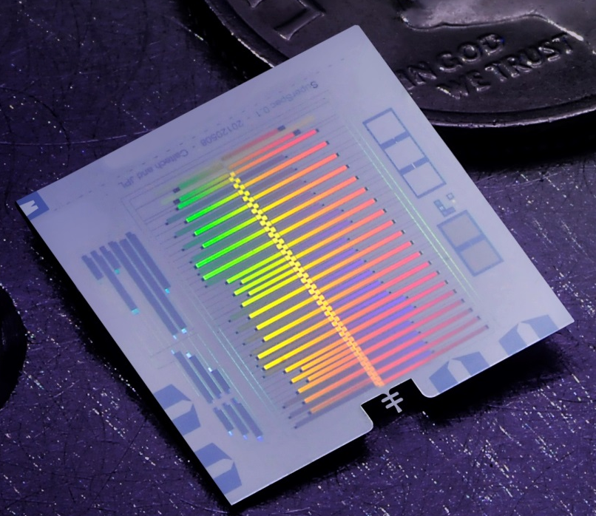
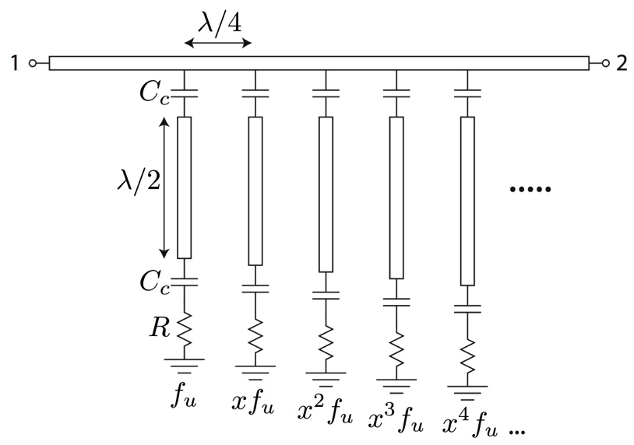
SuperSpec Overview
SuperSpec is an on-chip spectrometer we are developing for moderate resolution, large bandwidth, (sub)millimeter astronomy.
A single chip is coupled to one polarization of a single-mode beam and integrates:
  antenna
  moderate resolution (R ~ 100 – 500) filterbank with large BW (δv/v ~ 0.6)
  associated detectors (KIDs) and readout circuitry.
Each chip is ~few cm² in size
Prototype chips covering 200 – 300 GHz range. Also looking to higher frequencies.

Slide 11
SuperSpec Architecture
Coupling strength is tuned via spacing between feedline and U-shaped resonator and between resonator and detector. EM simulations calibrated with measurements
Meandered inductor is only ~3 cubic microns. Provides high response and low NEP.

Slide 12
SuperSpec Sub-Scale Filterbank Working
Have coupling strengths dialed in for R=300 system.
Currently scaling up to full-band system with 300 channels spanning 185-310 GHz.

Slide 13
Working towards demo at LMT
Example from Z-Spec on CSO. HFLS-1 z=2.96, Scott et al. 2011
Motivation: Follow up LMT AzTEC, MUSCAT, TolTEC continuum sources. Find redshifts, probe star-formation in the early Universe with CII. Complement RSR for CO excitation studies.
Approach: Field 6-chip (3 beams x 2 polarizations) demonstrator at LMT in existing crysotat. Use chopping mirror at pupil to provide modulation. Shared risk collaboration with Umass and Mexican scientists after engineering phase.
Future: Large multi-object system or imaging spectrometer with hundreds of spectrometer ‘pixels’.
Instrument team – 4 Co-I groups
Caltech/JPL
C. M. Bradford
S. Hailey-Dunsheath
A. Kovacs
H. G. LeDuc
J. Redford
J. Zmuidzinas
ASU
P. Mauskopf
S. Gordon
G. Che
Colorado
J. Glenn
J. Wheeler
S. Walker
(blue = students)
Chicago
E. Shirokoff
R. McGeehan
P. Barry

Slide 14
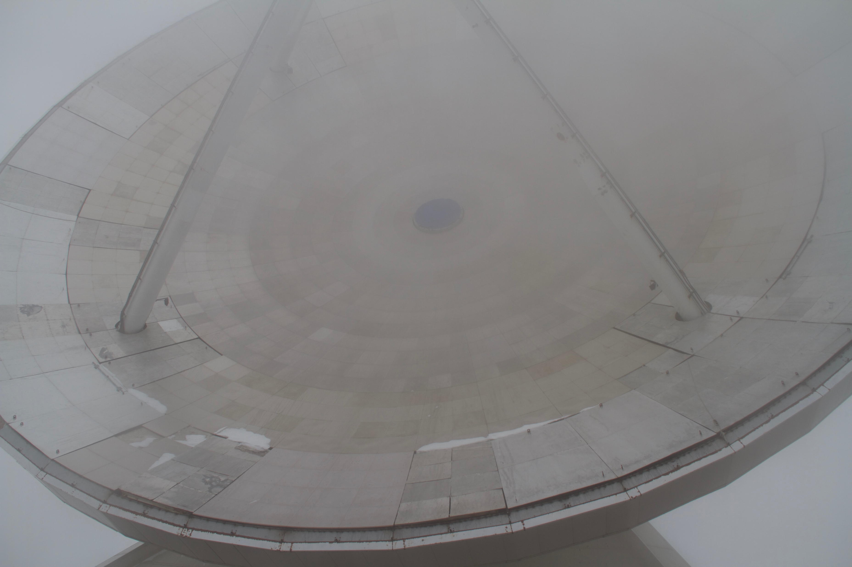
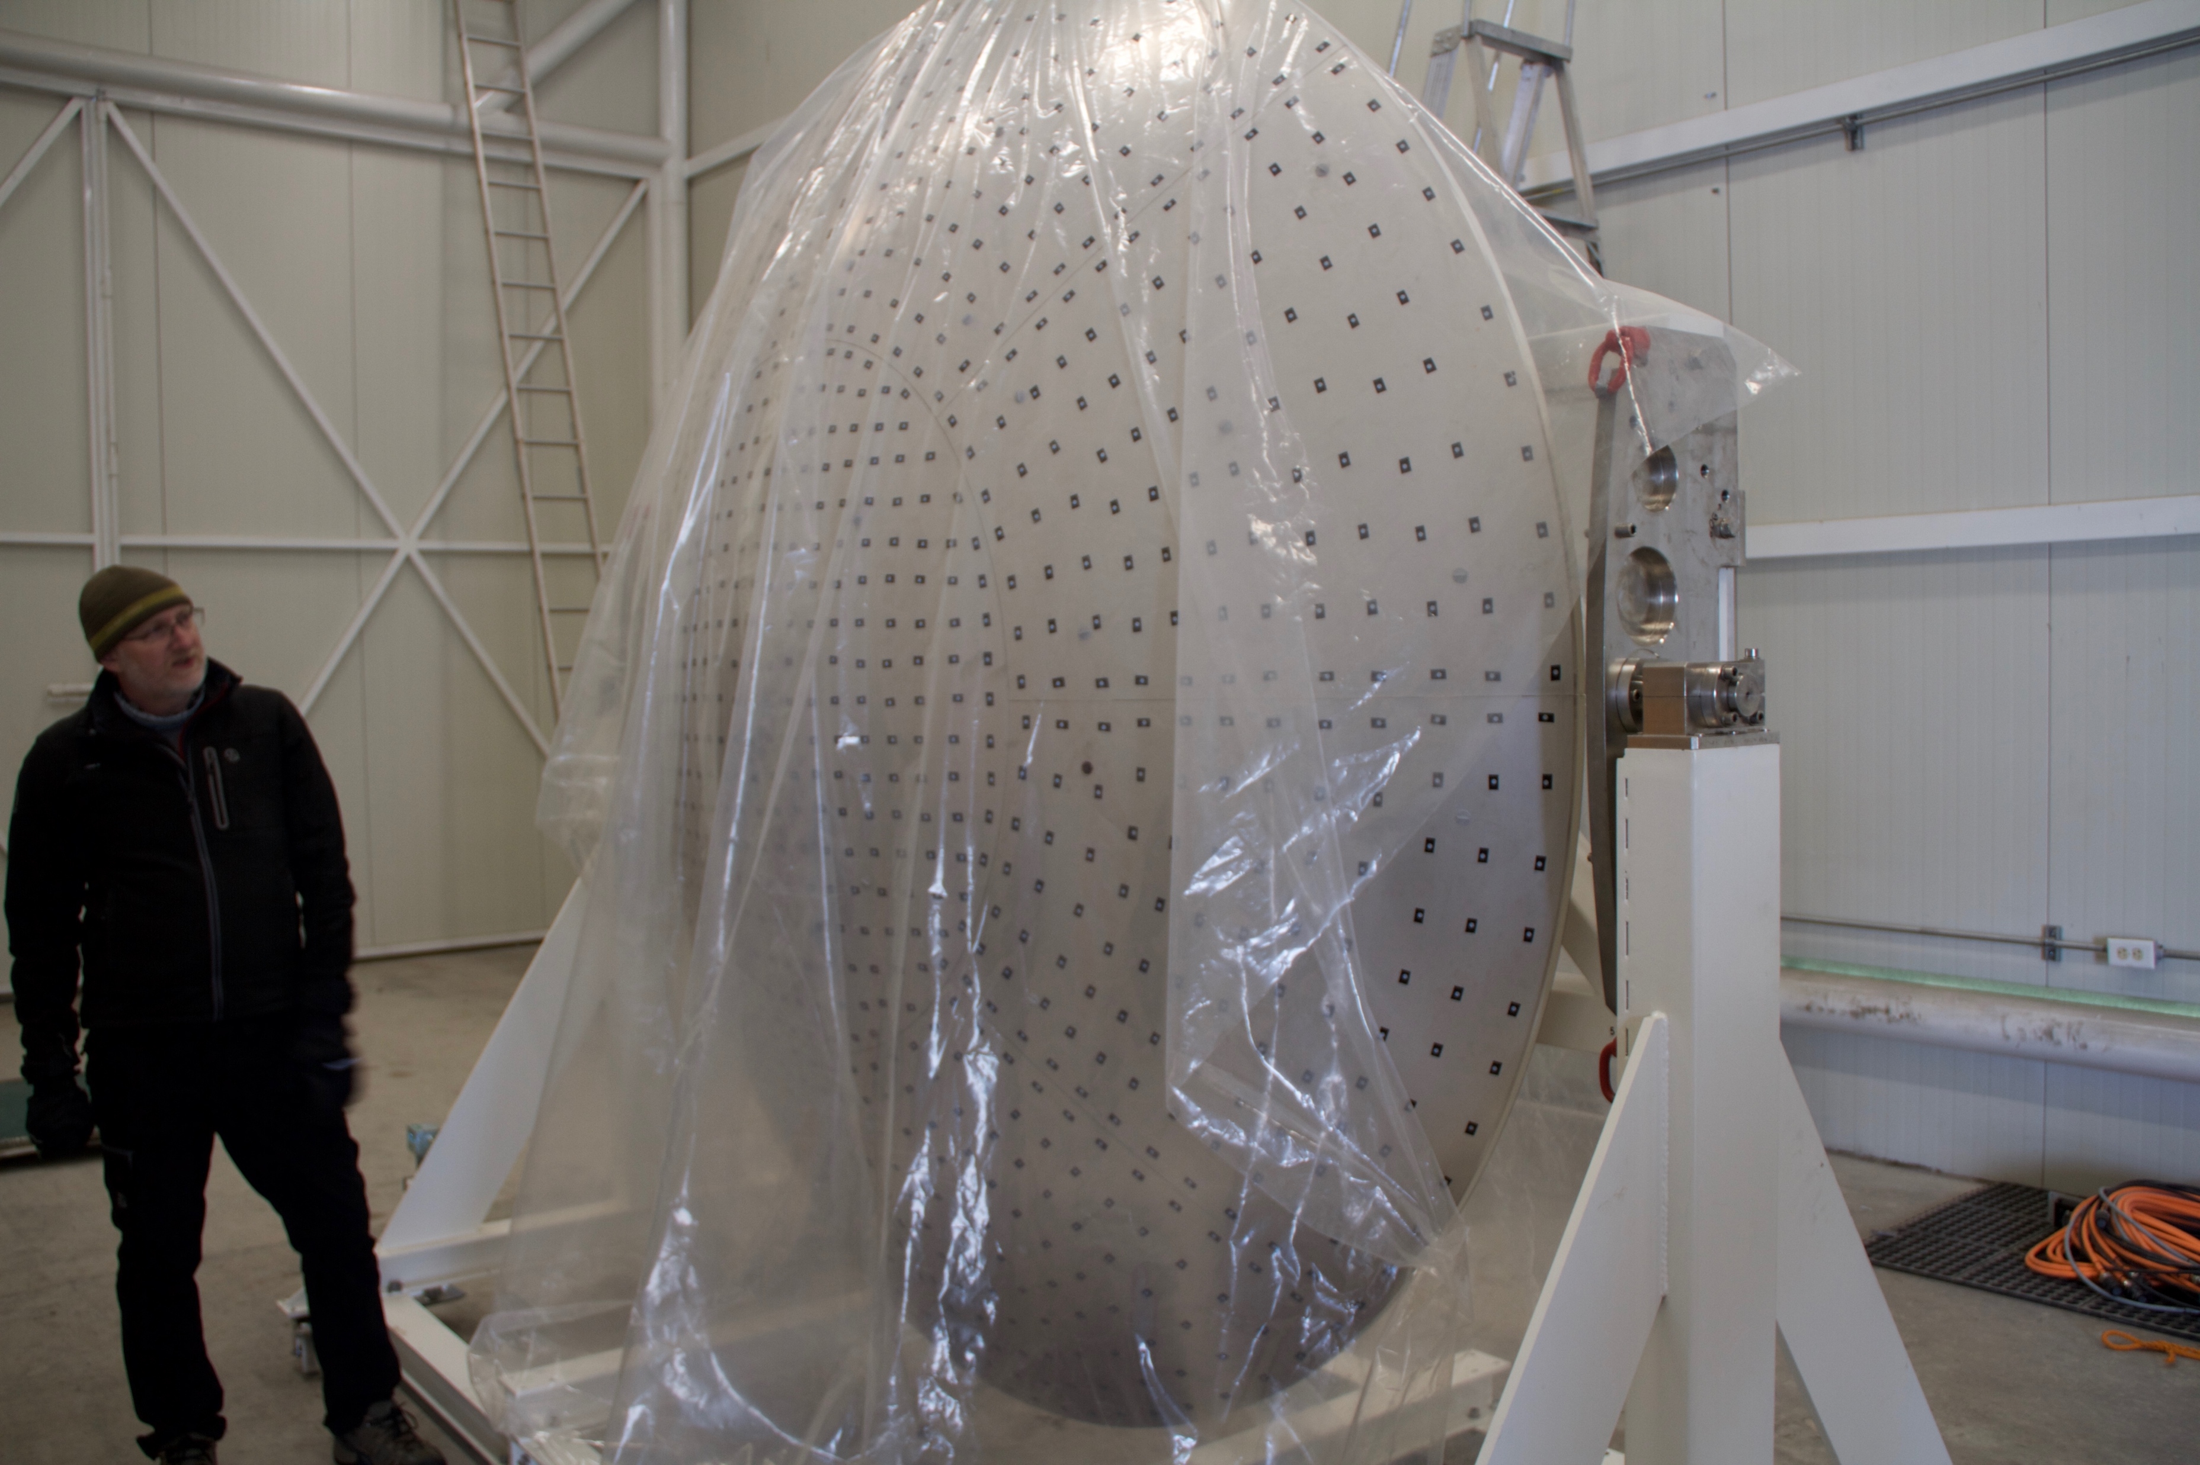
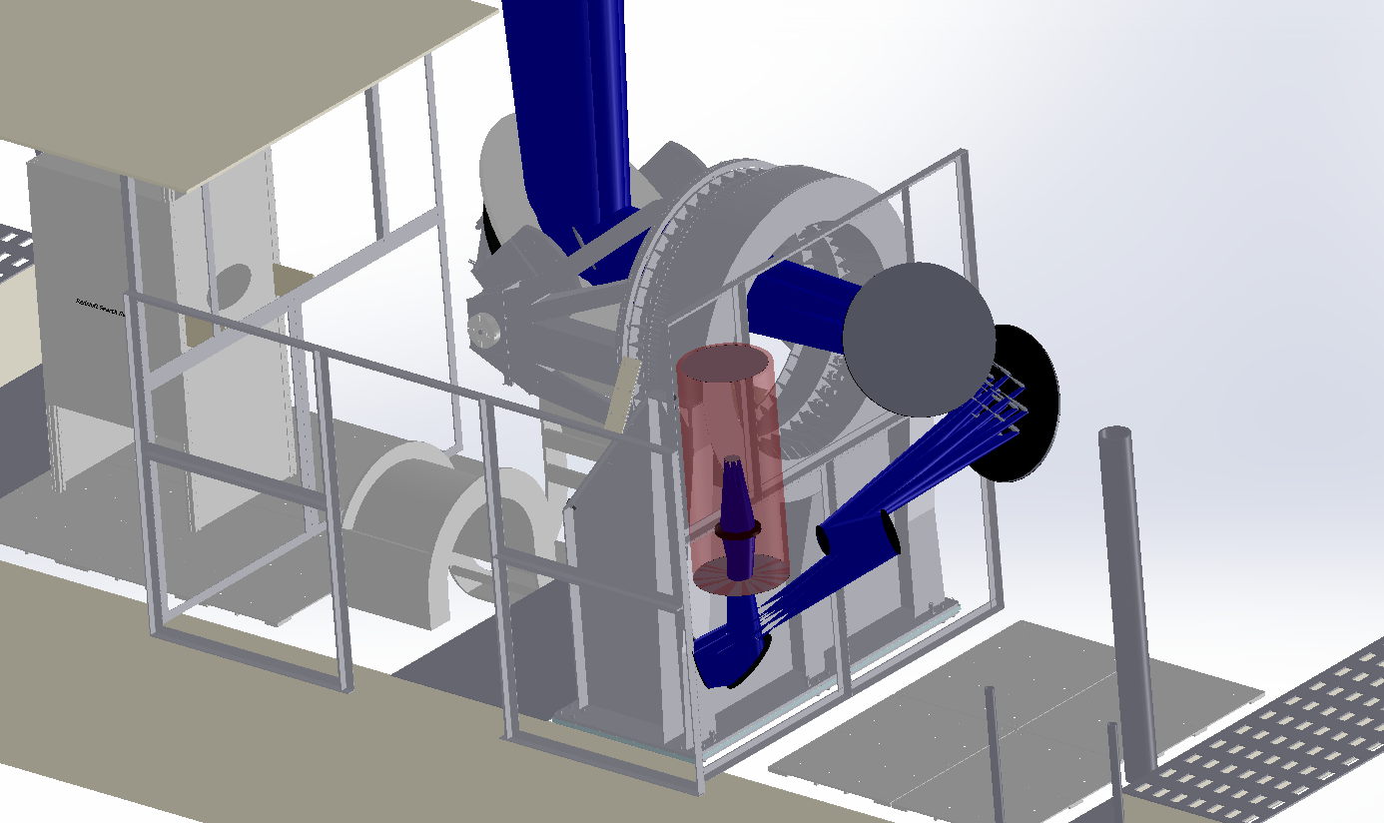
Working towards demo at LMT
LMT Right-Hand Nasmyth
MUSCAT mirrors M4 & M5, will use
Demo on LMT:
LMT panels and actuators for full 50m telescope being delivered and set in INOAE.
New secondary & hexapod for 50-m telescope in hand.
We will use MUSCAT large mirrors 4, 5 along with our M6 (chopping) and M7, M8.
Target spring 2018.
Possible 2nd run in late ‘18 / early ‘19.
SuperSpec 230 mK cryostat
SuperSpec Mirrors 6,7,8,9

Slide 15
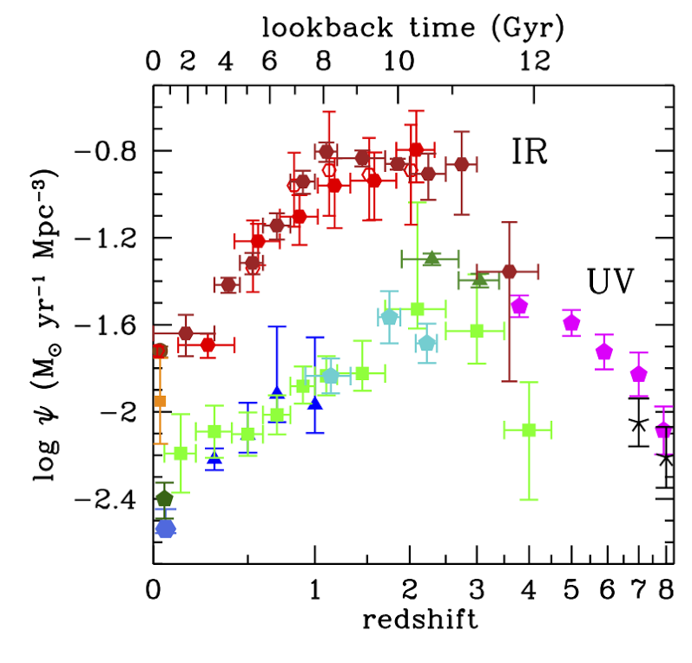
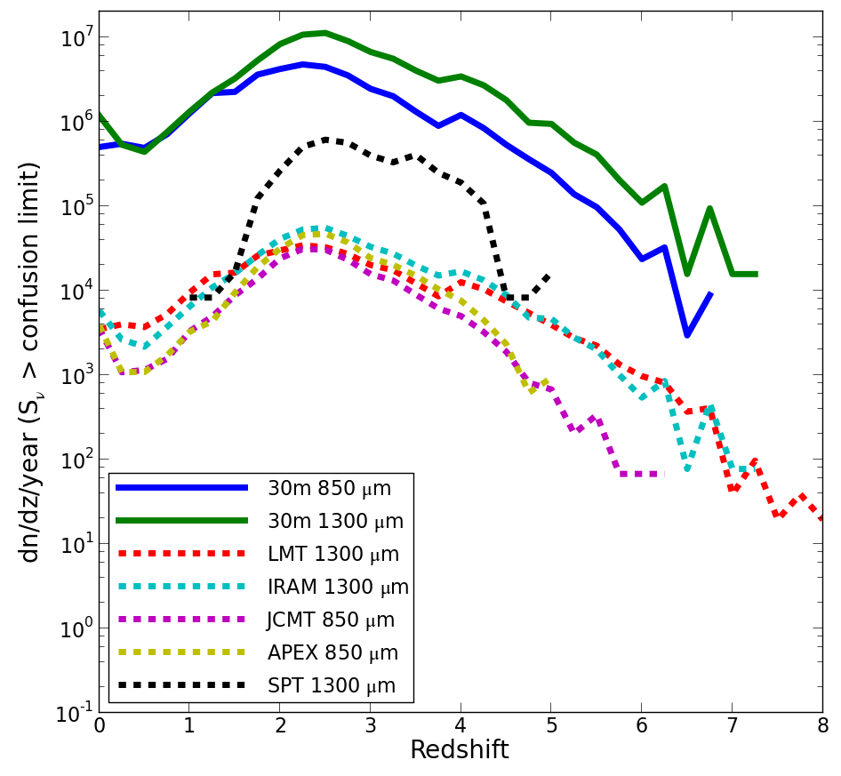
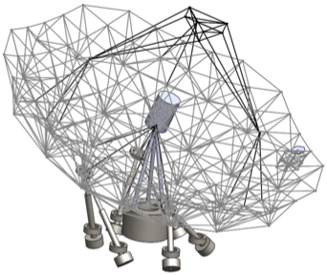
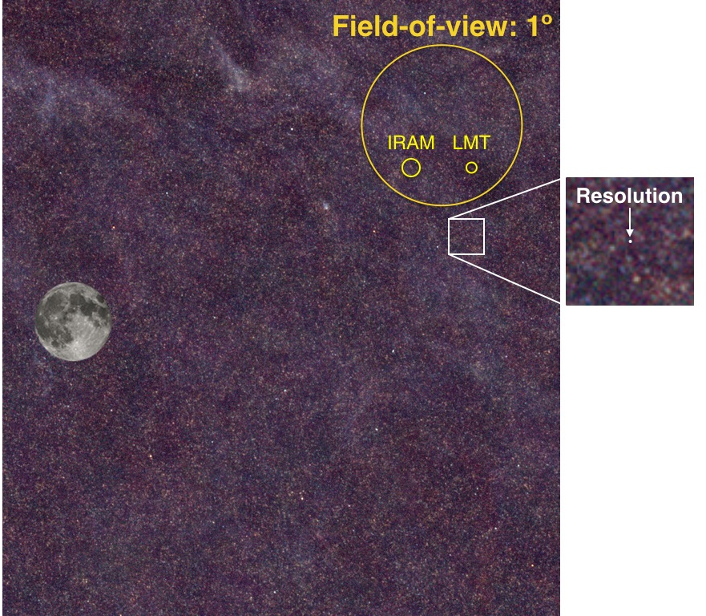
Dust-Enshrouded Galaxy Evolution at z > 4 with the Chajnantor Sub/mm Survey Telescope
?
Dusty, star-forming galaxies (DSFGs) dominate SFR density at epoch of
peak SFR, z ~1-3, with L✻,IR ≈ 10¹² LSun, SFR ~ 200 MSun/yr
What is the history of their appearance? How do they evolve in
(M✻, SFR) relative to the Star-Forming Main Sequence? How are they related
to UV-bright high-z galaxies? What are their ISM masses, gas fractions, and depletion times?
Hyperluminous DSFGs (e.g. HFLS-3) are signposts for extremely evolved regions in the first Gyr
How can they exist so early? What are their environments like?
CSST will reveal millions of z > 4 DSFGs with LIR > 10¹² LSun,
providing the data to answer these questions.
> 100x the mapping speed/detection rate
of current facilities
7
6
5
4
3
2
1
0
Novel, inexpensive center-of-gravity design
large FoV, excellent site
log10(#/unit redshift/yr above confusion limit)
CSST: 1000 deg²/yr
LMT, IRAM: 10 deg²/yr
H-ATLAS 4° x 5°
0 | 1 | 2 | 3 | 4 | 5 | 6 | 7 | 8
S. Golwala
redshift

Slide 16
Far-IR Detector Requirements
Per-pixel sensitivity below 3x10⁻²⁰ W Hz^{-1/2} for spectroscopy
Readout / system scheme enabling 10⁵ to 10⁶ total pixels in a large observatory.
Ability couple efficiency across the full 30 microns to 1 mm spectral band.
No other market for this technology -> NASA astrophysics + Euro & Japanese agencies must develop.

Slide 17
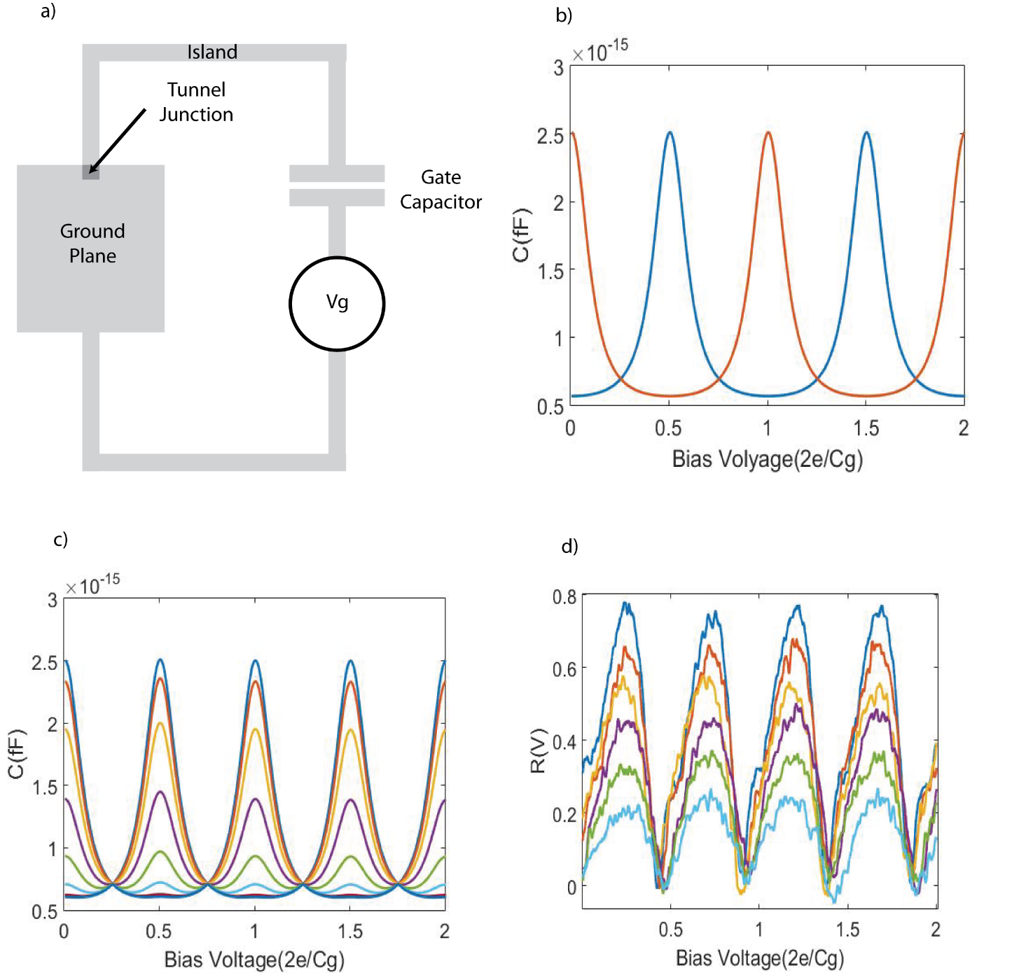
Quantum Capacitance Detector
Pierre Echternach et al @ JPL
Single Cooper Pair Box
Single Cooper-Pair Box (SCB) has sensitivity to single electrons (quasiparticles) which tunnel in and out. Capacitance shift is e-15 F, about 1/1000 of resonator capacitor.
Radiation breaks Cooper pairs in the reservoir (absorber) establishing a density of quasiparticles (QP) dependent on the optical signal. Determines tunneling rate.
Tunneling spoils either pure state, so more optical power reduces QC signal.
Incorporate gate capacitor into a half-wave microwave resonator, changing C shifts readout frequency. Naturally frequency-domain multiplexed.
In practice have to sweep DC bias because system is not DC stable.

Slide 18
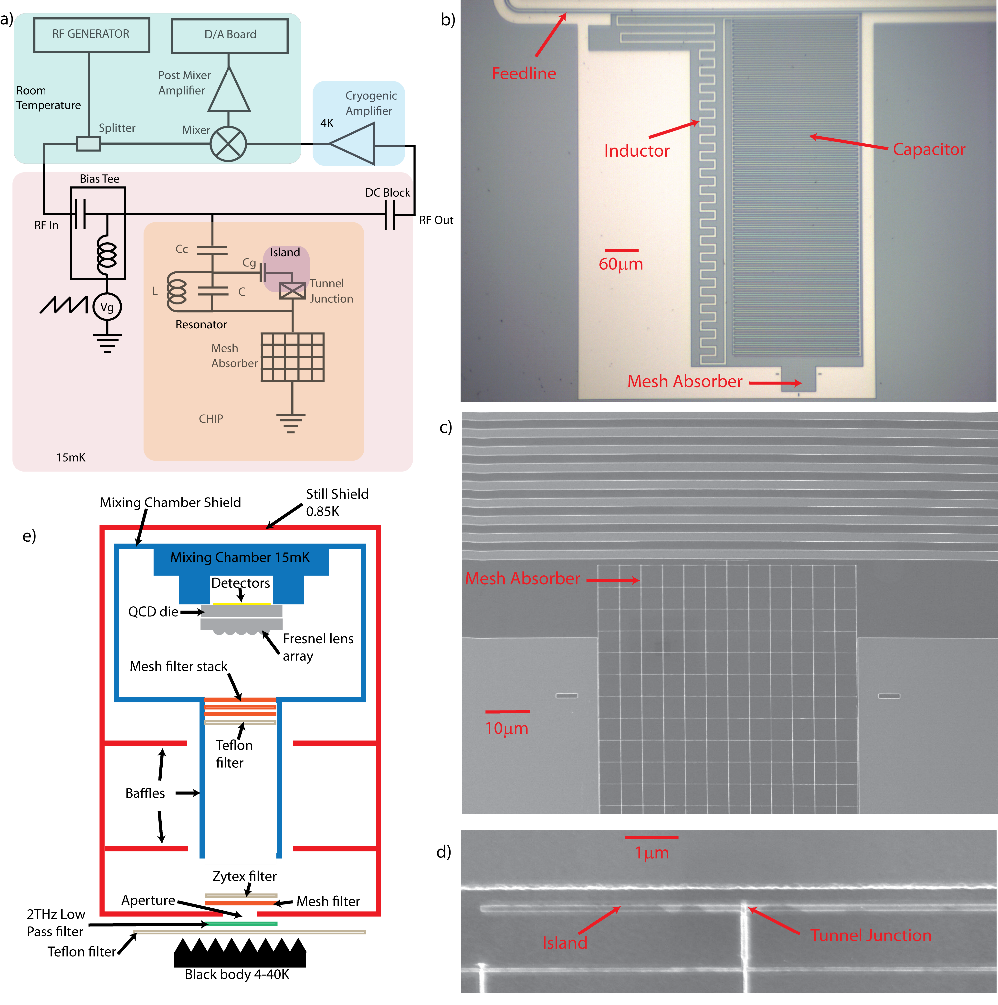
QCD – latest update on 200-micron devices
Aluminum mesh absorber which is impedance matched to free space (like typical far-IR KIDs),
But has a small volume: 1.6 microns^3. 60 microns extent (about lambda in silicon).
(Illuminated through silicon micro-lens)
Resonators operate around 3 GHz, each is ~700 x 300 microns in size: 0.2 mm^2, but not optimized
Area scales as f^-2, so to push down to ~1 GHz requires 1.9 mm^2, but expect can do ~2x better with more efficiency design.
Pierre Echternach et al.

Slide 19
QCD sensitivity meets OST requirement
Tunneling In >> Tunneling out -> Reaching saturation
Tunneling in < base tunneling rate
P^{1/2} dependence indicates photon-noise-limited performance.
Efficiency extracted from ratio of measured NEP and photon shot noise NEP.
Should be able to detect single photons.

Slide 20
Counting Far-IR Photons with the QCD
500 us
Photon
Photon
Photon
Sweep rate ~ 22kHz spanning 4 Quantum Capacitance Peaks => effective sweep rate ~ 88kHz
Should block background tunneling while still allowing tunneling due to single photon absorption
Raw QC time trace should be absolutely periodic
Gaps are due to high tunneling suppressing the Quantum Capacitance signal, due to photon absorption.
Photon counting not required for OST science, but does offer some system-level advantages:
*1/f noise not an issue,
* low NEP strictly speaking not required.
Notes:
We have a long way to go to make high-yield detector arrays suitable for flight, but at least we have a detector principle that offers high efficiency, nearly infinite sensitivity, and multiplexibility.
NASA is going to need to invest in all of the various technologies in order to enable the future vision of OST. Still a small part of the cost of even a modest mission.

Slide 21
Houck Principles of Spectroscopy at the Frontier
Wide instantaneous bandwidth
  (complete spectral coverage)
Best W/m² line sensitivity possible, enabled by best detectors possible
Simple, bolt and go
The best revenge is to live a happy life
Jim Houck office door, late 1990s

Slide 23
Lumped-Element QCD Response
Tunneling in < base tunneling rate
Tunneling In >> Tunneling out -> Reaching saturation

Slide 24
Lumped-Element QCD Sensitivity
PSD time span 2s
Gate sweep frequency 100Hz
One sweep = 6 peaks
QC peaks = 600Hz

Slide 25
Variance evaluated in 30 us bins shows photon events
From time traces calculated variance of slices corresponding to 2 QC peaks (to avoid problems at the edge of sweep with e-shifts) – slices are 30μs long
Subtracted this trace from the maximum of the traces
Gaps in the Quantum Capacitance trace will show up as peaks
Repeat for different black body source temperatures
1x10⁻²¹W
1Hz photon rate
4x10⁻¹⁹W
408Hz

Slide 26
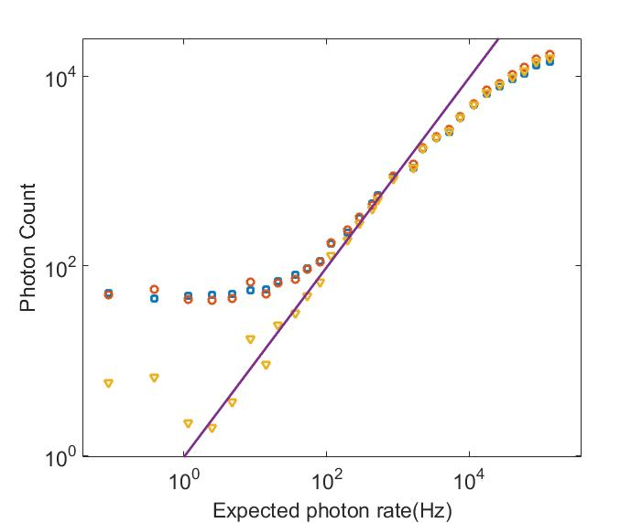
Counts of response between 0.6 and 0.9 versus number of expected photons
96% efficiency*
Efficiency will decrease with when time intervals between photons become comparable to the time separation of two Quantum Capacitance Peaks
Subtracting background rate
10⁻¹⁹ W
* With respect to absorbed power

